Slide 1

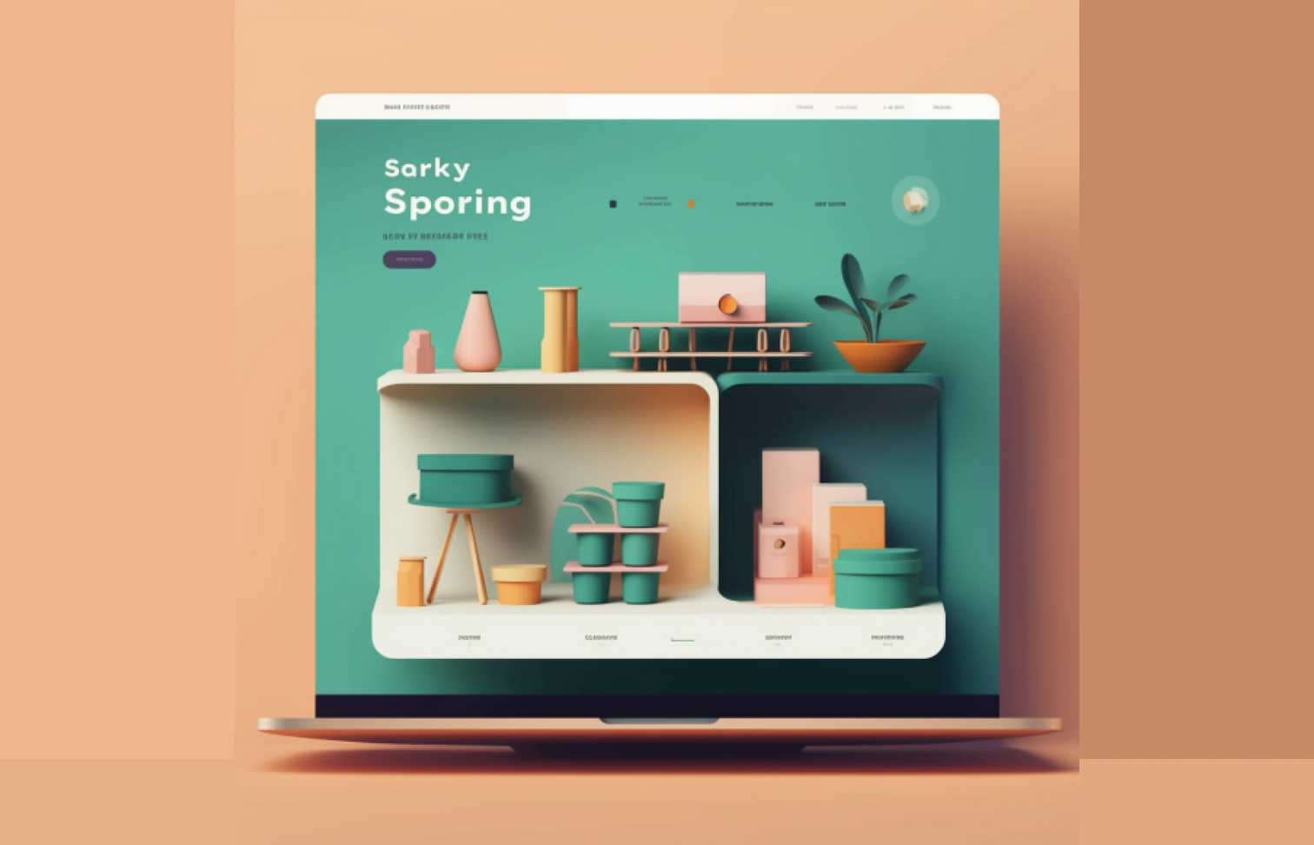
Quora Web Solution
Website Design and
Development
Company
Web Design & Web Development
Company in Bangalore, India
www.quorawebsolution.com
+91 9986 056 909
info@quorawebsolutions.com
24A, 1st Main Rd, Chandra Reddy
Layout, Koramangala 4th Block,
Koramangala, Bengaluru,
Karnataka 560034

Slide 2

The Ultimate Guide to Choosing the Right Website Design and Development Company for Your Business Growth
Introduction
In today’s digital age, having a professional and functional website is crucial for business success.
www.quorawebsolution.com

Slide 3

Whether you are a startup, a small business, or a large enterprise, choosing the right website design and development company can make or break your online presence. This guide will walk you through the key factors to consider when selecting the best web development agency for your needs.
www.quorawebsolution.com

Slide 4

1. Define Your Website Goals and Requirements
Before you start searching for a web development company, it is essential to clearly define your website's goals. Ask yourself:
www.quorawebsolution.com

Slide 5

What is the main objective of the website, and how does it align with your business goals?? (e.g., e-commerce, portfolio, blog, corporate site)
What features and functionalities do you need? (e.g., user login, payment gateways, chat support)
www.quorawebsolution.com

Slide 6
Who is your target audience?
What is your budget and timeline?
Having a clear understanding of your requirements will help you find a company that aligns with your vision.
2. Research Potential Companies
Start by researching website design and development companies. You can find potential candidates through:
Online searches
Social media platforms
Business directories
Referrals from colleagues and industry professionals
Shortlist companies based on their experience, expertise, and portfolio.
www.quorawebsolution.com

Slide 7
3. Evaluate Their Portfolio and Case Studies
A company’s portfolio gives you insight into their design style, technical expertise, and industry experience. Look for:
Diversity in projects (different industries and business types)
User-friendly and visually appealing designs
Functionality and responsiveness
Case studies showcasing successful projects
If a company has experience in your industry, it may be a good fit for your project.
4. Read Client Reviews and Testimonials
Client reviews provide an unbiased perspective on a company’s reliability and quality of work. Check:
www.quorawebsolution.com

Slide 8
Reviews on Google, Clutch, Trustpilot, and other review platforms
Testimonials on their website
References from past clients (contact them if necessary)
Pay attention to feedback about communication, deadlines, and post-launch support.
5. Assess Their Technical Expertise
A good web development company should be proficient in:
Modern web development technologies (HTML, CSS, JavaScript, React, Angular, etc.)
Content management systems (WordPress, Shopify, Magento, etc.)
Web security measures
SEO best practices
www.quorawebsolution.com

Slide 9
Mobile responsiveness and performance optimization
Ensure they use the latest technologies and follow industry standards.
6. Understand Their Development Process
The best companies follow a structured development process, including:
Discovery Phase – Understanding business needs and audience
Wireframing & UI/UX Design – Creating user-friendly layouts
Development & Coding – Turning designs into functional websites
Testing & Quality Assurance – Ensuring bug-free performance
Deployment & Maintenance – Launching and ongoing support
Ask about their project management approach and preferred communication tools.
www.quorawebsolution.com

Slide 10
7. Compare Pricing and Value for Money
Website development costs vary depending on complexity and features. Some companies charge:
Fixed pricing
Hourly rates
Custom quotes based on project scope
Instead of choosing the cheapest option, focus on the value they provide. A well-designed website is an investment in your business growth.
8. Evaluate Post-Launch Support and Maintenance
Websites require ongoing maintenance for security updates, bug fixes, and improvements. Ask about:
Support packages and maintenance plans
Response time for issues
www.quorawebsolution.com

Slide 11
Future scalability and upgrade options
A reliable company will offer continued support to ensure your website stays functional and up to date.
9. Check Their Communication and Transparency
Effective communication is key to a successful project. Consider:
Responsiveness to inquiries
Clarity in project timelines and deliverables
Transparency in pricing and contracts
Willingness to understand your business needs
A trustworthy company will keep you informed throughout the process and be open to feedback.
Conclusion
www.quorawebsolution.com

Slide 12
Choosing the right website design and development company requires careful consideration of your business needs, budget, and the company’s expertise. By following these steps, you can find a reliable partner who will help you build a website that enhances your online presence and drives business growth. Invest in quality web development today for long-term success!
Essential Features Every Business Website Needs in 2025: A Complete Checklist for Success
Introduction
In the fast-paced digital world of 2025, having a business website is no longer optional—it’s a necessity. A well-designed website helps establish credibility, attract customers, and drive business growth.
www.quorawebsolution.com

Slide 13
To stay ahead of the competition, your website must include essential features that enhance user experience, security, and functionality. This guide provides a complete checklist of must-have features for a successful business website in 2025.
1. Mobile-Friendly and Responsive Design
With mobile traffic surpassing desktop usage, a responsive website is crucial. Your website should:
Automatically adjust to different screen sizes (mobile, tablet, desktop)
Have a fast-loading and intuitive mobile user experience
Be tested on various devices to ensure compatibility
2. Fast Loading Speed
A slow website leads to high bounce rates and lost customers. Ensure your site:
Loads within 2-3 seconds
www.quorawebsolution.com

Slide 14
Uses optimized images and videos
Implements caching and Content Delivery Networks (CDN)
Minimizes the use of heavy scripts
3. Secure SSL Certification
Cybersecurity is a major concern in 2025. Protect your website and user data by:
Installing an SSL certificate (HTTPS)
Enforcing strong password policies for users
Implementing two-factor authentication (2FA) where necessary
Regularly updating software and plugins
4. SEO Optimization
For visibility on search engines, your website should be optimized for SEO. Key strategies include:
Using relevant keywords in content
www.quorawebsolution.com

Slide 15
Creating SEO-friendly URLs
Implementing schema markup
Optimizing images and meta tags
5. Clear and Engaging Call-to-Actions (CTAs)
A website should guide visitors toward taking action. Your CTAs should be:
Visibly placed and attention-grabbing
Direct and action-oriented (e.g., “Get a Free Quote,” “Subscribe Now”)
Optimized for conversions through A/B testing
6. Easy-to-Use Navigation
User experience plays a huge role in website success. Ensure your navigation:
Is simple and intuitive
www.quorawebsolution.com

Slide 16
Uses a sticky header for quick access
Includes a search bar for easy content discovery
Features a clear sitemap and logical menu structure
7. Contact Information and Live Chat Support
A business website should make it easy for customers to reach you. Essential contact features include:
Clickable phone numbers and email addresses
A professional and easy-to-use contact form
Integration with live chat or chatbots for instant support
Clear business hours and physical location (if applicable)
8. High-Quality Content and Blog Section
Content marketing is a powerful tool for attracting and engaging visitors. Your website should include:
Well-written, engaging, and informative content
www.quorawebsolution.com

Slide 17
A regularly updated blog covering industry trends and insights
Video content for better engagement and SEO benefits
User-generated content, testimonials, and case studies
9. E-commerce Capabilities (If Applicable)
For online businesses, an e-commerce-ready website is vital. Key features include:
Secure and easy-to-use payment gateways
A smooth checkout process with multiple payment options
Inventory management and order tracking features
Mobile-friendly shopping experience
10. Social Media Integration
Leverage social media to increase engagement and drive traffic. Your website should:
www.quorawebsolution.com

Slide 18
Include social media icons for quick access
Display recent social media posts (if relevant)
Allow users to share content with social share buttons
11. Analytics and Performance Tracking
Track your website’s success with analytical tools. Ensure your website is integrated with:
Google Analytics or an equivalent tool
Heatmaps to analyze user behavior
Conversion tracking for measuring business success
12. Accessibility Features
A website should be accessible to all users, including those with disabilities. Implement:
Alt text for images
www.quorawebsolution.com

Slide 19
Keyboard navigation support
Screen reader compatibility
High-contrast mode options
13. Regular Updates and Maintenance
Keeping your website updated is crucial for security and performance. Regularly:
Update software, plugins, and themes
Check for broken links and fix them
Perform security audits and backups
Optimize performance based on analytics
www.quorawebsolution.com

Slide 20
Conclusion
A business website in 2025 must be fast, secure, and user-friendly while providing a seamless experience for visitors. By implementing these essential features, you can ensure your website remains competitive, drives conversions, and supports business growth. Keep updating your site with the latest trends to stay ahead in the digital landscape.
www.quorawebsolution.com

Slide 21
Quora Web Solution: Quora Web Solution is a trusted website development company based in Bangalore, India, offering a wide array of services to not only domestic but global clientele. Be it Website Design and Development, SEO services, Digital Marketing, Branding, App Development, Ecommerce Solution, and Logo Creation . Quora Web Solution has the best website developers offering top quality services and that is the reason why we are well known as one of the best Website Development Companies in Bangalore, India.
Visit Us - www.quorawebsolution.com
Call Us - +91 9986 056 909
Mail Us - info@quorawebsolutions.com
www.quorawebsolution.com

Slide 22

WORDPRESS DEVELOPMENT
ECOMMERCE DEVELOPMENT
PHP DEVELOPMENT
CMS DEVELOPMENT
DRUPAL DEVELOPMENT
WEBSITE SERVICES
WEBPORTAL DEVELOPMENT
MAGENTO DEVELOPMENT
WEBSITE DEVELOPMENT
JOOMLA DEVELOPMENT
SMALL BUSINESS DEVELOPMENT
CHEAP WEBSITE DEVELOPMENT
STATIC WEBSITE DEVELOPMENT
DYNAMIC WEBSITE DEVELOPMENT
WEBSITE DESIGN COMPANY
TOUR AND TRAVEL WEBSITE DEVELOPMENT
Services

