Slide 1
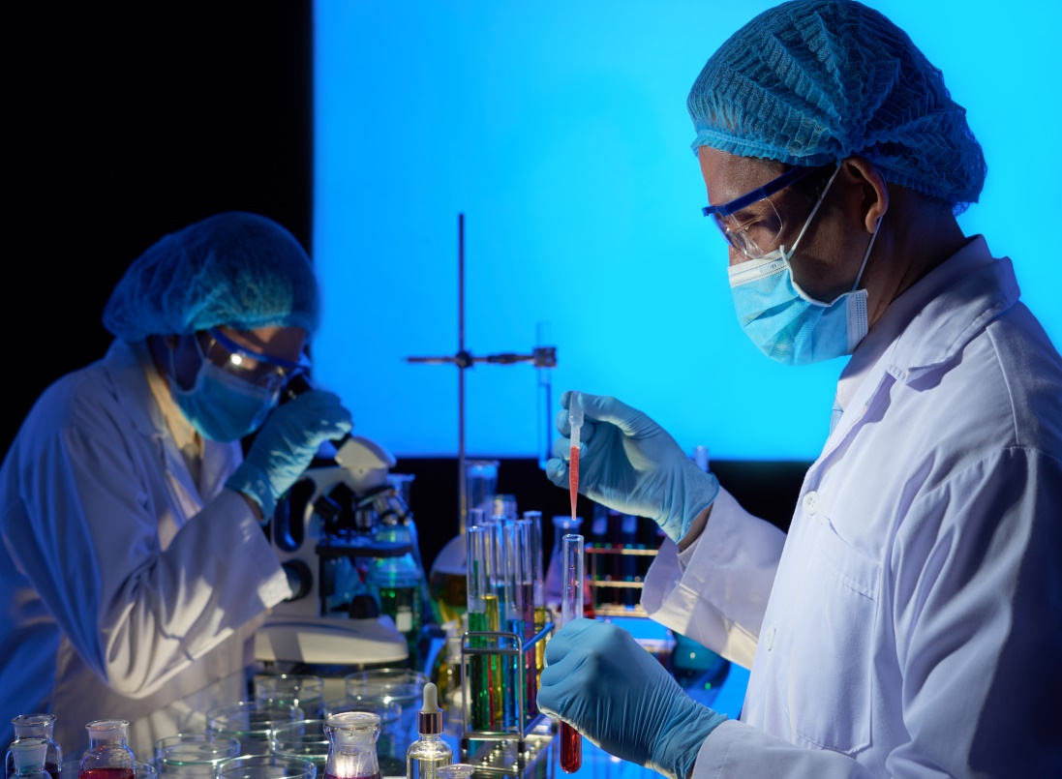
Research Chemical and Metals
Advance innovation with research chemical and metals, offering high-purity materials tailored for scientific research, testing & precision manufacturing needs.

Slide 2

Bulk Research Chemicals
Discover bulk research chemicals for laboratories, development programs & specialist applications, delivering dependable quality, purity, and reliable supply.

Slide 3
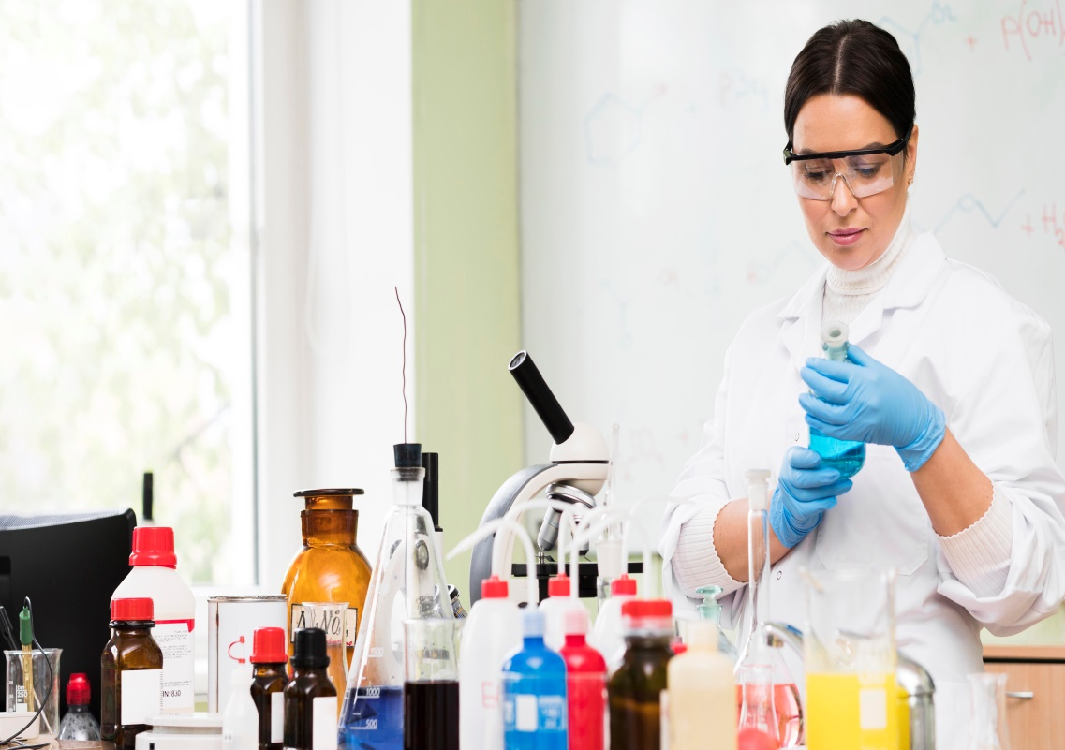
Best Place to Buy Research Chemicals
Choose the best place to buy research chemicals for access to high-purity, quality-tested materials, extensive product & support for research and development.

Slide 4

Contact Us
About: Viridis Materials provides high-quality metals, alloys, ceramics, and high-purity compounds for research and industry delivering trusted, eco-conscious materials with global reach and expert service.
Address: 8549 Wilshire Blvd Ste 2037 Beverly Hills, CA 90211, USA
Phone No.: +1 (323) 794-0820
Website: https://viridismaterials.com/

