Slide 1


Quora Web Solution
Website Design and
Development
Company
Web Design & Web Development
Company in Bangalore, India
www.quorawebsolution.com
+91 9986 056 909
info@quorawebsolutions.com
24A, 1st Main Rd, Chandra Reddy
Layout, Koramangala 4th Block,
Koramangala, Bengaluru,
Karnataka 560034

Slide 2

The Journey of Creating Stunning and Functional Websites with Expert Design and Development Teams
www.quorawebsolution.com

Slide 3
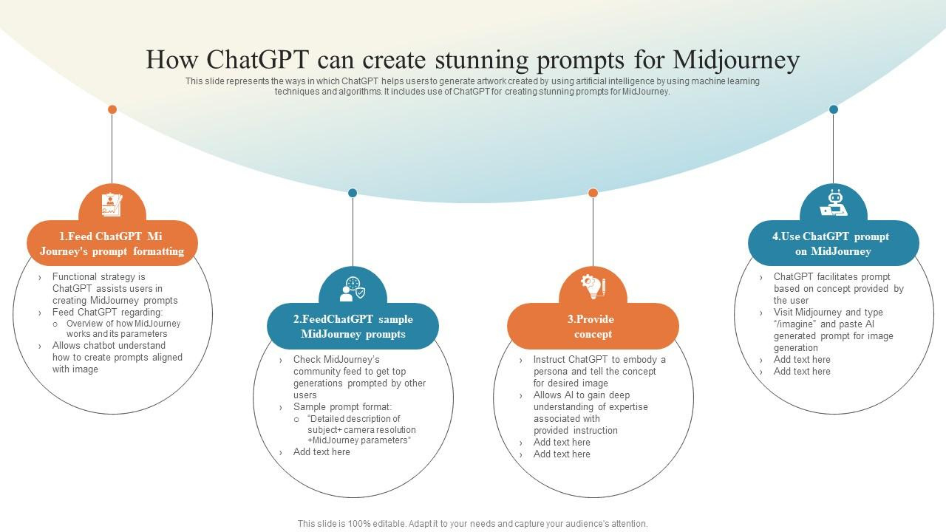
In today’s digital age, a website serves as the virtual storefront for businesses, organizations, and personal brands alike.
www.quorawebsolution.com

Slide 4
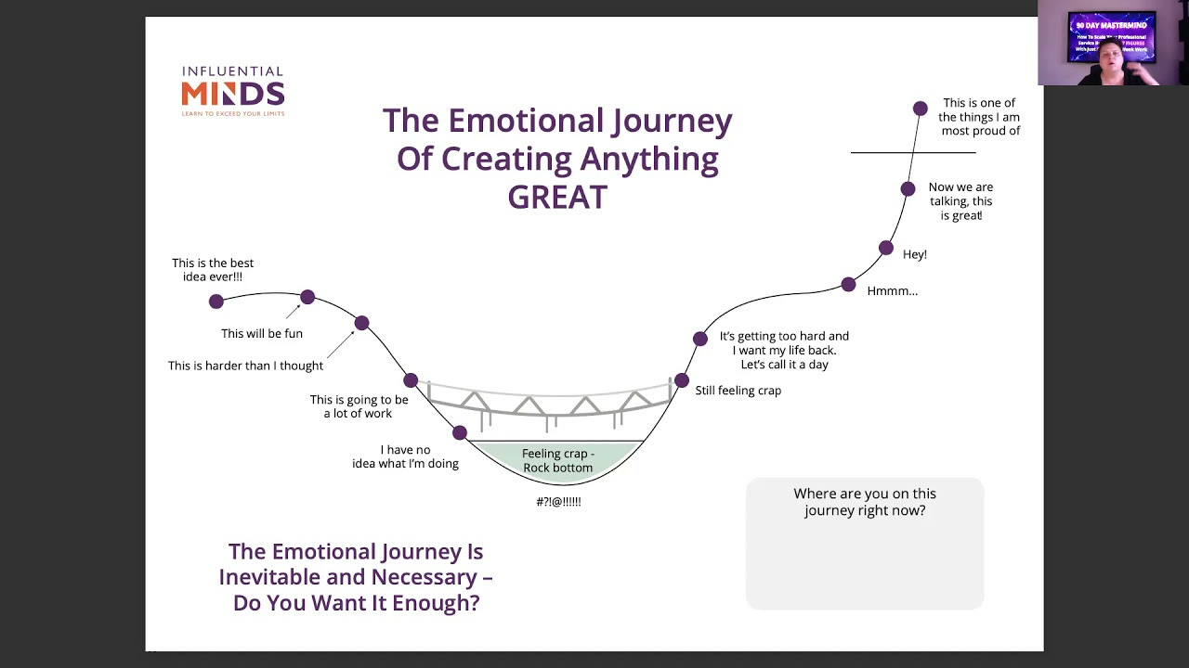
A stunning and functional website not only captures attention but also ensures seamless user experiences, driving engagement and conversions.
www.quorawebsolution.com

Slide 5
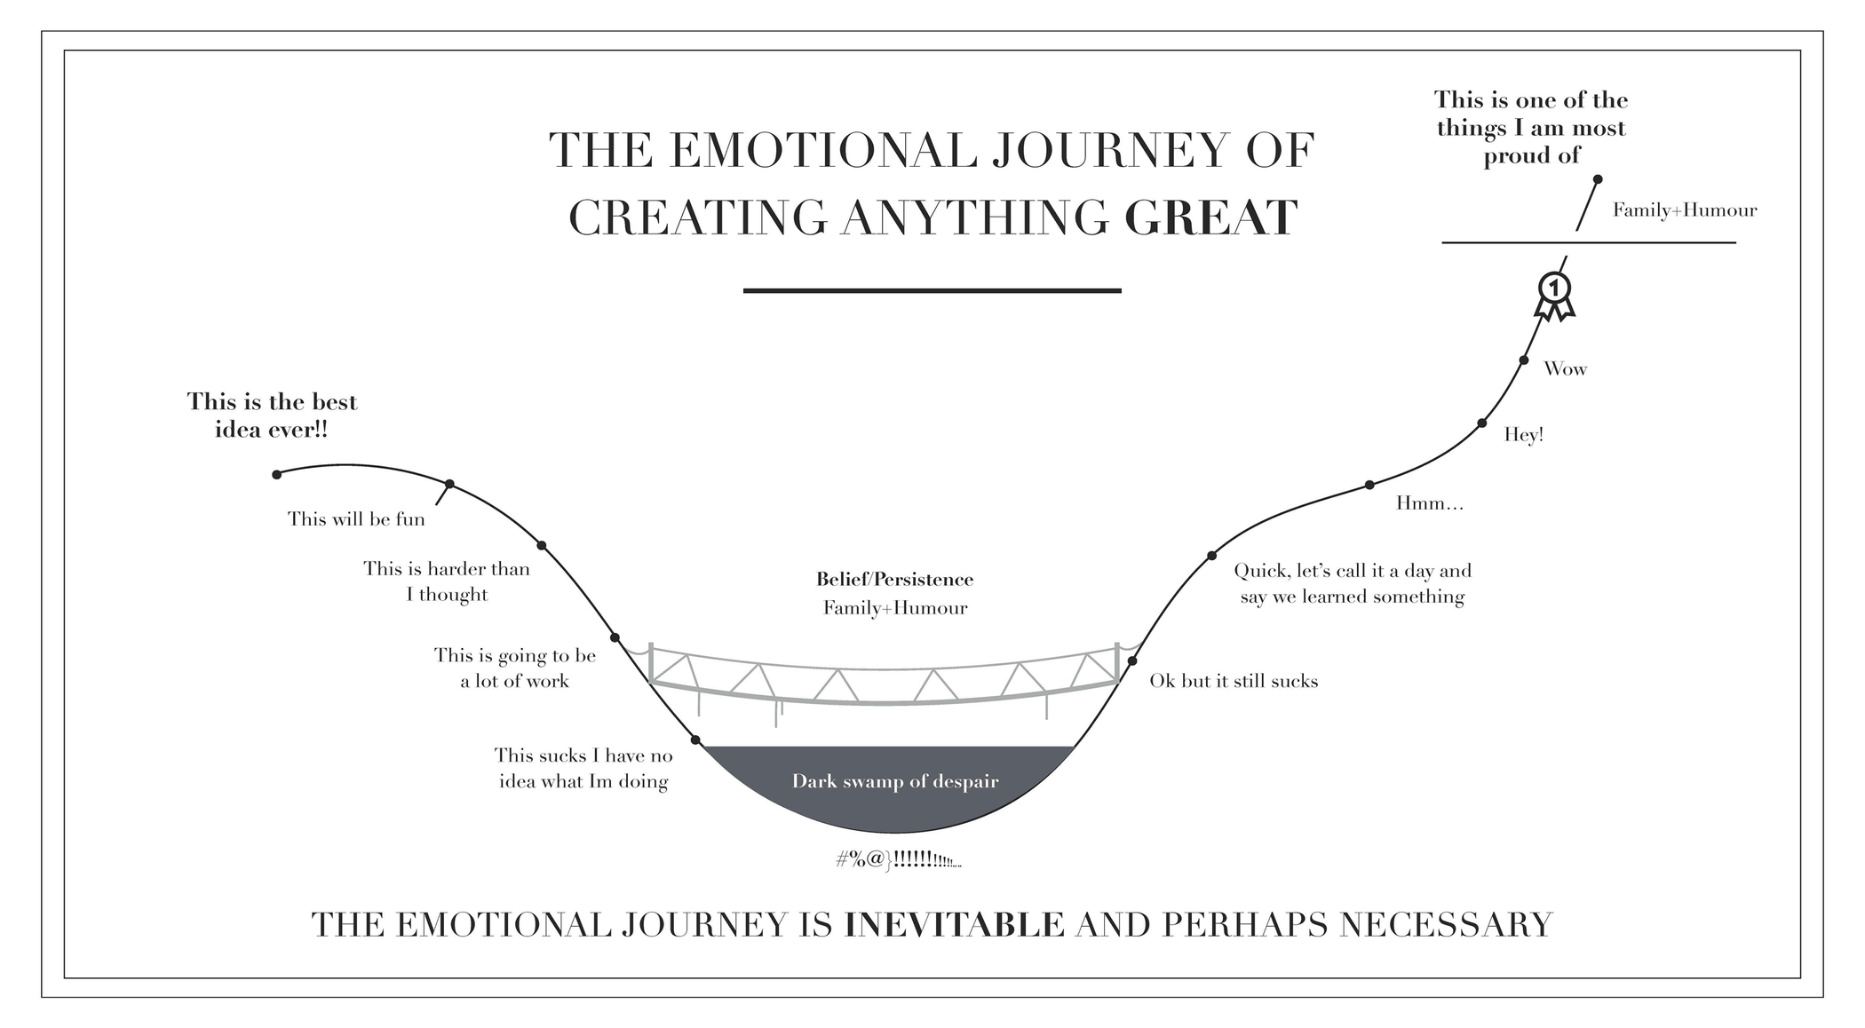
However, crafting such a digital masterpiece requires a blend of creativity, technical expertise, and strategic planning—qualities that expert design and development teams bring to the table.
www.quorawebsolution.com

Slide 6
Let’s dive into the journey of creating exceptional websites with the help of skilled professionals.
Step 1: Understanding the Vision
Every successful website begins with a clear understanding of its purpose and target audience. Design and development teams work closely with clients to gather insights into their brand identity, goals, and user expectations. This phase involves:
Discovery Workshops: Collaborative sessions to define objectives and outline the project scope.
User Research: Identifying the needs, behaviors, and preferences of the target audience.
Competitor Analysis: Studying industry trends and rival websites to ensure differentiation.
This foundational step sets the stage for a website that resonates with its intended users.
www.quorawebsolution.com

Slide 7
Step 2: Crafting the Blueprint
Once the vision is clear, the team creates a blueprint for the website. This includes:
Site Architecture: Structuring the layout to ensure intuitive navigation.
Wireframes: Sketching the skeletal framework of each page to map content placement and functionality.
Content Strategy: Planning the type and flow of content to convey the brand’s message effectively.
A well-thought-out blueprint serves as a roadmap, aligning everyone involved and minimizing potential missteps during development.
Step 3: Designing for Impact
Design is where creativity takes center stage.
www.quorawebsolution.com

Slide 8
Expert designers translate the blueprint into visually compelling interfaces that align with the brand’s identity. Key aspects of this phase include:
Visual Identity: Incorporating brand colors, typography, and imagery for consistency.
User Interface (UI) Design: Crafting an aesthetically pleasing layout that enhances usability.
Responsive Design: Ensuring the website adapts seamlessly across devices and screen sizes.
The goal is to create a design that not only looks stunning but also engages users at every touchpoint.
Step 4: Developing the Functionality
With the design finalized, it’s time to bring the website to life through development. This involves:
Front-End Development: Converting designs into interactive elements using HTML, CSS, and JavaScript.
www.quorawebsolution.com

Slide 9
Back-End Development: Building the server-side infrastructure to manage data and functionality.
Content Management System (CMS) Integration: Implementing platforms like WordPress or Drupal for easy content updates.
Expert developers ensure that the website is fast, secure, and scalable, using best practices and the latest technologies.
Step 5: Testing and Refining
Before launch, the website undergoes rigorous testing to identify and fix any issues. This includes:
Functionality Testing: Ensuring all features work as intended.
Performance Testing: Measuring loading speeds and optimizing for efficiency.
User Testing: Gathering feedback from real users to refine the experience.
www.quorawebsolution.com

Slide 10
This phase guarantees a polished product that meets both client expectations and user needs.
Step 6: Launching and Beyond
Once the website passes all tests, it’s ready to go live. But the journey doesn’t end here. Post-launch, expert teams provide ongoing support to:
Monitor Performance: Tracking analytics to measure success and identify areas for improvement.
Implement Updates: Keeping the website fresh with new features and content.
Ensure Security: Regularly updating software and monitoring for vulnerabilities.
A website is a dynamic entity that evolves with the business and its audience, requiring continuous attention and care.
www.quorawebsolution.com

Slide 11
The Power of Collaboration
Creating a stunning and functional website is not a solo endeavor. It requires collaboration between clients, designers, developers, and sometimes marketers and content creators. By combining their expertise, these teams craft digital experiences that leave lasting impressions.
In conclusion, the journey of building a website is as rewarding as the final product itself. With the guidance of expert design and development teams, businesses can create online platforms that not only meet but exceed expectations, setting the stage for success in the ever-competitive digital landscape.
Top Features to Expect from a Leading Website Design and Development Company in 2025
As the digital landscape continues to evolve, the demand for innovative, user-centric, and future-ready websites is higher than ever.
www.quorawebsolution.com

Slide 12
In 2025, businesses seeking to stay competitive will turn to leading website design and development companies that offer cutting-edge features and services. Here are the top features to expect from these industry leaders:
1. AI-Powered Personalization
The best companies in 2025 will leverage artificial intelligence (AI) to create hyper-personalized user experiences. AI tools will analyze user behavior, preferences, and interactions to deliver tailored content, product recommendations, and interface adjustments in real time. This feature ensures higher engagement and conversion rates.
2. Focus on Accessibility and Inclusivity
Accessibility will remain a priority, with companies adhering to Web Content Accessibility Guidelines (WCAG) to ensure their websites are usable by people with disabilities.
www.quorawebsolution.com

Slide 13
Features like voice navigation, screen reader compatibility, and customizable display options will be standard offerings.
3. Progressive Web Apps (PWAs)
Leading companies will prioritize Progressive Web Apps that combine the functionality of a website and a mobile app. PWAs offer offline access, faster load times, and app-like experiences without requiring downloads, making them indispensable for businesses targeting mobile-first users.
4. Advanced SEO Integration
Search engine optimization (SEO) will go beyond keywords. Companies will offer:
Voice Search Optimization: Tailoring websites for users who interact via smart speakers and voice assistants.
Semantic Search Capabilities: Structuring content to align with user intent rather than exact phrasing.
Core Web Vitals Enhancement: Ensuring optimal performance metrics for search engine rankings.
5. Immersive Design Elements
www.quorawebsolution.com

Slide 14
With advancements in technology, design trends in 2025 will include:
3D Graphics and Animations: Interactive visuals that captivate and engage users.
Augmented Reality (AR) Features: Integrating AR to let users visualize products or spaces in real time.
Dark Mode and Dynamic Themes: Giving users control over their viewing preferences.
6. No-Code and Low-Code Solutions
For clients looking for cost-effective and quick website updates, no-code and low-code platforms will be a staple. These tools empower non-technical users to make modifications and create new pages with ease.
7. Enhanced Cybersecurity Features
With increasing cyber threats, robust security measures will be non-negotiable. Expect leading companies to provide:
www.quorawebsolution.com

Slide 15
Advanced Encryption: Protecting sensitive data with cutting-edge encryption techniques.
AI-Driven Threat Detection: Using AI to monitor and respond to potential vulnerabilities in real time.
Regular Security Audits: Proactive testing to identify and fix issues before they escalate.
8. Sustainable Web Development
Sustainability will become a key focus, with companies designing energy-efficient websites. This includes:
Green Hosting Solutions: Using servers powered by renewable energy.
Optimized Code: Minimizing resource consumption during website operation.
Carbon-Neutral Practices: Offsetting emissions generated during development and hosting.
9. API-First Development
An API-first approach ensures seamless integration with third-party tools and platforms, allowing businesses to scale and adapt effortlessly.
www.quorawebsolution.com

Slide 16
This feature is particularly crucial for e-commerce, SaaS, and enterprise websites.
10. Comprehensive Analytics and Insights
In 2025, leading companies will provide advanced analytics dashboards that go beyond basic metrics. These tools will offer:
Behavioral Insights: Understanding user actions and preferences in-depth.
Predictive Analytics: Leveraging data to anticipate future trends and user needs.
Customizable Reporting: Tailoring analytics reports to match business goals.
11. Post-Launch Support and Maintenance
A hallmark of top-tier companies will be their commitment to long-term partnerships.
www.quorawebsolution.com

Slide 17
Clients can expect:
24/7 Support: Immediate assistance for troubleshooting and updates.
Regular Updates: Ensuring the website remains compatible with evolving technologies.
Continuous Optimization: Refining performance based on user feedback and analytics.
12. Emphasis on Scalability
Future-proof websites will be designed to grow with businesses. Scalability will be built into the architecture, allowing websites to handle increased traffic, new features, and expanded content without compromising performance.
www.quorawebsolution.com

Slide 18
Conclusion
The year 2025 will set new benchmarks for website design and development, with companies pushing the boundaries of technology, creativity, and user-centricity. Businesses partnering with these industry leaders can expect not just a website, but a powerful digital platform that drives growth, engagement, and success. Choosing the right partner—one that embraces these top features—will be critical in staying ahead in an ever-competitive digital world.
www.quorawebsolution.com

Slide 19
Quora Web Solution: Quora Web Solution is a trusted website development company based in Bangalore, India, offering a wide array of services to not only domestic but global clientele. Be it Website Design and Development, SEO services, Digital Marketing, Branding, App Development, Ecommerce Solution, and Logo Creation . Quora Web Solution has the best website developers offering top quality services and that is the reason why we are well known as one of the best Website Development Companies in Bangalore, India.
Visit Us - www.quorawebsolution.com
Call Us - +91 9986 056 909
Mail Us - info@quorawebsolutions.com
www.quorawebsolution.com

Slide 20

WORDPRESS DEVELOPMENT
ECOMMERCE DEVELOPMENT
PHP DEVELOPMENT
CMS DEVELOPMENT
DRUPAL DEVELOPMENT
WEBSITE SERVICES
WEBPORTAL DEVELOPMENT
MAGENTO DEVELOPMENT
WEBSITE DEVELOPMENT
JOOMLA DEVELOPMENT
SMALL BUSINESS DEVELOPMENT
CHEAP WEBSITE DEVELOPMENT
STATIC WEBSITE DEVELOPMENT
DYNAMIC WEBSITE DEVELOPMENT
WEBSITE DESIGN COMPANY
TOUR AND TRAVEL WEBSITE DEVELOPMENT
Services

