Slide 1


How Virtual Vaulting Solves Cash Safety Worries in Vegas Casinos

Slide 2

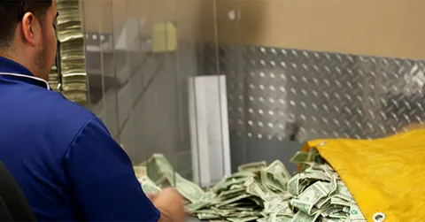
Rethinking Test Prep in an Era of Individualized Learning
The days of one-size-fits-all test preparation are over. In an educational climate increasingly defined by personalization, adaptability, and evidence-based learning, students expect more than worksheets and word lists. They want guidance that recognizes who they are—how they learn, what motivates them, and where their growth potential lies.

Slide 3
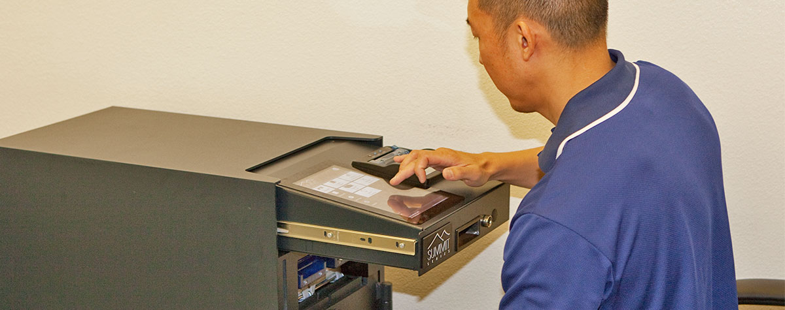
Why Human Connection Still Outperforms Algorithms
Frontline workers face more pressure during peak hours. They handle cash fast. They move in crowded rooms. They face long lines and quick hands. Virtual vaulting helps cut risk for them. Staff touch cash less. They only place funds in the device, follow a quick step, and move on. The cash stays locked right away.

Slide 4
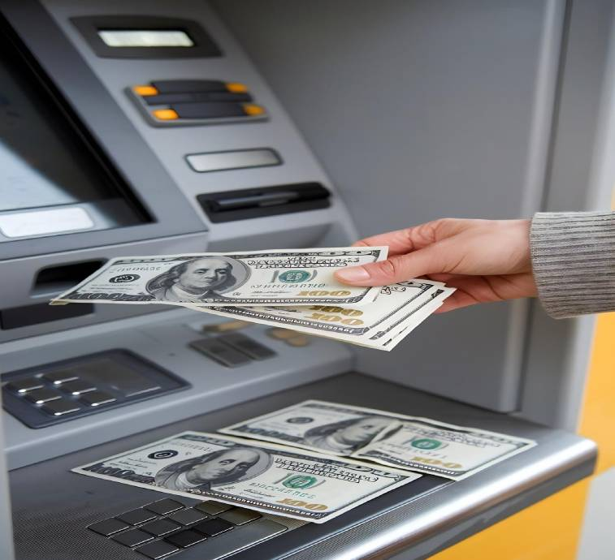
Clear Records Make Audits Faster
Each deposit goes into a digital record. You get a time stamp. You get the amount. You get the user ID. You get simple logs that match your floor activity. Strong records also prevent disputes. If a deposit shows a mismatch, the system helps trace the event and the user. Teams solve issues faster with less stress.

Slide 5
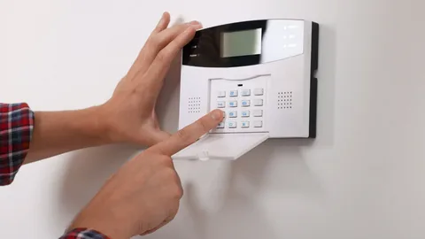
How It Connects With External Storage
The secure device holds funds until armored teams arrive. Those teams move the sealed cash to safe offsite locations. Many casinos also pair their virtual vault with added storage systems such as Arizona Vault and Safe Deposit Box for improved protection of high value items. It gives casinos two layers of safety. Onsite security plus offsite storage.

Slide 6



CONTACT US
www.sectransecurity.com
P.O.Box 227267 Los Angeles, CA 90022
(562)-(948)-(1446)
info@sectransecurity.com

