Slide 1









Frontier Airlines
BAGGAGE POLICY
Guide 2026
+1-888-212-0809
Understanding:
Topics:
Free Allowances & Fees
Baggage Sizes & Rules
www.airflypolicy.com

Slide 2



Frontier Airlines
Baggage
Allowance
Frontier Airlines operates as an ultra-low-cost carrier with strict Frontier Airlines baggage policies designed to keep base fares low. Unlike traditional airlines, no free checked bags are included with standard ticket purchases.
Understanding the Policy
Both carry-on bags and checked luggage require additional fees unless you purchase a fare bundle that includes baggage allowances. Planning ahead and understanding these policies helps you budget accurately for your trip.

Slide 3

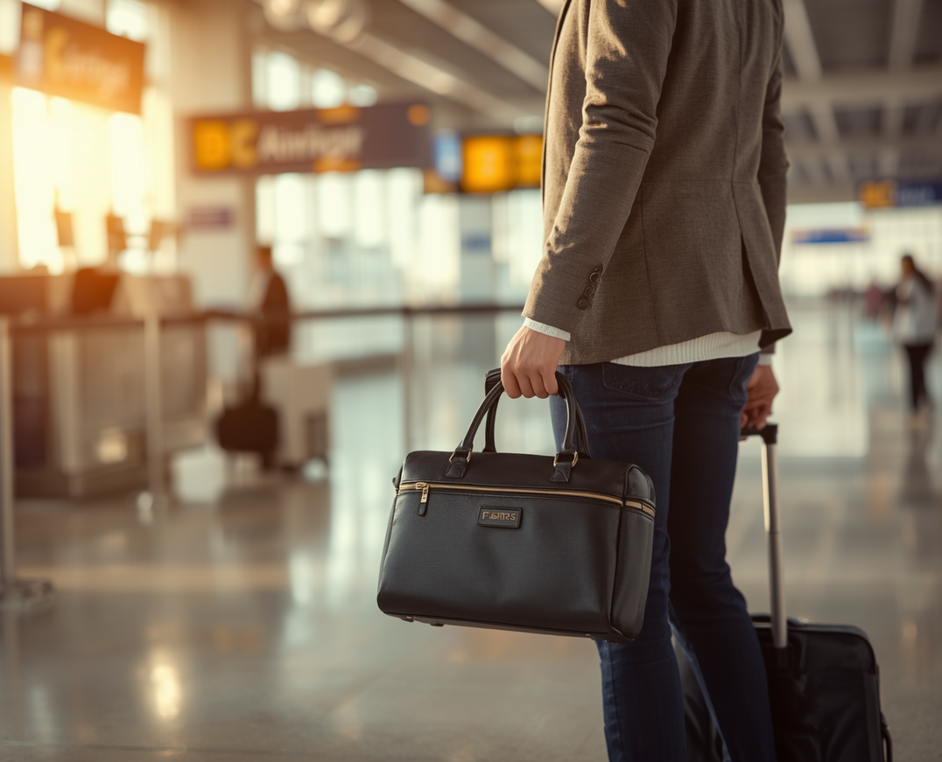
Frontier Airlines
Free Bags on
Frontier Airlines?
Understanding what you can bring at no extra cost and what requires payment on your Frontier flight.
1 free personal item
Carry-on bags not free
Checked bags require fees
One small personal item is allowed free of charge for every passenger on all Frontier flights.
Carry-on bags are not free unless included in your fare bundle or you have elite status membership.
Checked bags always require payment unless pre-purchased in a fare bundle or promotional offer.

Slide 4
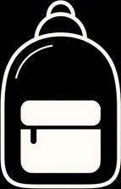


Frontier Airlines
Carry-On Size
& Allowance
Understanding Frontier Airlines carry-on baggage dimensions and personal item requirements is essential for a smooth travel experience. Know the size limits before you pack to avoid unexpected fees at the gate.
Carry-On Bag Size
Personal Item Size
Maximum dimensions: 24 x 16 x 10 inches (including wheels and handles). Must be able to lift into overhead bin unassisted.
Maximum dimensions: 18 x 14 x 8 inches. Must fit under the seat in front of you. This is your free baggage allowance.

Slide 5

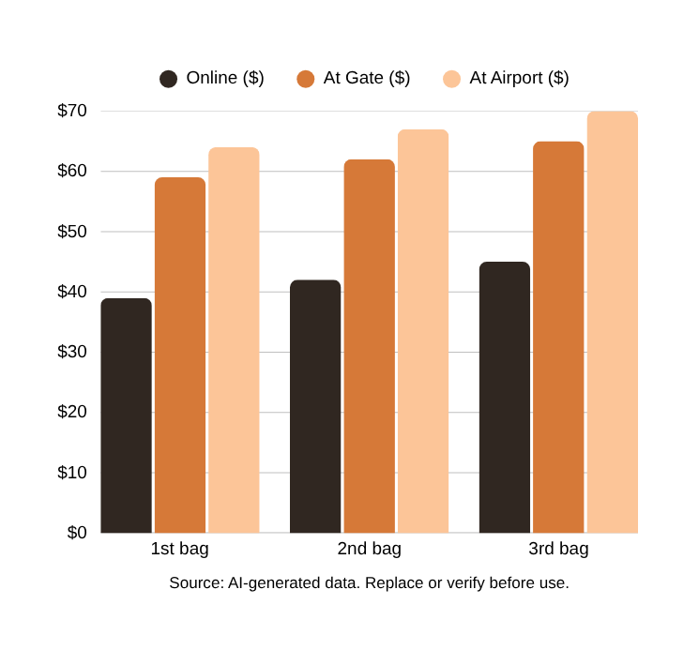
Frontier Airlines
Checked Baggage
Size & Fees
Maximum Size Limits
62 linear inches max (length + width + height combined)
Weight Restrictions
50 lbs (23 kg) maximum weight per checked bag
Fee Timing Matters
Prepay online for lowest rates; airport fees are higher

Slide 6
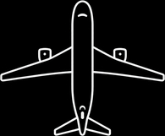
Frontier Airlines
Baggage
Tips
01
02
03
04
Prepay Online to Save Money
Use Personal Item to Avoid Fees
Measure Luggage Carefully
Consider Fare Bundles

Slide 7

Frontier Airlines
Frequently Asked
Questions
01
02
03
04
Are pets considered carry-on baggage?
Can I bring sports equipment?
What if my bag is overweight?
When should I pay for bags?

Slide 8

Frontier Airlines
Policy
Summary
01
02
03
04
1 Free Personal Item
Carry-On: 24x16x10 Inches
Checked: 62" & 50 lbs Max
Prepay Online to Save

Slide 9
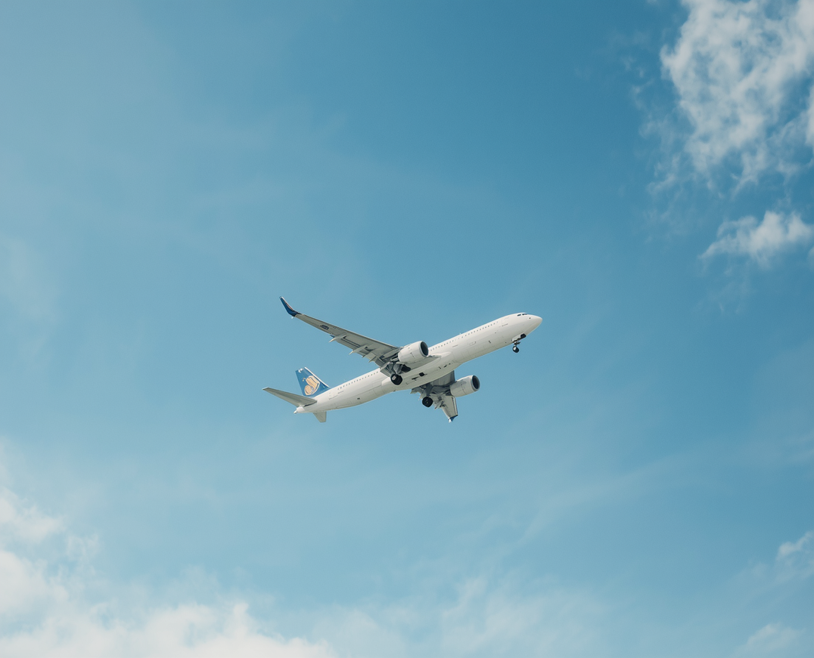
Frontier Airlines
THANK YOU
For Your Attention
More Info:
Contact:
www.airflypolicy.com
+1-888-212-0809

