Slide 1

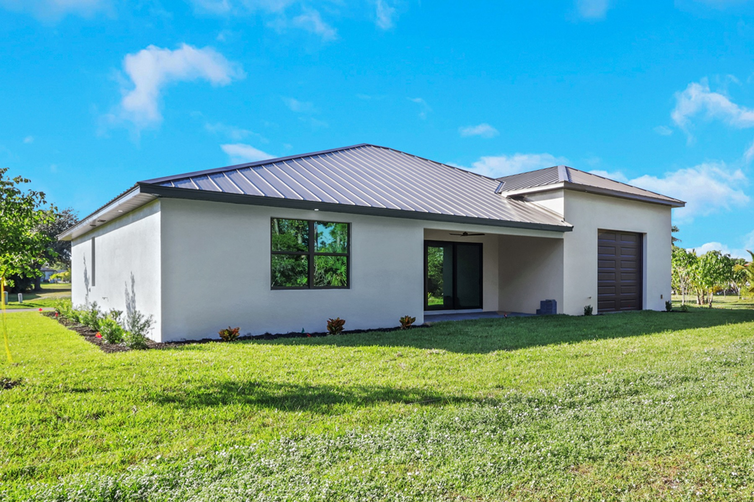
Smart Thermostat Benefits Explained By Custom Home Builders Cape Coral FL

Slide 2

In Florida, air conditioning systems need to run 24/7. Smart thermostats have become quite popular among Floridians. They are known as comfort-enhanced solutions for homes.
The thermostat system learns about your daily patterns and uses the same data to control indoor climate settings. Several home builders consider installing smart thermostats in their new construction projects.
The Function of Smart Thermostat
The smart thermostats learn your daily routines and develop a cooling plan according to your lifestyle. The system automatically decreases cooling capacity when you leave your home to conserve energy. The system can be operated through the mobile application as well. This will allow you to adjust the system even when you are traveling. Most smart thermostats also have a geofencing system. This system will allow the thermostats to know your location and change the cooling when you leave or arrive.
At Sposen Homes, we install smart thermostats in most homes because they suit the lifestyles of today’s buyers. As Custom Home Builders Cape Coral FL, we build homes with features that suit your lifestyle.
Energy Savings
Floridians have to deal with increased electricity bills as their air conditioning systems run all day and all night. The smart thermostat will assist in reducing these bills as it will make the system more efficient.

Slide 3
You can set your house temperature to maximum when you are home and decrease it when you are going out. You can achieve significant energy savings without losing your comfortable state. We have seen many homeowners enjoy energy savings when working with Cape Coral Custom Home Builders.
Humidity Management
Homeowners use smart thermostats to control the humidity levels within their homes. The system works effectively because it controls the HVAC system. The system controls the moisture levels, thus lowering the chances of mold growth.
This feature has become useful in Florida. The moisture levels in Florida remain high throughout the year. Custom Home Builders Cape Coral FL add smart thermostats while designing homes.
Convenience and Smart Features
Smart thermostats make life easy. You can use voice commands to operate the thermostat. They send you notifications when the filters need replacement. They help you maintain your HVAC system.
This feature provides peace of mind for the homeowners. You can stay in complete control even when you’re away from home. Buyers who work with Cape Coral Custom Home Builders look for this feature in their new homes.
Why Sposen Homes Recommends Smart Technology
Our team believes that all houses must provide their residents with comfort, energy efficiency, and financial

Slide 4
worth. We provide modern homes with modern technologies and architecture. We would help select the best for your needs. The smart thermostat is a more sensible option for contemporary homes.
Final Thoughts
Smart thermostats can significantly ease the lives of Floridians. Not only will this system save a lot of money, but it will also maintain your ideal temperature throughout the house. If you are constructing or renovating your home, it is something to think about.

Slide 5

For More Details Contact Us :
Name: Sposen Signature Homes
Address: 2311 Santa Barbara Blvd, Suite 112, 33991 Cape Coral, Florida, USA
Telephone: 239-244-8886
Email id: hello@sposenhomes.com
Website: https://sposenhomes.com

