Slide 1



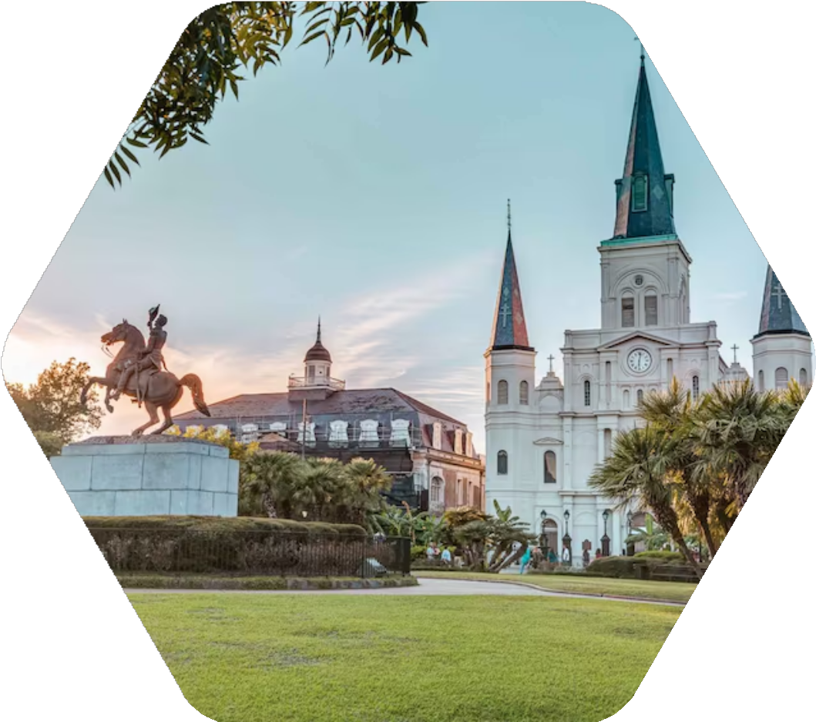

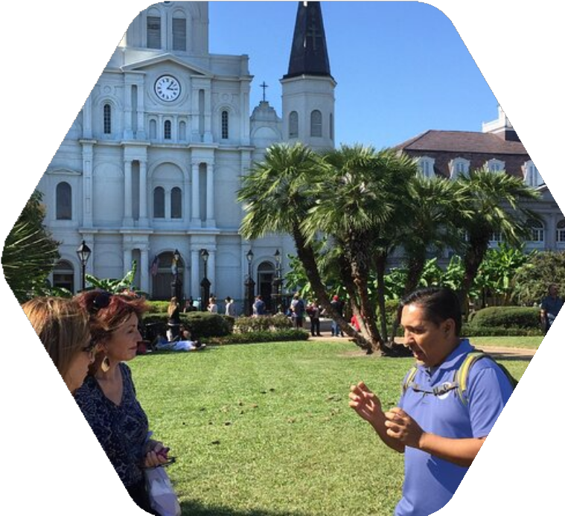

The Ultimate Guide to New Orleans Louisiana Walking Tours
www.tourorleans.com

Slide 2
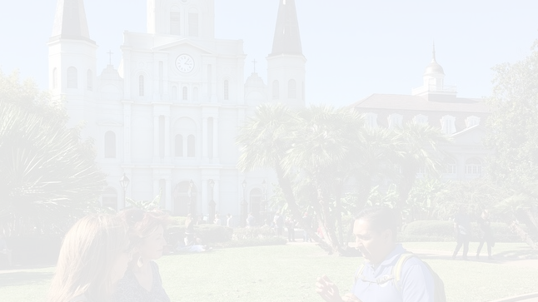


New Orleans Louisiana Walking Tours is a city with a rich history, diverse culture, and distinctive architecture. If you want to see the soul of this lively city, there's no better way than on foot. Walking tours provide an intimate and personal experience of New Orleans' iconic landmarks, neighborhoods, and off-the-beaten-path gems. Whether you're an enthusiast of history, or architecture, or just anyone interested in enjoying the beauty of this quirky city, a walking tour is the best way to learn about authentic New Orleans.

Slide 3




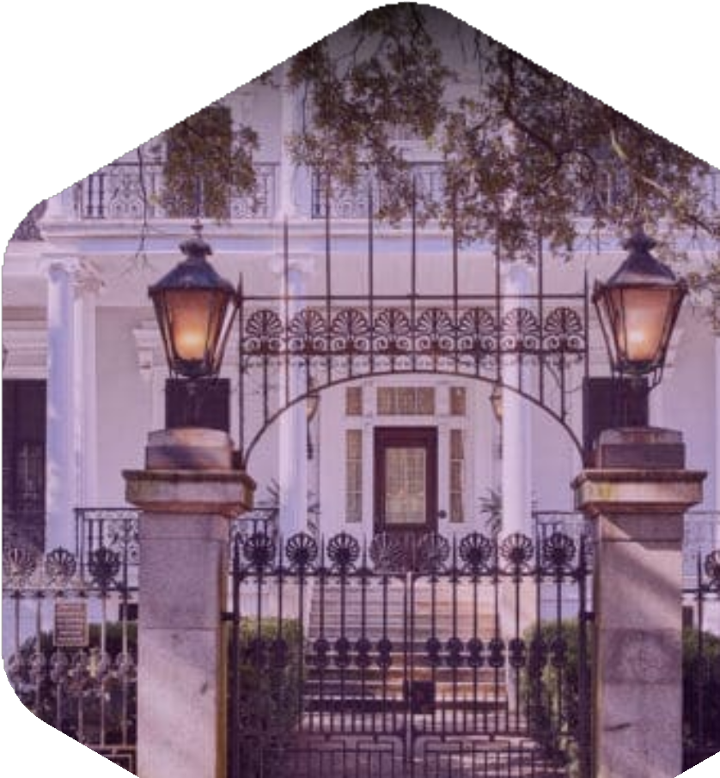
Why Choose a Walking Tour in New Orleans?
New Orleans is a city whose every street has a story to tell. By deciding to explore on foot, you can surround yourself with local culture, mingle with informed guides, and discover the sights and sounds that make the city so unique. Walking tours offer flexibility and intimacy, and you get to explore at your own comfortable pace while gaining insights into the history and customs of New Orleans.

Slide 4
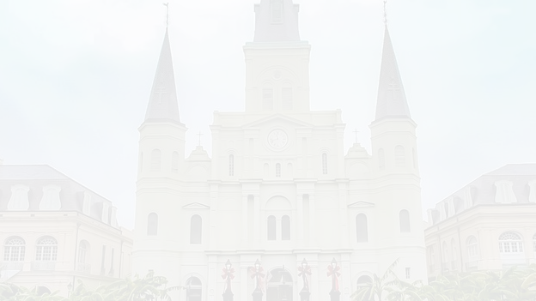


Popular Walking Tours in New Orleans
French Quarter Walking Tour
One of the city's most iconic neighborhoods, the French Quarter is not to be missed by first-time visitors. A French Quarter walking tour is your way to walk through the historic streets of colorful Creole townhouses, picturesque courtyards, and iconic Jackson Square.

Slide 5


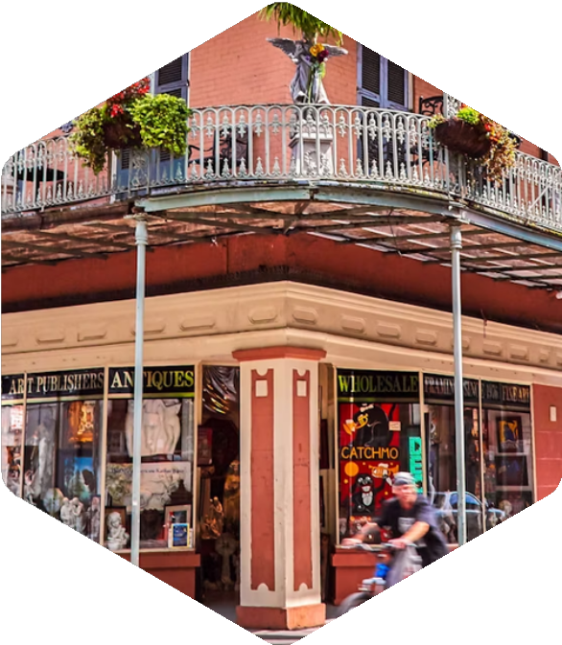

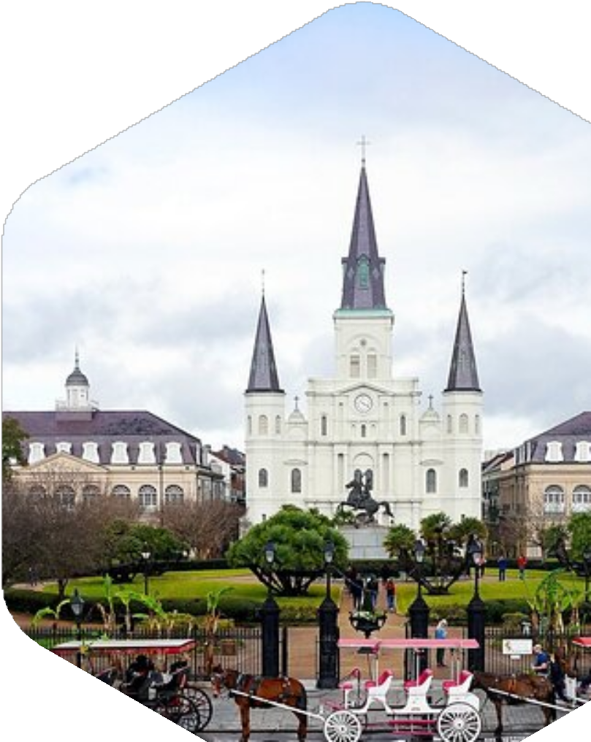
Cemetery and Haunted Tour
For those who need to get away from the hubbub of the French Quarter, the Garden District provides a more peaceful and scenic experience. Famous for its stately antebellum mansions, oak-shaded streets, and lovely gardens, the Garden District is an ideal location to find out about the city's interesting history and architectural development. On a guided walking tour, you’ll get a peek into the private homes of the city’s elite and the fascinating history behind the district's development.

Slide 6
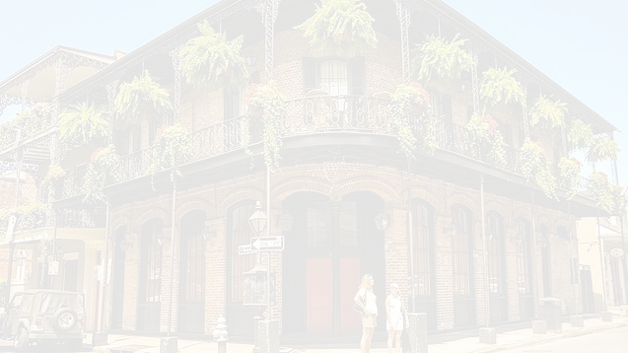
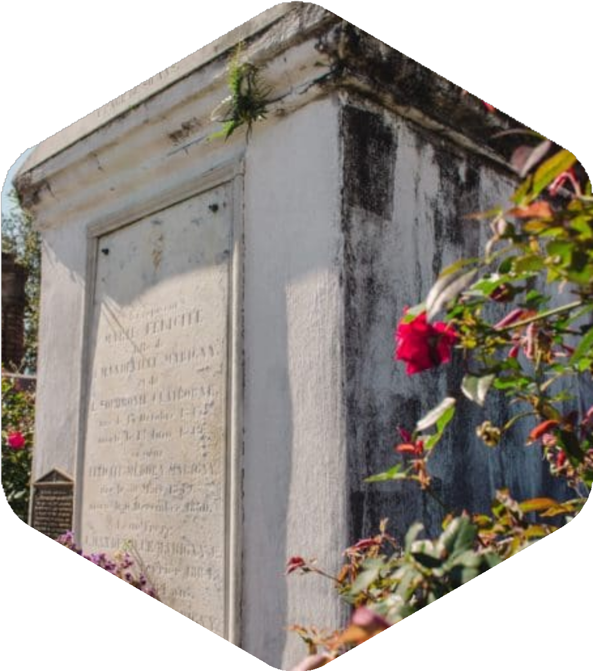
Voodoo and French Quarter Ghost Tour
For the thrill seeker of the paranormal, a French Quarter and Voodoo ghost tour provides a spooky experience that's not soon forgotten. This is a tour of the city's rich heritage and connections to the practices of Voodoo, digging deep into spiritual rituals and ceremonies that have become intertwined with New Orleans's history.
Travelers get an insider look at the spirits that haunt the French Quarter on this tour with visits to the most notoriously haunted sites.

Slide 7




GET IN TOUCH
www.tourorleans.com
info@tourorleans.com
+1 504-475-5214
New Orleans, LA 70130, USA

