Slide 1
BUY SCULPTURE ONLINE WITH MOJARTO
https://www.mojarto.com/

Slide 2


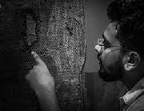
Introduction to Mojarto
ndia’s premier online art platform
Over 25,000+ artworks across categories
Curated collection of original paintings, sculptures, prints & photographs Trusted by thousands of art collectors and enthusiasts
Backed by the NDTV group
https://www.mojarto.com/

Slide 3
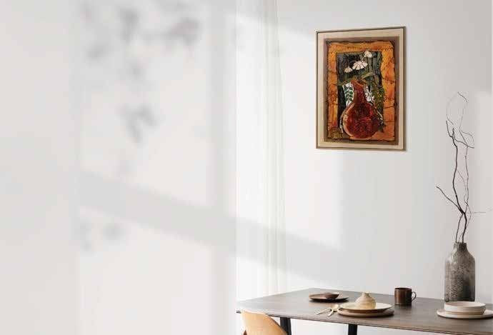
Why Buy Sculpture Online?
Explore a wide variety of art from the comfort of your home
Access to both emerging and established artists
Transparent pricing and verified authenticity
Easy comparison, detailed descriptions, and high-resolution images
Secure packaging and nationwide delivery
https://www.mojarto.com/

Slide 4
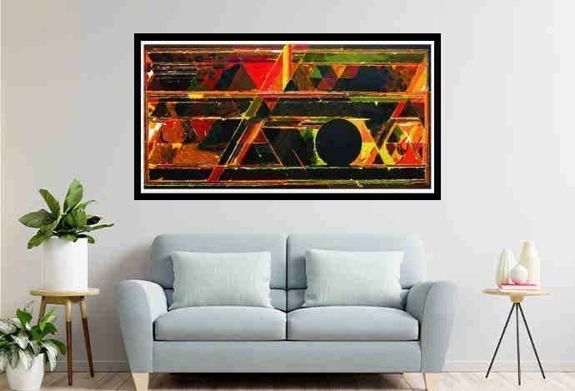
Mojarto's Sculpture Collection
Handpicked selection of original sculptures
Diverse materials: bronze, wood, stone, ceramic, metal, mixed media Themes ranging from spiritual & abstract to figurative & contemporary Artworks by acclaimed Indian sculptors
https://www.mojarto.com/

Slide 5

FOLLOW US
HTTPS://WWW.FACEBOOK.COM/MOJARTO-191313941210803/
https://www.mojarto.com/

Slide 6
CONTACT INFO
+916385753122
contactus@mojarto.com
https://www.mojarto.com/

Slide 7
Thank You
https://www.mojarto.com/

