Slide 1
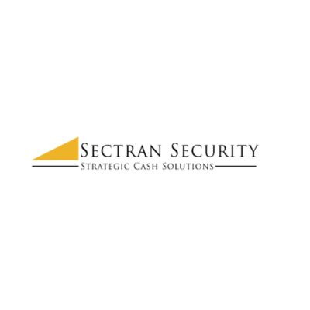

How Armored Truck Security Companies Simplify Cash Logistics

Slide 2


Why Do Many Businesses Stop Handling Cash Transport Themselves?
A professional cash logistics service removes that extra work. Cash is collected on a regular schedule, and every pickup follows the same process. Employees stay at work instead of leaving for bank deposits. Managers also spend less time planning daily cash movement. That creates a smoother workday for everyone.

Slide 3
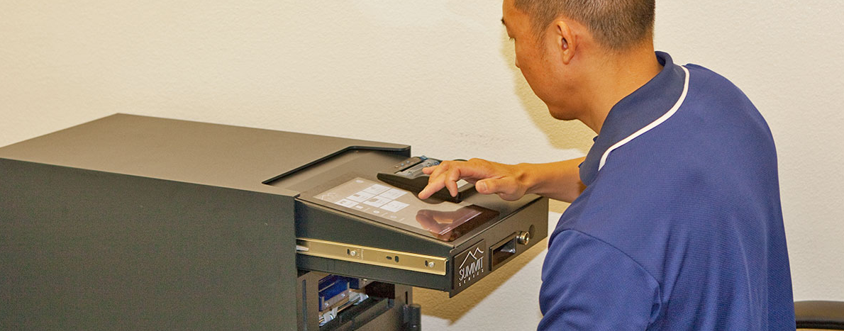
Why Does A Simple Process Matter So Much?
A planned process also reduces interruptions during the workday. Staff members stay focused on helping customers instead of preparing deposits or arranging transportation. Business owners can spend more time improving customer service instead of managing daily cash movement.

Slide 4
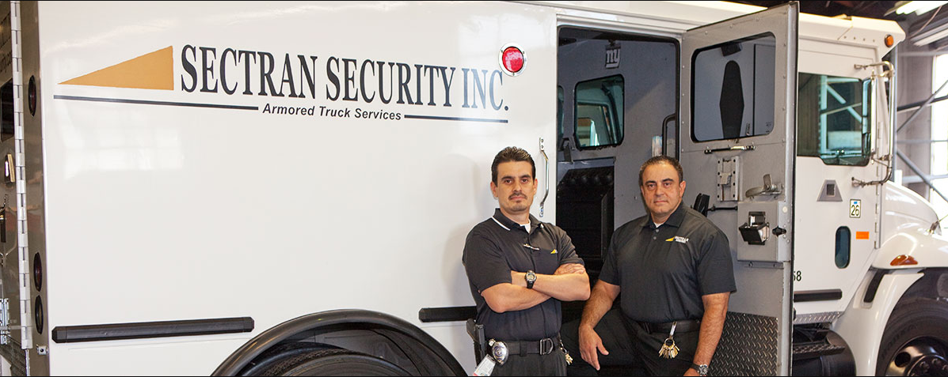
Better Cash Logistics Help Businesses Grow
Professional cash logistics services make growth easier. Pickup schedules can grow along with the business. Reporting stays organized, and cash continues moving through the same reliable process. Business owners gain confidence because cash handling stays simple, even as daily business becomes busier.

Slide 5
Bottom Line
Sectran Security helps businesses simplify cash handling with dependable cash logistics solutions. The company provides secure armored transportation, professional cash processing, and trusted vault services that fit daily business needs. Every service is designed to help businesses save time, stay organized, and keep cash moving safely from one step to the next.

Slide 6


CONTACT US
www.sectransecurity.com
P.O.Box 227267 Los Angeles, CA 90022
(562)-(948)-(1446)

