Slide 1



Quora Web Solution
Website Design and
Development
Company
Web Design & Web Development
Company in Bangalore, India
www.quorawebsolution.com
+91 9986 056 909
info@quorawebsolutions.com
24A, 1st Main Rd, Chandra Reddy
Layout, Koramangala 4th Block,
Koramangala, Bengaluru,
Karnataka 560034

Slide 2

Crafting a Captivating Digital Presence: A Comprehensive Guide to Website Design and Development Services
www.quorawebsolution.com

Slide 3
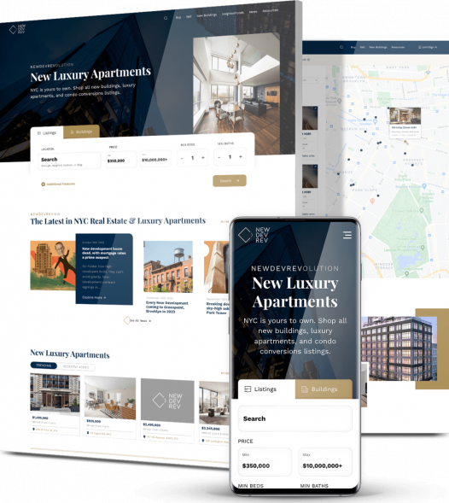
A well-crafted website is the cornerstone of a successful online presence.
www.quorawebsolution.com

Slide 4

It serves as a digital storefront, showcasing your brand, products, or services to the world.
www.quorawebsolution.com

Slide 5

A reputable website design and development company can help you create a website that is visually appealing, user-friendly, and effective at achieving your goals.
www.quorawebsolution.com

Slide 6
Essential Services Offered by Website Design and Development Firms
  **Website Design: Crafting visually stunning and user-friendly websites that align with the client's brand and objectives.
  Website Development: Building functional and efficient websites using various programming languages and frameworks.
  E-commerce Development: Creating online stores for businesses to sell products or services online.
  Content Management System (CMS) Development: Designing custom CMS platforms to manage website content easily.
  Mobile App Development: Developing mobile apps for iOS and Android platforms.
  Search Engine Optimization (SEO): Optimizing websites to improve their visibility in search engine results.
www.quorawebsolution.com

Slide 7
  Digital Marketing: Implementing various digital marketing strategies to attract and engage online audiences.**
Key Considerations When Selecting a Website Design and Development Partner
  Experience and Expertise: Look for companies with a proven track record and expertise in the specific areas you need.
  Portfolio: Review the company's portfolio to assess their design and development capabilities.
  Client Testimonials: Read testimonials from previous clients to get insights into their experience.
  Communication and Collaboration: Ensure that the company has effective communication channels and is willing to collaborate closely.
www.quorawebsolution.com

Slide 8
  Pricing: Compare pricing structures and ensure it aligns with your budget.
  Technical Expertise: Consider the company's technical expertise and their ability to stay updated with the latest industry trends.
  Scalability: Ensure the company can accommodate your website's growth and future needs.
  Customer Support: Assess the company's customer support services and their responsiveness to queries.
  Project Management: Evaluate the company's project management processes and their ability to deliver projects on time and within budget.
Advantages of Enlisting a Website Design and Development Firm
  Expertise and Efficiency: Professional companies can deliver high-quality websites with exceptional efficiency.
www.quorawebsolution.com

Slide 9
  Their in-depth knowledge and experience allow them to streamline processes, optimize workflows, and deliver projects on time and within budget.
  Time and Cost Savings: By entrusting your website project to experts, you can save valuable time and resources. Their efficient methodologies and problem-solving skills help minimize delays and avoid costly mistakes.
  Improved User Experience: A well-designed and developed website can significantly enhance the user experience. Professional companies focus on creating intuitive navigation, visually appealing layouts, and optimized content that engages visitors and encourages conversions.
  Enhanced Brand Image: A professional website can significantly elevate your brand's image.
www.quorawebsolution.com

Slide 10
  Expert designers and developers can create a cohesive and visually appealing online presence that reflects your brand's values and identity.
  Increased ROI: A well-optimized website can contribute to increased revenue and return on investment. By improving website performance, enhancing user experience, and implementing effective SEO strategies, professional companies can help you attract more qualified leads and drive sales.
By partnering with a reputable website design and development company, you can elevate your online presence to a new level. Their expertise, creativity, and dedication will help you craft a website that not only captivates your audience but also drives tangible results for your business. With their guidance, you can transform your digital footprint into a powerful tool for growth, success, and achieving your online goals.
www.quorawebsolution.com

Slide 11
Website Design and Development Services: A Comprehensive Guide
A reputable website design and development company is essential for establishing a strong online presence. A well-crafted website can serve as a powerful tool for businesses, organizations, and individuals to achieve their goals. By partnering with a skilled team of designers and developers, you can create a website that not only looks visually appealing but also delivers a seamless user experience.
Here are some key aspects of website design and development that a reputable company will focus on:
  User Experience (UX): A website should be intuitive and easy to navigate, with a clear layout and fast loading times. This includes factors such as:
    Intuitive navigation: Users should be able to easily find what they are looking for.
    Clear layout: The layout should be uncluttered and easy to read.
www.quorawebsolution.com

Slide 12
    Fast loading times: Users should not have to wait long for pages to load.
  Visual Design: The visual appearance of a website should be attractive and consistent with the brand's identity. This includes elements such as color scheme, typography, and imagery.
  Content: The content of a website should be relevant, informative, and engaging. This includes text, images, videos, and other multimedia elements.
  Technical Development: The technical infrastructure of a website should be robust and secure. This includes factors such as hosting, programming languages, and database management.
  Search Engine Optimization (SEO): A website should be optimized for search engines so that it appears high in search results for relevant keywords.
www.quorawebsolution.com

Slide 13
  This includes factors such as keyword research, on-page optimization, and link building.
  The process of website design and development typically involves the following stages:
  Planning: This phase entails meticulously outlining the website's objectives, identifying the target audience, and crafting compelling messages.
  Design: The visual aesthetic of the website is brought to life, carefully considering the brand's identity and adhering to user-centric design principles.
  Development: The website is constructed utilizing programming languages such as HTML, CSS, and JavaScript.
  Testing: The website undergoes rigorous testing to ensure its flawless functionality and adherence to the client's precise requirements.
  Launch: The website is officially unveiled to the public.
  Maintenance: The website receives ongoing maintenance and updates to maintain its optimal performance.
www.quorawebsolution.com

Slide 14
  Website design and development companies come in all shapes and sizes, each with its own unique specialties. Some specialize in crafting websites for small businesses, while others focus on creating complex e-commerce platforms or large-scale enterprise websites. When selecting a website design and development company, it's crucial to consider factors such as their portfolio, experience, and pricing to ensure they align with your specific needs and budget.
  In conclusion, a website design and development company can be a valuable asset for businesses and organizations seeking to establish a strong online presence. By partnering with a skilled team of professionals, you can create a website that not only looks visually appealing but also effectively communicates your brand message, engages your target audience, and drives business growth.
www.quorawebsolution.com

Slide 15
Quora Web Solution: Quora Web Solution is a trusted website development company based in Bangalore, India, offering a wide array of services to not only domestic but global clientele. Be it Website Design and Development, SEO services, Digital Marketing, Branding, App Development, Ecommerce Solution, and Logo Creation . Quora Web Solution has the best website developers offering top quality services and that is the reason why we are well known as one of the best Website Development Companies in Bangalore, India.
Visit Us - www.quorawebsolution.com
Call Us - +91 9986 056 909
Mail Us - info@quorawebsolutions.com
www.quorawebsolution.com

Slide 16




Services
WORDPRESS DEVELOPMENT
ECOMMERCE DEVELOPMENT
PHP DEVELOPMENT
CMS DEVELOPMENT
DRUPAL DEVELOPMENT
WEBSITE SERVICES
WEBPORTAL DEVELOPMENT
MAGENTO DEVELOPMENT
WEBSITE DEVELOPMENT
JOOMLA DEVELOPMENT
SMALL BUSINESS DEVELOPMENT
CHEAP WEBSITE DEVELOPMENT
STATIC WEBSITE DEVELOPMENT
DYNAMIC WEBSITE DEVELOPMENT
WEBSITE DESIGN COMPANY
TOUR AND TRAVEL WEBSITE DEVELOPMENT

