Slide 1

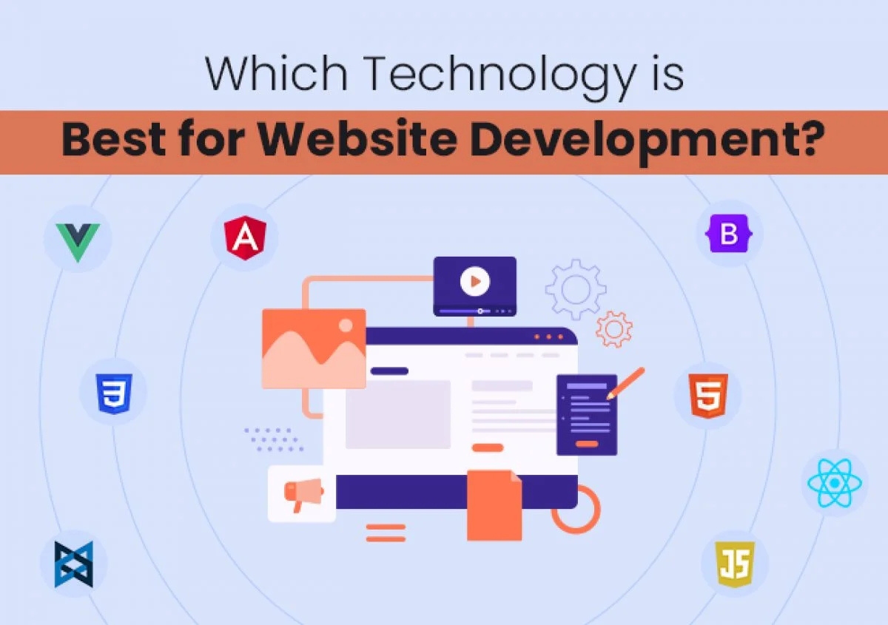

Quora Web Solution
Website Design and
Development
Company
Web Design & Web Development
Company in Bangalore, India
www.quorawebsolution.com
+91 9986 056 909
info@quorawebsolutions.com
24A, 1st Main Rd, Chandra Reddy
Layout, Koramangala 4th Block,
Koramangala, Bengaluru,
Karnataka 560034

Slide 2

Crafting Your Digital Presence: A Comprehensive Guide to Website Design and Development Companies
In today's digital age, a website is essential for businesses of all sizes.
www.quorawebsolution.com

Slide 3

Whether you're a budding entrepreneur or a seasoned corporation, a professional website can be the key to unlocking your online potential.
www.quorawebsolution.com

Slide 4
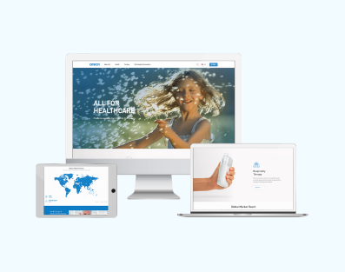
Imagine a world where your business is always open, accessible to customers around the clock, and capable of generating leads and sales even while you sleep.
www.quorawebsolution.com

Slide 5

This is the power of a website, and website design and development companies are the architects who can bring this vision to life.
www.quorawebsolution.com

Slide 6
Here are some specific examples of how a website can benefit your business:
  Increased brand awareness: A website is a great way to increase brand awareness and reach new customers.
  Improved customer engagement: A website can help you engage with your customers and build relationships.
  Increased sales: A website can help you generate leads and sales.
  Enhanced customer service: A website can help you provide better customer service.
  Improved SEO: A website can help you improve your search engine ranking, so that more people can find your business online.
No matter what your business goals are, a website can help you achieve them.
What is a Website Design and Development Company?
www.quorawebsolution.com

Slide 7
A website design and development company is a specialized team of professionals who create, design, and maintain websites. They work together to build websites that are not only visually appealing but also highly functional and user-friendly.
Why Choose a Website Design and Development Company?
Partnering with a website design and development company offers a multitude of advantages that can significantly benefit your business. Here are some compelling reasons to consider this collaboration:
  Expertise and Experience: These companies possess the technical know-how and creative expertise to build websites that are not only visually appealing but also highly functional and user-friendly.
www.quorawebsolution.com

Slide 8
  Custom Solutions: They can tailor websites to your specific needs, whether you require a simple brochure site or a complex e-commerce platform.
  SEO Optimization: They can optimize your website for search engines, ensuring that it ranks higher in search results and attracts more organic traffic.
  Responsive Design: They can create websites that adapt seamlessly to different screen sizes, providing an optimal user experience across devices.
  Ongoing Support and Maintenance: They can offer ongoing support and maintenance services to keep your website up-to-date and secure.
  Cost-Effective: Hiring a website design and development company can be more cost-effective than hiring in-house staff. They can provide a team of experts with the latest skills and tools, without the need for long-term commitments or overhead costs.
www.quorawebsolution.com

Slide 9
Choosing a website design and development company involves considering factors like reputation, portfolio, communication, pricing, client reviews, technical expertise, project management, and customization.
Conclusion
By partnering with a reputable website design and development company, you can unlock the full potential of your online presence. These companies can help you create a website that is not only visually stunning but also drives traffic, generates leads, and ultimately boosts your business.
In addition to the benefits mentioned above, here are some other reasons why you should consider hiring a website design and development company:
  Save time and money: Hiring a professional can save you time and money.
www.quorawebsolution.com

Slide 10
Get a high-quality website: A website design and development company can create a high-quality website that is both visually appealing and functional.
Improve your website's SEO: A good website design and development company can help you improve your website's SEO, so that you can attract more visitors to your site.
Get expert support: A website design and development company can provide you with expert support, so that you can keep your website running smoothly.
Choosing the right website design and development company is an important decision. Here are some additional tips to help you make the best choice:
Do your research: Read online reviews, compare portfolios, and ask for references.
www.quorawebsolution.com

Slide 11
Set a budget: Determine how much you are willing to spend on your website.
Ask the right questions: When you interview potential companies, be sure to ask about their experience, their process, and their pricing.
Get everything in writing: Once you have chosen a company, be sure to get everything in writing, including the scope of work, the timeline, and the payment terms.
By following these tips, you can find a website design and development company that can help you create a website that will help you achieve your business goals.
Elevating Your Digital Presence: A Tailored Approach to Website Design and Development
www.quorawebsolution.com

Slide 12
In today's digital age, a robust online presence is essential for businesses of all sizes. A well-designed and developed website serves as a digital storefront, attracting potential customers and conveying your brand's message effectively. For example, a small restaurant can use its website to showcase its menu, customer reviews, and location, while a large corporation can use its website to provide detailed information about its products and services, as well as to facilitate online sales and customer support. This article delves into the key aspects of website design and development companies, helping you make informed decisions when selecting the right partner for your project.
Understanding the Fundamentals
Website design and development is a collaborative process that involves the creation and maintenance of websites. It encompasses both the visual and technical aspects of web development. Design focuses on the aesthetics of a website, including its layout, color scheme, and typography.
www.quorawebsolution.com

Slide 13
Development focuses on the functionality of a website, including its coding and programming.
Key Services:
Website design and development companies offer a wide range of services to help businesses establish and maintain a strong online presence. Here are their key services:
  Website Design:
    UI/UX Design: Creating visually appealing and user-friendly interfaces that are easy to navigate.
    Responsive Design: Ensuring that your website looks and functions seamlessly across all devices, from desktops to smartphones.
    Branding and Identity Design: Developing a strong brand identity that sets your business apart from the competition.
  Website Development:
    Front-End Development: Building the visible part of your website using HTML, CSS, and JavaScript to create an engaging user experience.
www.quorawebsolution.com

Slide 14
    Back-End Development: Developing the server-side logic and database interactions that power your website, using languages like PHP, Python, or Ruby on Rails.
    E-commerce Development: Creating online stores with features like product catalogs, shopping carts, and secure payment gateways.
    Content Management Systems (CMS): Implementing platforms like WordPress or Drupal to make it easy for you to manage your website content.
  Digital Marketing Services:
    SEO: Optimizing your website to rank higher in search results.
    Pay-Per-Click (PPC) Advertising: Running targeted online advertising campaigns to reach your ideal customers.
    Social Media Marketing: Leveraging social media platforms to connect with your audience and build brand awareness.
www.quorawebsolution.com

Slide 15
    Email Marketing: Creating and sending email campaigns to nurture leads and drive conversions.
Choosing the right website design and development company depends on several factors, including their portfolio, expertise, communication skills, pricing, client reviews, and company culture.
When selecting a website design and development company, consider the following factors:
  Portfolio: Review their past projects to assess their design and development capabilities.
  Expertise: Ensure they have experience in your industry or niche.
  Communication: Effective communication is key for a successful project.
  Pricing: Obtain detailed quotes and compare them with different companies.
  Client Reviews and Testimonials: Read feedback from previous clients.
  Awards and Recognitions: Check if the company has received any industry awards or recognitions. This can show their quality of work.
www.quorawebsolution.com

Slide 16
  References: Ask the company for a list of references from previous clients. You can contact these clients to get their firsthand experience of working with the company.
  Company Culture: A good company culture can lead to better work. Look for a company that values creativity, innovation, and customer satisfaction.
  Project Management: Ensure the company has a dedicated project manager.
  Support and Maintenance: A good website design and development company will provide ongoing support and maintenance services. This includes fixing bugs, updating the website, and providing technical support.
Conclusion
A well-designed and developed website is an essential tool for businesses in today's competitive landscape. By partnering with a reputable website design and development company, you can create a digital presence that captivates your audience, drives traffic, and ultimately generates leads and sales.
www.quorawebsolution.com

Slide 17
In addition to the factors mentioned above, here are some additional tips for choosing the right website design and development company:
  Do your research: Take the time to research different companies and compare their services, pricing, and portfolio.
  Ask questions: Don't be afraid to ask questions about the company's experience, process, and team.
  Get quotes: Get quotes from multiple companies so you can compare prices and services.
  Read reviews: Read reviews from previous clients to get an idea of the company's reputation.
  Meet the team: Meet with the team to see if you feel comfortable working with them.
  Get everything in writing: Make sure to get everything in writing, including the scope of work, timeline, and pricing.
By following these tips, you can find the right website design and development company to help you create a successful online presence.
www.quorawebsolution.com

Slide 18
Quora Web Solution: Quora Web Solution is a trusted website development company based in Bangalore, India, offering a wide array of services to not only domestic but global clientele. Be it Website Design and Development, SEO services, Digital Marketing, Branding, App Development, Ecommerce Solution, and Logo Creation . Quora Web Solution has the best website developers offering top quality services and that is the reason why we are well known as one of the best Website Development Companies in Bangalore, India.
Visit Us - www.quorawebsolution.com
Call Us - +91 9986 056 909
Mail Us - info@quorawebsolutions.com
www.quorawebsolution.com

Slide 19




Services
WORDPRESS DEVELOPMENT
ECOMMERCE DEVELOPMENT
PHP DEVELOPMENT
CMS DEVELOPMENT
DRUPAL DEVELOPMENT
WEBSITE SERVICES
WEBPORTAL DEVELOPMENT
MAGENTO DEVELOPMENT
WEBSITE DEVELOPMENT
JOOMLA DEVELOPMENT
SMALL BUSINESS DEVELOPMENT
CHEAP WEBSITE DEVELOPMENT
STATIC WEBSITE DEVELOPMENT
DYNAMIC WEBSITE DEVELOPMENT
WEBSITE DESIGN COMPANY
TOUR AND TRAVEL WEBSITE DEVELOPMENT

