Slide 1


Slide 2
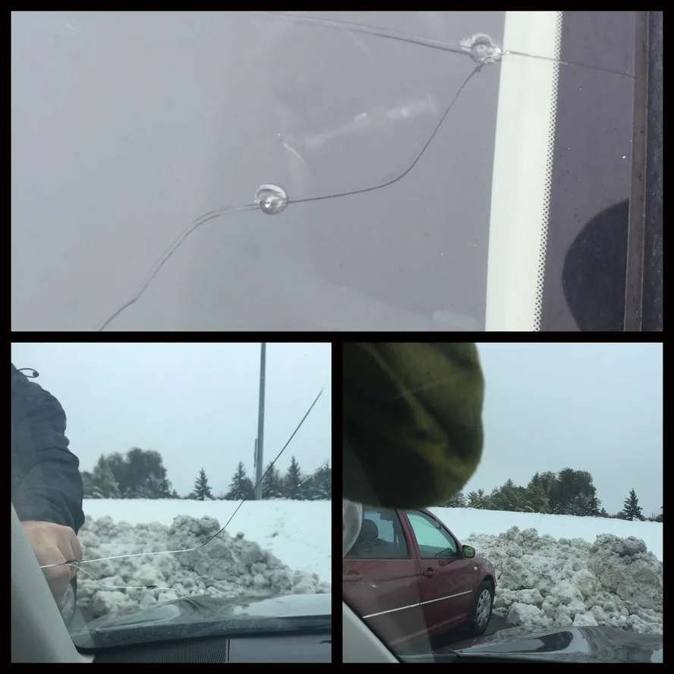
A small windshield chip may seem like a minor problem, but it should never be ignored. Changes in temperature, road vibrations, and everyday driving can cause a tiny chip to develop into a long crack. If you notice windshield damage, choosing professional Windshield Chip Repair Edmonton services can help address the issue before it becomes more serious.
Why Windshield Chips Should Be Repaired Quickly
Windshields do more than protect you from wind, rain, and road debris. They also contribute to overall vehicle safety and visibility. Even a small impact mark can become distracting, especially when it catches sunlight or headlights.

Slide 3
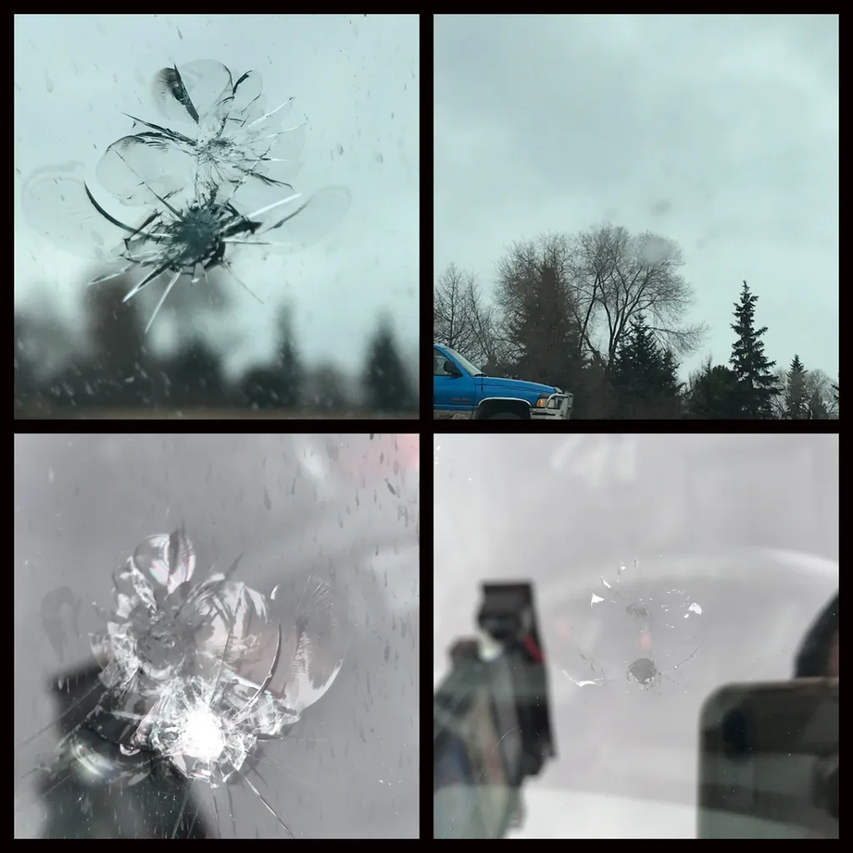
Prompt repair can often prevent further spreading and may help you avoid the expense and inconvenience of a complete windshield replacement. Professional technicians can assess the size, location, and condition of the damage and determine whether repair is an appropriate option.
Professional Windshield Chip Repair in Edmonton
At Crack Chip Repair, we understand that windshield damage can happen unexpectedly. A stone on the highway, loose gravel, or road debris can leave behind a noticeable chip in seconds. Our service focuses on convenient solutions for drivers dealing with chips and cracks.

Slide 4
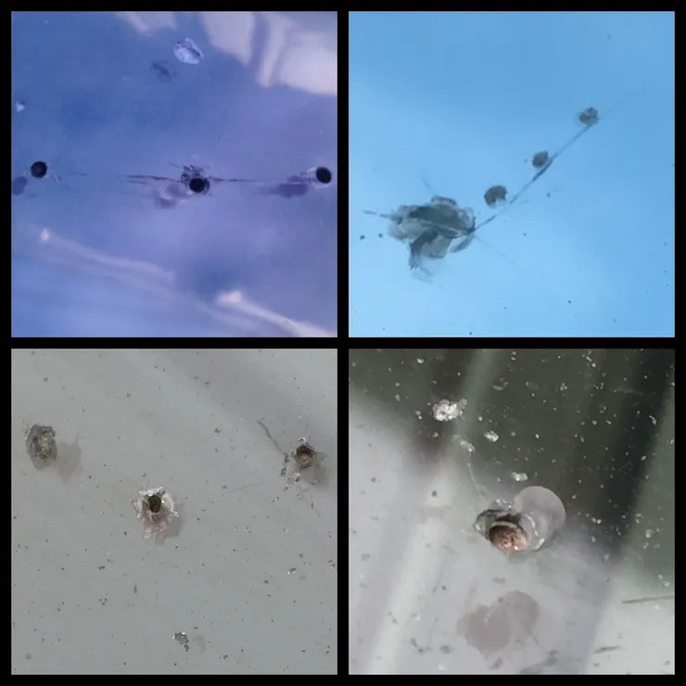
Whether you have a fresh rock chip or an existing area of windshield damage, having it inspected promptly is a practical step. Professional repair can improve the appearance of the glass while helping maintain clear visibility.
Convenient Service for Busy Drivers
Finding time to visit an auto glass shop is not always easy. That is why convenient mobile service can make the repair process much simpler. Instead of rearranging your entire day, you can arrange assistance at a suitable location. Crack Chip Repair provides mobile windshield repair solutions designed around customer convenience. Our technicians work carefully to address eligible chips and cracks while maintaining attention to workmanship and safety.

Slide 5

Why Choose Crack Chip Repair?
When selecting a windshield repair provider, experience, convenience, and customer service all matter. A professional assessment helps determine the right approach for your particular damage.
With Crack Chip Repair, customers can receive practical assistance for windshield chips and cracks without unnecessary delays. Our goal is to provide dependable service while helping drivers get back on the road with improved windshield condition and visibility.
If your windshield has recently been struck by a rock or another piece of road debris, don't wait for the damage to spread. Early attention can make a meaningful difference.

Slide 6

Contact Crack Chip Repair Today
A windshield chip does not always require a complete replacement, but the right solution depends on the type and extent of the damage. Getting professional advice as soon as possible can help you understand your options and prevent a small issue from becoming a bigger one.

Slide 7


