Slide 1

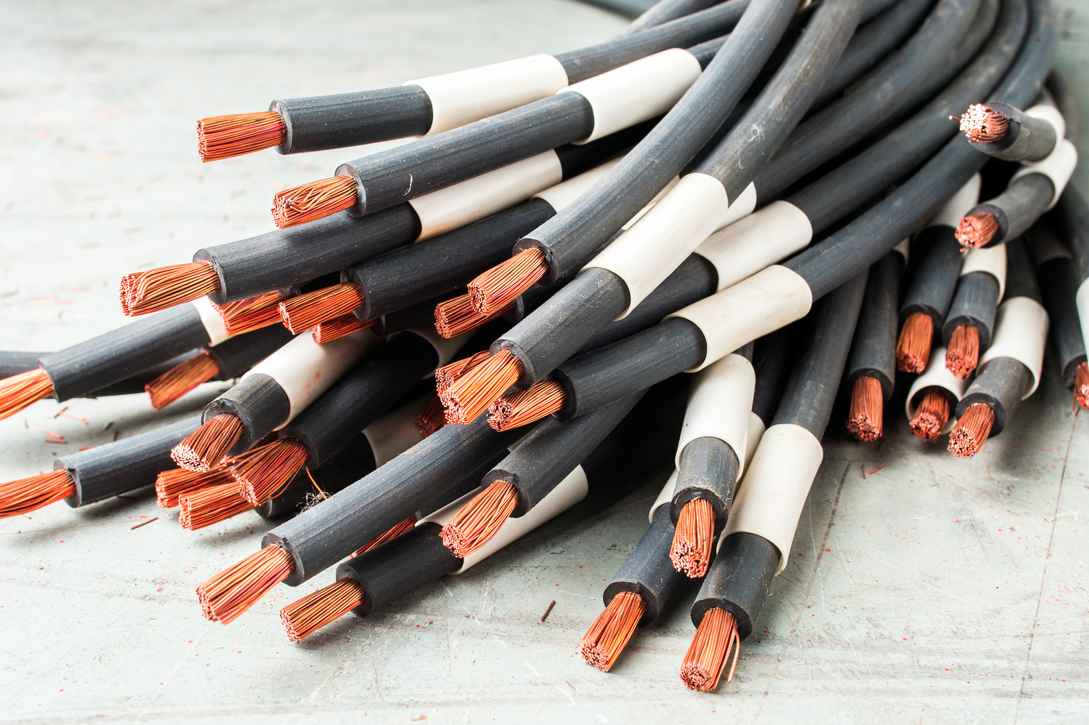
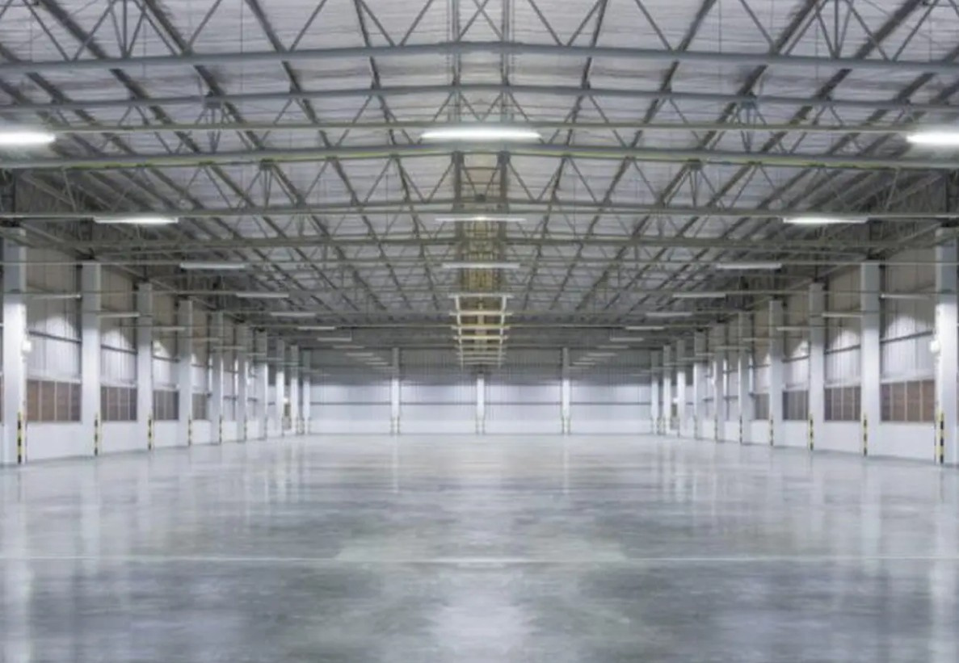
Scrap Copper in Newcastle and Scrap Copper in Wallsend for Fast and Fair Recycling
If you have old copper sitting around your home, workshop, or worksite, we are
here to help. At Kangaroo Copper Recycling, we offer trusted services for Scrap
Copper in Newcastle and Scrap Copper in Wallsend with quick pickup, fair pricing,
and friendly support.

Slide 2
Why More People Choose Us for Copper Recycling
When customers call us for Scrap Copper in Newcastle, they usually want three things: quick
service, good payment, and no hassle. We understand that because we work with local homes,
tradies, businesses, and industrial sites every day.
What we offer
Same-day pickup when available
Fast and fair quotes
On-the-spot payment
Free towing for suitable loads
Easy drop-off options
Friendly advice from our team
We always try to make sure you know what your scrap is worth before we collect it.

Slide 3
Our Experience Helps You Get Better Value
We have worked in scrap metal recycling for years, and we know that copper can deliver
strong returns when handled properly. That is why we always guide our customers
honestly.
For anyone looking for Scrap Copper in Wallsend, we recommend sorting your copper
before pickup if possible. Clean copper, copper pipes, and copper wires can often be
valued differently. A little sorting can help you get a better result.

Slide 4
We Serve Homes, Businesses, and Worksites
Our team works with a wide range of customers across the region. Whether it is a small
home clean-up or a large commercial collection, we are ready to help.
We regularly collect from
Residential properties
Commercial buildings
Construction sites
Workshops and warehouses
Industrial and civil projects
If you need reliable Scrap Copper in Newcastle or regular support for Scrap Copper in
Wallsend, we are ready to make it easy.

Slide 5
Choose a Local Team That Cares
Good service matters as much as good pricing. At Kangaroo Copper Recycling, we treat every customer with respect and ensure the job is done properly.
If you want a trusted team for copper recycling, contact us today. We are proud to offer dependable service, fair payouts, and a simple process that works for you.
Source: https://news.bangboxonline.com/scrap-copper-in-newcastle-and-scrap-copper-in-wallsend-for-fast-and-fair-recycling

Slide 6
Thank You
Phone: 61405404040
Website: https://kangaroocopperrecycling.com.au/

