Slide 1


Why Rely on Aged Care Oatley Service Providers?
Every individual needs support and companionship in old age. When family commitments make constant care impossible, Aged Care Oatley service providers step in — offering compassionate, respectful, and inclusive care so elders can live independently, with dignity and good health.

Slide 2
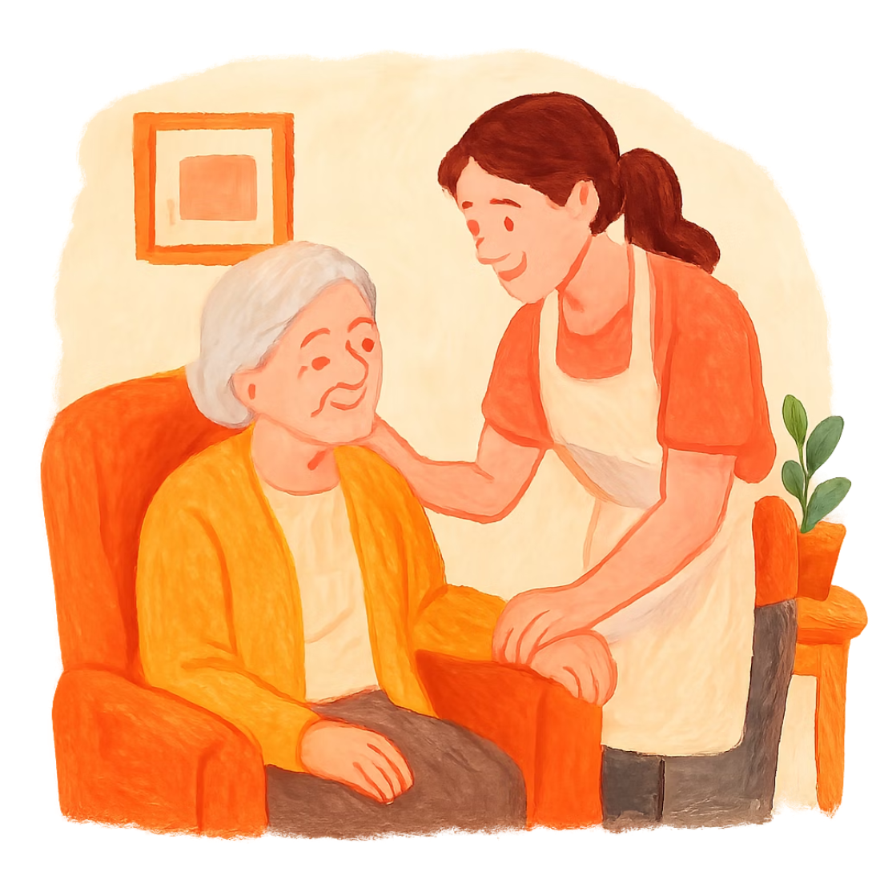
What Is an Aged Care Service?
Aged care services are offered exclusively by approved agencies under the Australian Government's My Aged Care Home Care Packages Scheme.
Professional caregivers provide support and necessary care to elders at a reasonable charge. They are trained, experienced, and understand that elders need not just physical support — but also emotional empathy.

Slide 3
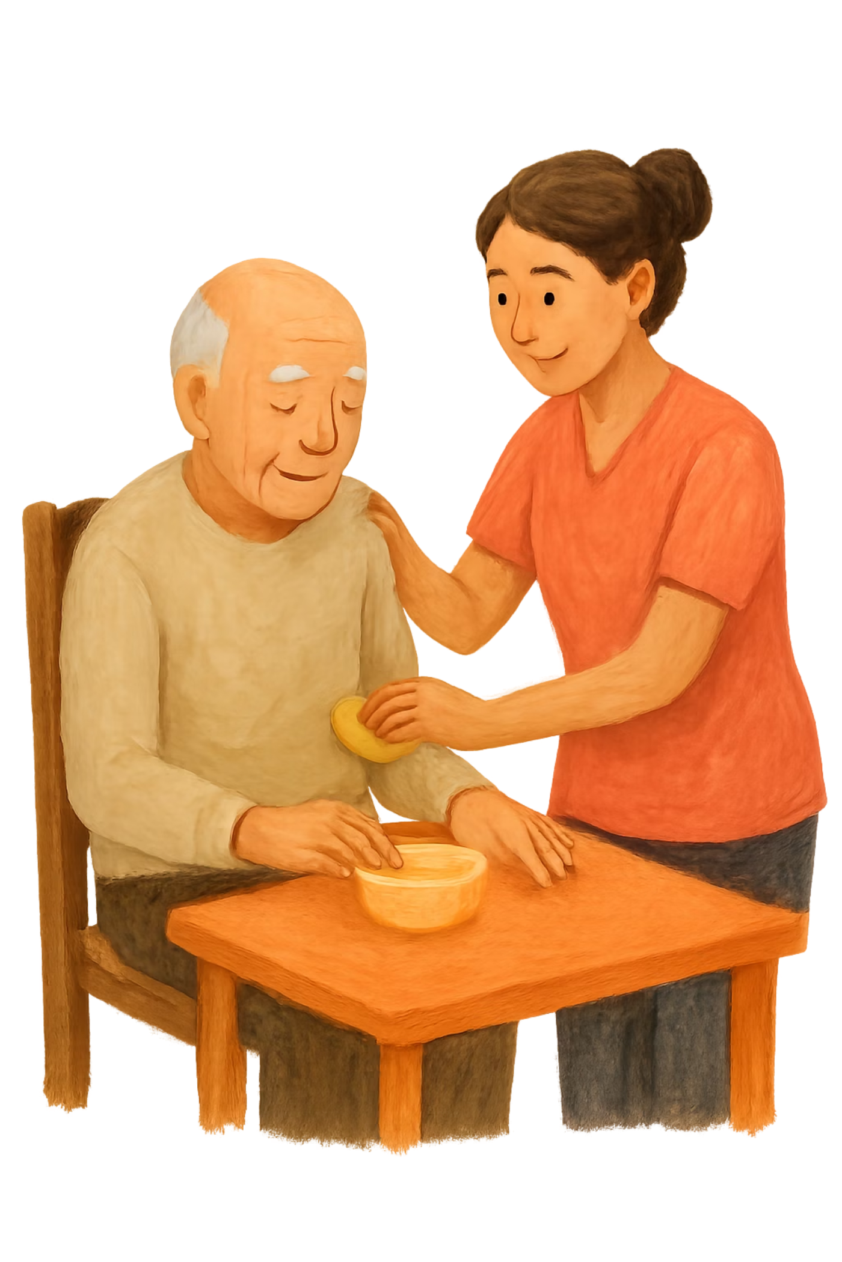
Reasons to Choose Quality Aged Care
Daily Living Assistance
24/7 help with eating, bathing, dressing, and taking medicines — with compassion.
Household Management
Meal preparation, grocery shopping, cleaning, and laundry handled by professionals.

Slide 4


Clinical & Nutritious Support
Clinical Assistance
Nutritious Support
Right medicine, right time, right proportion. Caregivers also manage diabetes monitoring, continence care, and dementia support.
Elders prone to chronic disease need balanced nutrition. Caregivers are trained to maintain proper protein, carbohydrates, fiber, and mineral intake.
Leading service providers ensure reliability and safety at the most reasonable price — a complete solution for all elder care needs.

Slide 5

Contact Circle of Hope (Aged Care)
Address
Email
Website
24 Ellis Parade, Yennora NSW 2161, Australia
info@circleofhope.com.au
circleofhope.com.au/aged-care/

