Slide 1

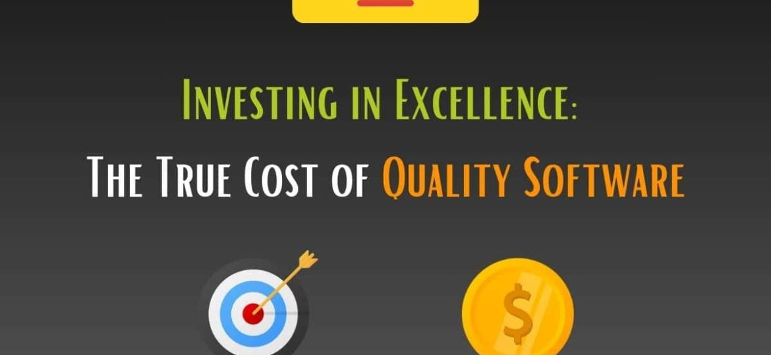
Quora Web Solution
Website Design and
Development
Company
Web Design & Web Development
Company in Bangalore, India
www.quorawebsolution.com
+91 9986 056 909
info@quorawebsolutions.com
24A, 1st Main Rd, Chandra Reddy
Layout, Koramangala 4th Block,
Koramangala, Bengaluru,
Karnataka 560034

Slide 2
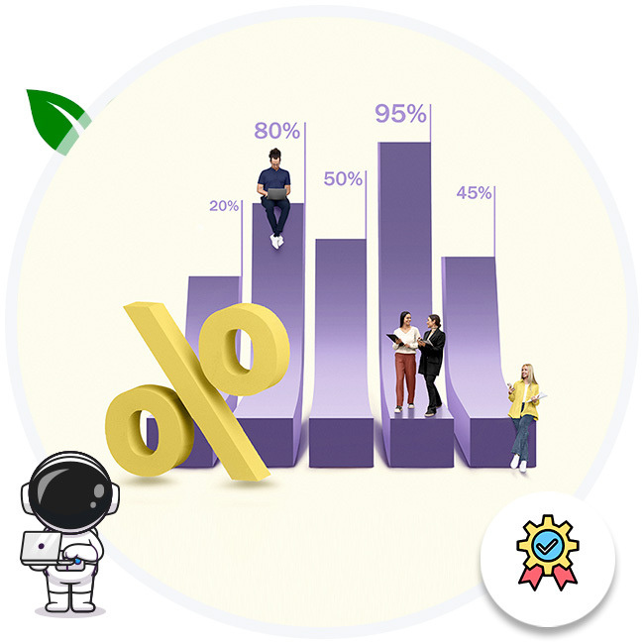
The Cost of Quality: Why a Top-Tier Website Design and Development Company Is Worth It
www.quorawebsolution.com

Slide 3
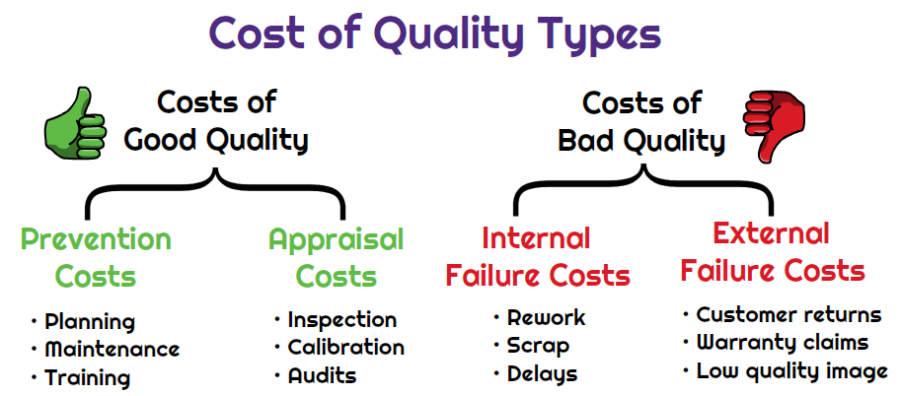
In today’s digital age, a company’s website is often its most important asset.
www.quorawebsolution.com

Slide 4

It serves as the face of the business, the primary interaction point for customers, and a key driver of growth.
www.quorawebsolution.com

Slide 5
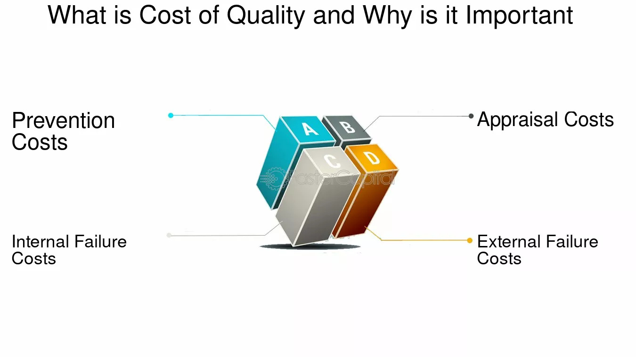
While it may be tempting to cut costs by opting for the cheapest website design and development services available, this decision can have long-term consequences that outweigh the initial savings.
www.quorawebsolution.com

Slide 6
Investing in a top-tier website design and development company is not just an expenditure; it’s a strategic investment in your brand’s success.
The Real Costs of Cheap Solutions
At first glance, budget-friendly website design services can seem like a great deal. However, these lower-cost options often come with hidden drawbacks, such as:
Limited Customization: Many budget services rely on templates that restrict creativity and fail to convey your brand’s unique identity.
Poor User Experience (UX): Cheap designs may lack essential UX features, leading to higher bounce rates and frustrated users.
www.quorawebsolution.com

Slide 7
Weak Performance: Lower-quality development can result in slow loading times, compatibility issues, and frequent crashes.
Hidden Expenses: While the upfront cost may be low, additional fees for updates, fixes, or added functionality can quickly add up.
These challenges not only harm your website’s effectiveness but can also damage your brand’s reputation and customer trust.
What Sets Top-Tier Companies Apart
A top-tier website design and development company provides value that far exceeds its cost. Here’s what you can expect:
www.quorawebsolution.com

Slide 8
1. Expertise and Experience
High-quality agencies employ seasoned professionals with extensive knowledge in design, development, and digital strategy. Their expertise ensures that your website is not only visually appealing but also functional, user-friendly, and optimized for performance.
2. Custom Solutions
Top-tier companies prioritize understanding your brand, target audience, and business goals. They create bespoke designs and functionalities tailored to meet your unique needs, helping you stand out in a crowded marketplace.
3. Advanced Technology and Tools
www.quorawebsolution.com

Slide 9
Premium agencies leverage the latest technologies and best practices to build secure, scalable, and future-proof websites. This includes responsive design, SEO optimization, and integration with third-party tools and platforms.
4. Ongoing Support and Maintenance
Quality doesn’t end at launch. Leading companies provide ongoing support, updates, and maintenance to ensure your website remains effective as your business evolves.
5. Focus on ROI
A well-designed website from a top-tier company is an asset that delivers measurable returns. From improved user engagement to increased conversions, the impact on your bottom line makes the investment worthwhile.
www.quorawebsolution.com

Slide 10
Why Quality Costs More
The higher price tag of a premium website design and development company reflects the level of effort, expertise, and resources involved. This includes:
Comprehensive Research: Understanding your market, competitors, and audience to inform the design and development process.
Collaboration: Working closely with you to align the website with your brand vision and business goals.
Rigorous Testing: Ensuring the website functions seamlessly across all devices and browsers.
Long-Term Value: Creating a product that supports your business growth for years to come.
www.quorawebsolution.com

Slide 11
The Bottom Line
Your website is an investment in your business’s future. While it may be tempting to cut corners, the risks of subpar quality can far outweigh the short-term savings. A top-tier website design and development company brings expertise, innovation, and a commitment to excellence that can elevate your brand and drive success.
By prioritizing quality, you’re not just paying for a website; you’re investing in a powerful tool that reflects your brand’s professionalism, enhances customer experience, and maximizes your return on investment. Remember, the cost of quality is an investment in lasting success.
From Concept to Launch: How Our Website Design and Development Company Brings Ideas to Life
www.quorawebsolution.com

Slide 12
In today’s digital world, having a strong online presence is essential for businesses of all sizes. At our website design and development company, we understand the significance of turning innovative ideas into functional, user-friendly websites. Our team of experts is dedicated to providing high-quality services, ensuring that each website we create not only looks amazing but also serves as a powerful tool for our clients' success.
1. Understanding Your Vision
The journey begins with understanding your brand, goals, and audience. Every project starts with a comprehensive consultation where we listen carefully to your ideas, vision, and specific requirements. Whether you're a startup or an established enterprise, our goal is to grasp the essence of your brand and ensure that the final product aligns perfectly with your expectations.
www.quorawebsolution.com

Slide 13
2. Research and Strategy
After gaining a solid understanding of your objectives, we dive into research and planning. We conduct competitor analysis, study industry trends, and identify the most effective design strategies to make sure your website stands out. This phase is crucial to define the project’s scope, establish timelines, and determine the technology stack that will best suit your needs.
3. Wireframing and Prototyping
Before diving into the actual design process, we create wireframes and prototypes that map out the layout, structure, and flow of your website. These blueprints allow us to visualize the user experience (UX) and make necessary adjustments before moving forward.
www.quorawebsolution.com

Slide 14
Wireframing helps ensure that the design is intuitive, easy to navigate, and meets your functional requirements.
4. Designing the User Interface (UI)
Once the wireframes are approved, our talented design team takes over to bring the vision to life. We focus on creating an aesthetically pleasing user interface (UI) that reflects your brand identity and resonates with your target audience. From color schemes and typography to imagery and branding, every design element is chosen carefully to create a cohesive and visually stunning website.
5. Development and Coding
With the design finalized, the development phase begins.
www.quorawebsolution.com

Slide 15
Our experienced developers use cutting-edge technologies and best practices to build a responsive, secure, and scalable website. Whether it’s HTML, CSS, JavaScript, or content management systems like WordPress, we ensure that your website functions seamlessly across all devices and platforms. During this phase, we also optimize the website for speed and performance, ensuring a smooth user experience.
6. Testing and Quality Assurance
Before the site goes live, we thoroughly test it to ensure everything works as expected. Our quality assurance (QA) process includes testing the website’s functionality, performance, and security. We conduct cross-browser testing, check for broken links, optimize load times, and make sure the site is mobile-friendly.
www.quorawebsolution.com

Slide 16
Any issues that arise are addressed promptly, ensuring the final product is flawless.
7. Launch and Deployment
Once everything is in place, we prepare for the big launch. Our team ensures that the website is deployed smoothly, making sure it is hosted securely and ready to be accessed by users worldwide. We also provide ongoing support to address any post-launch concerns and ensure the site continues to perform optimally.
8. Ongoing Maintenance and Updates
Launching a website is just the beginning.
www.quorawebsolution.com

Slide 17
We offer continuous maintenance and updates to ensure your site remains up-to-date with the latest technologies, security patches, and industry standards. We also provide analytics and tracking services to monitor the site’s performance and help you make data-driven decisions to improve user engagement and conversion rates.
Conclusion
At our website design and development company, we pride ourselves on turning concepts into reality.
www.quorawebsolution.com

Slide 18
From initial consultations to post-launch support, we work closely with you at every step of the process to ensure that your website not only meets your needs but exceeds your expectations. Whether you need a simple website or a complex web application, we have the skills, creativity, and expertise to bring your ideas to life and help you succeed in the digital world.
www.quorawebsolution.com

Slide 19
Quora Web Solution: Quora Web Solution is a trusted website development company based in Bangalore, India, offering a wide array of services to not only domestic but global clientele. Be it Website Design and Development, SEO services, Digital Marketing, Branding, App Development, Ecommerce Solution, and Logo Creation . Quora Web Solution has the best website developers offering top quality services and that is the reason why we are well known as one of the best Website Development Companies in Bangalore, India.
Visit Us - www.quorawebsolution.com
Call Us - +91 9986 056 909
Mail Us - info@quorawebsolutions.com
www.quorawebsolution.com

Slide 20

WORDPRESS DEVELOPMENT
ECOMMERCE DEVELOPMENT
PHP DEVELOPMENT
CMS DEVELOPMENT
DRUPAL DEVELOPMENT
WEBSITE SERVICES
WEBPORTAL DEVELOPMENT
MAGENTO DEVELOPMENT
WEBSITE DEVELOPMENT
JOOMLA DEVELOPMENT
SMALL BUSINESS DEVELOPMENT
CHEAP WEBSITE DEVELOPMENT
STATIC WEBSITE DEVELOPMENT
DYNAMIC WEBSITE DEVELOPMENT
WEBSITE DESIGN COMPANY
TOUR AND TRAVEL WEBSITE DEVELOPMENT
Services

