Slide 1


Quora Web Solution
Website Design and
Development
Company
Web Design & Web Development
Company in Bangalore, India
www.quorawebsolution.com
+91 9986 056 909
info@quorawebsolutions.com
24A, 1st Main Rd, Chandra Reddy
Layout, Koramangala 4th Block,
Koramangala, Bengaluru,
Karnataka 560034

Slide 2

What to Expect When You Hire a Professional Web Design Company – A Step-by-Step Breakdown
In today’s digital-centric era, your website often serves as the initial touchpoint between your brand and potential customers. That’s why hiring a professional web design company can make all the difference. But what exactly happens once you decide to work with one? What should you expect from the process?
www.quorawebsolution.com

Slide 3

In this article, we’ll take you through a step-by-step breakdown of what it’s like to hire a professional web design company—from the initial consultation to the final launch and beyond.
Step 1: Initial Discovery Call or Consultation
www.quorawebsolution.com

Slide 4
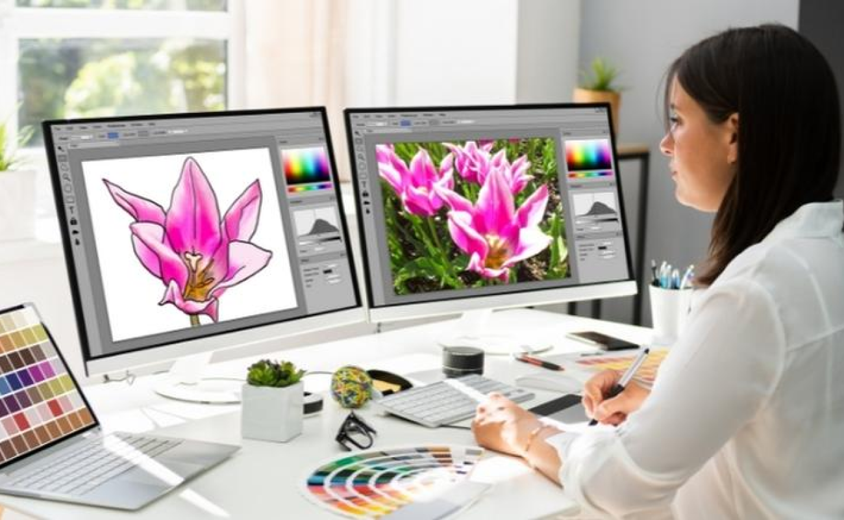
The process usually begins with a discovery session—this could be a phone call, Zoom meeting, or an in-person discussion. The goal here is to understand your business, brand, goals, target audience, and challenges.
What’s covered:
www.quorawebsolution.com

Slide 5

Business overview
Website goals (e.g., sales, lead generation, information)
Competitor analysis
Initial budget and timeline
www.quorawebsolution.com

Slide 6
Preferred design styles or examples
This stage helps the company tailor their approach and also gives you a chance to evaluate their professionalism and communication.
Step 2: Proposal and Quote
Based on the discovery session, the web design company will draft a proposal that includes:
Scope of work
Timeline
Deliverables
Cost breakdown
Design and development phases
www.quorawebsolution.com

Slide 7
This gives you a transparent overview of the project scope, timeline, and what to expect throughout the development journey. Some companies may also include visual mockups or references to showcase their vision for your project.
Step 3: Signing the Contract
After mutual agreement on the proposal and terms, both parties proceed to formalize the collaboration by signing a contract. The contract formalizes the partnership and clearly details the responsibilities and expectations of both parties:
Payment schedule
Intellectual property rights
Revision policies
www.quorawebsolution.com

Slide 8
Termination clauses
At this point, you may need to make an upfront payment or deposit before work begins.
Step 4: Research and Planning
Before any design work starts, the agency will conduct in-depth research and planning:
User personas and journey mapping
SEO and keyword strategy (if included)
Content inventory
Sitemap creation
Wireframes (basic layout blueprints)
This strategic phase sets the foundation for a user-centric website that’s designed with purpose.
www.quorawebsolution.com

Slide 9
Step 5: Design Phase
With the blueprint in place, the design team begins crafting the look and feel of your website.
You’ll receive:
Mood boards or style tiles
Mockups of key pages (homepage, service pages, etc.)
Fonts, colors, and branding integrations
You’ll typically go through 1–3 rounds of revisions to fine-tune the visuals before moving to development.
Step 6: Development Phase
Once designs are approved, the development team brings the website to life using code.
Tasks in this phase:
www.quorawebsolution.com

Slide 10
Front-end development (HTML, CSS, JavaScript)
Back-end development (CMS setup, databases, integrations)
Responsive adjustments for mobile and tablets
Basic on-page SEO (title tags, alt text, meta descriptions)
You might also get access to a staging site to see the progress in real-time.
Step 7: Content Integration
Your content—either provided by you or created by the agency—is added to the website. This includes:
Text for pages
Images and graphics
Videos
www.quorawebsolution.com

Slide 11
Testimonials, case studies, and blog posts
Content is placed strategically to support UX and SEO goals.
Step 8: Quality Assurance and Testing
Before launch, a thorough QA process ensures your site is polished and ready for users.
Testing includes:
Browser and device compatibility
Load speed
Functional testing (forms, links, buttons)
Security checks
Accessibility compliance
This step helps eliminate bugs or performance issues.
Step 9: Launch!
www.quorawebsolution.com

Slide 12
After final approval, the website goes live. The company handles:
Domain setup
Hosting configuration
DNS changes
Google indexing (if applicable)
They may also provide launch announcements or support with marketing the new site.
Step 10: Post-Launch Support and Maintenance
The relationship doesn’t have to end at launch. Many reputable web design companies provide continued post-launch support, which may include:
Regular backups
Software updates
www.quorawebsolution.com

Slide 13
Security monitoring
Content updates
Analytics reporting
You can often opt for a maintenance package to keep your website running smoothly.
Final Thoughts
Hiring a professional web design company is a collaborative journey. From strategy and creativity to development and support, each step plays a critical role in building a website that not only looks great but performs effectively.
Whether you're a startup, small business, or growing enterprise, understanding the process helps you make informed decisions and ensures you get the most value from your investment.
www.quorawebsolution.com

Slide 14
The Ultimate Guide to Modern Website Design: Trends, Best Practices, and Tools You Need in 2025
In an increasingly digital world, your website is more than just a presence—it's a critical part of your brand, your marketing, and your customer experience. As we move into 2025, web design continues to evolve rapidly, influenced by new technologies, user expectations, and design philosophies. This comprehensive guide explores the latest trends, essential best practices, and top tools that define modern website design in 2025.
Section 1: Web Design Trends for 2025
1. Immersive, Interactive Experiences
Websites are embracing interactivity like never before—think 3D elements, micro-interactions, scroll-triggered animations, and immersive storytelling. These features not only engage users but also enhance brand identity.
2. AI-Powered Personalization
www.quorawebsolution.com

Slide 15
Personalized content, layouts, and product recommendations are becoming the norm. AI and machine learning help deliver tailored experiences based on user behavior, preferences, and location.
3. Minimalist Design with Bold Typography
Less clutter, more impact. Designers are leaning into whitespace and oversized, expressive fonts to convey clarity and emphasis.
4. Voice and Gesture Navigation
With the growth of voice assistants and gesture-based interfaces, forward-thinking websites are integrating voice navigation and touchless controls to enhance accessibility and UX.
5. Sustainability-Focused Design
Eco-conscious design choices—like optimized images, green hosting, and dark mode—are rising in popularity as brands take responsibility for digital carbon footprints.
Section 2: Web Design Best Practices in 2025
www.quorawebsolution.com

Slide 16
1. Mobile-First, Always
Designing for mobile is no longer optional. Mobile-first design ensures your site performs flawlessly across all screen sizes and devices.
2. Accessibility for All
Web accessibility is essential. Follow WCAG guidelines to make your website usable for people with disabilities, including screen reader compatibility, keyboard navigation, and high-contrast visuals.
3. Fast Load Times and Performance Optimization
Speed remains a ranking and retention factor. Minify code, use lazy loading, compress media, and leverage CDN for faster performance.
4. SEO-Friendly Architecture
Build websites with clean code, semantic HTML, fast loading speeds, and structured content that search engines can easily crawl and rank.
www.quorawebsolution.com

Slide 17
5. Security by Design
In 2025, website security must be proactive. Implement HTTPS, regular updates, firewalls, and secure authentication protocols from the ground up.
Section 3: Top Web Design Tools for 2025
1. Figma and Adobe XD
Still leading the pack, these tools are perfect for prototyping, collaboration, and seamless handoff to developers.
2. Webflow
A favorite among designers and marketers, Webflow bridges design and development with its visual builder and CMS functionality.
3. Framer
www.quorawebsolution.com

Slide 18
Ideal for creating highly interactive and animated sites, Framer is gaining popularity for fast prototyping and production-ready builds.
4. AI Design Assistants (e.g., Wix ADI, Uizard)
AI-powered design tools are evolving to generate layouts, write content, and optimize designs with minimal human input.
5. Lighthouse and GTmetrix
These performance auditing tools help designers monitor site speed, accessibility, SEO, and overall experience metrics.
Final Thoughts
Modern web design in 2025 is about balancing aesthetics, performance, accessibility, and technology. Whether you're redesigning your website or launching something new, staying up-to-date with the latest trends, best practices, and tools ensures your digital presence is both future-proof and user-centric.
www.quorawebsolution.com

Slide 19
If you're ready to elevate your website, consider working with a professional web design company that understands the intricacies of modern digital experiences.
www.quorawebsolution.com

Slide 20
Quora Web Solution: Quora Web Solution is a trusted website development company based in Bangalore, India, offering a wide array of services to not only domestic but global clientele. Be it Website Design and Development, SEO services, Digital Marketing, Branding, App Development, Ecommerce Solution, and Logo Creation . Quora Web Solution has the best website developers offering top quality services and that is the reason why we are well known as one of the best Website Development Companies in Bangalore, India.
Visit Us - www.quorawebsolution.com
Call Us - +91 9986 056 909
Mail Us - info@quorawebsolutions.com
www.quorawebsolution.com

Slide 21

WORDPRESS DEVELOPMENT
ECOMMERCE DEVELOPMENT
PHP DEVELOPMENT
CMS DEVELOPMENT
DRUPAL DEVELOPMENT
WEBSITE SERVICES
WEBPORTAL DEVELOPMENT
MAGENTO DEVELOPMENT
WEBSITE DEVELOPMENT
JOOMLA DEVELOPMENT
SMALL BUSINESS DEVELOPMENT
CHEAP WEBSITE DEVELOPMENT
STATIC WEBSITE DEVELOPMENT
DYNAMIC WEBSITE DEVELOPMENT
WEBSITE DESIGN COMPANY
TOUR AND TRAVEL WEBSITE DEVELOPMENT
Services

