Slide 1


Quora Web Solution
Website Design and
Development
Company
Web Design & Web Development
Company in Bangalore, India
www.quorawebsolution.com
+91 9986 056 909
info@quorawebsolutions.com
24A, 1st Main Rd, Chandra Reddy
Layout, Koramangala 4th Block,
Koramangala, Bengaluru,
Karnataka 560034

Slide 2

The Ultimate Guide to Website Design and Development: Creating a Powerful Online Presence from Scratch
www.quorawebsolution.com

Slide 3
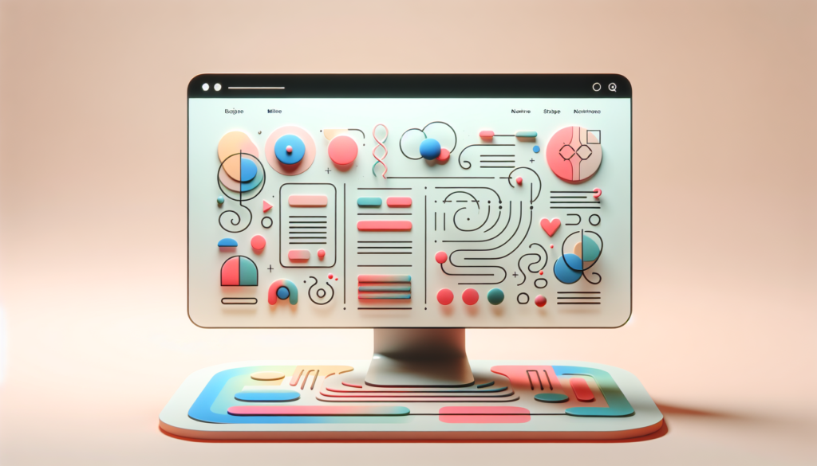
In today’s digital age, having a professional website is essential for businesses, organizations, and individuals.
www.quorawebsolution.com

Slide 4

Whether you're starting a new business, rebranding, or launching a personal blog, creating a strong online presence begins with a well-designed and functional website.
www.quorawebsolution.com

Slide 5

This guide will walk you through the key steps in website design and development to ensure you create a site that’s not only visually appealing but also user-friendly and efficient.
www.quorawebsolution.com

Slide 6
1. Planning Your Website
Before diving into design and development, it's important to plan out your website’s purpose and goals. Ask yourself:
What is the main objective of the site? (e.g., to sell products, showcase services, share information)
Who is your target audience?
What key features and functionalities are essential for your site (e.g., e-commerce capabilities, contact forms, or a blog)?
This planning stage will help guide your design choices and ensure your website meets your business or personal needs.
2. Choosing the Right Platform
www.quorawebsolution.com

Slide 7
Next, you'll need to decide on the platform for your website. Popular options include:
WordPress: A flexible, open-source platform suitable for blogs, businesses, and portfolios.
Wix and Squarespace: User-friendly website builders that provide easy drag-and-drop functionality for beginners.
Custom Development: If you need more control or have complex requirements, custom-built websites offer flexibility and scalability but require more technical expertise.
Consider your budget, skill level, and the features you need when making this decision.
3. Designing the Website
Design is crucial to making a great first impression. Here are some tips to create an engaging website design:
www.quorawebsolution.com

Slide 8
Keep it simple: A clean, minimalist design tends to work best. Avoid clutter and focus on clear navigation.
Use branding elements: Incorporate your company’s logo, colors, and fonts to create a consistent brand identity.
Prioritize user experience (UX): Ensure your website is easy to navigate and users can quickly find what they’re looking for.
Mobile-friendly design: With more users browsing on mobile devices, a responsive design that adapts to different screen sizes is essential.
4. Developing the Website
Once you have your design in place, it's time to start building. Here’s what you should focus on during the development process:
www.quorawebsolution.com

Slide 9
Coding: If you’re using a custom-built site, HTML, CSS, and JavaScript will be your primary tools. Alternatively, website builders automate much of this.
Site speed: Make sure your website loads quickly. Slow websites can frustrate users and harm your SEO rankings.
SEO (Search Engine Optimization): Implement best SEO practices to improve your site’s visibility in search engines, such as using proper meta tags, alt text for images, and high-quality content.
5. Testing and Launching
Before going live, thoroughly test your website. Check for:
Broken links
Mobile compatibility
www.quorawebsolution.com

Slide 10
Cross-browser functionality
Load time
Once everything is working properly, it’s time to launch your site!
6. Post-Launch: Maintenance and Updates
After your website is live, it's important to maintain it by regularly updating content, fixing any issues, and optimizing for speed and security. Additionally, tracking website analytics (e.g., through Google Analytics) will help you understand how visitors are interacting with your site and where improvements can be made.
Conclusion
www.quorawebsolution.com

Slide 11
Building a website from scratch may seem daunting, but with careful planning, attention to design, and a solid development strategy, you can create a powerful online presence that effectively serves your audience and business goals. Keep testing, improving, and staying up-to-date with the latest trends to ensure your website remains competitive and relevant.
How to Choose the Right Website Design and Development Company for Your Business: Key Factors to Consider
www.quorawebsolution.com

Slide 12
Choosing the right website design and development company is crucial for building a strong online presence for your business. A well-designed website can help attract customers, showcase your products or services, and establish your brand's credibility. With so many options out there, it’s important to evaluate potential agencies carefully. Here are key factors to consider when making your decision.
1. Experience and Expertise
Look for a company with a proven track record in website design and development. A company with experience in your industry can understand your unique needs and goals. Review their portfolio to get a sense of their design style and technical skills. Ideally, they should have experience with both front-end and back-end development, as well as experience in responsive and mobile-friendly design.
2. Services Offered
Make sure the company offers a full range of services to meet your needs.
www.quorawebsolution.com

Slide 13
This may include:
Custom design: Tailored to your brand’s personality and target audience.
Web development: Strong coding skills for creating robust websites.
E-commerce solutions: If you're running an online store, ensure they have experience with e-commerce platforms.
SEO and digital marketing: A great website needs to be optimized for search engines to attract traffic.
Ongoing support: Post-launch maintenance and updates are crucial for keeping your website up to date.
3. Client Testimonials and Reviews
Client feedback is a great way to gauge a company’s reliability and customer service.
www.quorawebsolution.com

Slide 14
Look for reviews and testimonials on their website, social media, or third-party review platforms. If possible, reach out to past clients for firsthand insight into their experience working with the company.
4. Budget and Pricing Structure
Establish your budget before reaching out to potential agencies. While pricing varies depending on the complexity of the website and the company’s reputation, make sure the company provides clear pricing information and fits within your budget. Beware of companies offering unusually low prices—it could indicate subpar work or hidden costs.
5. Communication and Collaboration
www.quorawebsolution.com

Slide 15
Effective communication is key to a successful project. Choose a company that listens to your ideas and is responsive to your questions. They should involve you in the decision-making process and keep you updated on the project’s progress. Clear communication will help ensure the final product aligns with your vision.
6. Timeline and Delivery
Ask about the company’s typical timeline for completing projects and whether they can meet your deadlines. A reputable agency should be able to provide a clear project schedule, with milestones and deadlines, to ensure timely delivery.
www.quorawebsolution.com

Slide 16
7. Post-Launch Support
A good website requires ongoing maintenance, including updates, security monitoring, and bug fixes. Ask if the company offers post-launch support or a maintenance plan to keep your site running smoothly after it's live.
Conclusion
Choosing the right website design and development company is a significant decision that impacts your business’s online success. Take the time to evaluate their expertise, services, and reputation. A strong partnership with the right company will help you create a website that not only looks great but also supports your business goals in the long run.
www.quorawebsolution.com

Slide 17
Quora Web Solution: Quora Web Solution is a trusted website development company based in Bangalore, India, offering a wide array of services to not only domestic but global clientele. Be it Website Design and Development, SEO services, Digital Marketing, Branding, App Development, Ecommerce Solution, and Logo Creation . Quora Web Solution has the best website developers offering top quality services and that is the reason why we are well known as one of the best Website Development Companies in Bangalore, India.
Visit Us - www.quorawebsolution.com
Call Us - +91 9986 056 909
Mail Us - info@quorawebsolutions.com
www.quorawebsolution.com

Slide 18

WORDPRESS DEVELOPMENT
ECOMMERCE DEVELOPMENT
PHP DEVELOPMENT
CMS DEVELOPMENT
DRUPAL DEVELOPMENT
WEBSITE SERVICES
WEBPORTAL DEVELOPMENT
MAGENTO DEVELOPMENT
WEBSITE DEVELOPMENT
JOOMLA DEVELOPMENT
SMALL BUSINESS DEVELOPMENT
CHEAP WEBSITE DEVELOPMENT
STATIC WEBSITE DEVELOPMENT
DYNAMIC WEBSITE DEVELOPMENT
WEBSITE DESIGN COMPANY
TOUR AND TRAVEL WEBSITE DEVELOPMENT
Services

