Slide 1

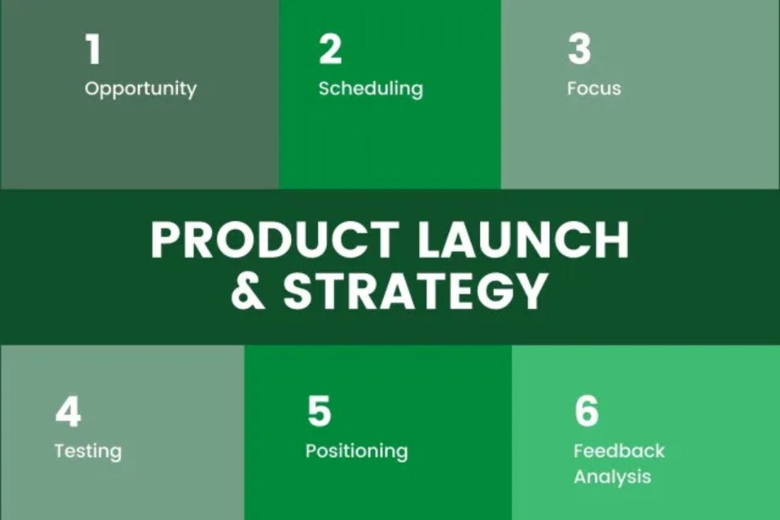
Quora Web Solution
Website Design and
Development
Company
Web Design & Web Development
Company in Bangalore, India
www.quorawebsolution.com
+91 9986 056 909
info@quorawebsolutions.com
24A, 1st Main Rd, Chandra Reddy
Layout, Koramangala 4th Block,
Koramangala, Bengaluru,
Karnataka 560034

Slide 2
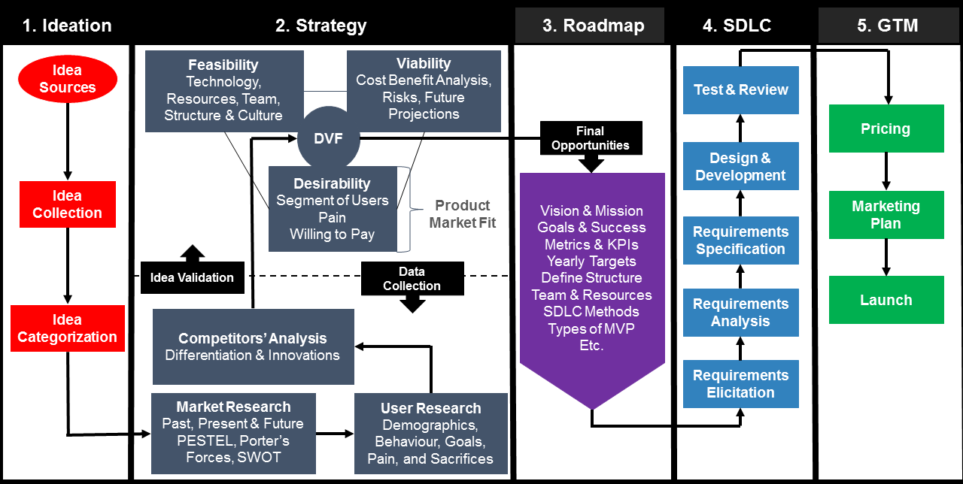
From Concept to Launch: A Comprehensive Overview of the Website Design and Development Process for Modern Businesses
www.quorawebsolution.com

Slide 3
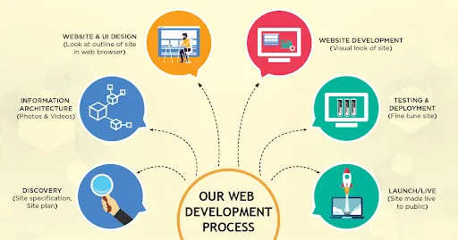
In today’s digital age, having a professional website is essential for any business aiming to establish an online presence.
www.quorawebsolution.com

Slide 4
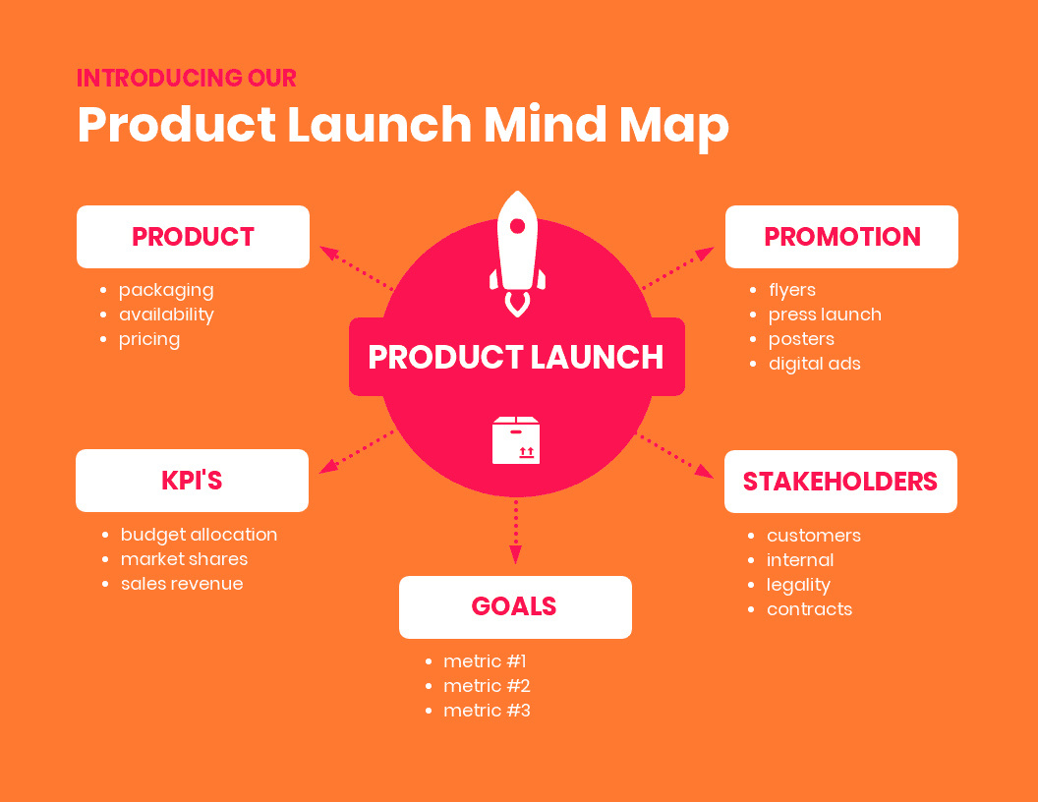
But how do you go from an initial idea to a fully functional, high-performing website?
www.quorawebsolution.com

Slide 5
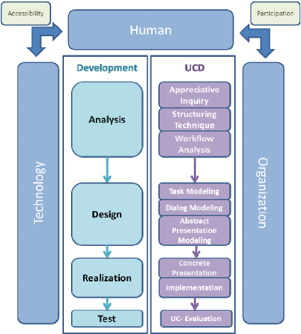
The process of website design and development is complex, involving several key stages that, when executed correctly, result in a seamless online experience.
www.quorawebsolution.com

Slide 6
Here's a comprehensive overview of the process, broken down step by step.
1. Initial Consultation and Discovery
The process begins with an in-depth consultation between the business and the design/development team. This phase is all about understanding the client's goals, target audience, brand identity, and key features required for the website. During discovery, the team gathers information on the client’s objectives, such as increasing conversions, improving user experience, or expanding the online presence. A roadmap is then created to align these goals with the design and technical requirements.
2. Planning and Strategy
Once the goals are clear, the team develops a strategy and site architecture. This includes mapping out the site structure (sitemap), defining user flows, and creating wireframes.
www.quorawebsolution.com

Slide 7
A wireframe is a visual guide that represents the skeletal structure of the website—how the layout will look and where content, navigation, and calls to action will be placed. Planning also involves selecting the right content management system (CMS), determining the technical requirements, and setting timelines and milestones.
3. Design Phase
With the wireframe approved, the design team moves forward with creating visual mockups and prototypes. This phase focuses on aesthetics, ensuring the website reflects the brand's identity. Designers work on color schemes, typography, imagery, and overall layout. They also ensure that the design is responsive, meaning it will look great on both desktop and mobile devices. Client feedback is crucial during this stage to ensure the design aligns with the vision before development begins.
www.quorawebsolution.com

Slide 8
4. Development Phase
Once the design is approved, the development team takes over to turn the visuals into a working website. This phase involves coding the website, integrating the CMS (if needed), and setting up databases, plugins, and any necessary third-party tools. Developers focus on building the website's structure, implementing interactive elements, and ensuring all features are functional. At this stage, the site is also optimized for speed and performance, ensuring it loads quickly and runs smoothly.
5. Testing and Quality Assurance
Before launching the website, extensive testing is performed to catch any bugs or issues. This includes checking for browser compatibility, testing for mobile responsiveness, ensuring links work, and verifying that forms and interactive elements are functioning correctly.
www.quorawebsolution.com

Slide 9
Additionally, the team ensures the website meets SEO best practices and is optimized for fast loading times. Quality assurance guarantees that the site is ready for a smooth, error-free launch.
6. Launch
After successful testing, the website is ready to go live. This is the exciting moment where all the hard work comes together. The development team ensures that the site is properly hosted, all domains are connected, and everything is working as intended. They also monitor the website after launch to ensure there are no immediate issues.
7. Post-Launch Maintenance and Updates
Even after launch, the work doesn’t stop.
www.quorawebsolution.com

Slide 10
Regular maintenance is essential to ensure the website stays secure, up-to-date, and functional. This may include software updates, security patches, and adding new features or content. Additionally, monitoring website analytics helps to assess user behavior, identify areas for improvement, and refine the site to enhance performance over time.
Conclusion
Creating a website is not a one-size-fits-all process. From initial consultation to post-launch, each step plays a crucial role in ensuring the final product meets the business goals and delivers an excellent user experience. Whether you’re looking to redesign an existing website or build one from scratch, understanding the full process of design and development is key to making informed decisions that lead to a successful online presence.
www.quorawebsolution.com

Slide 11
With the right team of designers and developers, businesses can navigate these stages seamlessly, creating a website that not only looks great but also functions flawlessly, providing value to users and driving business growth.
Mastering the Art of Website Design and Development: Essential Steps for Building User-Centric, High-Performance Websites
www.quorawebsolution.com

Slide 12
In today’s competitive digital landscape, creating a website that not only looks visually appealing but also delivers a seamless, high-performance experience is critical for business success. To master the art of website design and development, it's important to focus on user-centric principles and performance optimization at every step. Here’s a concise guide to building a website that offers both style and substance.
1. Understand Your Users’ Needs
The foundation of any great website is a deep understanding of its target audience. Before diving into design and development, it’s essential to define who your users are, what their pain points are, and what they expect from your site. Conduct user research through surveys, interviews, or analytics to gain insights into their preferences and behaviors.
www.quorawebsolution.com

Slide 13
This information helps shape the website’s content, layout, and features, ensuring it speaks directly to the needs of your audience.
2. Plan and Structure Your Content
Effective website design begins with clear, well-organized content. A user-centric site must present information in a way that is easy to navigate and consume. Begin by mapping out a logical site structure that aligns with user needs—this includes defining key pages, navigation menus, and calls to action. Content should be concise, easy to read, and properly formatted, with a strong focus on clarity and value. An intuitive structure prevents frustration and helps visitors quickly find what they’re looking for.
3. Create a Responsive and Accessible Design
www.quorawebsolution.com

Slide 14
Responsive design ensures that your website looks great and functions properly across all devices, from desktops to mobile phones. With mobile traffic now accounting for a significant portion of website visits, responsiveness is a must. Alongside responsiveness, accessibility is equally important. Design your website to be inclusive of all users, including those with disabilities. This includes optimizing for screen readers, using accessible color contrasts, and ensuring keyboard navigation is smooth.
4. Optimize for Speed and Performance
Website performance is critical for both user experience and SEO. Slow-loading websites lead to high bounce rates and can negatively impact your rankings on search engines.
www.quorawebsolution.com

Slide 15
To optimize speed, streamline the website’s design by minimizing large files, using optimized images, and implementing lazy loading for media. Additionally, choose a reliable hosting provider, utilize caching, and implement a content delivery network (CDN) to ensure fast load times no matter where your visitors are located.
5. Focus on SEO and Usability
A beautifully designed website won’t be effective if users can’t find it. SEO (Search Engine Optimization) is a crucial element in driving organic traffic to your site. Ensure your website follows best practices for on-page SEO, such as using keyword-rich titles, meta descriptions, header tags, and alt text for images.
www.quorawebsolution.com

Slide 16
Additionally, usability should be a priority. A site that’s easy to use, with clear navigation, fast load times, and engaging content, will naturally lead to higher user satisfaction and engagement.
6. Implement Conversion Optimization
Building a high-performance website means not only attracting visitors but also converting them into customers or leads. Conversion Rate Optimization (CRO) techniques such as strategic placement of calls to action, easy-to-fill forms, and trust-building elements (e.g., testimonials, security badges) can significantly improve conversion rates. A/B testing allows you to experiment with different design elements and layouts to determine which versions yield the best results.
www.quorawebsolution.com

Slide 17
7. Continuous Testing and Improvement
A truly high-performance website is never “finished.” Continuous testing and refinement are essential for keeping your site ahead of the curve. Regularly test usability, functionality, and performance to identify and resolve any issues that could hinder user experience. Pay attention to feedback, analyze user behavior through analytics, and make improvements based on data. This ongoing process ensures that your website evolves in response to changing user expectations and market trends.
www.quorawebsolution.com

Slide 18
Conclusion
Mastering the art of website design and development involves a blend of creativity, technical expertise, and a constant focus on the end user. By understanding user needs, optimizing performance, and continuously testing and improving, businesses can build websites that not only attract visitors but also keep them engaged and drive conversions. In today’s fast-paced digital world, crafting user-centric, high-performance websites is key to achieving long-term success.
www.quorawebsolution.com

Slide 19
Quora Web Solution: Quora Web Solution is a trusted website development company based in Bangalore, India, offering a wide array of services to not only domestic but global clientele. Be it Website Design and Development, SEO services, Digital Marketing, Branding, App Development, Ecommerce Solution, and Logo Creation . Quora Web Solution has the best website developers offering top quality services and that is the reason why we are well known as one of the best Website Development Companies in Bangalore, India.
Visit Us - www.quorawebsolution.com
Call Us - +91 9986 056 909
Mail Us - info@quorawebsolutions.com
www.quorawebsolution.com

Slide 20

WORDPRESS DEVELOPMENT
ECOMMERCE DEVELOPMENT
PHP DEVELOPMENT
CMS DEVELOPMENT
DRUPAL DEVELOPMENT
WEBSITE SERVICES
WEBPORTAL DEVELOPMENT
MAGENTO DEVELOPMENT
WEBSITE DEVELOPMENT
JOOMLA DEVELOPMENT
SMALL BUSINESS DEVELOPMENT
CHEAP WEBSITE DEVELOPMENT
STATIC WEBSITE DEVELOPMENT
DYNAMIC WEBSITE DEVELOPMENT
WEBSITE DESIGN COMPANY
TOUR AND TRAVEL WEBSITE DEVELOPMENT
Services

