Slide 1


Quora Web Solution
Website Design and
Development
Company
Web Design & Web Development
Company in Bangalore, India
www.quorawebsolution.com
+91 9986 056 909
info@quorawebsolutions.com
24A, 1st Main Rd, Chandra Reddy
Layout, Koramangala 4th Block,
Koramangala, Bengaluru,
Karnataka 560034

Slide 2

E-Commerce Website Development: How to Build a High-Converting Online Store
Introduction
In today’s digital age, having a well-designed e-commerce website is crucial for any business looking to sell products or services online.
www.quorawebsolution.com

Slide 3

However, simply having an online store is not enough—it needs to be optimized for conversions to maximize sales. This guide will walk you through the essential steps to building a high-converting e-commerce website that attracts visitors, keeps them engaged, and turns them into loyal customers.
Step 1: Choose the Right E-Commerce Platform
www.quorawebsolution.com

Slide 4
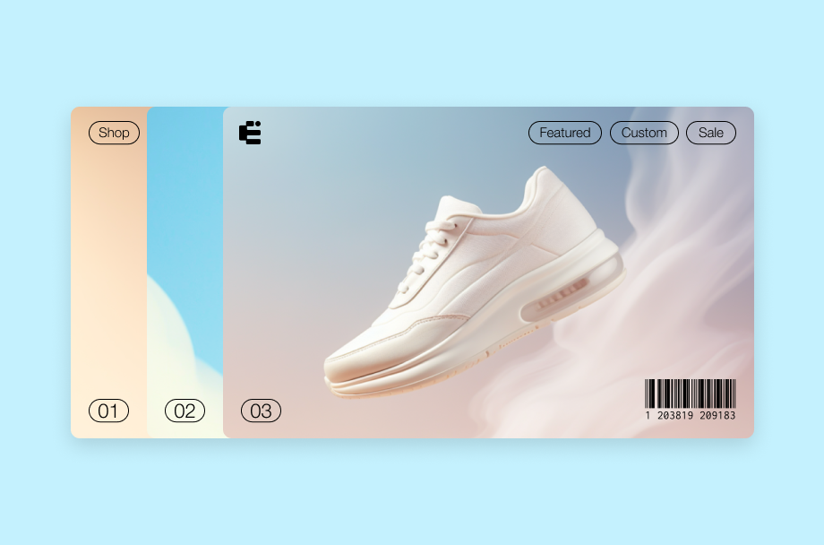
Selecting the right platform is the foundation of your online store’s success. Consider the following popular e-commerce platforms:
Shopify – Easy to use, great for beginners, and offers a wide range of plugins.
WooCommerce (for WordPress) – Highly customizable and ideal for those who already have a WordPress site.
www.quorawebsolution.com

Slide 5

Magento – Powerful and scalable, best for larger businesses with complex needs.
BigCommerce – A good alternative for those looking for built-in SEO and scalability.
Choose a platform based on your business needs, budget, and level of technical expertise.
Step 2: Design for User Experience (UX) and Conversion Optimization
www.quorawebsolution.com

Slide 6
A user-friendly design is key to increasing conversions. Here’s what to focus on:
Mobile-First Design – Ensure your website is responsive and works seamlessly on all devices.
Fast Loading Speed – Optimize images, use caching, and choose a reliable hosting provider.
Simple Navigation – Make it easy for users to find products with clear categories and filters.
Clear Call-to-Actions (CTAs) – Use strong and visible buttons like “Buy Now” or “Add to Cart.”
High-Quality Images and Videos – Show multiple angles and include zoom-in features.
Step 3: Optimize Product Pages for Conversions
Your product pages should be designed to persuade visitors to make a purchase. Consider implementing the following:
Compelling Product Descriptions – Use clear, engaging, and SEO-friendly descriptions.
Customer Reviews and Ratings – Build trust by showcasing testimonials and product ratings.
www.quorawebsolution.com

Slide 7
Scarcity and Urgency – Use limited-time offers and stock availability to create urgency.
Multiple Payment Options – Provide a variety of payment methods, including credit cards, PayPal, and digital wallets.
Step 4: Implement Secure Payment and Checkout Process
A seamless and secure checkout process is vital for reducing cart abandonment rates. Here’s how:
Guest Checkout Option – Allow customers to purchase without forcing account creation.
One-Page Checkout – Minimize steps required to complete a purchase.
Auto-Fill and Address Suggestions – Speed up the checkout process.
SSL Certificate – Ensure your site is encrypted for secure transactions.
Step 5: Utilize SEO and Marketing Strategies to Drive Traffic
www.quorawebsolution.com

Slide 8
A well-developed e-commerce store needs effective marketing strategies to attract customers. Here are key tactics:
SEO Optimization – Use keywords in product descriptions, meta tags, and URLs.
Content Marketing – Publish blogs and guides related to your products to boost organic traffic.
Email Marketing – Send personalized offers, cart abandonment reminders, and newsletters.
Social Media Advertising – Leverage paid promotions on platforms like Facebook, Instagram, and TikTok to target specific audiences, increase brand awareness, and drive conversions.
Influencer Marketing – Partner with industry-relevant influencers to showcase your products authentically, increase brand credibility, and reach a broader audience through social media campaigns and sponsored content.
www.quorawebsolution.com

Slide 9
Step 6: Analyze Performance and Continuously Improve
Consistently tracking and analyzing your website’s performance allows you to identify opportunities for optimization and growth. Use the following tools:
Google Analytics – Track visitor behavior and sales performance.
Heatmaps – Identify where users are clicking and where they drop off.
A/B Testing – Experiment with different layouts, CTA buttons, and product images to see what works best.
Conclusion
Building a high-converting e-commerce website requires careful planning and execution. By choosing the right platform, optimizing design and product pages, ensuring a secure checkout process, and using effective marketing strategies, you can increase sales and grow your online business. Stay updated with the latest trends and continuously optimize your website to stay ahead of the competition.
www.quorawebsolution.com

Slide 10
Are you ready to launch your e-commerce store? Take action today by implementing these strategies, and witness a significant boost in your online sales!
The Ultimate Guide to Website Design and Development: From Concept to Launch
Introduction
Building a website from scratch requires careful planning, strategic design, and technical execution.
www.quorawebsolution.com

Slide 11
Whether you're creating a personal blog, an e-commerce store, or a corporate website, understanding the process from concept to launch is essential. This guide will walk you through each step of website design and development to ensure your site is effective, user-friendly, and optimized for success.
Step 1: Establish Your Website’s Vision and Objectives
Before you begin designing or developing your website, it's crucial to determine its purpose. Ask yourself:
What is the primary goal of the website? (E.g., selling products, sharing content, generating leads)
Who is the target audience?
What specific actions do you want visitors to take, such as signing up for a newsletter, making a purchase, or contacting your business??
Having clear answers will guide your design and development process to align with your objectives.
Step 2: Plan and Structure Your Website
A well-structured website improves user experience and helps with search engine optimization (SEO).
www.quorawebsolution.com

Slide 12
Consider these key elements:
Site Map – Outline the main pages and navigation structure.
User Flow – Map out how users will interact with the site.
Wireframes and Mockups – Create visual blueprints of each page before development begins.
Step 3: Choose the Right Technology Stack
Your website’s technology will impact its functionality, scalability, and performance. Consider the following options:
Content Management Systems (CMS) – WordPress, Joomla, Drupal.
E-Commerce Platforms – Shopify, WooCommerce, Magento.
Custom Development – HTML, CSS, JavaScript, and backend languages like PHP, Python, or Node.js.
Choose the stack that best fits your business needs and technical expertise.
Step 4: Design for User Experience (UX) and User Interface (UI)
www.quorawebsolution.com

Slide 13
A visually appealing and intuitive design enhances user engagement. Focus on:
Mobile-First Design – Ensure responsiveness across devices.
Intuitive Navigation – Keep menus clear and user-friendly.
Consistent Branding – Use cohesive colors, typography, and imagery.
Accessibility – Make the website usable for all visitors, including those with disabilities.
Step 5: Develop Your Website
Once the design is finalized, it's time to start development. The process typically includes:
Front-End Development – Coding the visible parts using HTML, CSS, and JavaScript.
Back-End Development – Building server-side functionalities with PHP, Python, or other programming languages.
Database Integration – Storing user data securely using MySQL, PostgreSQL, or MongoDB.
www.quorawebsolution.com

Slide 14
CMS Implementation – If using WordPress or another CMS, customize it according to your needs.
Step 6: Optimize for Performance and SEO
A slow or poorly optimized website can hurt user experience and rankings. Follow these best practices:
Optimize Images – Reduce file sizes using modern compression techniques to maintain high quality while improving load times.
Minimize HTTP Requests – Limit the number of files and resources loaded on a page by combining scripts, using CSS sprites, and optimizing asset delivery.
Implement Caching – Enable browser and server caching mechanisms to store frequently accessed resources, reducing load times and improving website performance.
SEO Optimization – Use relevant keywords, meta descriptions, and alt text for images.
www.quorawebsolution.com

Slide 15
Step 7: Test and Debug Your Website
Before launching, thoroughly test your website to fix any issues. Perform:
Cross-Browser Testing – Ensure compatibility with Chrome, Firefox, Safari, and Edge.
Mobile Testing – Check responsiveness on different devices.
Functionality Testing – Test all links, forms, and interactive elements.
Speed Testing – Use tools like Google PageSpeed Insights to assess performance.
Step 8: Launch and Promote Your Website
Once your website passes testing, it's time to launch. Follow these steps:
Choose a Reliable Hosting Provider – Ensure high uptime and security.
Set Up Website Analytics – Use Google Analytics to track user behavior.
www.quorawebsolution.com

Slide 16
Submit to Search Engines – Index your site on Google and Bing.
Promote Your Website – Leverage social media, email campaigns, influencer partnerships, and paid advertisements to increase visibility and attract visitors.
Step 9: Maintain and Update Your Website
A successful website requires ongoing maintenance and updates. Regularly:
Update Software and Plugins – Keep your CMS and tools secure and functional.
Monitor Performance – Use analytics to assess user behavior and make improvements.
Refresh Content – Keep information relevant and up-to-date.
Enhance Security – Regularly back up your site and implement security measures.
www.quorawebsolution.com

Slide 17
Conclusion
Website design and development is a continuous process that involves planning, execution, and ongoing improvements. By following these steps, you can create a high-performing website that meets your business goals and provides an excellent user experience. Start implementing these best practices today and set your website up for long-term success!
www.quorawebsolution.com

Slide 18
Quora Web Solution: Quora Web Solution is a trusted website development company based in Bangalore, India, offering a wide array of services to not only domestic but global clientele. Be it Website Design and Development, SEO services, Digital Marketing, Branding, App Development, Ecommerce Solution, and Logo Creation . Quora Web Solution has the best website developers offering top quality services and that is the reason why we are well known as one of the best Website Development Companies in Bangalore, India.
Visit Us - www.quorawebsolution.com
Call Us - +91 9986 056 909
Mail Us - info@quorawebsolutions.com
www.quorawebsolution.com

Slide 19

WORDPRESS DEVELOPMENT
ECOMMERCE DEVELOPMENT
PHP DEVELOPMENT
CMS DEVELOPMENT
DRUPAL DEVELOPMENT
WEBSITE SERVICES
WEBPORTAL DEVELOPMENT
MAGENTO DEVELOPMENT
WEBSITE DEVELOPMENT
JOOMLA DEVELOPMENT
SMALL BUSINESS DEVELOPMENT
CHEAP WEBSITE DEVELOPMENT
STATIC WEBSITE DEVELOPMENT
DYNAMIC WEBSITE DEVELOPMENT
WEBSITE DESIGN COMPANY
TOUR AND TRAVEL WEBSITE DEVELOPMENT
Services

