Slide 1

Aseptic Fillers with MicroThermics
aseptic fillers

Slide 2
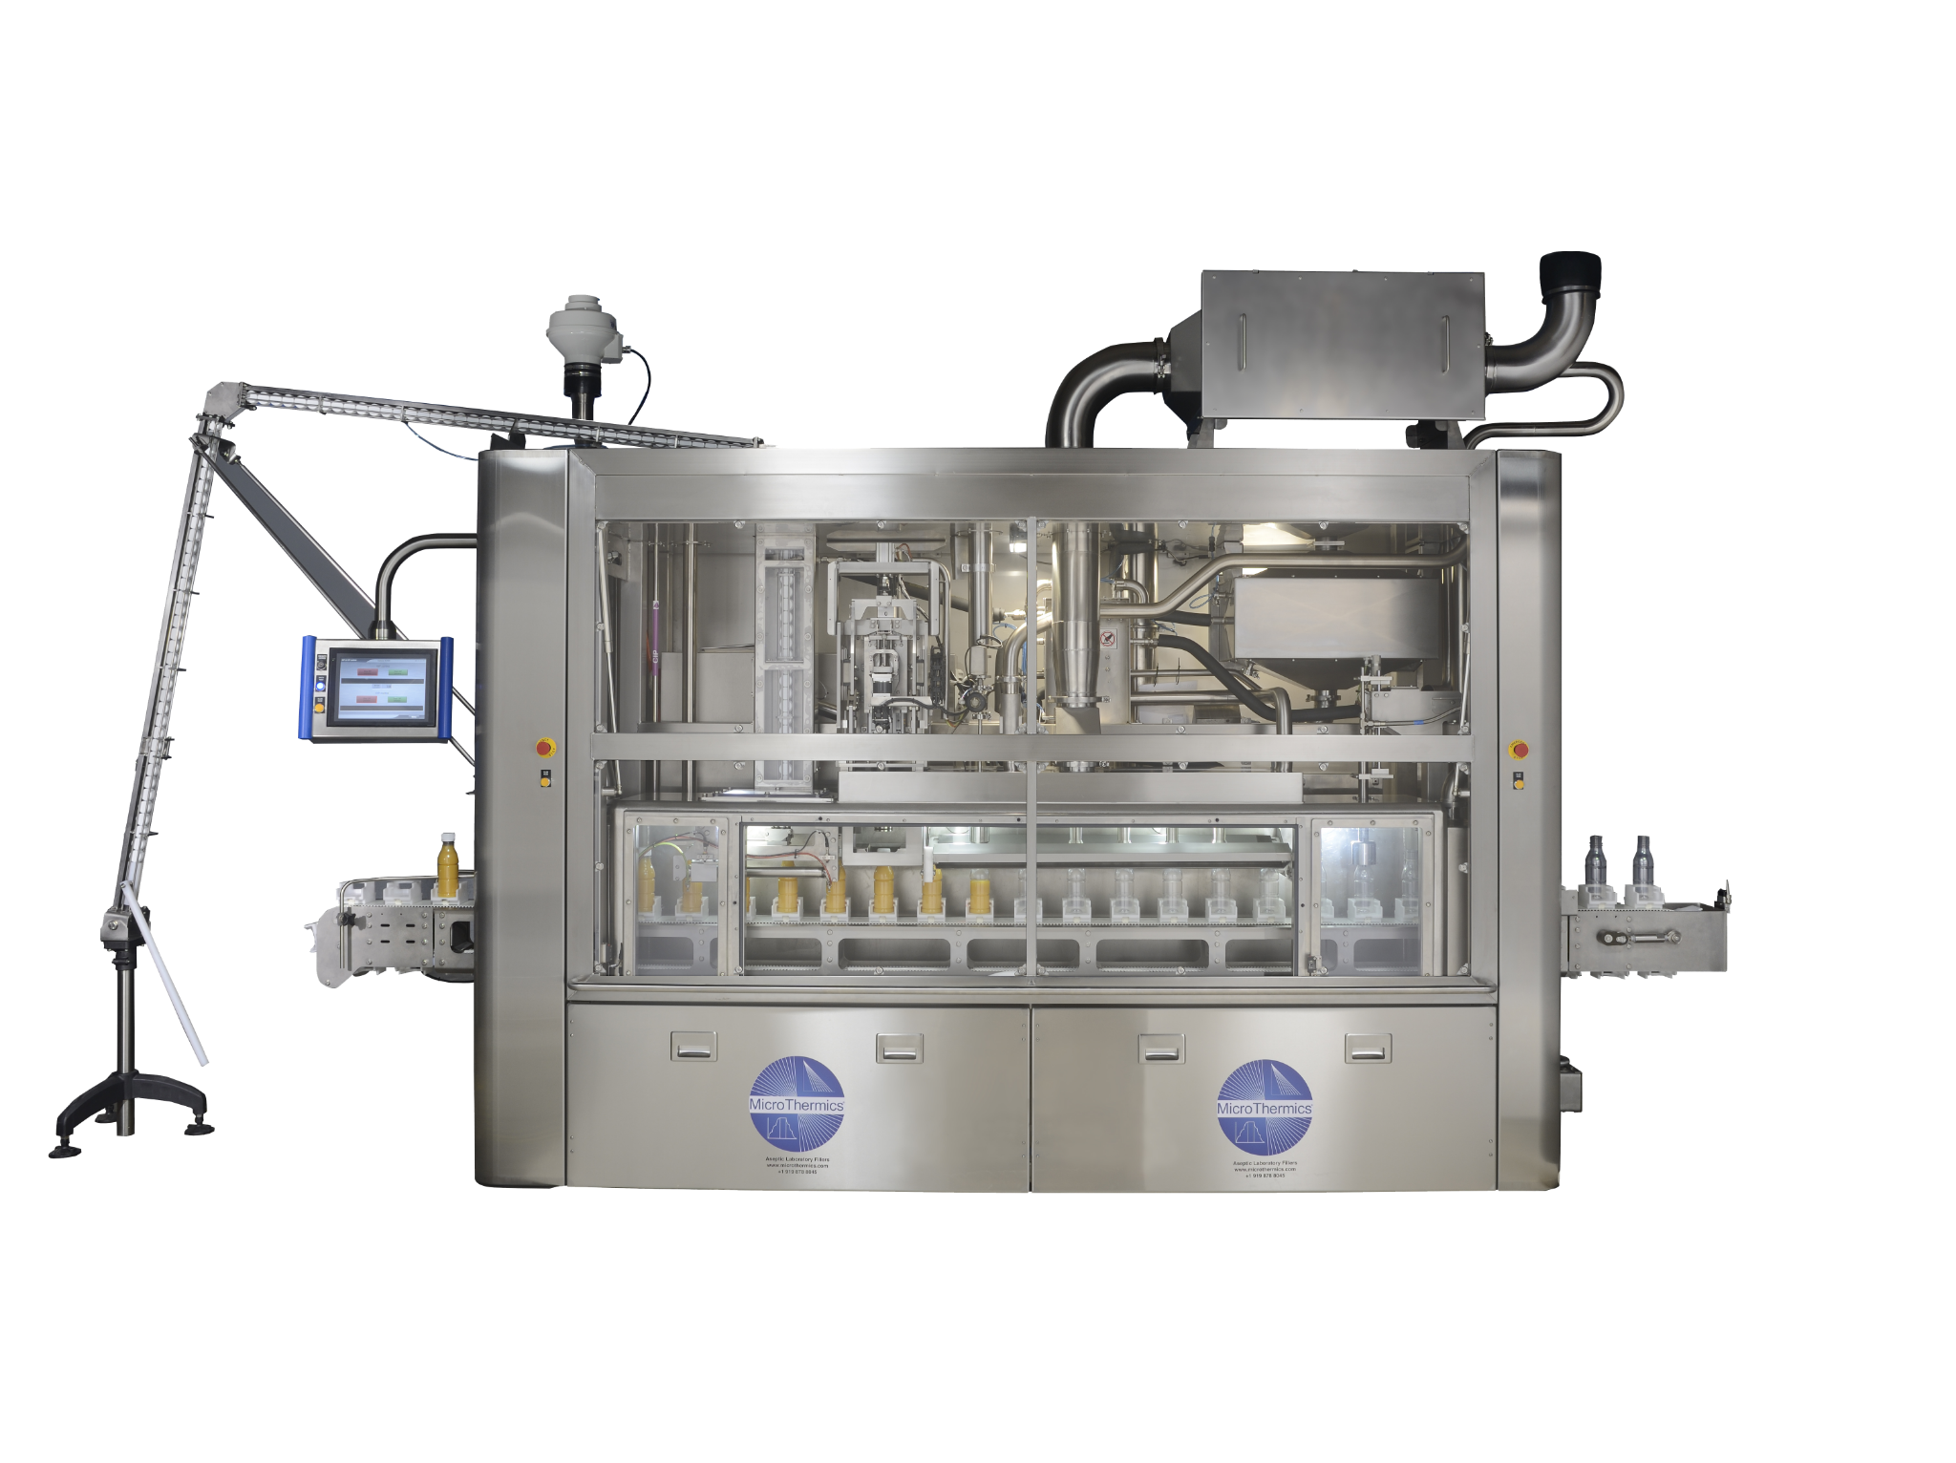
Introduction
Aseptic filling, a process that ensures the sterility of products during packaging, is crucial in industries such as food and beverage, pharmaceuticals, and biotechnology. As consumer demand for safe, high-quality products continues to rise, the importance of reliable aseptic filling solutions cannot be overstated. Enter MicroThermics, a brand at the forefront of aseptic processing equipment, renowned for its innovative and efficient solutions.

Slide 3
Understanding Aseptic Filling
Aseptic filling involves the packaging of products in a sterile environment to prevent contamination by microorganisms. This process is vital for extending the shelf life of perishable goods without the need for preservatives. It ensures that products, particularly those sensitive to microbial contamination, remain safe and high-quality from production to consumption.

Slide 4
The Role of MicroThermics in Aseptic Filling
MicroThermics has established itself as a leader in the aseptic processing industry, offering advanced aseptic fillers designed to meet the stringent demands of modern production facilities. Their equipment is engineered to provide precise control over the filling process, ensuring that each product is packaged under optimal sterile conditions.
Key Features of MicroThermics Aseptic Fillers
Precision and Consistency: MicroThermics' aseptic fillers are designed to deliver precise and consistent filling volumes, reducing waste and ensuring uniformity across batches. This precision is crucial for maintaining product quality and meeting regulatory standards.

Slide 5
Advanced Sterilization Techniques: The aseptic fillers from MicroThermics employ cutting-edge sterilization techniques, including thermal and non-thermal methods. These techniques effectively eliminate microbial contamination, ensuring that the packaging process maintains the highest levels of sterility.
User-Friendly Operation: Designed with user convenience in mind, MicroThermics' aseptic fillers are easy to operate and maintain. The intuitive interface and robust construction minimize downtime and ensure smooth, efficient operations.
Versatility: MicroThermics' aseptic fillers are versatile, capable of handling a wide range of products, from liquids and semi-solids to particulate-containing items. This flexibility makes them suitable for diverse applications across various industries.

Slide 6
The Future of Aseptic Filling with MicroThermics
As the demand for safe, high-quality products continues to grow, the need for reliable aseptic filling solutions will only become more critical. MicroThermics is committed to staying at the forefront of this industry, continually innovating to provide cutting-edge aseptic fillers that meet the evolving needs of their clients.
MicroThermics' aseptic fillers offer a blend of precision, reliability, and versatility that is unmatched in the industry. Whether you're looking to enhance product safety, extend shelf life, or improve operational efficiency, MicroThermics has the solutions you need. Trust in their expertise and experience to elevate your aseptic filling processes and deliver exceptional products to your customers.

Slide 7
Contact Us
3216–102 Wellington Ct. Raleigh, NC 27615 USA
Phone: 9198788045
Email: info@microthermics.com
https://www.linkedin.com/company/microthermics-inc
https://www.facebook.com/microthermics
https://twitter.com/microthermics
https://microthermics.com/

