Slide 1

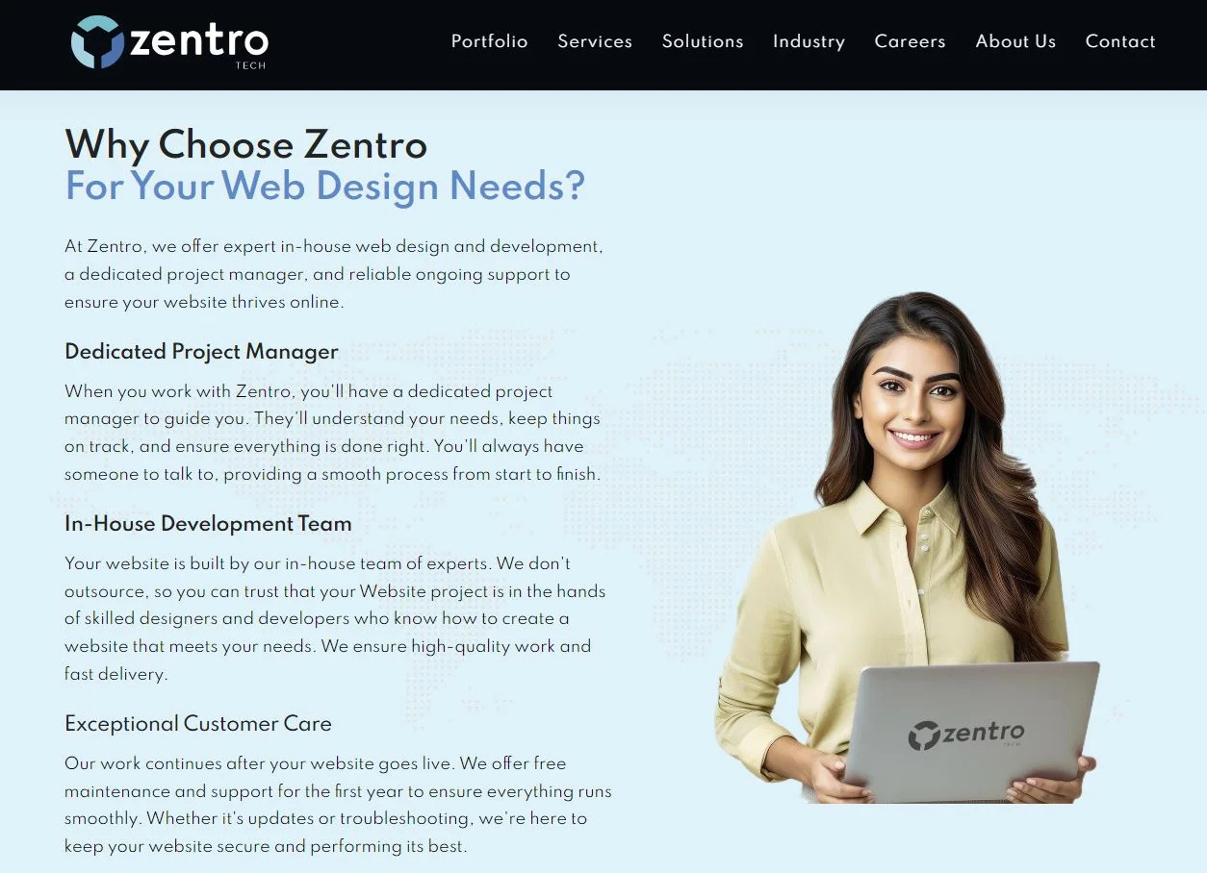
Quora Web Solution
Website Design and
Development
Company
Web Design & Web Development
Company in Bangalore, India
www.quorawebsolution.com
+91 9986 056 909
info@quorawebsolutions.com
24A, 1st Main Rd, Chandra Reddy
Layout, Koramangala 4th Block,
Koramangala, Bengaluru,
Karnataka 560034

Slide 2

**Boost Your Business with Expert Website Design & Development**
www.quorawebsolution.com

Slide 3
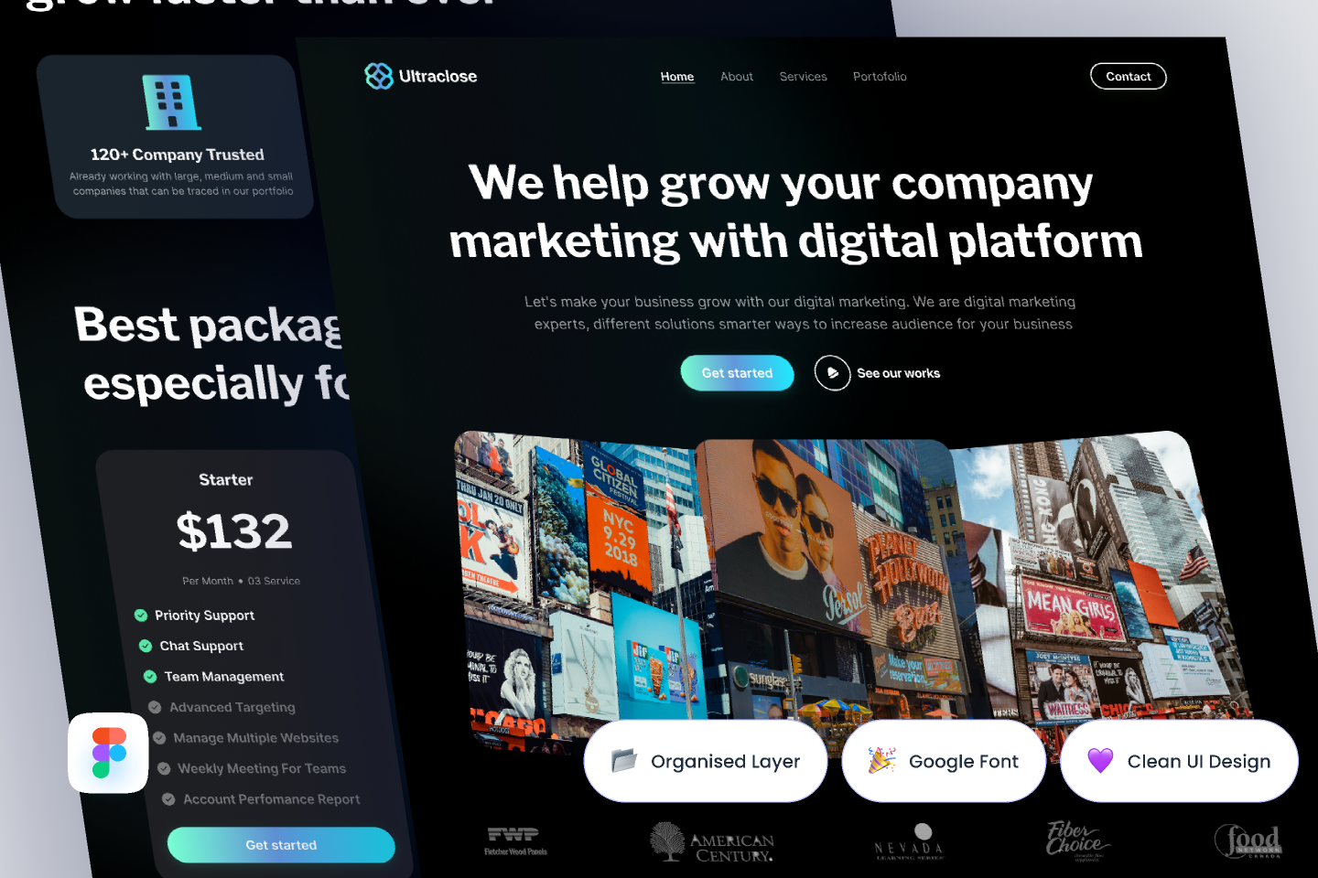
In today's hyper-connected world, your website is more than just an online brochure; it's the cornerstone of your digital presence.
www.quorawebsolution.com

Slide 4
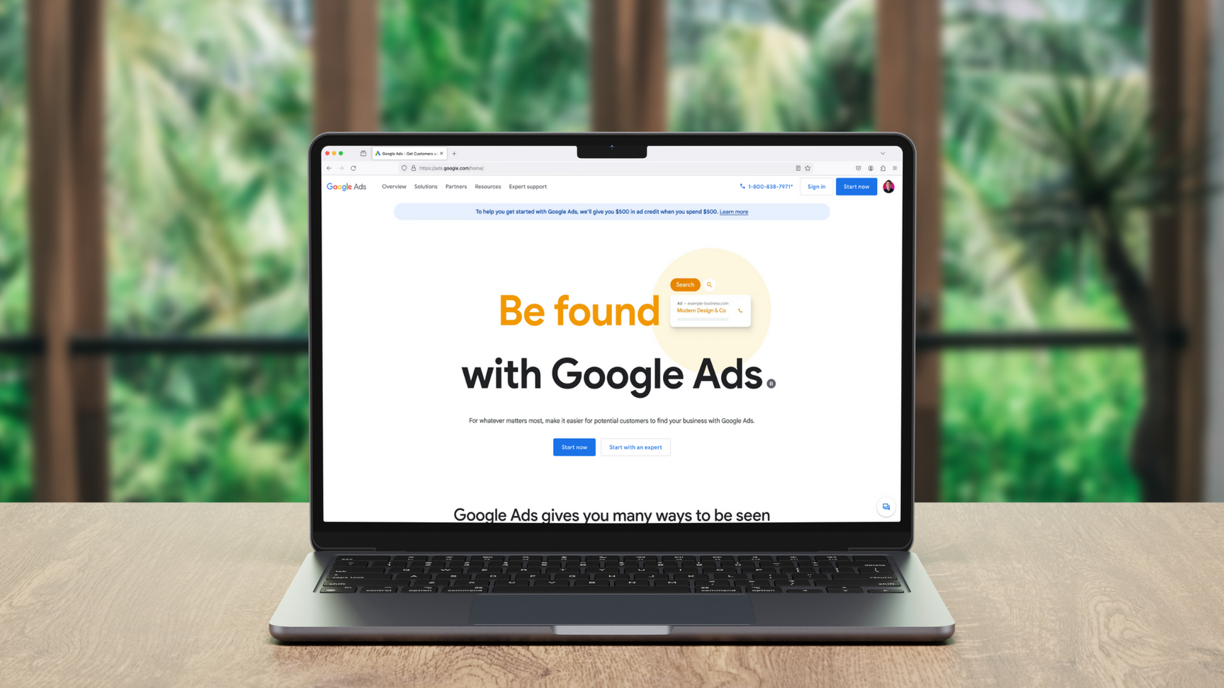
It's the first impression potential customers have of your brand, and it plays a crucial role in building trust, generating leads, and driving sales.
www.quorawebsolution.com

Slide 5

A poorly designed website can alienate visitors, hinder user experience, and ultimately damage your brand's credibility.
www.quorawebsolution.com

Slide 6
It can alienate visitors, confuse prospects, and ultimately damage your brand's reputation. On the other hand, a well-crafted website, designed and developed by experts, can be a powerful tool for business growth.
**Here's how expert website design and development can boost your business:**
* **Enhanced Brand Image:** A professional website reflects positively on your brand. It conveys a sense of credibility, professionalism, and attention to detail.
* **Improved User Experience:** A user-friendly website with intuitive navigation and clear calls to action keeps visitors engaged and encourages them to explore further.
* **Increased Visibility:** Search engine optimization (SEO) is a critical aspect of website development.
www.quorawebsolution.com

Slide 7
Search Engine Optimization (SEO) enhances website visibility in search results, driving organic traffic and attracting more potential customers.
* **Boosted Conversions:** A well-designed website can effectively guide visitors through the sales funnel, from initial interest to purchase.
* **Enhanced Customer Engagement:** Interactive elements, such as live chat, contact forms, and social media integration, can foster stronger relationships with your customers.
Investing in expert website design and development is an investment in your business's future. It's a strategic move that can yield significant returns in terms of increased brand awareness, lead generation, and revenue growth.
www.quorawebsolution.com

Slide 8
**Key takeaways:**
* Your website is your digital storefront.
A poorly designed website can negatively impact brand perception, erode trust, and hinder business growth.
* Expert design and development can enhance your brand image, improve user experience, and boost conversions.
* SEO is crucial for website success.
Investing in a professional website is a strategic investment that fosters long-term business growth, enhances online visibility, and strengthens your competitive advantage.
www.quorawebsolution.com

Slide 9
By partnering with a reputable website design and development agency, you can unlock the full potential of your online presence and achieve your business goals.
The Importance of Website Design & Development for Business Growth
In today's digital age, a robust online presence is no longer a luxury, but a non-negotiable for businesses of all sizes. Your website serves as your 24/7 storefront, the first impression potential customers have of your brand.1 A well-designed and developed website isn't just about aesthetics; it's a strategic investment that directly impacts your business growth.
www.quorawebsolution.com

Slide 10
2
Here's why website design and development are crucial:
  Building Brand Credibility: A professional website instantly communicates credibility and professionalism.3 A sleek design, intuitive navigation, and high-quality content inspire trust and confidence in potential customers.4
  Enhanced User Experience (UX): A user-centric design ensures visitors can easily find what they're looking for.5 Clear calls-to-action, seamless navigation, and mobile responsiveness all contribute to a positive user experience, keeping visitors engaged and encouraging them to explore further.6
  Improved Search Engine Optimization (SEO): A well-structured website with optimized content is more likely to rank higher in search engine results pages (SERPs).
www.quorawebsolution.com

Slide 11
  This increased visibility drives organic traffic to your site, attracting potential customers actively searching for your products or services.7
  Increased Conversions: A well-designed website can effectively guide visitors through the sales funnel.8 Clear calls-to-action, compelling product descriptions, and secure payment gateways encourage conversions, whether it's making a purchase, signing up for a newsletter, or requesting a quote.9
  24/7 Accessibility: Your website is available 24/7, expanding your reach beyond traditional business hours.10 This allows customers to explore your offerings, make inquiries, and even make purchases at their convenience.11
  Data-Driven Insights: Website analytics provide valuable insights into customer behavior.
www.quorawebsolution.com

Slide 12
  12 You can track website traffic, identify popular pages, and analyze user interactions to understand customer preferences and tailor your marketing strategies accordingly.13
In Conclusion:
Investing in professional website design and development is an investment in your business's future.14 It's about creating a digital experience that not only reflects your brand identity but also effectively engages your target audience, drives conversions, and ultimately fuels business growth.15
Key Takeaways:
  Your website is your digital storefront.
www.quorawebsolution.com

Slide 13
  16
  A well-designed website builds brand credibility and trust.17
  User experience is paramount for website success.
  SEO is crucial for improving search engine rankings.18
  A well-designed website drives conversions and increases sales.19
  Website analytics provide valuable data-driven insights.20
By prioritizing website design and development, you're laying the foundation for a strong online presence that will propel your business towards success in the competitive digital landscape.
www.quorawebsolution.com

Slide 14
Quora Web Solution: Quora Web Solution is a trusted website development company based in Bangalore, India, offering a wide array of services to not only domestic but global clientele. Be it Website Design and Development, SEO services, Digital Marketing, Branding, App Development, Ecommerce Solution, and Logo Creation . Quora Web Solution has the best website developers offering top quality services and that is the reason why we are well known as one of the best Website Development Companies in Bangalore, India.
Visit Us - www.quorawebsolution.com
Call Us - +91 9986 056 909
Mail Us - info@quorawebsolutions.com
www.quorawebsolution.com

Slide 15

WORDPRESS DEVELOPMENT
ECOMMERCE DEVELOPMENT
PHP DEVELOPMENT
CMS DEVELOPMENT
DRUPAL DEVELOPMENT
WEBSITE SERVICES
WEBPORTAL DEVELOPMENT
MAGENTO DEVELOPMENT
WEBSITE DEVELOPMENT
JOOMLA DEVELOPMENT
SMALL BUSINESS DEVELOPMENT
CHEAP WEBSITE DEVELOPMENT
STATIC WEBSITE DEVELOPMENT
DYNAMIC WEBSITE DEVELOPMENT
WEBSITE DESIGN COMPANY
TOUR AND TRAVEL WEBSITE DEVELOPMENT
Services

