Slide 1
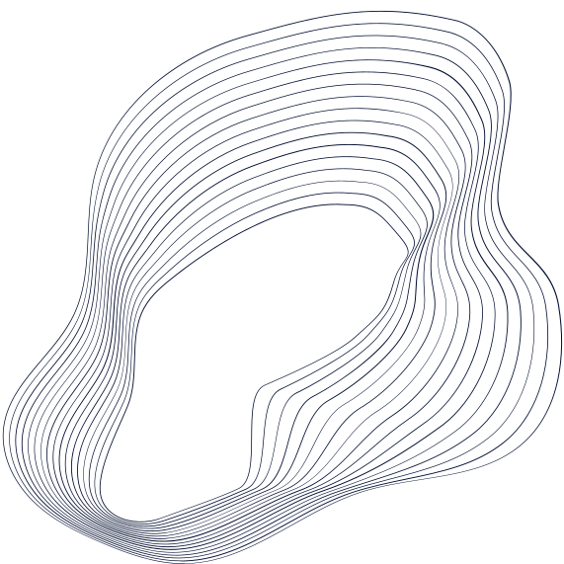
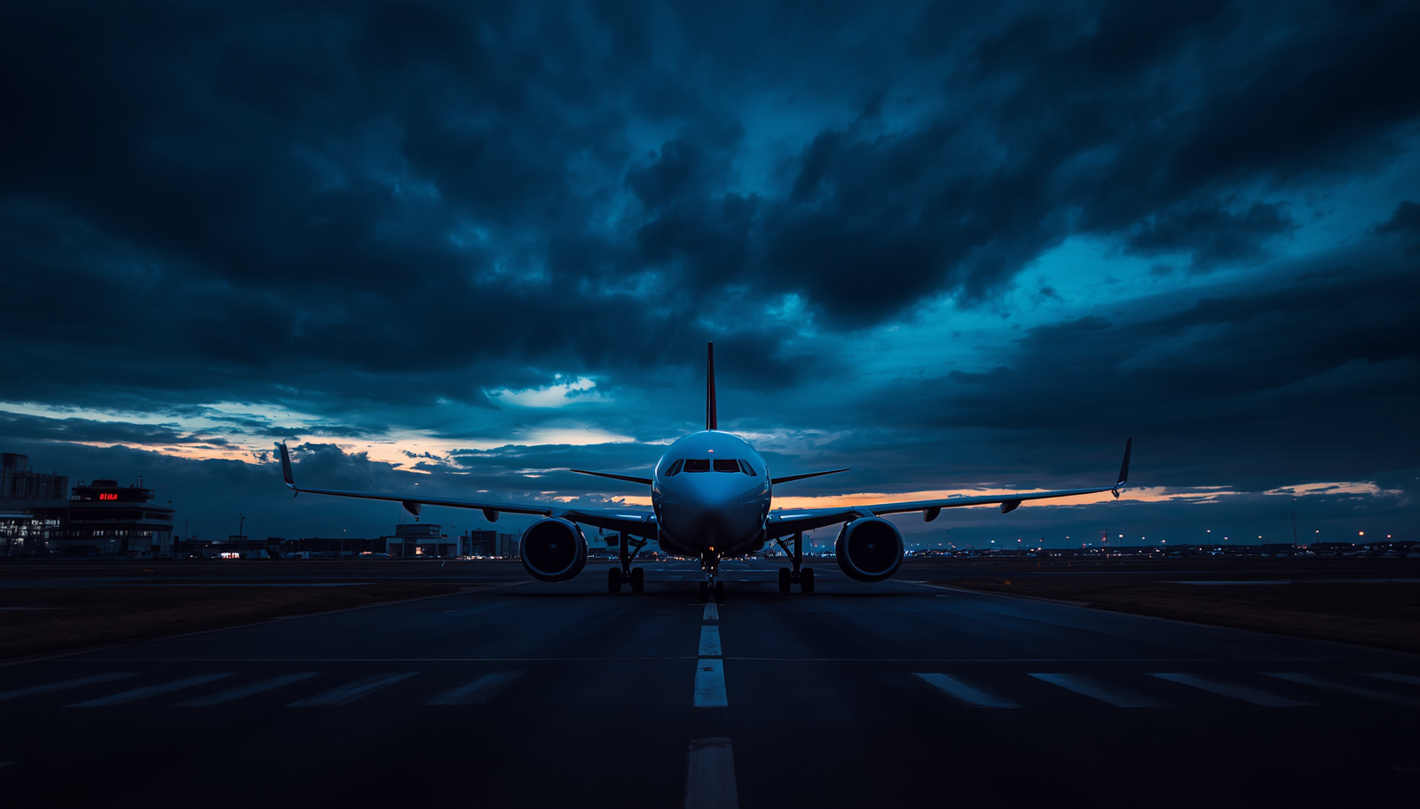


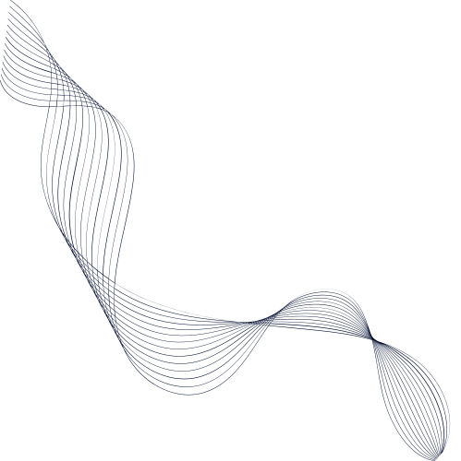
IS IT POSSIBLE TO CHANGE YOUR DELTA FLIGHT THE SAME DAY?
Understanding Delta Same Day Flight Change Options

Slide 2

What Is Delta Same Day Flight Change?
Delta Same Day Flight Change is an option that allows travelers to switch to a different flight on the same day of their original departure. This service is designed to give passengers greater flexibility when travel plans shift unexpectedly.
How It Works: Eligible passengers can request a same day flight change to an earlier or later flight on the same route, subject to available seat inventory. The change must be made on the actual day of travel.
Who Benefits: This option is especially helpful for business travelers, those with changing schedules, or anyone who wants to catch an earlier connection. Delta Medallion members often enjoy additional flexibility and fee waivers.
Key Condition: Availability is not guaranteed — it depends on open seats on the desired flight and your ticket type. Basic Economy fares may have restrictions or be ineligible for same day changes.

Slide 3
Who Can Use Same Day Changes:
• Available to most ticket types except Basic Economy fares
• Delta Medallion members often receive fee waivers
• Must travel on the same calendar day as original flight
Eligibility & Fees
Fee Structure:
• Standard same day change fee varies by fare class and status
• Fare difference may apply if new flight costs more
• No fee for Platinum and Diamond Medallion members
Important Reminders:
• Always check your ticket's fare rules before attempting a change
• Seat availability on the desired flight is required
• Changes subject to availability at time of request

Slide 4



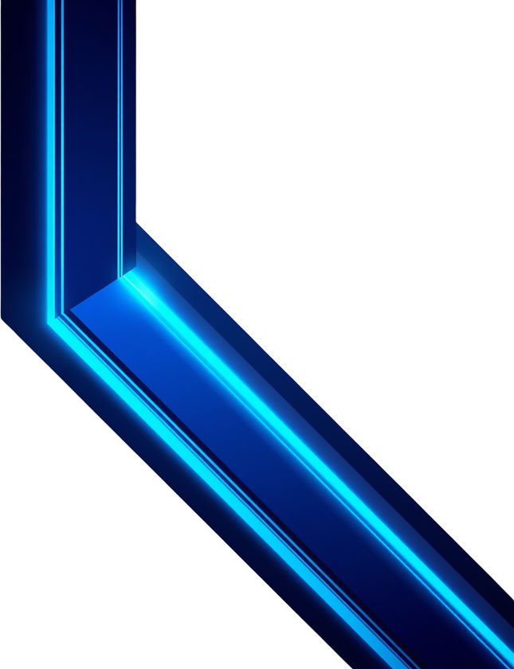
1
LOG IN TO DELTA ACCOUNT OR FLY DELTA APP
5
CONFIRM & PAY FEES
2
GO TO "MY TRIPS"
How to Change Your Delta Flight Same Day
6
CHECK CONFIRMATION EMAIL
3
SELECT "SAME DAY FLIGHT CHANGE"
7
ARRIVE WITH UPDATED ITINERARY
4
CHOOSE AVAILABLE FLIGHT

Slide 5

Key Takeaways
• Delta same day flight change allows flexible travel adjustments on your travel day.
• Eligibility and fees depend on your ticket type and Delta Medallion status.
• Use Delta's website or Fly Delta app for quick and easy same day flight changes.
• Always check fare rules and seat availability before planning to change your flight.
• Basic economy fares may not qualify — know your ticket before you travel.
"Plan ahead and know your options with Delta same day flight change!"

