Slide 1
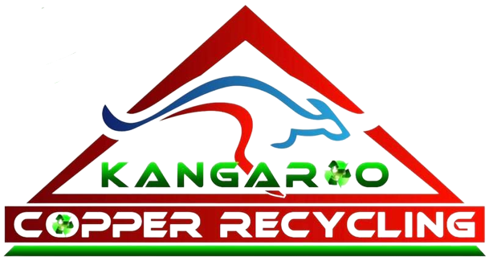
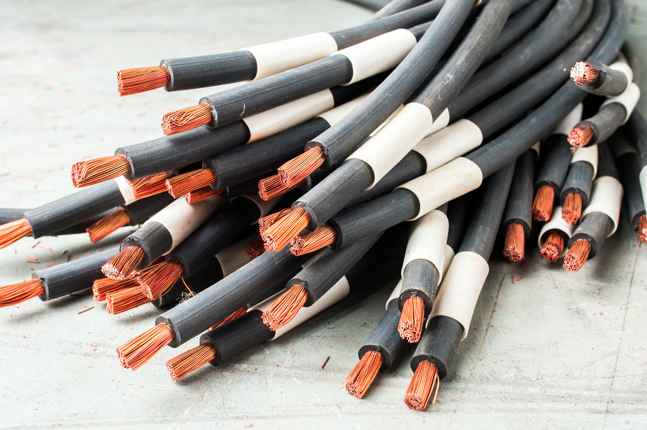
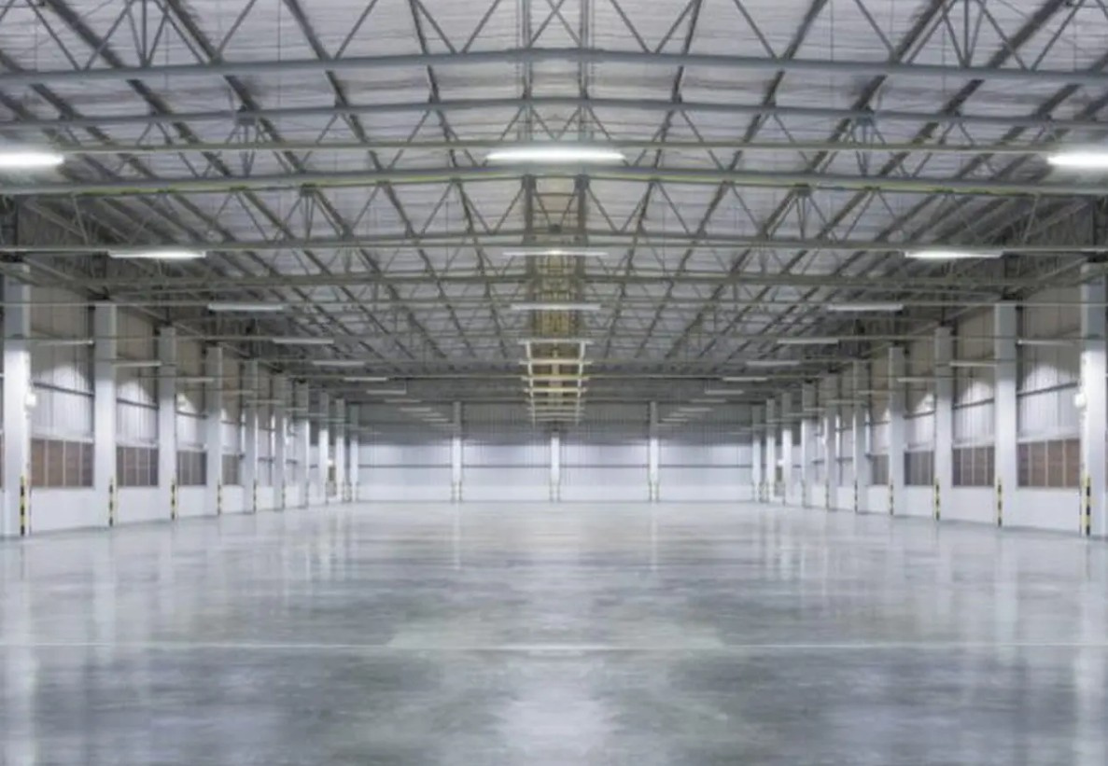
Scrap Copper Thornton Recycling Made Easy -Serving Raymond Terrace Area
Getting rid of scrap copper is no longer a complex task. If you are in Thornton or Raymond Terrace,
recycling your copper is easier and more rewarding than you think. Residential and commercial
property owners can benefit from copper recycling. It helps them make some extra cash and
safeguard the environment.

Slide 2
Why should you opt for copper recycling?
Copper is not just valuable because of its price tag. You can see this metal everywhere. It can be seen in
electrical wiring, air conditioners, plumbing, appliances, roofing and more. It can be recycled multiple times
without losing any quality. When you recycle copper, you can reduce the mining to produce new versions.
Energy use will come down significantly. Moreover, you can keep this valuable metal out of the landfill.
Therefore, hire a trusted scrap copper Thornton company to sell your metal instead of throwing it in the
trash. The best recyclers will visit your spot and haul away the metal waste. They will offer a deserving
amount for the scrap.

Slide 3
Leading recyclers accept a wide variety of copper metal waste.
Reputable scrap copper Raymond Terrace dealers or yards take all sorts of copper, including electrical wiring, air conditioner coils, offcuts in construction sites, plumbing pipes and fittings, roofing materials, motors and transformers. You can also sell brass, aluminium and stainless steel scrap to them. You can expect maximum value from stripped wires.

Slide 4
Recycling to meet everyone’s needs
Homeowners can approach professional scrap copper Thornton recyclers to sell their scrap copper. They have to deal with copper waste during renovation, clearing out the garage and upgrading appliances. There is no need to keep them idle. They will collect dust and cause environmental pollution and health issues. You can hire an experienced scrap merchant to efficiently remove and recycle the waste. Business owners can hire these firms to meet their recycling needs. The best companies will collect or allow drop-offs based on your convenience. You can even expect regular pickups from them. Industrial establishments will also find their services highly beneficial. Reputable recyclers will arrange bulk pickups and manage all the heavy lifting for you.

Slide 5
Conclusion
Scrap copper offers maximum value for sellers. When you sell large quantities, you can expect sizeable revenue. Removal and recycling will be done with the utmost accountability. Their certified facilities will ensure safe processing.
Source: https://writeupcafe.com/scrap-copper-thornton-recycling-made-easy-serving-raymond-terrace-area

Slide 6
Thank You
Phone: 61405404040
Website: https://kangaroocopperrecycling.com.au/

