Slide 1
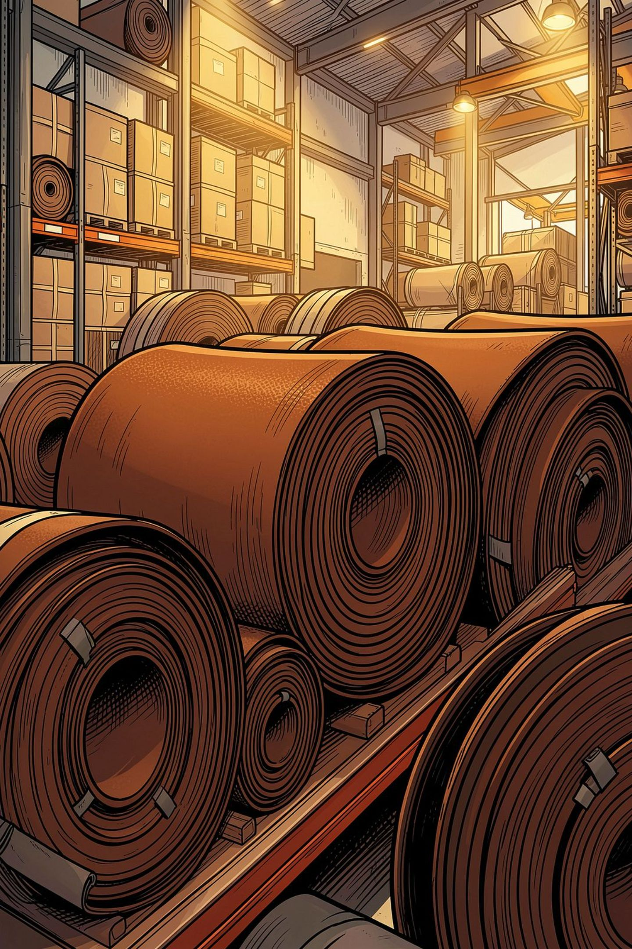
Why Is PVC Leather for Bags the Best Choice for Durable and Stylish Designs?
Some people focus only on the appearance when selecting bags. The look is important. However, the most vital aspect is to identify the best material. You should check how the bag feels. The longevity is important. Moreover, how it fits into your life is vital. No one buys a bag hoping it will fall apart in a season. That is why PVC leather keeps winning people over. There is a reason designers keep coming back to it. You can expect style and durability for a good price.

Slide 2
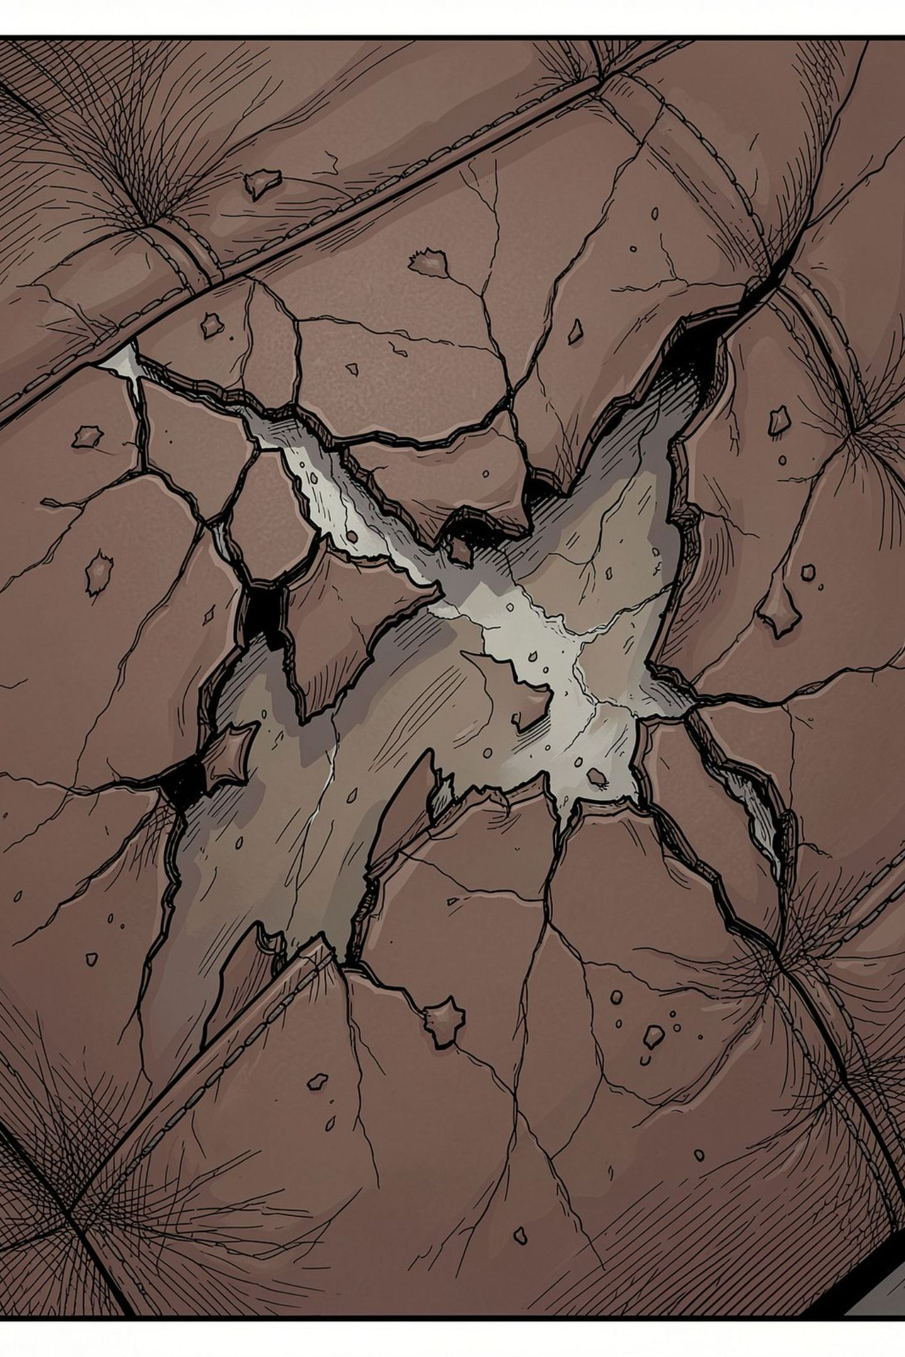
Built To Last For Many Years
Bags go through a lot. People toss them in the car, drag them through rain, and fill them with various items. PVC leather doesn’t disappoint users. It resists scratches and scuffs better than many traditional options. If you actually want to get the best value, you should select PVC leather for bags. It will meet all your expectations.

Slide 3
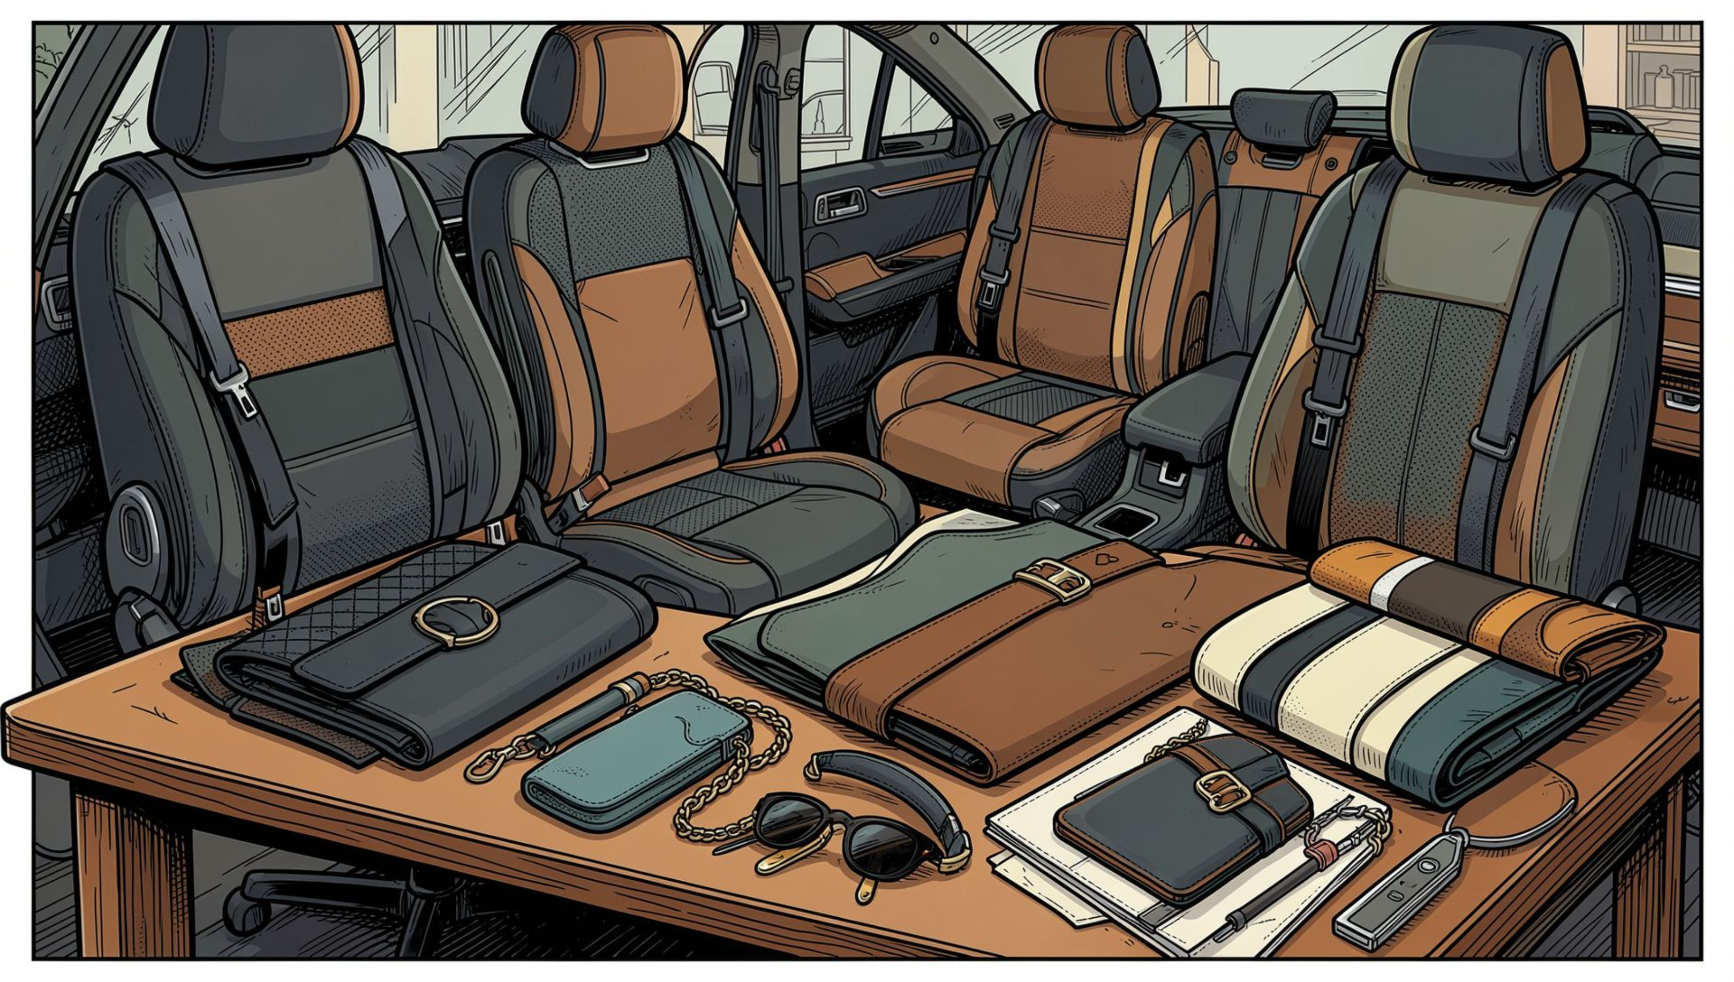
Various Looks To Choose From
Fashion trends are always changing. PVC leather doesn’t have to try hard to keep pace. Do you want bright colours, soft neutrals, matte, glossy, prints, or even some wild texture? It is all there. Designers get to experiment without worrying about quality or breaking budgets. PVC film manufacturers in India deliver a wide range of options with different looks.

Slide 4
Forget About Water Damage And Rain.
What if you get caught in a downpour with your leather bag? Many people accidentally spill coffee on their bags. Your leather bag will easily get damaged. When you use PVC leather for bags, water just beads up and wipes right off. No ugly stains to worry about. Cleanup is basically using a damp cloth to wipe off. That kind of worry-free upkeep is a big reason people gravitate towards it.

Slide 5
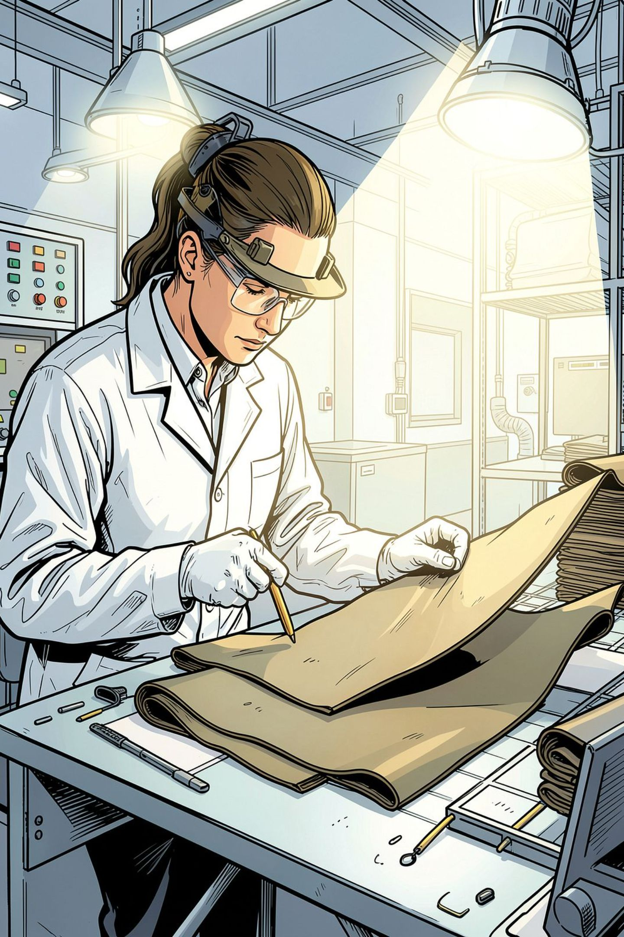
Low Maintenance And High Reward
Nobody wants a bag that is highly demanding. People don’t have a lot of time to spend on upkeep. With PVC leather, you skip all the special sprays and complicated cleaning routines. You just wipe it down and keep going. That is why leading bag makers rely on PVC film manufacturers in India to source their raw materials.
Looks Good And Costs Less
You need to spend a fortune on bags made from exotic materials. PVC leather keeps costs low for buyers and the brands that make them. You get reliable quality and great style without the steep price tag.

Slide 6
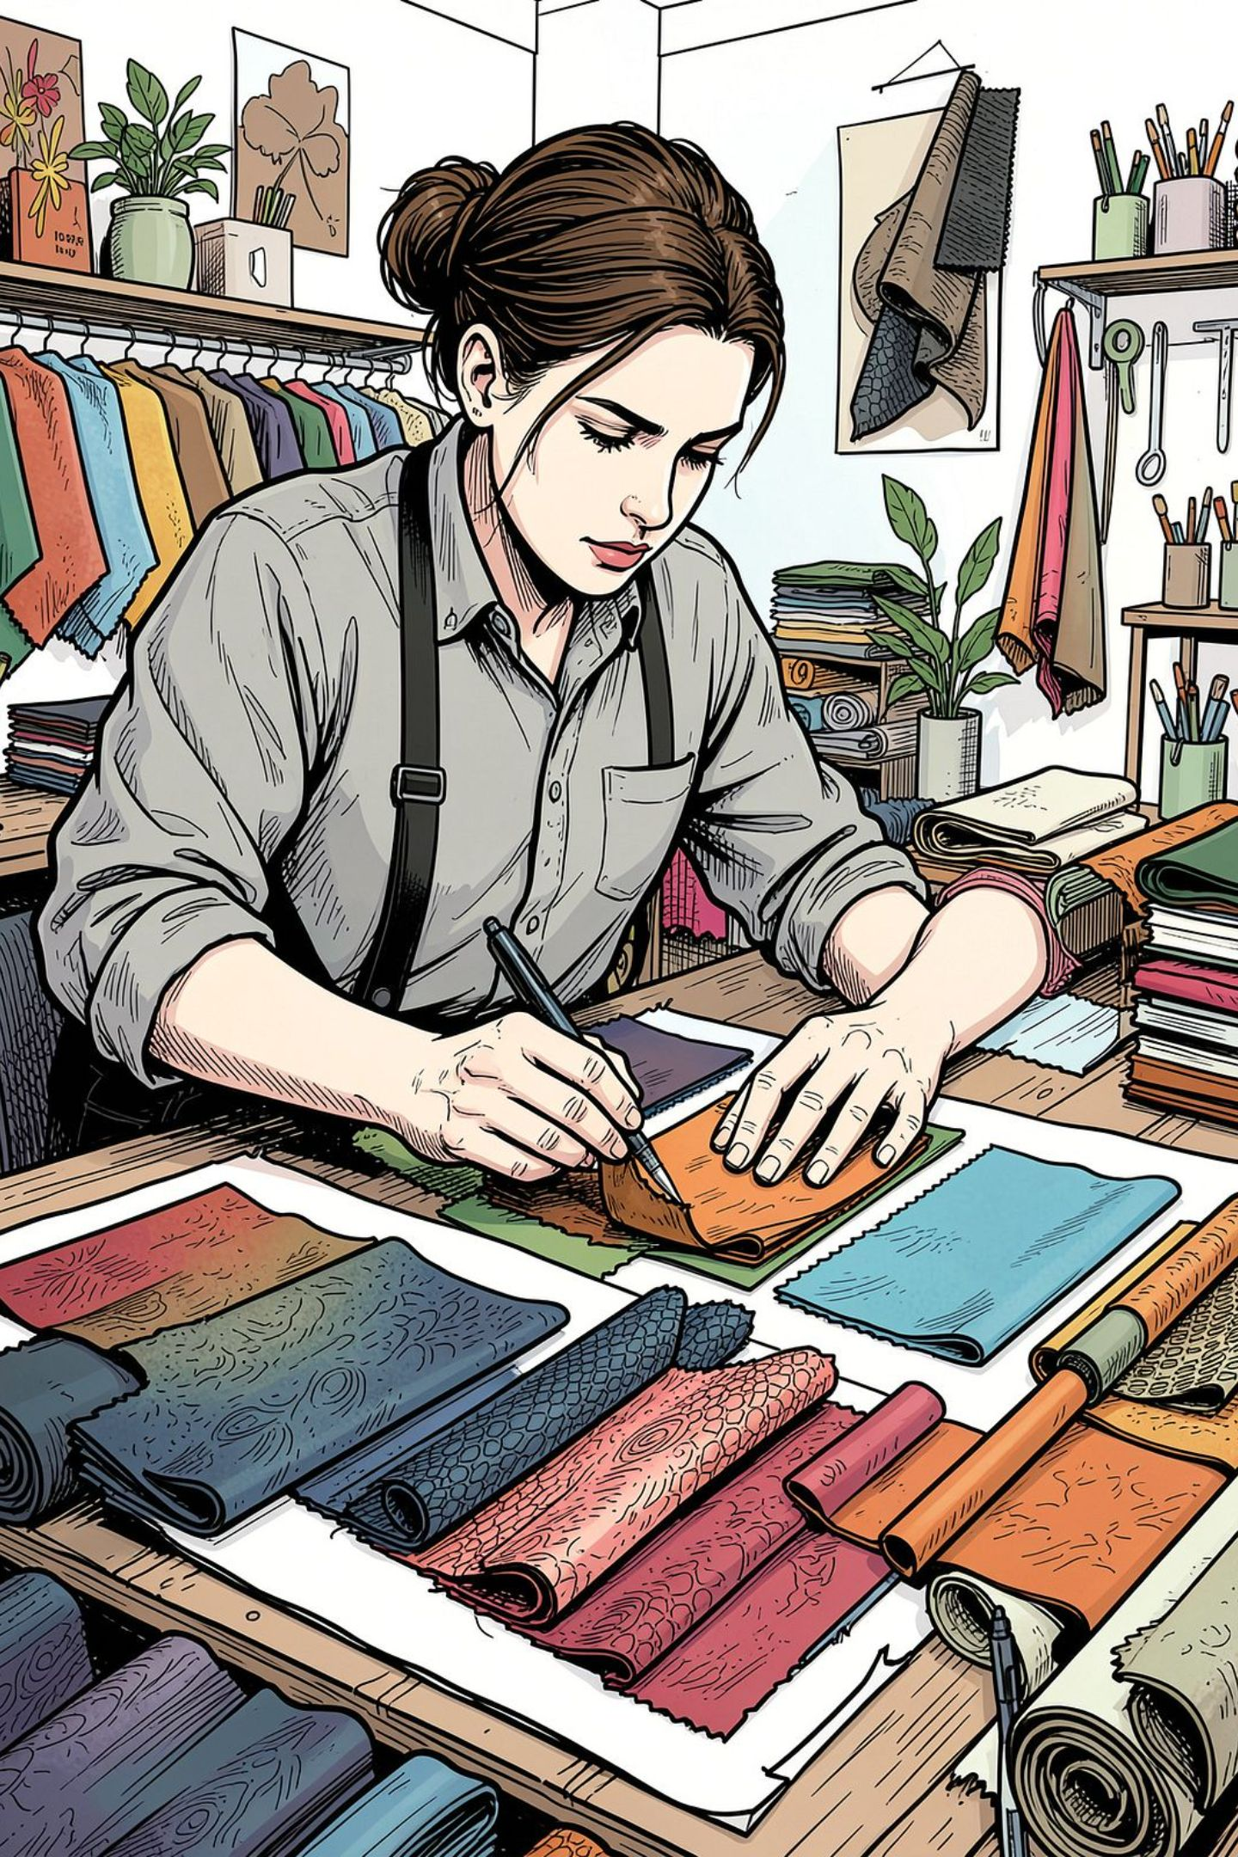
Conclusion
Modern PVC leather can mimic just about any look, including classic leather, fancy embossing, or even imitation crocodile. Designers love the freedom to test bold ideas without worrying about the bag falling apart.
Resource blog: https://guestcountry.com/@vortexflexpvtltd/why-is-pvc-leather-for-bags-the-best-choice-for-durable-and-stylish-designs

Slide 7
Get in Touch Today:
Phone = +919081901112
Address= Survey No 320, Kalwach Road, Alipore, Chikhli, Navsari, Gujarat, 396409, India
Website = https://vortexflex.com/ »
Mail: info@vortexflex.com »
Social Links
LinkedIn = https://www.linkedin.com/company/vortexflex/ »
Twitter = https://twitter.com/vortexflex »
Facebook = https://www.facebook.com/vortexflex »

