Slide 1
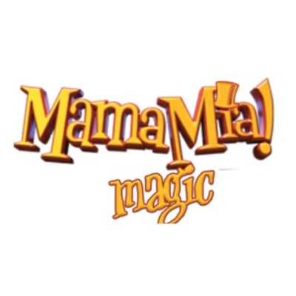
MamaMia Magic LLC
Experience the Wonders of Magic

Slide 2
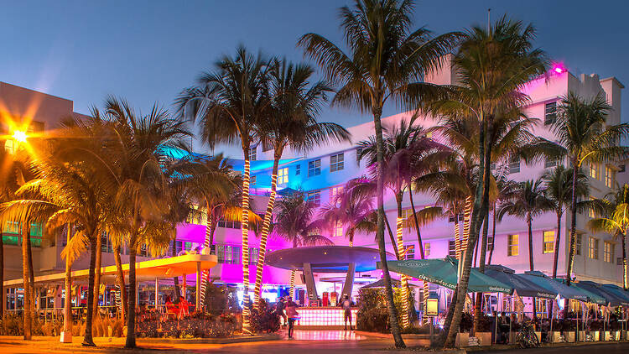
Unforgettable Outdoor Party Ideas in Miami
Looking to throw a memorable outdoor party in Miami? You're in luck! Miami is a city known for its vibrant culture and energetic atmosphere, making it the perfect backdrop for a fun and exciting gathering.
Presentations are communication tools that can be used as demonstrations, lectures, speeches, reports, and more. It is mostly presented before an audience.

Slide 3
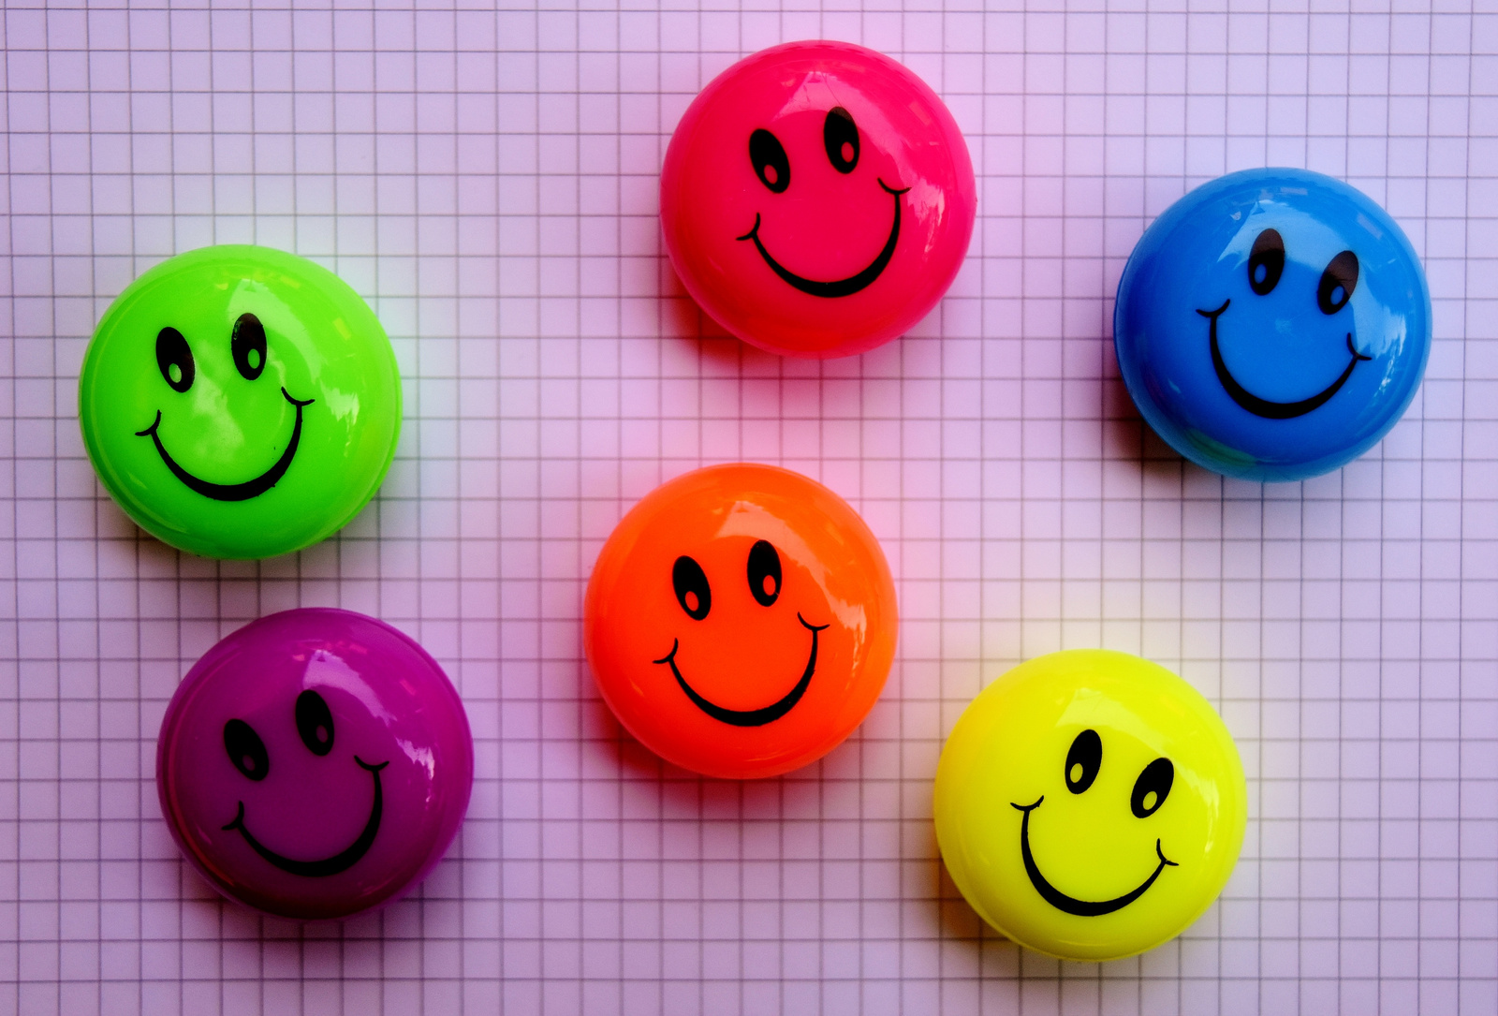
Fun for All Ages
No party is complete without exciting entertainment, and Miami has it in abundance. From talented magicians to lively DJs and skilled musicians, you can find a variety of Miami Party Entertainment options to suit your preferences.
Presentations are communication tools that can be used as demonstrations, lectures, speeches, reports, and more. It is mostly presented before an audience.

Slide 4
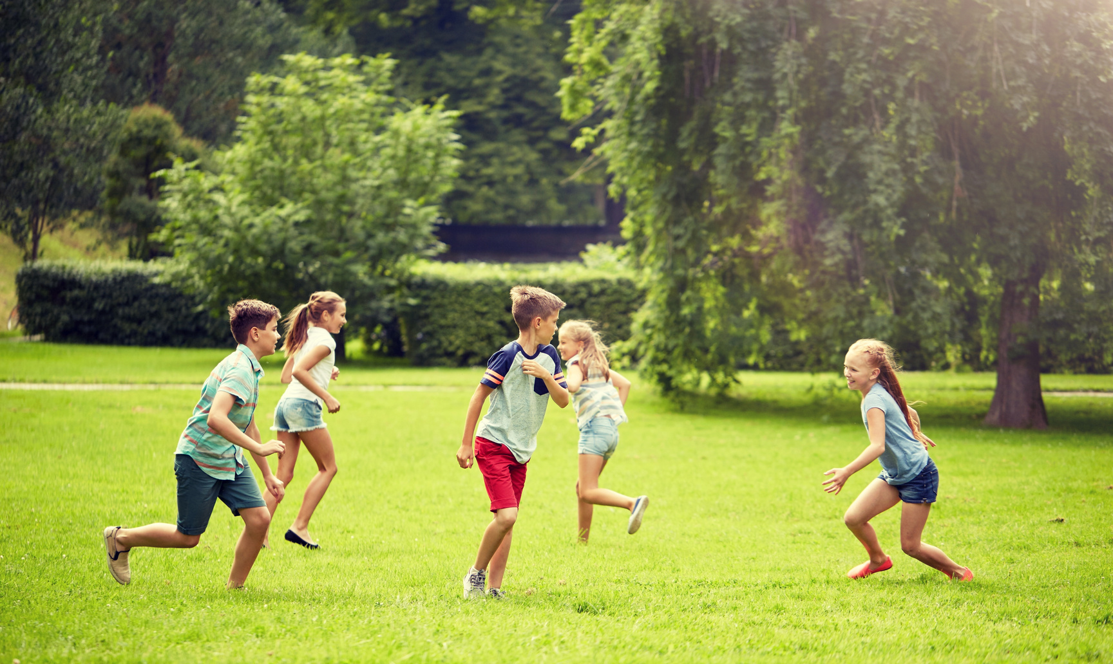
Outdoor Games and Activities
Take advantage of Miami's fantastic weather and plan outdoor games and activities that will keep your guests entertained throughout the event. Set up a friendly competition with games like cornhole, giant Jenga, or a mini soccer tournament.
Presentations are communication tools that can be used as demonstrations, lectures, speeches, reports, and more. It is mostly presented before an audience.

Slide 5
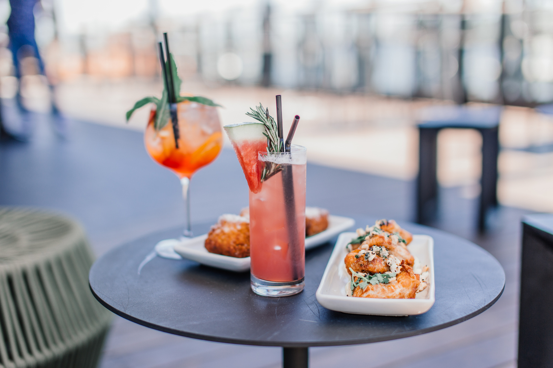
Food and Drink
No party is complete without delicious food and refreshing drinks. Miami offers a wide array of catering options to suit every taste and budget. From food trucks serving gourmet street food to professional caterers offering a diverse menu, you can create a culinary experience that will leave your guests satisfied.
Presentations are communication tools that can be used as demonstrations, lectures, speeches, reports, and more. It is mostly presented before an audience.

Slide 6
Website : https://mamamiamagic.com
Email : info@mamamiamagic.com
Contact Us
Address : 10691 SW 155th Pl APT 1513, Miami, FL 33196, United States
Phone : (786) 769-3385

Slide 7
THANK YOU

