Slide 1








Cathay Pacific
Travel Tips & Policy Overview
Airline Baggage Guide
Cathay Pacific Carry-On Baggage Policy: Size, Weight Limits & Travel Tips
Pack Smart, Fly Smooth: Know Your Cathay Pacific Baggage Rules Before You Travel
Need Help? Call
+1-888-212-0809
https://www.airflypolicy.com/

Slide 2
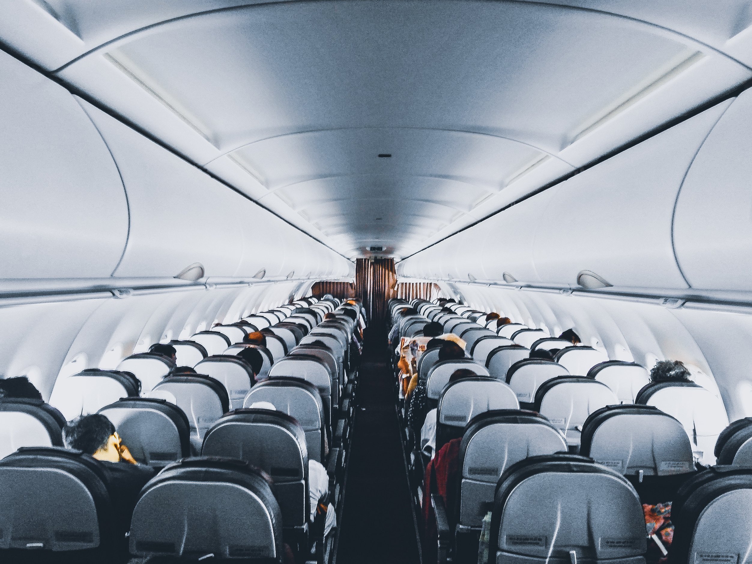

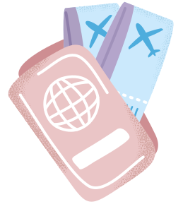
Cathay Pacific Carry-On Baggage Policy
Introduction
Why Baggage Rules Matter
Understanding Cathay Pacific baggage rules simplifies your journey and helps you avoid airport surprises. The airline provides clear guidelines for cabin bags, personal items, and checked luggage, though allowances vary by travel class and route. This guide covers size limits, weight restrictions, and practical packing tips for both business and leisure travelers.

Slide 3



Cabin Class & Ticket Type
Carry-on allowance depends on your cabin class and ticket type.
Carry-On Allowance
Main Cabin Bag + Personal Item
Cathay Pacific Baggage Basics
Passengers may bring one main cabin bag plus one personal item under the seat.
Size Requirements Apply
Cabin bags must meet Cathay Pacific size requirements.
Verify Before Departure
Check updated allowance before departure and pack to avoid boarding delays.

Slide 4





Cathay Pacific Carry-On Baggage Policy
Personal Item Size & Cabin Bag Rules
Know Your Baggage Rules
Personal items must fit comfortably under the seat in front of you. Common examples include small bags, backpacks, and laptop cases. Keep travel documents easily accessible and check route-specific requirements before flying.
Small Bags
Backpacks
Personal Items
Cabin Bag Rules

Slide 5



Is Cathay Pacific Strict About Carry-On Size?
Size Enforcement
Tip
Cathay Pacific expects cabin bags to match approved dimensions. Airport staff may inspect baggage size at check-in or boarding, so lightweight packing and staying within the allowance helps avoid delays and extra handling before your flight.
Pack Within Limits

Slide 6
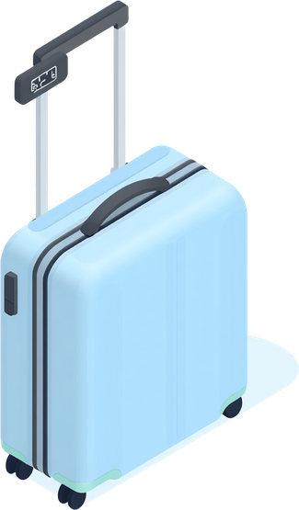


Cathay Pacific Carry-On Baggage Policy
Carry-On Baggage Weight Limit Explained
Weight Limits & Handling Tips
Weight allowance varies by ticket category, and heavy cabin bags may not be accepted onboard. Balance belongings for easier handling, keep valuables inside cabin baggage, and follow Cathay Pacific weight limit guidelines for smooth travel.

Slide 7

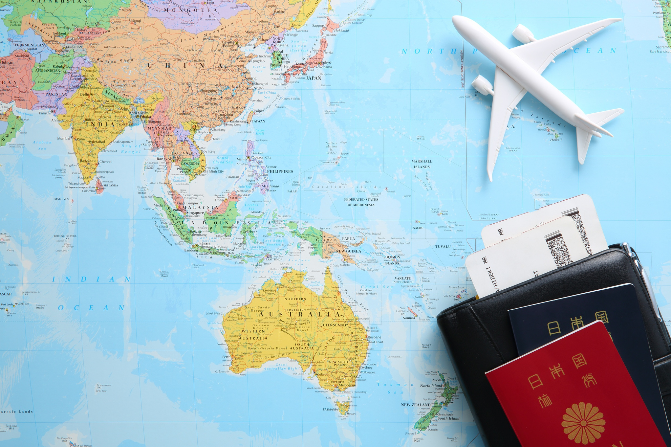



Carry-On Essentials
What Is Allowed in Carry-On Luggage?
Pack Smart for Screening
Keep travel documents, electronics, and valuables inside your cabin bag. Follow security rules for liquids and personal care items, avoid restricted or prohibited goods, and organize belongings so they are easy to inspect at airport screening.

Slide 8


Cathay Pacific Checked Baggage
How Many Bags Can You Check for Free on International Flights?
Checked Baggage Allowance
Free checked baggage on Cathay Pacific international flights depends on your itinerary and cabin class. Confirm your allowance before travel, as extra baggage rules differ by route. Pack within permitted limits to avoid fees and review your booking details for accurate information.

Slide 9
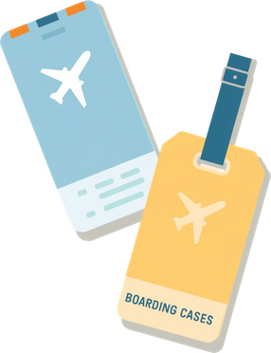


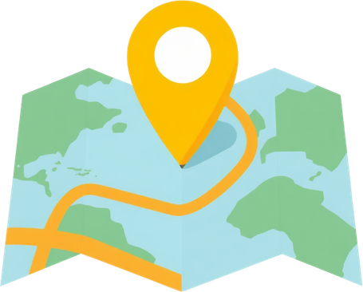

Cathay Pacific Baggage Guide
Plan Your Bags Right
Conclusion
Proper baggage planning keeps your journey comfortable and hassle-free. Understanding cabin bag size, personal item rules, and weight limits helps avoid airport complications. Follow Cathay Pacific’s baggage limits for smooth boarding, and always check the latest airline guidelines before departure.

Slide 10





Need Help With Airline Baggage Policies?
airflypolicy.com
+1-888-212-0809
AirFlyPolicy – Your Guide to Airline Travel Information

