Slide 1




API AUTOMATION TESTING 101:
A BEGINNER’S GUIDE TO FASTER RELEASES
www.karatelabs.io

Slide 2
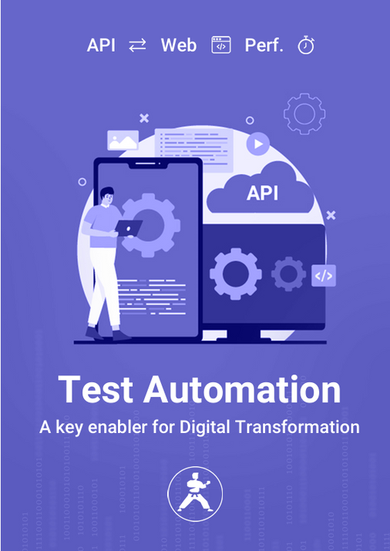
INTRODUCTION
API automation testing helps teams check if these connections are working properly. It does this quickly and without human effort. Apps like online shopping platforms, banking systems, and social media rely on APIs. If these connections break, users face issues. Automated testing avoids errors and speeds up releases, it saves a lot of time.
www.karatelabs.io

Slide 3
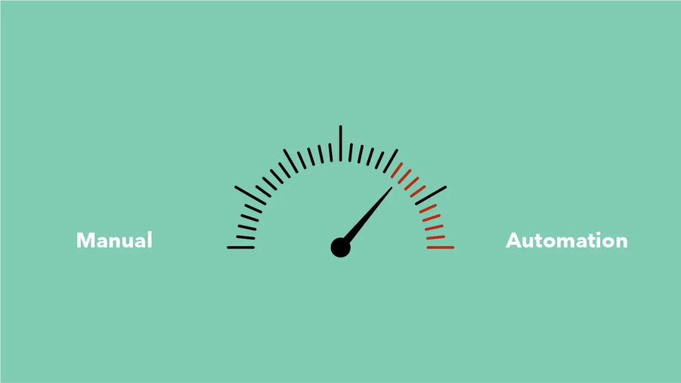
WHAT IS AN API AND WHY DOES IT NEED TESTING?
API automation testing is the process of checking if these connections work well, but without doing it manually each time. Instead of a person testing each function, a tool runs the tests automatically. This makes things quicker and easier.
Just like you check if a light switch works after fixing it, APIs need testing too. Here are some reasons:
01
To check if the right data is coming back
02
To catch problems early before users face them
03
To see how fast the API responds
www.karatelabs.io

Slide 4


WHAT CAN BE AUTOMATED IN API TESTING?
1.Response Time Checks: Tests how fast the API responds. Automation can run this often without delay.
2.Data Accuracy Tests: Verifies if the API returns correct and expected data.
3.Error Message Validation: Sends wrong input to see if the API gives proper error responses.
4.Security Testing: Checks if access is limited to allowed users only.
www.karatelabs.io

Slide 5
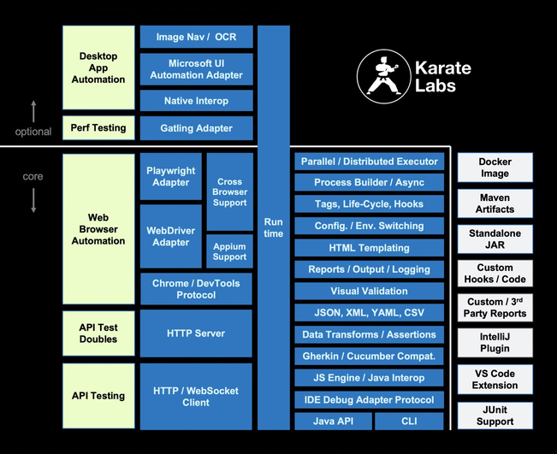
CHOOSE AUTOMATION OVER MANUAL TESTING
Manual API testing takes time and effort. Testers write each step, check results, and repeat. It works for small apps but not for fast-moving projects.
Automation uses scripts and tools to do the testing. It is quicker and runs anytime without human help.
START SIMPLE: API TESTING MADE EASY FOR BEGINNERS
If you are just starting, begin with tools that don’t need much setup. For example, Postman allows users to test APIs with a few clicks. You send a request and check the reply. Over time, you can move to more advanced tools that help run tests automatically.
www.karatelabs.io

Slide 6
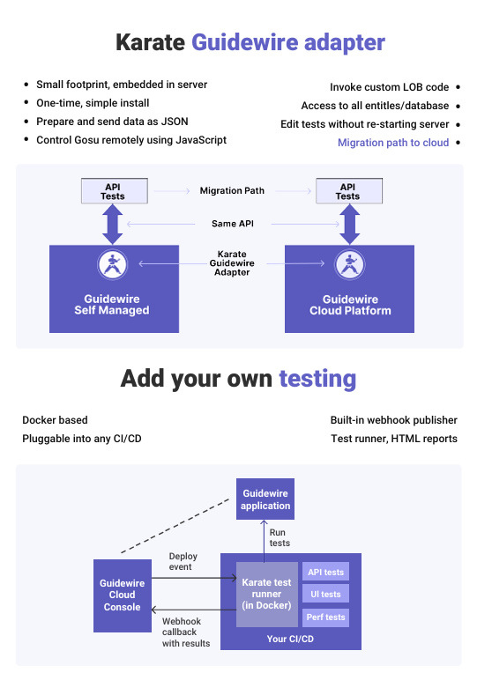
STEP-BY-STEP OF API AUTOMATION TESTING:
1.Setup the environment: Prepare the system with all required tools and test data.
2.Write test cases: These are like instructions. For example, "Send this order to the API and expect a successful response."
3.Run the tests: Use automation tools to run tests again and again. No need to write each step again.
4.Check results: The tool shows which tests passed and which failed.
5.Fix and retest: Developers fix errors. The tests are run again to confirm the fix worked.
www.karatelabs.io

Slide 7
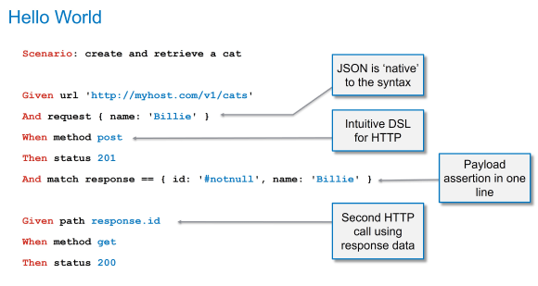
FINAL WORDS: READY TO SPEED UP RELEASES?
APIs help apps run smoothly. But to function APIs smoothly, basic testing is needed. Testing API tools reduces bugs, helps teams work faster and saves time. API automation testing is a smart step toward better software. It allows quick releases and happy users. If you are a beginner aiming for speed and accuracy with less stress, opt for tools like Karate Labs as it makes the job easier and faster. Start simple, use the right tools and keep improving.
www.karatelabs.io

Slide 8
CONTACT US
Mail :
info@karatelabs.io
Phn No :
+44 7900 225047
Address :
1507 Sandcroft Ln, Sugar Land, TX 77479, United States
Website :
www.karatelabs.io
Thank You

