Slide 1

ACHARYA SHAKTI
Art of Numbers
Best Numerologist & Astrologer in Bengaluru
Numerology • Astrology • Vastu • Spiritual Healing
Notes:
Welcome. Acharya Shakti - Art of Numbers offers numerology, astrology, Vastu and spiritual guidance in Bengaluru.

Slide 2

Who We Are
Acharya Shakti is a Bengaluru-based practice guiding people through numbers, the stars and spiritual wisdom.
We combine numerology, astrology and Vastu to give clear, practical direction for name, career, business, marriage and home.
Consult in person at our Vijayanagar studio or online, from anywhere.
Numerologist
Astrologer
Vastu Expert
Life Coach
Notes:
Introduce the practice and the four roles: numerologist, astrologer, Vastu expert, life coach.

Slide 3
Our Services
1
Numerology Consultation
2
Name Correction
3
Business Name Numerology
Personal number reading, in person or online
Align your name with your numbers
Choose a name that supports growth
4
Kundali Matching
5
Horoscope Analysis
6
Spiritual Healing
Compatibility analysis for marriage
Career, health, finance and life path
Counselling for calm and clarity
Notes:
Six core services. Details follow on the next slides.

Slide 4
Numerology: The Art of Numbers
Every name and birth date carries a vibration. Our professional numerologists read these numbers to reveal strengths, challenges and the right timing for decisions.
1
2
3
4
5
6
7
8
9
Expert Consultation
Online Sessions
Life Guidance
Personalised reading of your core numbers
Numerology consultation from anywhere
Career, relationships and finance
Notes:
Numbers 1 to 9 form the base of numerology. Mention online and in-person consultation.

Slide 5
Name Correction & Business Names
Name Correction by Numerology
Top Business Name Numerology
Small spelling changes can shift the vibration of your name. We analyse your name against your birth number and suggest a corrected spelling that supports confidence, success and harmony.
Ideal for individuals, newborns and professionals.
A business name works like an identity number. We test names for brand, logo and company against the founder’s numbers and your goals, so the name supports growth and trust.
Ideal for start-ups, shops and rebrands.
Notes:
Two high-demand services: personal name correction and business name selection.

Slide 6
Astrology & Kundali
Kundali Matching
1
Compatibility checks for a confident marriage decision
Marriage Astrology
2
Timing, harmony and guidance for married life
Horoscope Analysis
3
Career, finance, health and yearly outlook
Acharya astrology in Bengaluru, trusted for kundali matching.
Notes:
Cover kundali matching, marriage astrology and horoscope analysis.

Slide 7
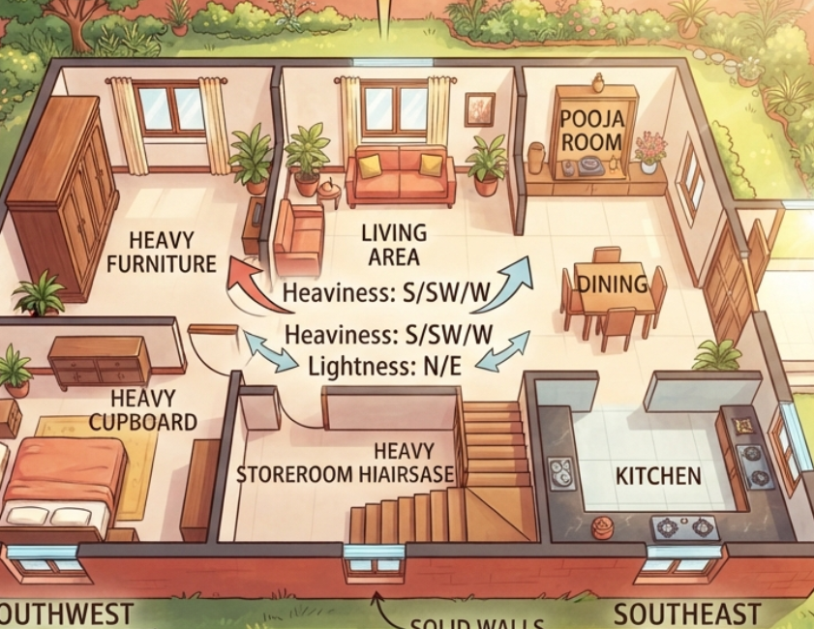
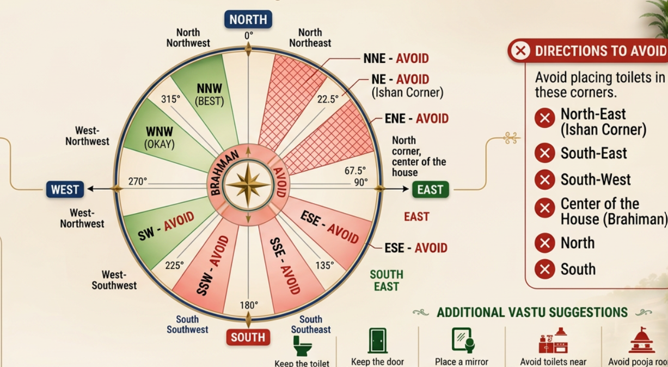

Vastu Shastra Guidance
Harmonise your home or office with directions, energy and layout.
Room placement • Entrances • Pooja room • Kitchen & toilets
Notes:
Vastu: direction-based layout advice for homes and workplaces.

Slide 8
Spiritual Healing & Life Coaching
Spiritual Healing
Spiritual Research
Life Coaching
Counselling that brings calm, balance and clarity
Insight rooted in study of numbers and the stars
Practical goals, confidence and direction
A whole-person approach: mind, name, home and stars.
Notes:
Position the spiritual and coaching side as complementary to numerology and astrology.

Slide 9
How a Consultation Works
1
→
2
→
3
→
4
Book
Share
Consult
Act
Call us or reach out online
Name, birth date and your questions
In person or online session
Clear remedies and next steps
Online numerology consultation available across Bengaluru and beyond.
Notes:
Four-step process from booking to remedies.

Slide 10
Visit or Call Us
ADDRESS
OPEN HOURS
76, 18th Cross, 20th Main Rd, Marenahalli, Vijayanagar, Bengaluru, Karnataka 560040
Tue - Sat
PHONE
9 am - 6 pm
063641 91155
Sunday
WEBSITE
9 am - 10 pm
https://share.google/Vb6AUCFrgjNy4uKjR
Monday
9 am - 5 pm
Notes:
Close with contact details and opening hours.

