Slide 1


Quora Web Solution
Website Design and
Development
Company
Web Design & Web Development
Company in Bangalore, India
www.quorawebsolution.com
+91 9986 056 909
info@quorawebsolutions.com
24A, 1st Main Rd, Chandra Reddy
Layout, Koramangala 4th Block,
Koramangala, Bengaluru,
Karnataka 560034

Slide 2
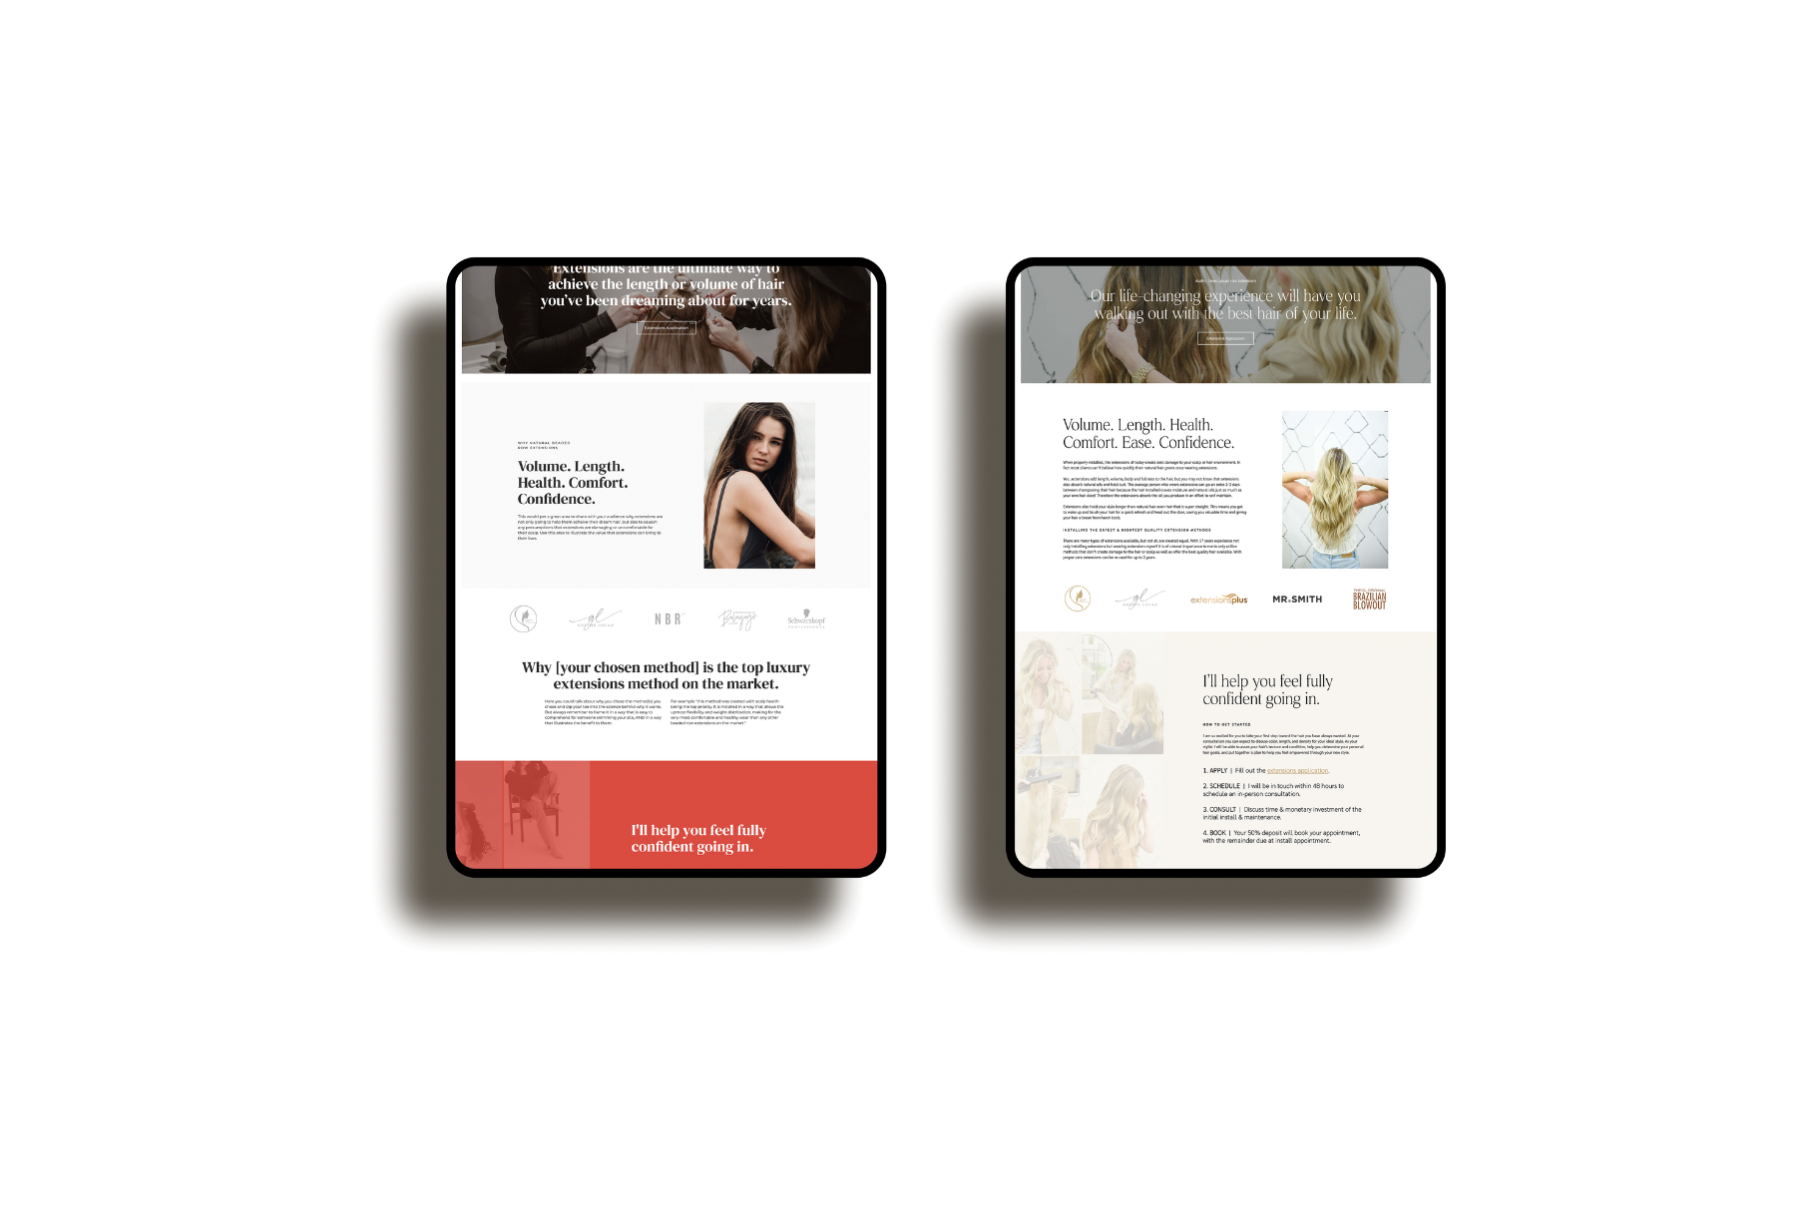
A Step-by-Step Breakdown of the Website Design and Development Process: From Idea to Launch
www.quorawebsolution.com

Slide 3
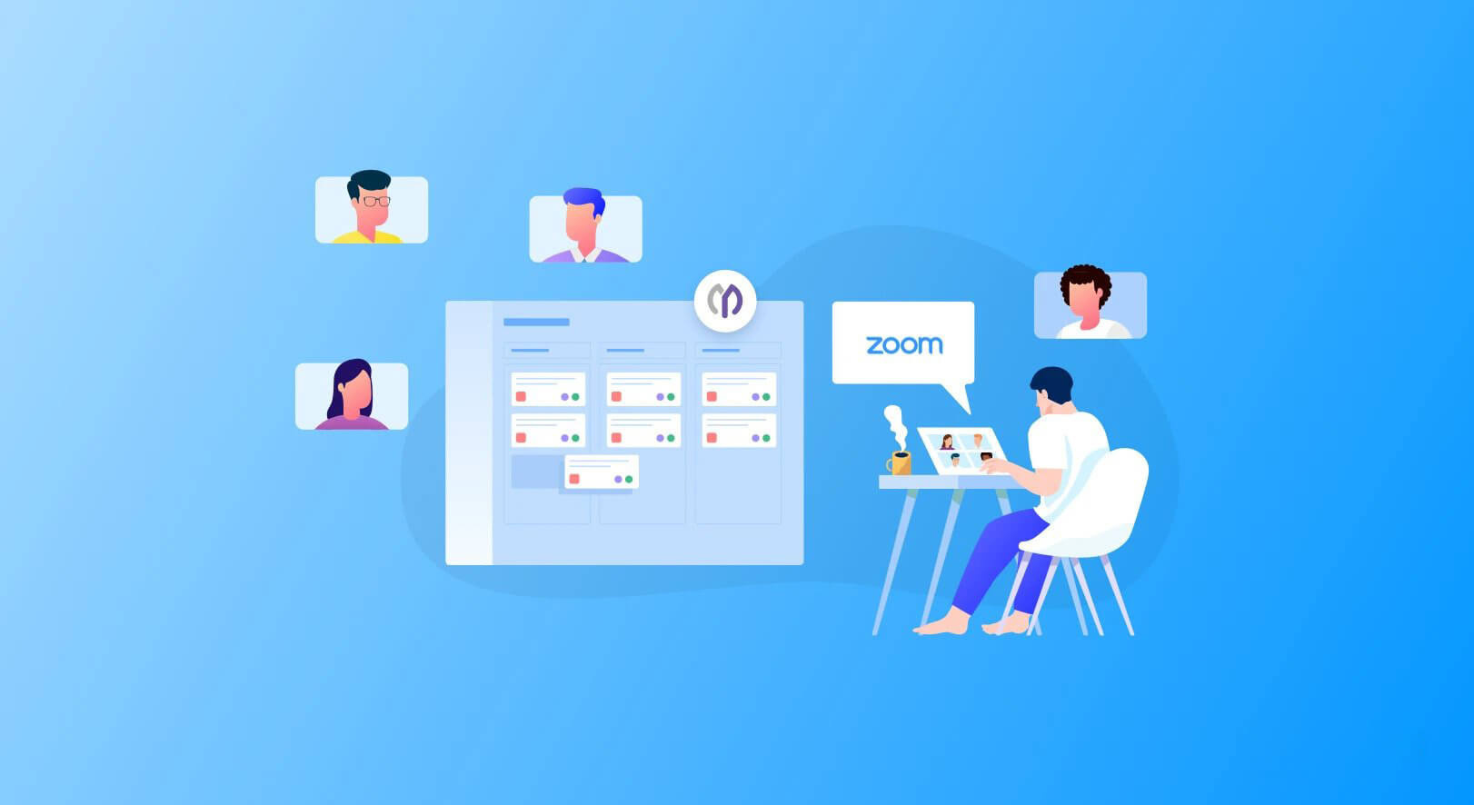
Building a website can be a daunting task, but with the right approach, the process becomes much more manageable.
www.quorawebsolution.com

Slide 4
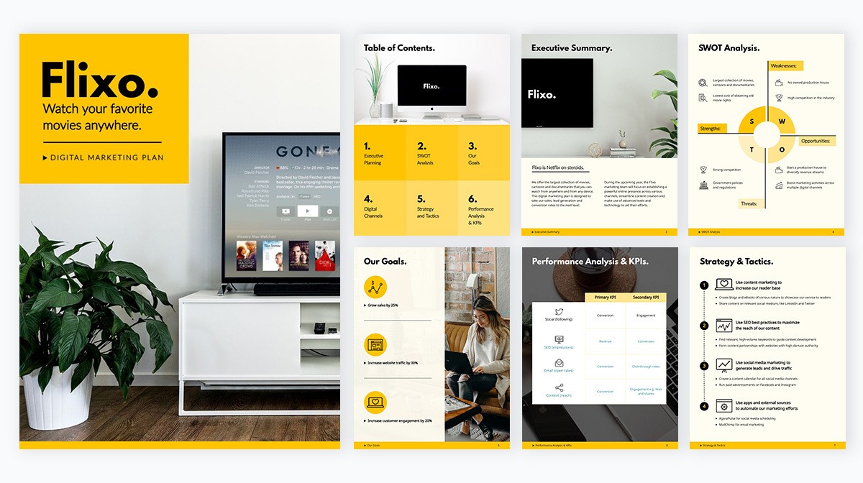
Whether you’re starting from scratch or redesigning an existing site, understanding each step of the website design and development process can help you create a site that meets your goals.
www.quorawebsolution.com

Slide 5
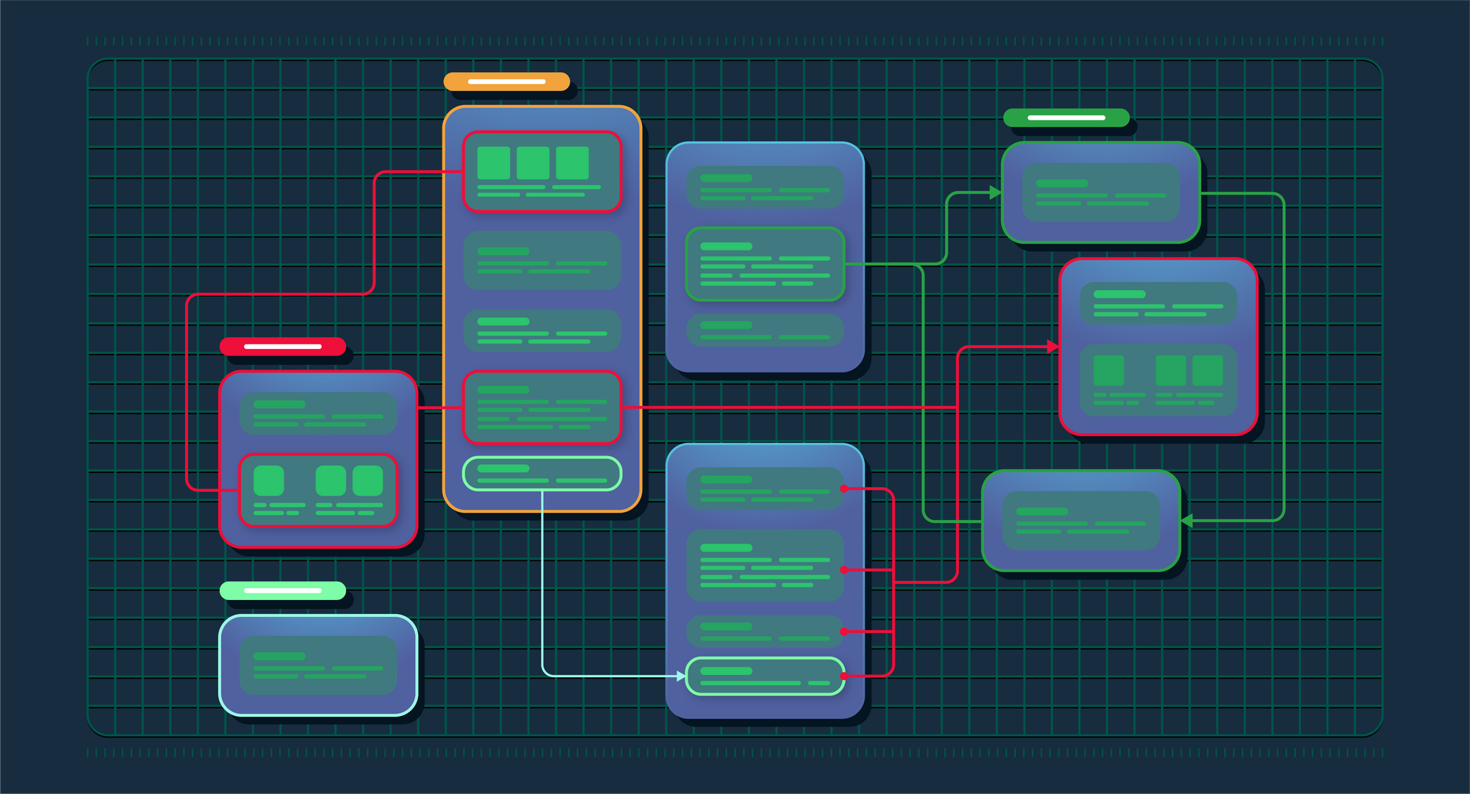
Here's a breakdown of the key phases, from concept to launch.
www.quorawebsolution.com

Slide 6
1. Initial Planning and Research
Every successful website starts with a plan. In this phase, you’ll define the project’s scope, target audience, goals, and objectives.
Goals & Purpose: Why are you building this website? Is it for business, portfolio, e-commerce, or a blog? Identifying the core purpose will guide the design and functionality.
Target Audience: Understanding your audience helps shape both design elements and user experience (UX).
Competitor Research: Look at what your competitors are doing—this can help you identify opportunities and avoid common mistakes.
2. Wireframing and Design
With a clear plan in place, the next step is to create the layout and design of the website. This typically begins with wireframes and prototypes.
www.quorawebsolution.com

Slide 7
Wireframing: These are basic, visual blueprints that outline the website’s structure. Wireframes help you visualize where content, navigation, and buttons will go.
Design Mockups: Once the wireframe is approved, the design team will create high-fidelity mockups that show how the final website will look, including colors, fonts, and images. Feedback is essential in this stage to ensure the design aligns with your vision.
3. Content Creation
Content is the backbone of your website. In this phase, you’ll create the text, images, videos, and other media that will populate your site.
Copywriting: Write compelling, clear, and SEO-friendly copy for each page.
Imagery: Gather or create high-quality images that align with your brand and enhance the user experience.
4. Website Development
www.quorawebsolution.com

Slide 8
Once the design is finalized, it’s time to turn it into a fully functioning website. This phase involves coding the site and adding interactivity.
Frontend Development: This focuses on the elements users interact with—like navigation menus, buttons, and forms. Frontend developers use HTML, CSS, and JavaScript to bring the design to life.
Backend Development: This involves setting up servers, databases, and application logic. Backend developers ensure that everything works behind the scenes, from processing forms to managing content.
Responsive Design: Ensuring your site looks and works well on mobile devices is a must. Developers make sure your site is responsive to different screen sizes and devices.
5. Testing and Quality Assurance (QA)
www.quorawebsolution.com

Slide 9
Before launching, thorough testing is essential to ensure everything works as expected.
Functionality Testing: Test all buttons, forms, and links to make sure they work correctly.
Cross-Browser Testing: Ensure your site looks great and functions well across different browsers (Chrome, Firefox, Safari, etc.).
Performance Testing: Test load times and make necessary adjustments to ensure fast page speeds.
Usability Testing: Get feedback from real users to ensure your site is easy to navigate and user-friendly.
6. Launch and Post-Launch Maintenance
After testing and approval, it’s time to launch your website to the public.
Final Deployment: The website is moved from the development environment to the live server. Make sure to back up everything and ensure proper security measures are in place.
www.quorawebsolution.com

Slide 10
Post-Launch Monitoring: After launch, monitor the website for any performance issues, bugs, or user feedback that might arise.
Ongoing Maintenance: Websites need regular updates, including software upgrades, content refreshes, and bug fixes. Regular maintenance ensures the site stays secure and functional.
Conclusion
Building a website is a multi-step process that requires careful planning, collaboration, and attention to detail. By following these steps—from initial planning to post-launch maintenance—you can create a website that meets your goals, engages your audience, and performs well across devices. While the process may seem complex, breaking it down into clear phases makes it more manageable and sets you up for success.
Creating a Seamless Online Experience: The Importance of Integrating Website Design with Advanced Development Techniques
www.quorawebsolution.com

Slide 11
In today’s fast-paced digital world, users expect a smooth and intuitive online experience. Whether it’s browsing, shopping, or interacting with content, a seamless website is crucial to keeping visitors engaged and ensuring they return. Achieving this seamless experience requires more than just aesthetic design—it requires a smart integration of design and advanced development techniques. Here’s why combining both is so important for creating an exceptional online experience.
1. User-Centered Design Meets Robust Functionality
Great design isn’t just about looks—it’s about usability. When website design is closely integrated with advanced development, it allows for more intuitive and user-friendly interfaces.
Design & Development Harmony: A well-thought-out design works hand-in-hand with backend functionality.
www.quorawebsolution.com

Slide 12
For example, a beautifully designed product page with clear visuals can be let down by a slow, buggy checkout process. When design and development are integrated from the start, it ensures both front-end and back-end elements complement each other, resulting in a smooth user journey.
Custom Interactions: Advanced development enables complex user interactions like dynamic content, hover effects, or personalized recommendations. When these elements are built into the design process, it ensures that the user experience feels cohesive and seamless, rather than feeling like separate functions pieced together.
2. Optimized Performance Across Devices
Today, users access websites on a range of devices—smartphones, tablets, laptops, and desktops—each with different screen sizes and capabilities.
www.quorawebsolution.com

Slide 13
Advanced development techniques, like responsive web design and mobile-first development, ensure that a website looks and performs well no matter the device.
Responsive Design: By using flexible layouts and scalable images, the website adjusts to different screen sizes without compromising design or functionality.
Speed Optimization: Site speed is critical to both user satisfaction and SEO rankings. Advanced development practices, such as lazy loading, image compression, and efficient coding, ensure fast load times without sacrificing design quality.
3. Enhanced SEO and User Experience
SEO (Search Engine Optimization) and user experience (UX) are closely linked.
www.quorawebsolution.com

Slide 14
A well-optimized site that loads quickly, has clean code, and offers a smooth experience ranks better on search engines and keeps visitors engaged.
SEO-Friendly Design: Integrating SEO best practices into both the design and development process—such as structuring content with proper HTML tags, creating mobile-friendly layouts, and using schema markup—helps search engines understand and rank your content better.
User Experience Considerations: Incorporating UX principles during the development phase, such as ensuring easy navigation, fast load times, and clear calls-to-action, improves both user satisfaction and SEO performance.
4. Security and Scalability
Web security and scalability are key to maintaining a site’s integrity, especially as traffic and data increase.
www.quorawebsolution.com

Slide 15
Advanced development techniques like secure coding practices, regular updates, and encryption measures protect both user data and site functionality.
Security Integration: Designing with security in mind—by considering secure logins, HTTPS encryption, and protecting against common vulnerabilities—ensures users feel safe and trust the website.
Scalability: As your business grows, your website needs to scale. A well-integrated design and development approach ensures that the site can grow alongside your business, with the ability to add new features or handle increased traffic without performance drops.
5. Real-Time Data and Personalization
Today’s websites need to deliver dynamic, personalized content to users.
www.quorawebsolution.com

Slide 16
Whether it’s recommending products based on past purchases or showing location-specific offers, these features rely on advanced development techniques working in tandem with the site’s design.
Personalized Experience: By integrating APIs and data-driven development into the design process, you can offer a more engaging and tailored experience for your visitors, leading to increased engagement and conversion rates.
Real-Time Updates: Advanced development enables real-time interactions, such as live chat, notifications, or changing content based on user behavior, all of which can be incorporated seamlessly into the website’s design.
Conclusion
www.quorawebsolution.com

Slide 17
A seamless online experience doesn’t just happen by chance—it’s the result of integrating cutting-edge design with advanced development techniques. By aligning both elements from the start, you can create a website that not only looks great but also functions smoothly, performs well across devices, enhances SEO, and delivers personalized experiences. This holistic approach ensures that your website will keep users engaged and provide long-term value to your business.
www.quorawebsolution.com

Slide 18
Quora Web Solution: Quora Web Solution is a trusted website development company based in Bangalore, India, offering a wide array of services to not only domestic but global clientele. Be it Website Design and Development, SEO services, Digital Marketing, Branding, App Development, Ecommerce Solution, and Logo Creation . Quora Web Solution has the best website developers offering top quality services and that is the reason why we are well known as one of the best Website Development Companies in Bangalore, India.
Visit Us - www.quorawebsolution.com
Call Us - +91 9986 056 909
Mail Us - info@quorawebsolutions.com
www.quorawebsolution.com

Slide 19

WORDPRESS DEVELOPMENT
ECOMMERCE DEVELOPMENT
PHP DEVELOPMENT
CMS DEVELOPMENT
DRUPAL DEVELOPMENT
WEBSITE SERVICES
WEBPORTAL DEVELOPMENT
MAGENTO DEVELOPMENT
WEBSITE DEVELOPMENT
JOOMLA DEVELOPMENT
SMALL BUSINESS DEVELOPMENT
CHEAP WEBSITE DEVELOPMENT
STATIC WEBSITE DEVELOPMENT
DYNAMIC WEBSITE DEVELOPMENT
WEBSITE DESIGN COMPANY
TOUR AND TRAVEL WEBSITE DEVELOPMENT
Services

