Slide 1


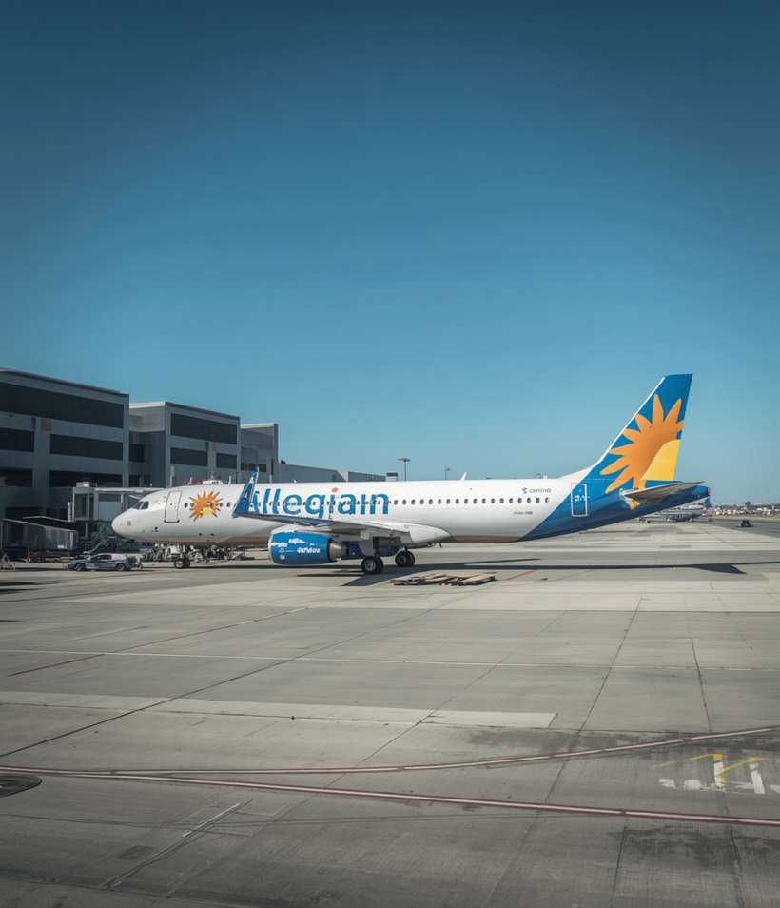
Allegiant Air | Flight Update
Why Is Allegiant Cancelling Flights to Florida Today?
+1-888-212-0809
Understanding allegiant flights to florida cancellations on July 9, 2026

Slide 2


Overview of Allegiant Flights to Florida Cancellations
Multiple Allegiant flights to Florida have been cancelled on July 9, 2026, disrupting travel for thousands of passengers. Florida ranks as one of Allegiant's top destinations, with dozens of daily routes serving cities like Orlando, Tampa, Fort Lauderdale, and Miami. Today's cancellations impact key routes across the state, leaving passengers stranded or facing significant delays. Allegiant Airlines operates more Florida-bound flights than almost any other budget carrier, making today's disruptions especially widespread.

Slide 3


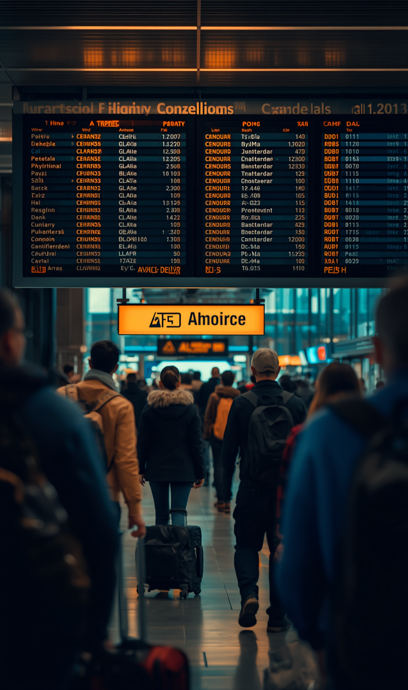

Main Reasons for Cancellations
Weather Disruptions: Storms, strong winds, and severe weather patterns near Florida airports are forcing ground stops and rerouting.
Operational Challenges: Crew shortages and aircraft maintenance or technical issues are limiting available flights on allegiant flights to florida routes.
Air Traffic Control: ATC delays and airspace restrictions over Florida are compounding scheduling problems.
Logistical Complications: Cascading scheduling conflicts specific to allegiant flights to florida today are causing further widespread cancellations.

Slide 4


Impact on Passengers & Allegiant's Response
BEFORE: Allegiant flights to Florida were operating as scheduled, with passengers checked in and boarding on time. Routes to Orlando, Tampa, Fort Lauderdale, and Miami proceeded without disruption, as originally planned for July 9, 2026.
AFTER: Widespread cancellations and delays left passengers stranded at gates. Allegiant's response includes rebooking on the next available flights, full refunds for cancelled itineraries, and proactive customer communications via email and SMS. Tip: Contact Allegiant support at 702-505-8888, check allegiantair.com for updates, and keep your travel insurance details handy to minimize disruption.

Slide 5
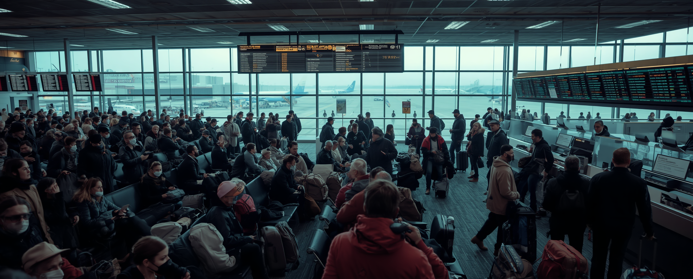
On the Ground: Allegiant Flights to Florida Disruption
July 9, 2026 — Passengers at Florida-bound gates face mounting delays as multiple Allegiant flights to Florida are cancelled today. Crowded terminals, long queues at service desks, and stranded travelers paint a vivid picture of the disruption. Affected passengers are urged to check flight status, contact Allegiant customer service for rebooking options, and monitor official channels for the latest updates.

Slide 6
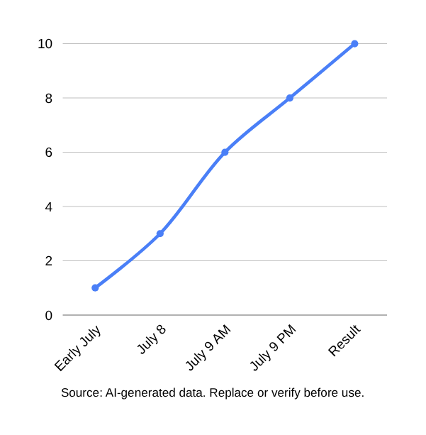
Flight Cancellation Timeline
Early July: Weather forecasts warn of potential storms near Florida airports, raising concerns for Allegiant routes.
July 8: Crew scheduling challenges emerge, leaving several Florida-bound flights understaffed.
July 9 AM: Technical inspections ground multiple aircraft, causing cascading delays.
July 9 PM: Air traffic control restrictions compound existing issues, blocking Florida airspace.
Result: Multiple Allegiant flights to Florida cancelled on July 9, 2026.

Slide 7


• Check your flight status online at allegiant.com before heading to the airport — real-time updates can save you a wasted trip.
• Contact Allegiant customer service immediately to explore rebooking options or request a refund for cancelled allegiant flights to florida.
• Arrive early at the airport and prepare for longer-than-usual wait times at check-in and gate areas.
How to Manage Your Allegiant Flights to Florida Disruption
• Stay updated via Allegiant's official social media channels and website for the latest announcements on allegiant flights to florida disruptions.
• Keep your travel insurance information handy — file a claim promptly if your policy covers flight cancellations or delays.
• Stay calm and patient: Allegiant staff are working to assist all affected passengers as quickly as possible.

Slide 8


What's Next for Allegiant Flights to Florida?
Allegiant is actively monitoring weather and operational conditions to resume allegiant flights to florida as soon as possible. Passengers should continue checking flight status online before heading to the airport. For rebooking or refunds, contact Allegiant customer service directly. Stay updated via Allegiant's official website and social media channels. Keep travel insurance information handy if applicable. Stay informed and plan accordingly to minimize disruption — thank you, and please reach out with any questions.

Slide 9

Thank You!
Questions & Follow-Up Welcome

