Slide 1

PACKETTALK

Slide 2
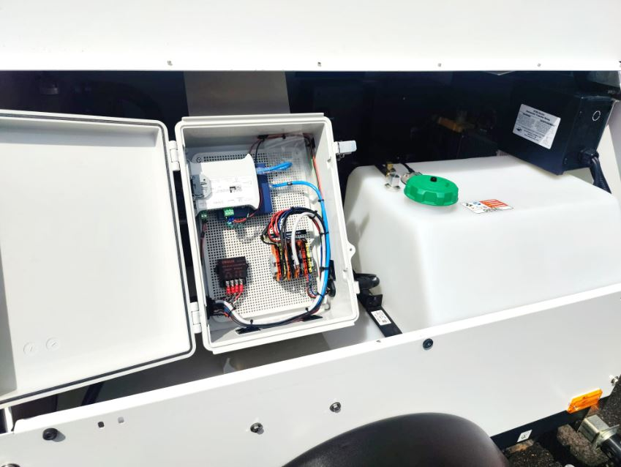
Security Cameras Company / Best Business Surveillance System
Setup the Packetalk’s Security Cameras at your Company is one of the smartest moves you can make for enhanced safety and peace of mind. All its cameras are equipped with advanced features to capture every detail, including fast-moving objects with remarkable clarity. This makes them an invaluable tool for deterring criminal activities and maintaining the safety of public and other spaces. To find more information about Packetalk’s reliable surveillance solutions, visit the website.
The Best Business Surveillance System is not just a camera, but it's a comprehensive solution designed to ensure safety, boost productivity, and protect assets. Its high-definition cameras provide crystal-clear video quality that captures even the smallest detail. With advanced motion detection capabilities, you’ll receive real-time alerts for unusual activities, which will help you respond swiftly to potential security threats. If you want to know more about this product, visit Packetalk!

Slide 3
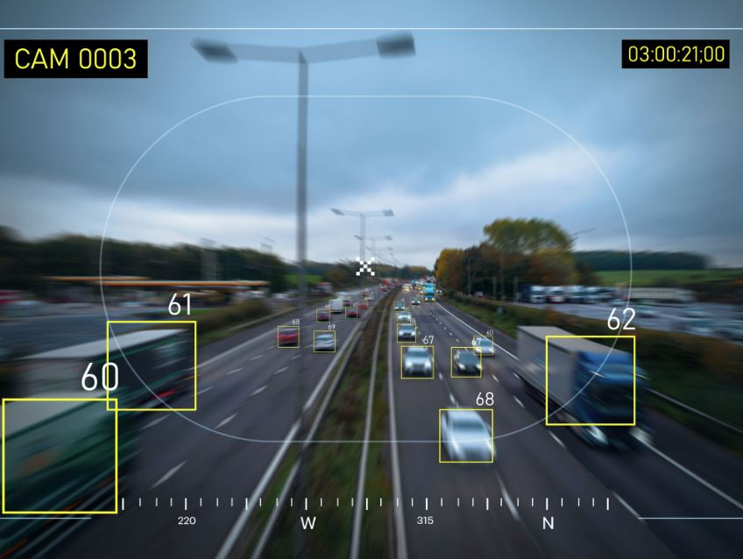
Outdoor Camera and Light / Outdoor Surveillance Camera System
When it comes to Outdoor Camera and Light, Packetalk stands out as the perfect choice, thanks to its advanced technology. With its features, Packetalk allows you to monitor your surroundings effectively and provides a reliable way to reduce risks such as fraud and criminal activity. These innovations not only enhance security but also contribute to creating a safer and more secure environment for the public. Whether it’s for businesses, public spaces, or residential areas, Packetalk combines functionality and peace of mind in one comprehensive solution. For more details about its capability, click on the website.
An Outdoor Surveillance Camera System is an essential tool of Packetalk for enhancing security in residential, public, and commercial spaces. Its advanced features, like motion detection, night vision, and wide-angle lenses, enable these cameras to provide 24/7 monitoring, ensuring no detail goes unnoticed. It's also easily integrated with smart devices, which allows users to receive real-time alerts and monitor activity remotely through their smartphones. For installing this device in your space, call today at (201) 355- 3323.

Slide 4

Good Outdoor Camera System
Built to protect public space, the Packetalk Good Outdoor Camera System is crafted with durable materials that ensure long-lasting performance in any outdoor setting. Its advanced technology delivers crystal-clear images and video, even in low-light environments that making it perfect for 24/7 surveillance. What truly sets Packetalk apart is its seamless integration with smart devices and its intuitive app, allowing users to monitor their property in real time from anywhere in the world. To get more information about Packetalk’s products, tap below on the link.

Slide 5
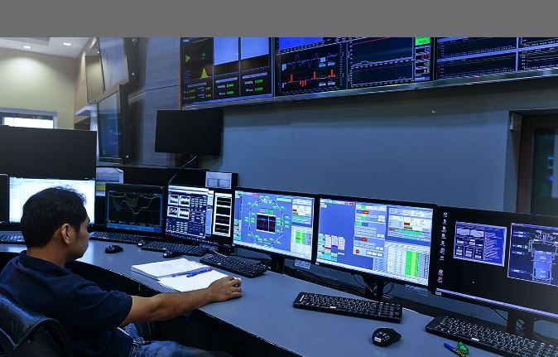
Solar Camera Trailer / Surveillance Camera Trailer
A Solar Camera Trailer from Packetalk is an innovative solution for ensuring safety and security on construction sites and other areas requiring constant monitoring. Designed for convenience and efficiency, this portable system can be easily installed anywhere and eliminating the need for complex infrastructure. With its real-time monitoring capabilities, it allows you to keep a close eye on your site activities, no matter where you are. The camera's advanced technology ensures high-quality footage, even in low-light conditions which making it a reliable choice for around-the-clock surveillance. For more information, follow the website.
Packetalk stands out as the premier platform for Surveillance Camera Trailer that offering unmatched live video streaming capabilities at development locations. Its feature plays a crucial role in reducing criminal activities and fostering a secure environment for everyone involved. What truly sets Packetalk apart is its full camera customization options, allowing users to tailor their systems with advanced PTZ functionality. Whether you need ALPR (Automatic License Plate Recognition), video analytics, people counting, or even thermal imagery, Packetalk provides the best solutions to enhance surveillance precision and effectiveness. To learn more, click on the link.

Slide 6
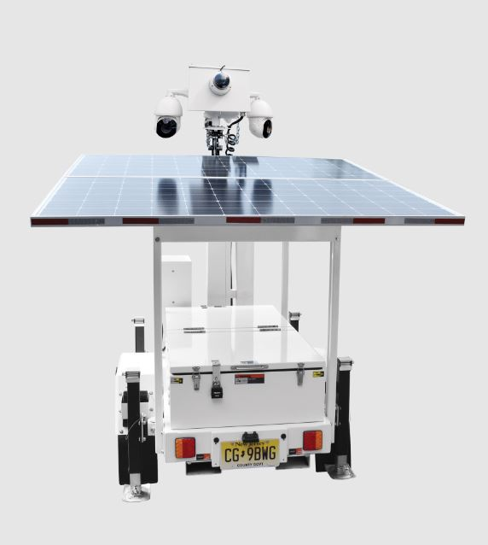
Trailer Surveillance Camera / Solar Powered Video Surveillance Camera
Keep your surroundings secure with the Trailer Surveillance Camera from Packetalk. Designed for 24/7 monitoring, this innovative solution ensures maximum safety by capturing unauthorized activity and delivering real-time alerts straight to you. Its ability to capture high-speed moments and provide clear footage, even in challenging lighting conditions, makes it a reliable choice for any place. The best part? It’s incredibly easy to install in any location and offers a hassle-free way to enhance security and maintain peace of mind. For more details, visit the website.
Solar Powered Video Surveillance Camera of Packetalk operates independently of traditional power sources which making it an ideal solution for remote locations or other areas. By harnessing energy from the sun, it provides uninterrupted monitoring, ensuring that every moment is captured without compromise. Plus, its advanced technology, such as motion detection and night vision, enhances its effectiveness in identifying potential threats at any time of day or night. To get more information about this camera, visit Packetalk!

Slide 7
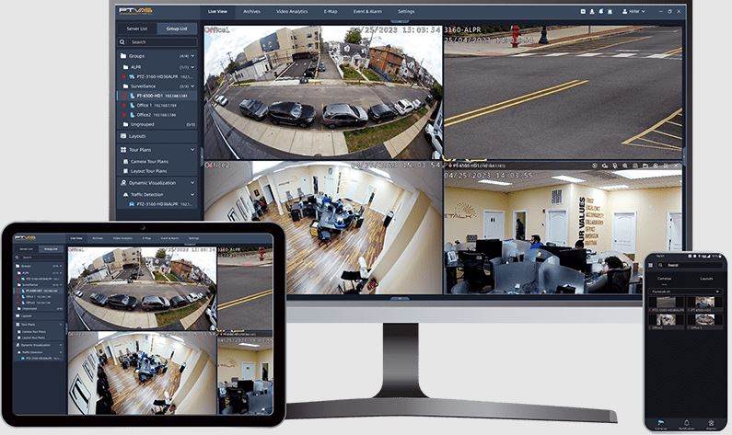
LPR Software / CCTV Analytics Software
By automating the process of identifying and recording license plate numbers, Packetalk’s LPR Software allows authorities to respond faster and more effectively to potential threats. It aids in tracking stolen vehicles, identifying suspects in criminal activities, and enforcing traffic laws with unparalleled precision. Additionally, its advanced capability reduces human error, ensuring greater accuracy in monitoring high-risk areas or managing entry points in secure spaces. If you want to get more information about this application, call now at (201) 355- 3323.
CCTV Analytics Software is provided by Packetalk, which enables real-time detection of unusual activity, automates incident alerts, and even analyzes patterns to prevent potential threats. From retail stores deterring shoplifting to large-scale enterprises, this software improves perimeter security. Investing in this advanced solution of Packetalk not only strengthens your protective measures but also provides valuable insights to optimize monitoring operations. For more details, visit the website.

Slide 8
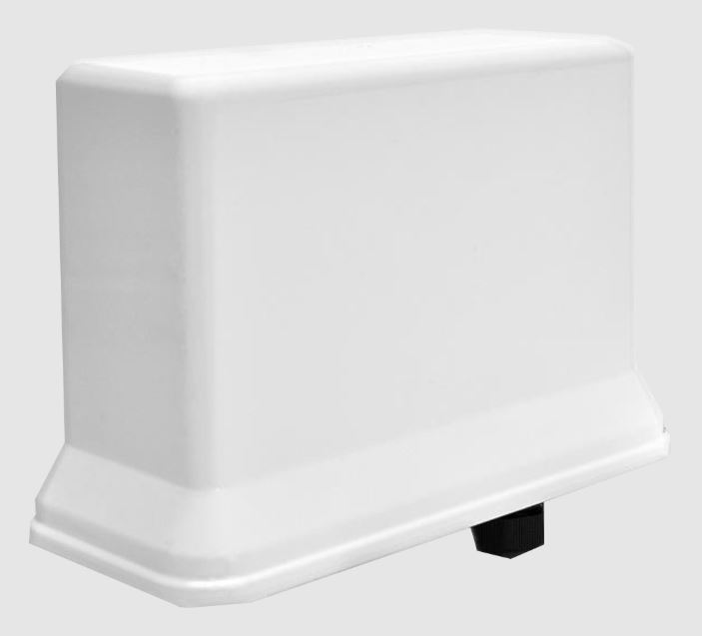
Video Monitoring System Software
With advanced features, including real-time video streaming, Packetalk's Video Monitoring System Software ensures users can access live feeds from multiple locations seamlessly. It provides alert notifications to any unusual activity, reducing response times and improving situational awareness. Plus, it also integrates high-definition video recording with customizable storage options, ensuring all critical footage is securely saved for review when needed. To learn more about its capability, visit Packetalk today!

Slide 9

packetalk.net

