Slide 1


Quora Web Solution
Website Design and
Development
Company
Web Design & Web Development
Company in Bangalore, India
www.quorawebsolution.com
+91 9986 056 909
info@quorawebsolutions.com
24A, 1st Main Rd, Chandra Reddy
Layout, Koramangala 4th Block,
Koramangala, Bengaluru,
Karnataka 560034

Slide 2
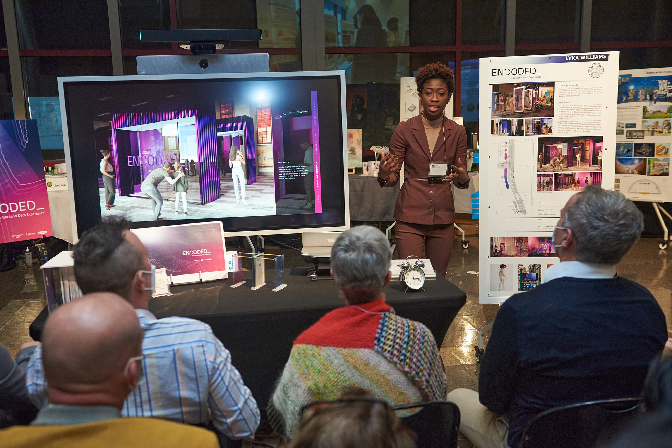
Experiential Website Design & Development: Crafting Immersive Digital Journeys
www.quorawebsolution.com

Slide 3
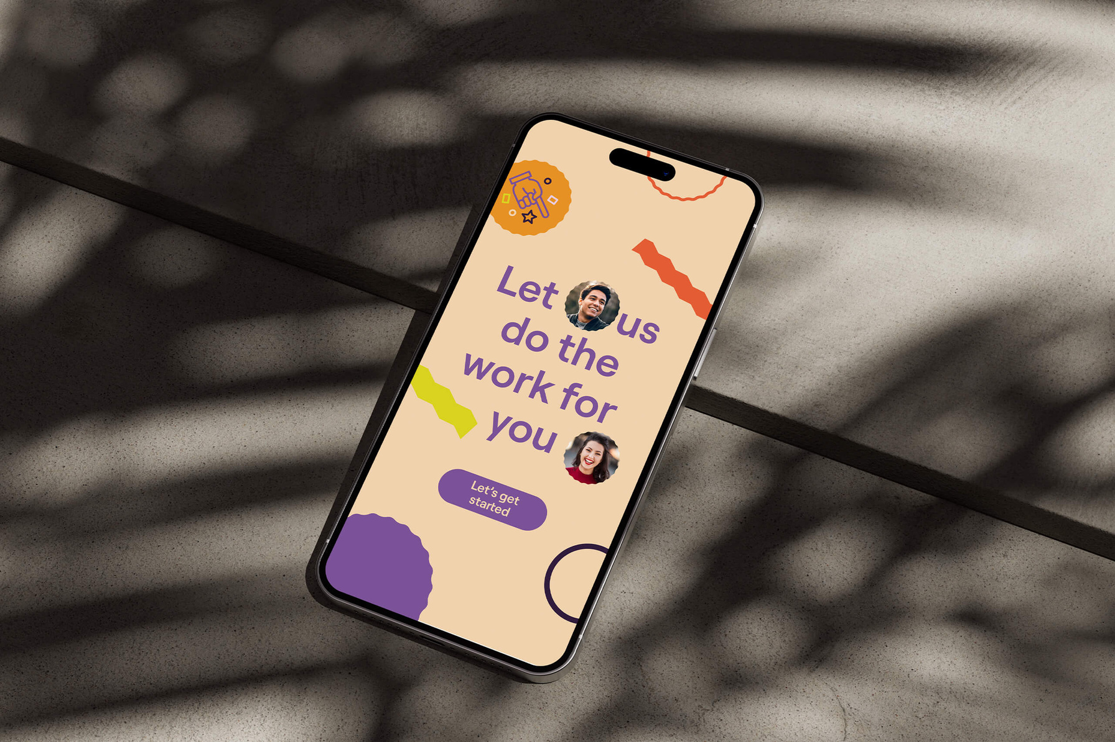
Introduction
In today's fast-paced digital world, websites are no longer just static platforms for information.
www.quorawebsolution.com

Slide 4
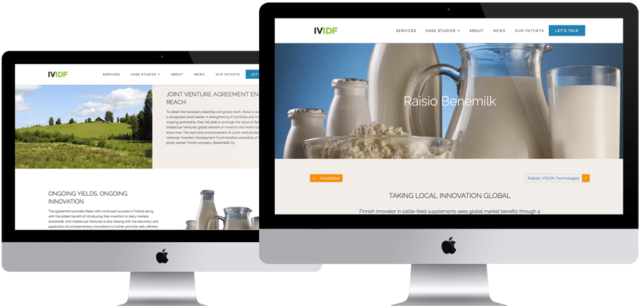
They have evolved into immersive experiences that captivate audiences and leave a lasting impression.
www.quorawebsolution.com

Slide 5
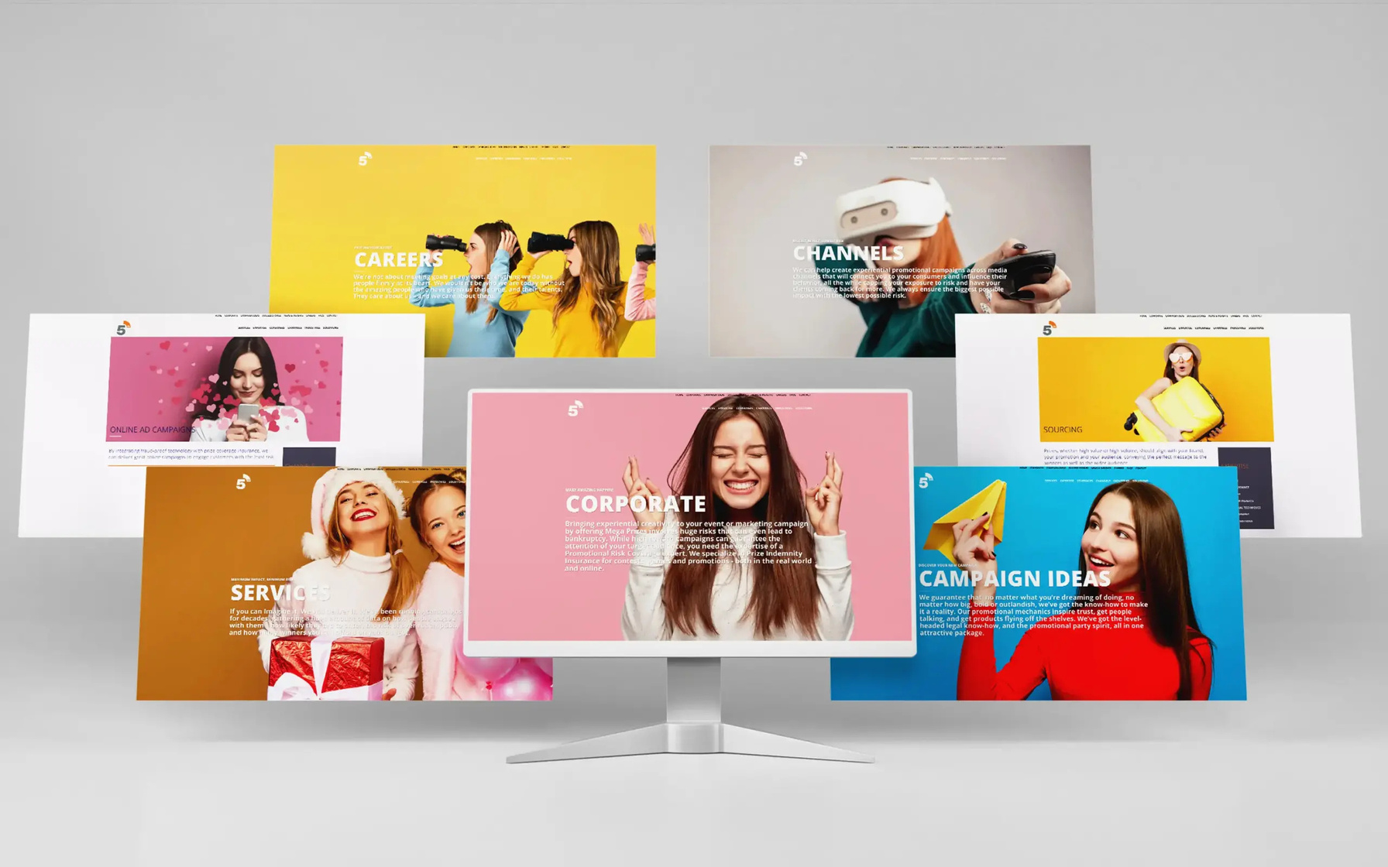
1 Experiential website design and development focuses on creating interactive, engaging, and emotionally resonant online experiences that go beyond the traditional boundaries of web design.
www.quorawebsolution.com

Slide 6
2
What is Experiential Website Design?
Experiential website design is an approach that prioritizes user experience and emotional connection over mere functionality.3 It leverages innovative technologies and design techniques to create websites that feel more like interactive installations or digital art pieces than traditional websites.4
Key Elements of Experiential Website Design
  Interactive Elements: Incorporating interactive elements like animations, parallax scrolling, 360-degree views, and virtual reality (VR) experiences to engage users and encourage exploration.5
  Storytelling: Weaving compelling narratives through the website's design and content to create an emotional connection with the audience.
www.quorawebsolution.com

Slide 7
  6
  Immersive Design: Utilizing techniques like sound design, motion graphics, and 3D elements to create a sense of immersion and presence.7
  User-Centric Approach: Prioritizing user experience and understanding user behavior to create intuitive and enjoyable interactions.8
Benefits of Experiential Website Design
  Increased Engagement: Interactive elements and immersive experiences capture user attention and encourage exploration, leading to longer website visits and higher engagement rates.9
  Enhanced Brand Experience: Experiential websites provide a unique and memorable brand experience, strengthening brand identity and customer loyalty.
www.quorawebsolution.com

Slide 8
  Improved User Experience: By focusing on user needs and preferences, experiential websites create a more intuitive and enjoyable user experience.10
  Competitive Advantage: In a crowded digital landscape, experiential websites stand out from the competition and attract attention.
Examples of Experiential Websites
  Airbnb: Airbnb's website uses stunning visuals and interactive maps to showcase travel destinations and create a sense of wanderlust.11
  The New York Times: The New York Times' website features interactive graphics, videos, and immersive storytelling to bring news to life.
www.quorawebsolution.com

Slide 9
  12
  Google Arts & Culture: Google Arts & Culture uses virtual reality technology to transport users to museums and art galleries around the world.13
The Future of Experiential Website Design
As technology continues to evolve, we can expect even more innovative and immersive experiences on the web. The future of experiential website design may include:
  Augmented Reality (AR) Experiences: Integrating AR elements into websites to allow users to interact with virtual objects in the real world.14
  Artificial Intelligence (AI)-Powered Personalization: Using AI to tailor website experiences to individual user preferences and behaviors.
www.quorawebsolution.com

Slide 10
  15
  Voice-Activated Interactions: Enabling users to interact with websites using voice commands for a more natural and intuitive experience.16
Conclusion
Experiential website design is a powerful tool for creating engaging and memorable online experiences.17 By prioritizing user experience, leveraging innovative technologies, and telling compelling stories, businesses can create websites that stand out from the competition and leave a lasting impression on their audience.
## Sustainable Web Design & Development: Building Eco-Friendly & Efficient Websites
www.quorawebsolution.com

Slide 11
**Introduction**
Websites have become indispensable in today's digital world. However, the ever-growing number of websites also contributes to a significant environmental impact. This is where sustainable web design and development come into play. By adopting eco-conscious practices, we can minimize the carbon footprint of our online presence and create a greener digital future.
**What is Sustainable Web Design?**
www.quorawebsolution.com

Slide 12
Sustainable web design is an approach that prioritizes environmental responsibility throughout the entire website lifecycle. It involves making conscious choices about technology, design, and development to reduce energy consumption, minimize resource usage, and promote a more sustainable digital ecosystem.
**Key Principles of Sustainable Web Design**
* **Energy Efficiency:**
* **Optimize website performance:** Minimize the size of website files (images, videos, code) to reduce loading times and energy consumption for users.
www.quorawebsolution.com

Slide 13
* **Choose green hosting providers:** Opt for hosting services that use renewable energy sources and implement energy-efficient practices.
* **Resource Conservation:**
* **Reduce reliance on third-party scripts:** Limit the use of third-party scripts and widgets that can slow down website performance and increase energy consumption.
* **Minimize data usage:** Design websites that prioritize essential content and avoid excessive use of data.
* **Environmental Impact:**
* **Reduce e-waste:** Promote the use of open-source software and tools that minimize the need for hardware upgrades and e-waste.
www.quorawebsolution.com

Slide 14
* **Offset carbon emissions:** Consider carbon offsetting programs to compensate for the environmental impact of your website.
**Benefits of Sustainable Web Design**
Sustainable web design helps minimize your carbon footprint and contributes to a healthier planet.
* **Improved Website Performance:** Faster loading times and optimized code can lead to better user experience and higher search engine rankings.
www.quorawebsolution.com

Slide 15
* **Cost Savings:** Reduced energy consumption and optimized resource usage can translate into lower operational costs.
* **Enhanced Brand Image:** Demonstrate your commitment to environmental responsibility and attract eco-conscious customers.
**Examples of Sustainable Web Design Practices**
* **Using a Content Delivery Network (CDN):** Distribute website content across multiple servers worldwide, reducing loading times and energy consumption for users.
www.quorawebsolution.com

Slide 16
* **Implementing a Mobile-First Approach:** Design websites that are optimized for mobile devices, as they typically consume less energy than desktop computers.
* **Choosing Eco-Friendly Fonts:** Opt for fonts that are designed for optimal readability and performance, minimizing the need for excessive rendering.
* **Educating Users:** Encourage users to adopt eco-friendly browsing habits, such as using energy-efficient devices and minimizing data usage.
www.quorawebsolution.com

Slide 17
**Conclusion**
Sustainable web design is not just a trend; it is a crucial step towards a more sustainable future. By adopting eco-conscious practices, we can minimize the environmental impact of our online presence and create a greener digital ecosystem for generations to come.
www.quorawebsolution.com

Slide 18
Quora Web Solution: Quora Web Solution is a trusted website development company based in Bangalore, India, offering a wide array of services to not only domestic but global clientele. Be it Website Design and Development, SEO services, Digital Marketing, Branding, App Development, Ecommerce Solution, and Logo Creation . Quora Web Solution has the best website developers offering top quality services and that is the reason why we are well known as one of the best Website Development Companies in Bangalore, India.
Visit Us - www.quorawebsolution.com
Call Us - +91 9986 056 909
Mail Us - info@quorawebsolutions.com
www.quorawebsolution.com

Slide 19

WORDPRESS DEVELOPMENT
ECOMMERCE DEVELOPMENT
PHP DEVELOPMENT
CMS DEVELOPMENT
DRUPAL DEVELOPMENT
WEBSITE SERVICES
WEBPORTAL DEVELOPMENT
MAGENTO DEVELOPMENT
WEBSITE DEVELOPMENT
JOOMLA DEVELOPMENT
SMALL BUSINESS DEVELOPMENT
CHEAP WEBSITE DEVELOPMENT
STATIC WEBSITE DEVELOPMENT
DYNAMIC WEBSITE DEVELOPMENT
WEBSITE DESIGN COMPANY
TOUR AND TRAVEL WEBSITE DEVELOPMENT
Services

