Slide 1
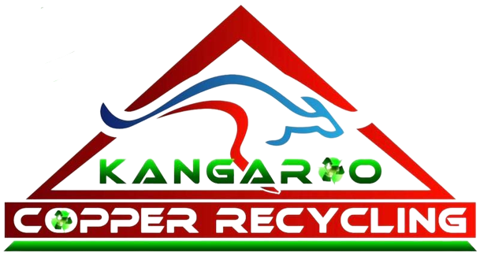
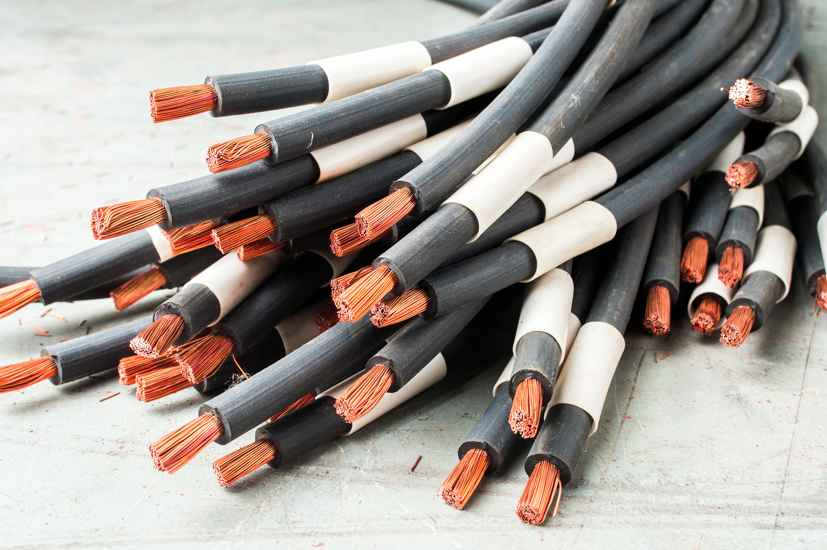
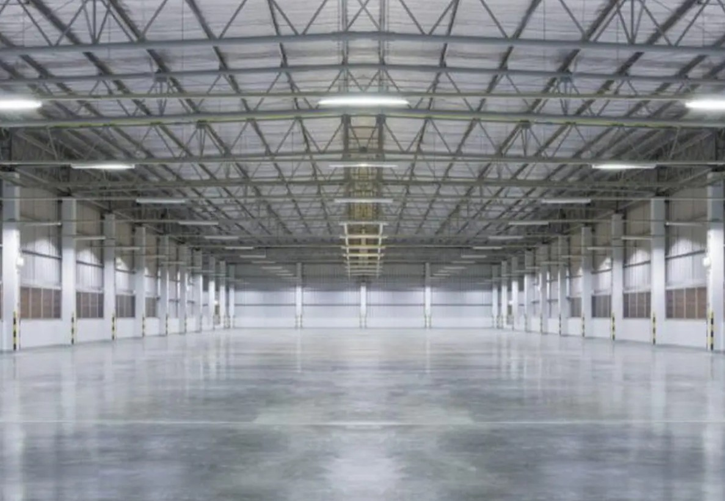
How Scrap Metal Recycling Supports Singleton’s Environment
Whether it be your own garage or the site that you work in, you are bound to some
scrap metal lying around. The majority of people never even consider how their
scrap metal affects the environment.
This guest post will explain how recycling scrap metal has a positive impact on the
environment of Singleton. The post will also explain why selecting the correct
service provider is critical.

Slide 2
How Recycling Helps Save the Environment
Recycling scrap ensures that there is no pollution and avoids any additional depletion of resources. The cost of mining is very high, compared to recycling, not only because of the energy used but also because of the amount of land and water that is required.’
Many people who search for scrap metal Singleton also want to ensure responsible waste management. You can achieve this objective by using the services of a professional recycler.

Slide 3
Reduction Of Waste in Landfills
Metals can decompose after about 1,000 years before rusting. Throwing metal garbage creates an additional environmental burden. Recycling metals will ensure that there is no waste deposited in the landfill sites and also prevent any environmental pollution. Every time you recycle scrap metal Muswellbrook, you assist in minimising landfill waste.
Every time you visit a recycling facility, you aid in decreasing landfill waste.

Slide 4
Effective Collection and Processing
The process adopted by Kangaroo Copper Recycling is efficient in many ways. They collect scrap right from home, offices, and construction sites. Materials such as copper, aluminium, brass, stainless steel, wiring, and air conditioners are collected.
Following collection, they are weighed and paid instantly based on prevailing prices in the market. People are motivated to recycle when this is done, since the process takes a shorter time and is lucrative. People who seek Scrap Metal Singleton take advantage of this simple process.

Slide 5
Final Thoughts
Recycling metal scraps reduces waste generated, saves the environment, and ensures that your surroundings remain clean. At Kangaroo Copper Recycling, we have all the items required for effective recycling of your metal.
Recycling metal scrap may seem like a small act from your side, but the effect it would have on the environment and your surroundings is massive.
Source: https://news.bangboxonline.com/how-scrap-metal-recycling-supports-singletons-environment

Slide 6
Thank You
Phone: 61405404040
Website: https://kangaroocopperrecycling.com.au/

