Slide 1
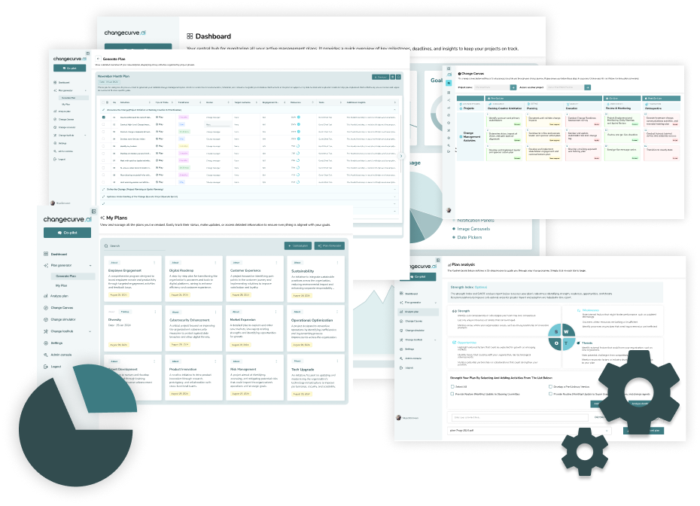
Ai-driven change management
Make change easy with AI-Driven Change Management. Our smart AI tools help predict outcomes, create better strategies, and speed up transformation smoothly.

Slide 2

Next gen plan analyzer
Boost your success with Next Gen Plan Analyzer, upload your plan, get instant AI insights, and enhance adoption with smart, data-driven recommendations.

Slide 3
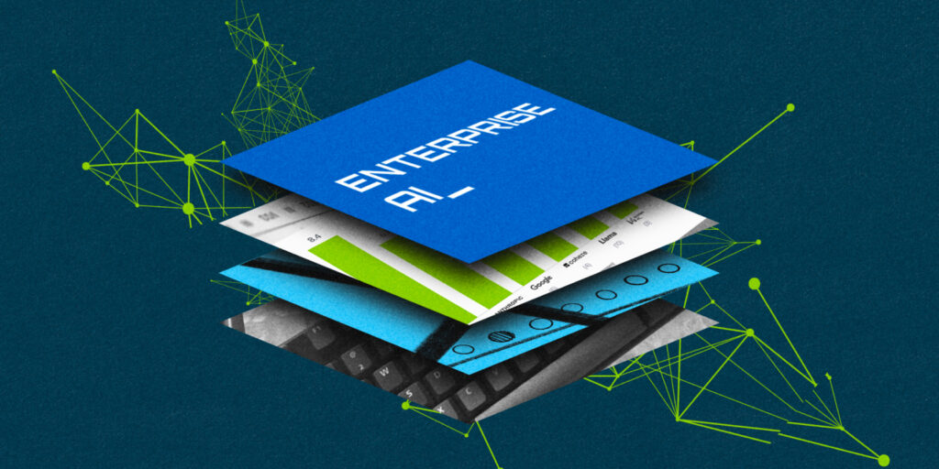
Business transformation ROI
Maximize success with Business Transformation ROI, cut costs, enhance efficiency, and drive change with AI-powered tools and expert support for lasting results.

Slide 4
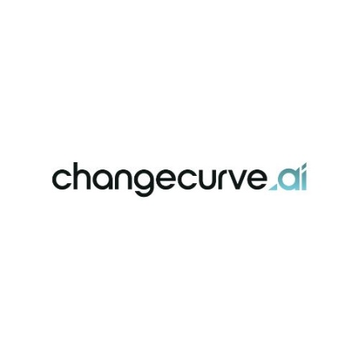
Conatct Us
About: ChangeCurve uses AI to help businesses manage change more efficiently. Our tools make transformations faster, & easier, improving employee adoption & ensuring projects deliver results quickly.
Address: United States
Website: https://changecurve.ai/

