Slide 1


Quora Web Solution
Website Design and
Development
Company
Web Design & Web Development
Company in Bangalore, India
www.quorawebsolution.com
+91 9986 056 909
info@quorawebsolutions.com
24A, 1st Main Rd, Chandra Reddy
Layout, Koramangala 4th Block,
Koramangala, Bengaluru,
Karnataka 560034

Slide 2
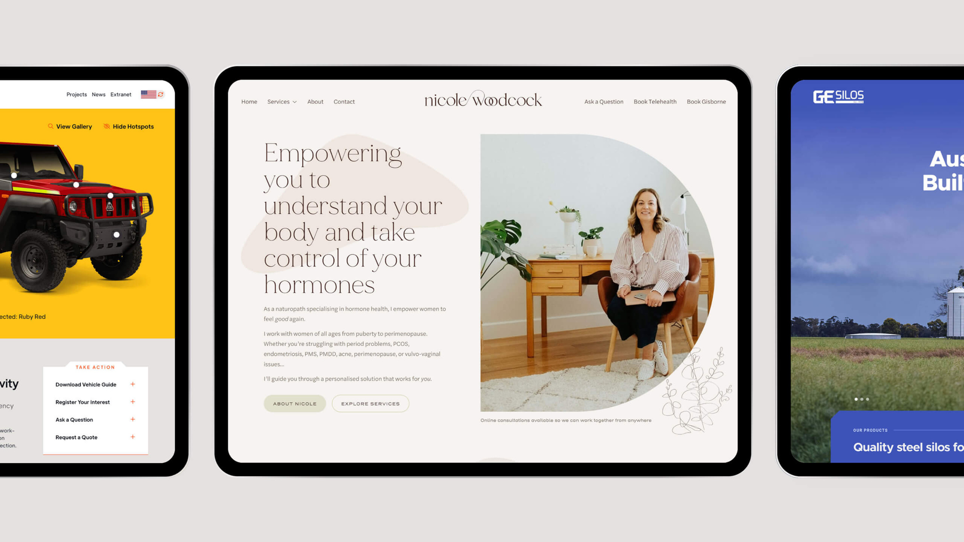
Custom Website Development vs. Website Builders: Which One is Right for Your Business in 2025?
In today’s digital age, having a strong online presence is crucial for any business. Whether you’re a startup, a small business, or an enterprise, your website is often the first interaction potential customers have with your brand.
www.quorawebsolution.com

Slide 3

When it comes to building a website, business owners have two primary options: custom website development or website builders. But which one is right for your business in 2025? In this article, we’ll compare the pros and cons of both options to help you make an informed decision.
Understanding Custom Website Development
www.quorawebsolution.com

Slide 4

Custom website development involves building a website from scratch using coding languages such as HTML, CSS, JavaScript, and frameworks like React, Angular, or Laravel. It typically requires hiring professional web developers or a web development agency to create a unique, tailored experience that aligns with your brand’s vision and functionality needs.
www.quorawebsolution.com

Slide 5

Pros of Custom Website Development:
Unique Design & Branding – A custom website allows for complete creative freedom, ensuring your website stands out from competitors.
www.quorawebsolution.com

Slide 6
Scalability – Custom websites can be built with future growth in mind, making it easier to add new features and expand functionality.
Better Performance & Speed – Custom coding eliminates unnecessary bloat, leading to faster load times and improved user experience.
Advanced Security – Developers can implement robust security measures, reducing vulnerabilities often found in template-based websites.
SEO Optimization – A custom website can be fully optimized for search engines, providing better rankings and increased organic traffic.
Full Control & Ownership – Unlike website builders, custom websites give you complete control over the code, hosting, and updates.
www.quorawebsolution.com

Slide 7
Cons of Custom Website Development:
Higher Cost – Custom development typically requires a larger initial investment compared to website builders.
Longer Development Time – Building a website from scratch takes time, often weeks or months, depending on complexity.
Requires Technical Expertise – Maintenance and updates may require ongoing developer support.
Understanding Website Builders
Website builders, such as Wix, Squarespace, Shopify, and WordPress (with pre-built themes), provide a user-friendly platform to create websites without coding knowledge. These platforms offer drag-and-drop functionality and customizable templates, making website creation accessible to anyone.
Pros of Website Builders:
www.quorawebsolution.com

Slide 8
Lower Cost – Website builders are generally more affordable, with monthly subscription plans ranging from free to premium.
Ease of Use – No coding skills are needed, making it easy for beginners to create and manage websites.
Quick Deployment – Pre-designed templates and drag-and-drop tools allow businesses to launch their websites within hours or days.
Built-in Features – Many website builders come with essential tools such as SEO settings, e-commerce functionality, and analytics.
Automatic Updates & Maintenance – Platforms handle security updates and software maintenance, reducing technical hassle.
Cons of Website Builders:
www.quorawebsolution.com

Slide 9
Limited Customization – While templates are customizable, they have restrictions compared to custom-built websites.
Scalability Issues – As businesses grow, the limitations of website builders can become a bottleneck for adding advanced features.
Slower Performance – Website builders often include unnecessary code and plugins, potentially slowing down website speed.
Dependence on Platform – Businesses are tied to the platform’s pricing and policies, with limited control over hosting and customization.
SEO Limitations – While most website builders have SEO tools, they may not offer the same level of optimization as a custom website.
Which One Is Right for Your Business in 2025?
www.quorawebsolution.com

Slide 10
The best choice depends on your business needs, budget, and long-term goals. Here’s a quick breakdown:
Choose Custom Website Development if:
You need a highly unique design and advanced features.
You plan for long-term growth and scalability.
You want full control over performance, security, and SEO.
You have the budget to invest in professional development.
Choose a Website Builder if:
You need a cost-effective and quick solution.
You have minimal technical knowledge and prefer a DIY approach.
You’re running a small business, portfolio, or personal website.
You don’t require advanced features or custom integrations.
Conclusion
www.quorawebsolution.com

Slide 11
Both custom website development and website builders have their advantages and disadvantages. If you prioritize flexibility, scalability, and unique branding, a custom-built website is the best choice. However, if you need a budget-friendly and easy-to-manage solution, a website builder can be an excellent option. Ultimately, understanding your business needs and long-term goals will help you make the right decision for your website in 2025.
The Complete Guide to Website Design and Development: How to Build a High-Performance Business Website in 2025
Introduction
In the fast-evolving digital landscape, having a high-performance business website is no longer optional—it's a necessity.
www.quorawebsolution.com

Slide 12
A well-designed and well-developed website can drive engagement, improve conversions, and establish credibility. Whether you're a startup, small business, or large enterprise, understanding the key elements of website design and development is crucial. This guide will walk you through the essential steps and best practices to build a website that is fast, secure, and optimized for success in 2025.
Step 1: Define Your Website Goals and Audience
Before you start designing or developing your website, it’s important to define its purpose and target audience. Ask yourself:
What primary objective do I want my website to achieve? (e.g., lead generation, e-commerce, portfolio, or brand awareness)
Who is my target audience, and what are their preferences?
What features and functionalities will my website need to meet user expectations?
Pro Tip:
www.quorawebsolution.com

Slide 13
Conduct market research and competitor analysis to understand industry trends and identify what works best in your niche.
Step 2: Choose the Right Website Development Approach
There are two primary ways to develop a website:
Custom Website Development: A fully customized website built from scratch using technologies like HTML, CSS, JavaScript, and frameworks such as React, Angular, or Laravel.
Website Builders & CMS: Platforms like WordPress, Wix, Shopify, or Webflow allow for easier website creation without extensive coding knowledge.
Choosing the Best Option:
For businesses that need scalability and unique features: Custom website development is recommended.
For small businesses, startups, or personal brands: Website builders and CMS platforms provide a cost-effective and user-friendly solution.
www.quorawebsolution.com

Slide 14
Step 3: Design a User-Centric Interface (UI/UX Design)
A well-designed website should prioritize user experience (UX) and a visually appealing interface (UI). Follow these principles:
Mobile-First Design: Ensure your website is fully responsive across all devices.
Intuitive Navigation: Create a clear, logical site structure that makes it easy for users to find information.
Fast Loading Speeds: Optimize images, minimize code bloat, and use caching to improve site speed.
Brand Consistency: Maintain consistent branding, colors, and typography across all pages.
Step 4: Develop a Secure and High-Performance Website
The development stage is where your website’s functionality takes shape. Key aspects to focus on include:
Coding Best Practices: Write clean, well-structured, and optimized code for performance.
Security Measures: Implement SSL certificates, firewalls, and security plugins to protect against cyber threats.
SEO Optimization: Use clean URLs, structured data, and metadata to improve search engine rankings.
www.quorawebsolution.com

Slide 15
Speed Optimization: Leverage Content Delivery Networks (CDNs) and lazy loading for better performance.
Step 5: Implement SEO Best Practices
Search Engine Optimization (SEO) plays a crucial role in increasing organic traffic and improving a website’s visibility on search engines. Focus on:
Keyword Optimization: Use relevant keywords naturally within content, titles, and meta descriptions.
Technical SEO: Improve website structure, page speed, and mobile-friendliness.
Quality Content: Publish informative and valuable content regularly to engage users and rank higher on search engines.
Backlink Strategy: Build authoritative backlinks to enhance your site’s credibility.
Step 6: Test and Launch Your Website
Before launching, conduct thorough testing to ensure a seamless experience. Key tests include:
Usability Testing: Check navigation, forms, and overall user experience.
www.quorawebsolution.com

Slide 16
Performance Testing: Analyze load times, page speed, and server response times.
Cross-Browser Testing: Ensure the website works smoothly on Chrome, Firefox, Safari, and Edge.
Mobile Testing: Test responsiveness on various screen sizes.
After successful testing, deploy your website using a reliable hosting service.
## Step 7: Maintain and Continuously Optimize Your Website
A website is not a one-time project—it requires ongoing maintenance and updates. Key tasks include:
Regular Security Updates: Keep plugins, themes, and CMS platforms updated.
Content Refreshing: Update old blog posts, landing pages, and product descriptions.
Performance Monitoring: Use tools like Google Analytics and Google Search Console to track user behavior and optimize accordingly.
User Feedback Implementation: Collect user feedback and make necessary improvements for better engagement.
www.quorawebsolution.com

Slide 17
Conclusion
Building a high-performance business website in 2025 requires a strategic approach, from planning and design to development and ongoing maintenance. By focusing on user experience, security, SEO, and scalability, businesses can create a website that not only attracts visitors but also drives long-term growth and success. Whether you choose custom development or a CMS-based solution, prioritizing quality and performance will set your website apart in the competitive digital space.
www.quorawebsolution.com

Slide 18
Quora Web Solution: Quora Web Solution is a trusted website development company based in Bangalore, India, offering a wide array of services to not only domestic but global clientele. Be it Website Design and Development, SEO services, Digital Marketing, Branding, App Development, Ecommerce Solution, and Logo Creation . Quora Web Solution has the best website developers offering top quality services and that is the reason why we are well known as one of the best Website Development Companies in Bangalore, India.
Visit Us - www.quorawebsolution.com
Call Us - +91 9986 056 909
Mail Us - info@quorawebsolutions.com
www.quorawebsolution.com

Slide 19

WORDPRESS DEVELOPMENT
ECOMMERCE DEVELOPMENT
PHP DEVELOPMENT
CMS DEVELOPMENT
DRUPAL DEVELOPMENT
WEBSITE SERVICES
WEBPORTAL DEVELOPMENT
MAGENTO DEVELOPMENT
WEBSITE DEVELOPMENT
JOOMLA DEVELOPMENT
SMALL BUSINESS DEVELOPMENT
CHEAP WEBSITE DEVELOPMENT
STATIC WEBSITE DEVELOPMENT
DYNAMIC WEBSITE DEVELOPMENT
WEBSITE DESIGN COMPANY
TOUR AND TRAVEL WEBSITE DEVELOPMENT
Services

