Slide 1

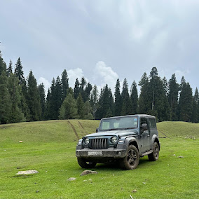

Kashmir to Ladakh Self Drive Car
Explore the Himalayas Your Way with Self Steer Kashmir
Kashmir to Ladakh is one of the most beautiful road journeys in India. A self-drive car gives travellers the freedom to explore mountain landscapes, scenic valleys, local villages and famous destinations at their own pace. With Self Steer Kashmir, travellers can choose a suitable vehicle for their journey and enjoy a more flexible road-trip experience.
Notes:
1

Slide 2






Why Choose a Kashmir to Ladakh Self Drive Car?
A Kashmir to Ladakh self drive car is a great option for travellers who want independence during their Himalayan journey. Instead of following a fixed sightseeing schedule, you can decide where to stop, how long to stay and which places to explore.
With a self-drive vehicle, you can enjoy:
Flexible travel schedules
Private travel with family or friends
Easy luggage management
Freedom to stop at scenic locations
A personalised road-trip experience
Better control over your daily itinerary
Self Steer Kashmir provides self-drive rental options designed for travellers who want to explore Kashmir and plan their journey towards Ladakh.
Notes:
2

Slide 3
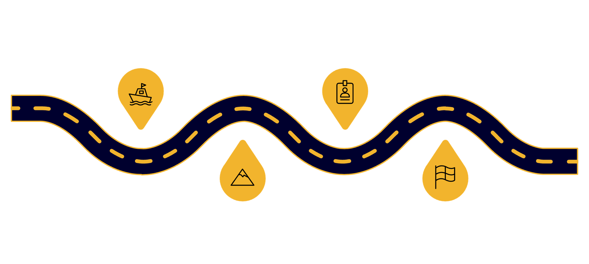
Kashmir to Ladakh Road Trip Route
A popular road journey can begin from Srinagar and continue towards Ladakh through some spectacular Himalayan landscapes.
Srinagar Start
Zoji La Crossing
Begin from the scenic city
High mountain pass ascent
Sonamarg Pass
Leh Arrival
Alpine meadows and views
Reach Ladakh’s capital
Srinagar → Sonamarg → Zoji La → Drass → Kargil → Lamayuru → Leh
Srinagar is an ideal starting point for the journey. From there, travellers can experience the changing landscape as Kashmir's green valleys gradually transform into the dramatic mountains of Ladakh.
Important stops such as Sonamarg, Drass and Kargil make the journey memorable. Once you reach Leh, you can continue exploring destinations such as Nubra Valley, Pangong Lake and other nearby attractions, subject to road conditions and permits.
Notes:
3

Slide 4




Benefits of Self Drive Travel
The biggest advantage of a Kashmir to Ladakh self drive car is freedom.
You are not restricted by a driver's sightseeing plan or a fixed itinerary. You can stop for photographs, enjoy a peaceful mountain view or spend extra time at a destination that interests you.
Self-drive travel also offers:
Privacy
Flexibility
Travel comfortably with your own group.
Change your plan according to weather and road conditions.
Convenience
Adventure
Keep your luggage and travel essentials with you.
Experience the road journey personally rather than simply travelling from one destination to another.
For travellers who enjoy road trips, the journey itself becomes an important part of the holiday.
Notes:
4

Slide 5
What to Check Before Starting Your Journey
A Kashmir to Ladakh road trip requires proper preparation because mountain conditions can change quickly.
Before collecting your rental car, check:
Vehicle & Documents
Road & Safety
  Vehicle condition
  Tyres and spare tyre
  Brakes and lights
  Fuel level
  Rental documents
  Driving documents
  Required permits
  Current road conditions
  Weather forecast
  Emergency contact information
It is also useful to carry warm clothes, drinking water, snacks, power banks and basic travel essentials.
Always follow local traffic rules and drive according to the current road and weather conditions.
Notes:
5

Slide 6
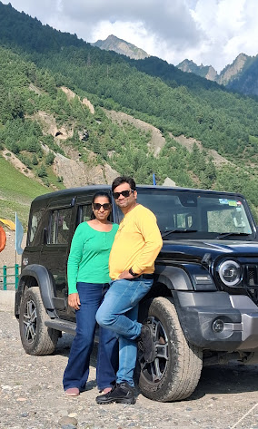

Best Time for a Kashmir to Ladakh Self Drive Trip
The ideal time for a Kashmir to Ladakh self drive car journey depends on road accessibility and weather conditions.
The main road-trip season is generally during the warmer months when major mountain routes are more accessible. However, Himalayan weather can change rapidly, so travellers should always check current road conditions before starting their journey.
Instead of creating a very tight itinerary, keep some extra time in your travel plan. Mountain roads can experience unexpected delays because of weather, traffic, maintenance or other local conditions.
A flexible itinerary makes the journey more comfortable and enjoyable.
Notes:
6

Slide 7





Why Choose Self Steer Kashmir?
Self Steer Kashmir is focused on providing self-drive car rental solutions for travellers exploring Kashmir.
The aim is simple: give travellers more freedom to Rent, Ride and Explore.
With Self Steer Kashmir, travellers can:
Choose a vehicle according to their travel requirements
Plan their own road-trip schedule
Travel privately with their group
Discuss rental requirements before booking
Prepare for their planned Kashmir and Ladakh journey
Whether you are planning a short Kashmir trip or a longer Himalayan road adventure, selecting the right rental vehicle can make your journey more convenient.
Notes:
7

Slide 8
Tips for a Safe Kashmir to Ladakh Road Trip
A successful Himalayan road trip is about enjoying the scenery while driving responsibly.
Start your journey early when conditions are suitable and avoid unnecessary rushing. Take regular breaks during long drives and stay alert on mountain roads.
Some useful tips include:
Drive at a safe speed
Avoid unnecessary overtaking
Follow local traffic rules
Check weather and road updates
Keep sufficient fuel and essential supplies
Take proper rest during the journey
Respect local communities
Avoid littering in the mountains
Remember that reaching your destination safely is more important than reaching quickly.
Notes:
8

Slide 9
Kashmir to Ladakh Self Drive Car – Travel Checklist
Before starting your journey, make sure everything is ready.
Booking Checklist
Travel Checklist
  Confirm rental dates
  Confirm pickup location
  Understand rental terms
  Check vehicle availability
  Carry valid driving documents
  Warm clothes
  Water and snacks
  Power bank
  Offline maps
  Basic medicines and personal essentials
  Emergency contact details
Vehicle Checklist
A little preparation before departure can make a big difference during a long mountain journey.
  Check tyres
  Check spare wheel
  Check brakes
  Check lights
  Check fuel level
  Inspect the vehicle for existing damage
Notes:
9

Slide 10
Start Your Kashmir to Ladakh Self Drive Journey
Ready to explore Kashmir and Ladakh your way?
A Kashmir to Ladakh self drive car can turn your holiday into an exciting Himalayan road adventure. From the green valleys of Srinagar to the dramatic landscapes around Kargil and the high-altitude beauty of Leh, every part of the journey offers something different.
With Self Steer Kashmir, travellers can plan their journey with greater freedom and flexibility.
Rent
Ride
Explore
Self Steer Kashmir Rent • Ride • Explore
Website: www.selfsteer.in
Plan your route, choose your vehicle and get ready to experience the mountains at your own pace.
Notes:
10

