Slide 1
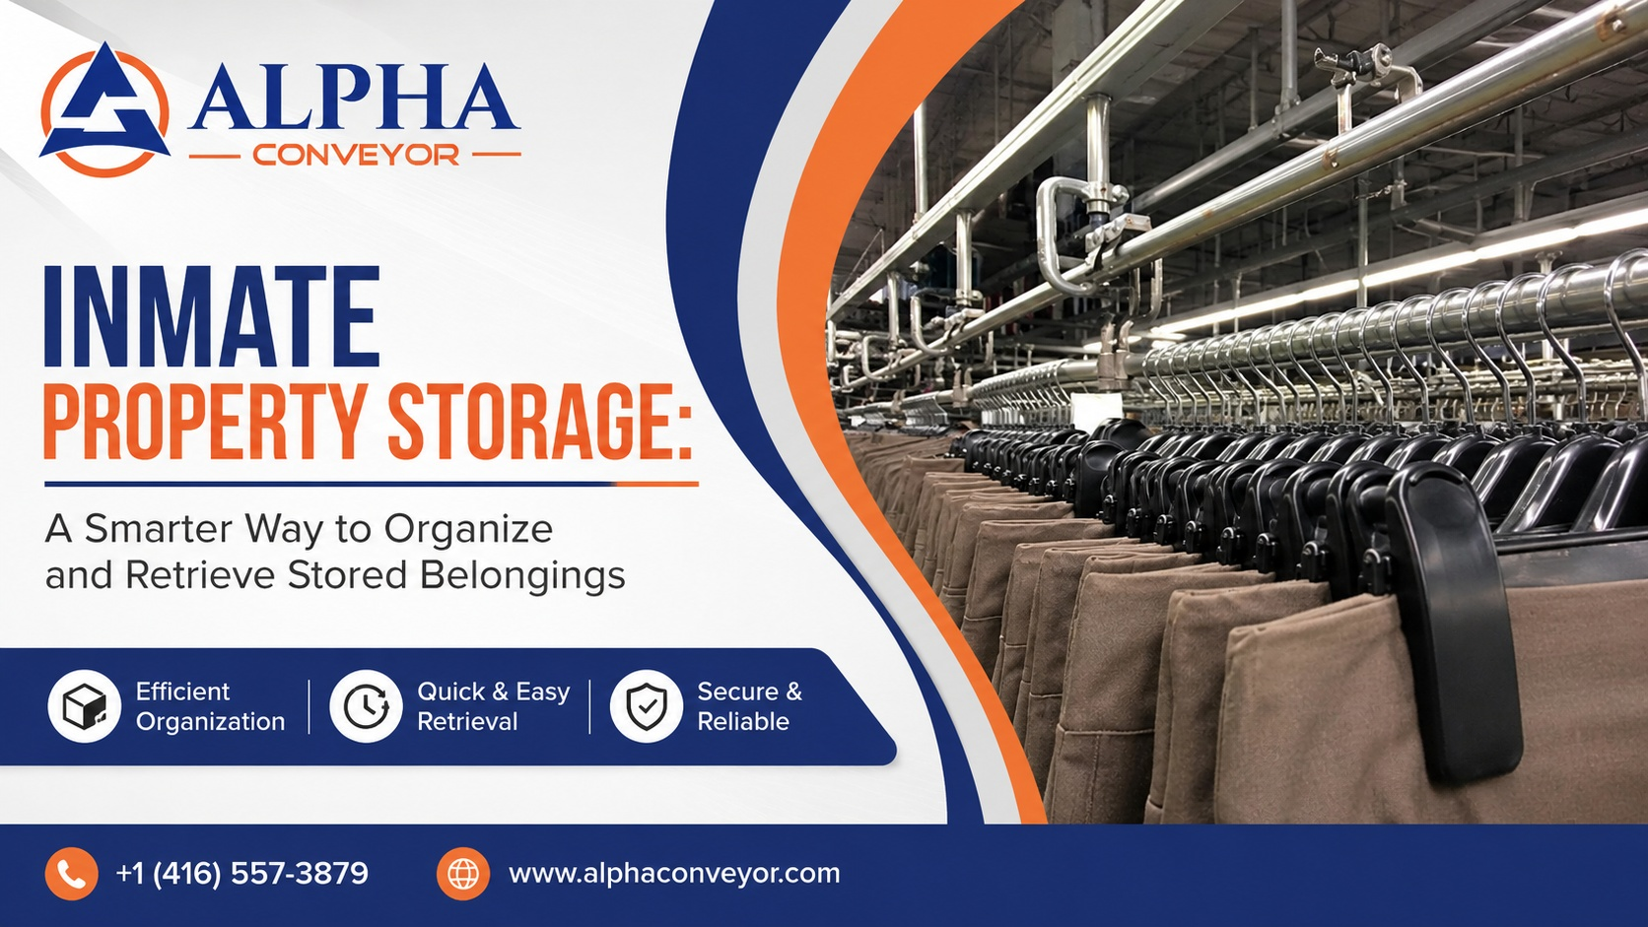

Slide 2
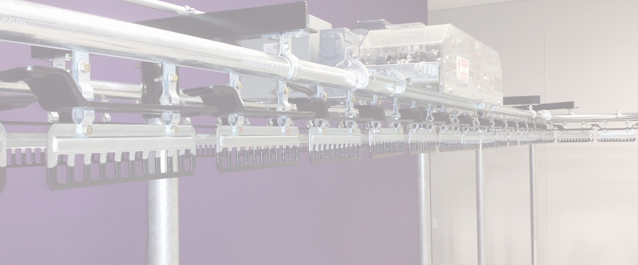

Managing inmate property in a correctional facility requires organization, accuracy, and a reliable storage process. With large volumes of clothing and personal belongings moving through a facility, traditional storage methods can make retrieval difficult and increase the risk of items being misplaced. Alpha Conveyor offers modern Inmate Property Storage solutions that make storing, organizing, and retrieving garments more efficient and convenient.
Simplifying Inmate Property Management
Correctional facilities need a dependable way to keep inmate clothing and property secure and properly organized. Alpha Conveyor’s clothing storage and retrieval conveyor systems are designed to streamline this process. Instead of relying entirely on manually searching through stored items, staff can use an automated conveyor system to locate and retrieve property more efficiently.

Slide 3

The system can be operated through a touchscreen interface, making the retrieval process straightforward. When an inmate is preparing to leave the facility, staff can quickly access the stored property without spending unnecessary time searching through shelves, racks, or individual storage areas.
Reducing Misplaced or Lost Items
One of the biggest challenges in managing stored property is keeping track of individual items. When garments are stored in large quantities, disorganization can lead to delays and misplaced belongings. A properly designed conveyor storage system provides a more structured approach to property management.

Slide 4
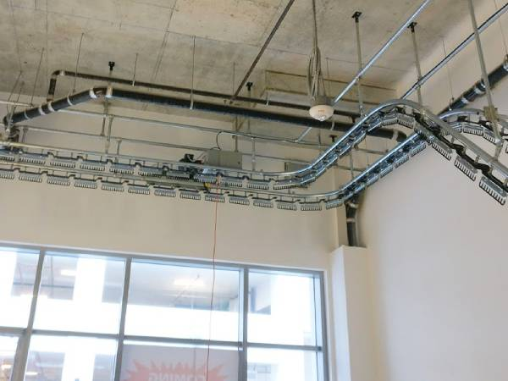

Alpha Conveyor’s systems help reduce the possibility of garments being misplaced or lost while in storage. By keeping items organized within an automated retrieval process, correctional staff can manage property more systematically and improve overall operational efficiency.
Customized Storage Solutions for Different Facilities
Every facility has different space requirements, storage volumes, and operational procedures.

Slide 5
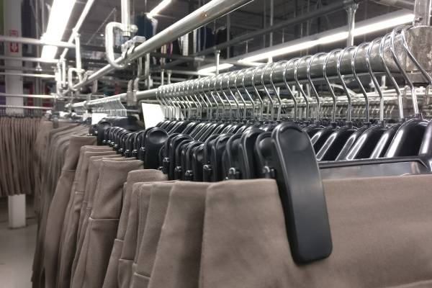
That is why Alpha Conveyor’s engineers can design customized solutions that integrate garment conveyor systems with dedicated garment storage units.
This approach allows the conveyor and storage components to work together smoothly, creating a practical system for facilities handling large quantities of garments. Whether the goal is to maximize available space, simplify retrieval, or improve organization, a customized solution can be developed around the facility’s specific needs.

Slide 6
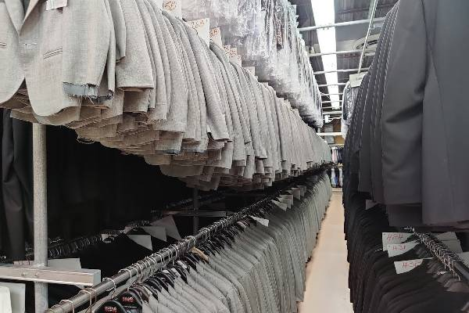
Beyond Correctional Facilities
Although Inmate Property Storage is an important application, Alpha Conveyor’s technology is also useful in other industries where large volumes of garments need to be stored and retrieved efficiently. Hotels and hospitals, for example, can use garment conveyor systems to organize employee uniforms and make them readily accessible.
By automating parts of the storage and retrieval process, organizations can reduce unnecessary handling, improve workflow, and make better use of their available storage space.

Slide 7
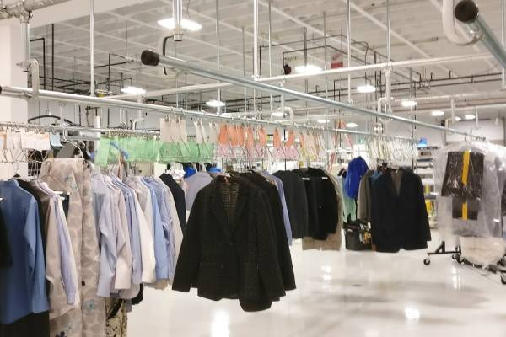
A Practical Approach to High-Volume Garment Storage
When a facility manages hundreds or thousands of garments, an efficient storage system can make a noticeable difference. Alpha Conveyor combines practical engineering with automated retrieval technology to create solutions that help organizations manage garments more effectively.
For correctional facilities seeking a dependable way to organize inmate property, an automated conveyor-based system can provide a more efficient alternative to conventional storage methods. Alpha Conveyor is ready to develop a solution tailored to your facility’s requirements.

Slide 8
