Slide 1


Quora Web Solution
Website Design and
Development
Company
Web Design & Web Development
Company in Bangalore, India
www.quorawebsolution.com
+91 9986 056 909
info@quorawebsolutions.com
24A, 1st Main Rd, Chandra Reddy
Layout, Koramangala 4th Block,
Koramangala, Bengaluru,
Karnataka 560034

Slide 2
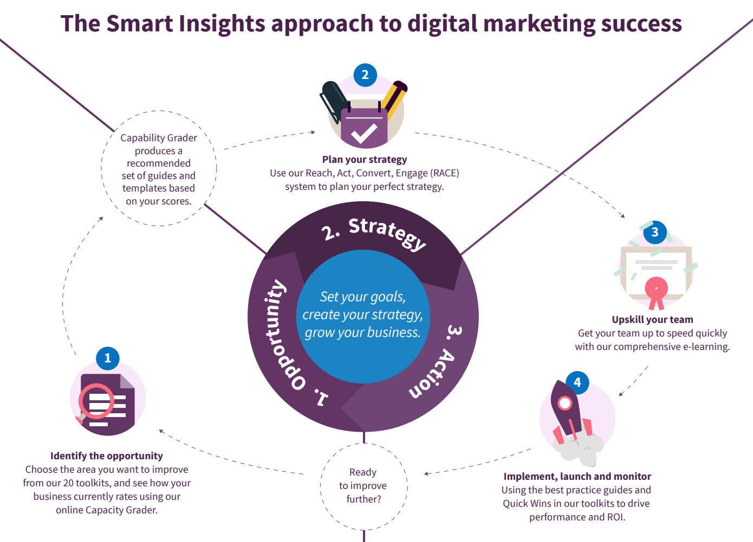
Your Guide to Growing Online: Strategies from a Leading Website Design and Development Agency
www.quorawebsolution.com

Slide 3
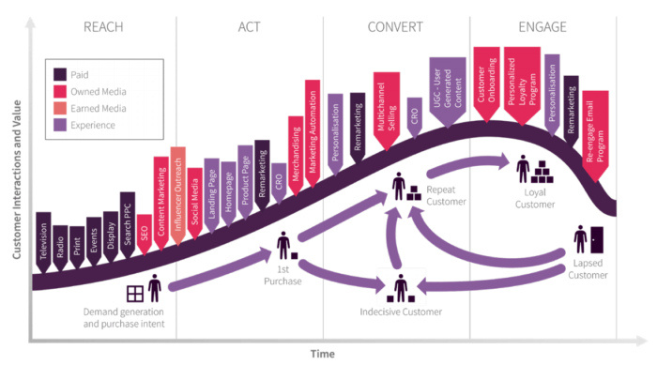
In an increasingly digital world, establishing a strong online presence is vital for any business looking to grow and thrive.
www.quorawebsolution.com

Slide 4

A well-crafted website is not just an online address\u2014it\u2019s your brand\u2019s virtual headquarters.
www.quorawebsolution.com

Slide 5

Drawing on insights from a leading website design and development agency, this guide offers actionable strategies to help you stand out and succeed in the online space.
www.quorawebsolution.com

Slide 6
1. User Experience is King
User experience (UX) can determine whether visitors stay on your website or bounce off within seconds. A seamless, user-friendly interface creates positive impressions and encourages engagement.
Pro Tips to Enhance UX:
Mobile First: With mobile usage dominating, ensure your site is optimized for smaller screens without compromising functionality.
Page Speed: Every second counts. Optimize images, reduce heavy scripts, and use a reliable hosting service to speed up your site.
Easy Navigation: Implement a simple, intuitive structure with clear menus and logical content flow.
www.quorawebsolution.com

Slide 7
2. Leverage SEO to Drive Traffic
Search engine optimization (SEO) ensures your audience finds you amidst the noise of the internet. A well-optimized website increases visibility, attracting more visitors and potential customers.
SEO Checklist:
Keyword Targeting: Use tools like Google Keyword Planner to identify relevant search terms.
On-Page SEO: Optimize meta titles, descriptions, and headings while keeping content natural and user-centric.
Content Marketing: Publish high-quality, value-driven content that addresses user needs and questions.
3. Design for Impact
Your website\u2019s design is often the first impression visitors have of your brand.
www.quorawebsolution.com

Slide 8
A professional and visually appealing design can establish trust and set you apart from competitors.
Design Elements to Focus On:
Brand Consistency: Use colors, fonts, and imagery that reflect your brand\u2019s identity.
Visual Hierarchy: Guide user attention with strategic placement of elements like CTAs (calls-to-action).
Whitespace: Avoid clutter by balancing text and visuals with ample whitespace for readability.
4. Track, Analyze, and Improve
Data is the backbone of online growth. Regularly analyzing your website\u2019s performance helps you make informed decisions and identify areas of improvement.
Tools for Success:
Google Analytics: Monitor traffic sources, bounce rates, and user demographics.
www.quorawebsolution.com

Slide 9
Heatmaps: Use tools like Hotjar to understand how users interact with your site.
Feedback Forms: Directly ask visitors for input on their experience and areas for enhancement.
5. Secure Your Digital Presence
A secure website protects your users and builds their trust. In a world where data breaches are common, security is a priority you cannot ignore.
Security Essentials:
SSL Certificates: Encrypt all user data to ensure privacy and safety.
Regular Updates: Keep your website\u2019s software, themes, and plugins updated to avoid vulnerabilities.
Firewall Protection: Employ firewalls and security plugins to fend off cyber threats.
www.quorawebsolution.com

Slide 10
6. Harness the Power of Social Media
Social media isn\u2019t just a marketing tool; it\u2019s an extension of your website. Integrating social media into your website can enhance engagement and drive traffic.
Effective Strategies:
Social Sharing: Add sharing buttons to blogs and key pages to encourage content distribution.
Live Feeds: Embed real-time social media feeds to showcase your latest updates.
Engagement Prompts: Use clear CTAs to direct visitors to your profiles for additional interaction.
www.quorawebsolution.com

Slide 11
7. Collaborate with Experts
While DIY platforms are tempting, a professional website design and development agency can bring unparalleled value. With their expertise, you gain access to cutting-edge designs, technical knowledge, and industry trends.
Conclusion
Growing your online presence requires a holistic strategy that blends creativity, technology, and analytics. By focusing on user experience, leveraging SEO, and ensuring your website\u2019s design and security are top-notch, you can create an online presence that not only attracts but also retains your target audience. Collaborate with experts and embrace continuous improvement\u2014your path to online success starts today.
Let me know if you'd like any further refinements or adjustments!
www.quorawebsolution.com

Slide 12
How to Evaluate a Website Design and Development Company for Long-Term Collaboration
In today's competitive digital landscape, your website is often the first interaction customers have with your business. Choosing the right website design and development company for long-term collaboration is crucial to ensuring your website remains relevant, functional, and engaging. Here’s how to make an informed decision and find the ideal partner for your needs.
1. Review Their Portfolio and Expertise
The first step in evaluating a website design and development company is to look at their portfolio. This provides insight into their creativity, technical capabilities, and the industries they have experience with. Key things to consider include:
Design Aesthetic: Are their designs clean, professional, and visually appealing?
www.quorawebsolution.com

Slide 13
Functionality: Do their websites offer smooth navigation and user-friendly features?
Relevance: Have they worked with companies in your industry or on projects of similar scope?
Experience in various technologies and platforms, such as WordPress, Shopify, or custom-built solutions, is a strong indicator of their versatility and expertise.
2. Check Client Feedback and Testimonials
Client reviews and testimonials are excellent sources of unbiased feedback. They can give you an idea of the company’s strengths and weaknesses. Look for reviews on:
Third-party platforms like Clutch or Google Reviews.
Social media channels, where clients may share their experiences.
www.quorawebsolution.com

Slide 14
The company’s website, though ensure these are genuine and not overly curated.
For a more in-depth perspective, you can reach out directly to previous clients to ask about their experiences.
3. Evaluate Their Technical Expertise
Your chosen company should have strong technical skills to meet your current and future needs. Confirm their proficiency in:
Programming Languages: Such as HTML, CSS, JavaScript, and back-end languages like PHP or Python.
Content Management Systems (CMS): Experience with platforms like WordPress, Magento, or custom CMS solutions.
www.quorawebsolution.com

Slide 15
Responsive Design: Ensuring seamless performance on mobile, tablet, and desktop devices.
SEO Practices: Designing websites optimized for search engine visibility.
Additionally, inquire about their approach to staying updated with emerging trends and technologies.
4. Understand Their Development Process
A transparent development process is a hallmark of a professional company. During your discussions, ask about their workflow, including:
Discovery Phase: How they gather requirements and understand your business goals.
Design and Development: Their process for creating wireframes, prototypes, and final builds.
Testing: How they ensure the website is bug-free and performs well.
Deployment: Steps for launching your website and addressing post-launch issues.
www.quorawebsolution.com

Slide 16
A clear roadmap helps avoid misunderstandings and ensures you’re aligned throughout the project.
5. Gauge Communication Skills
Communication is key to successful collaboration. Assess how effectively the company communicates during your initial interactions. Look for:
Responsiveness: Do they answer inquiries promptly?
Clarity: Are they transparent about timelines, costs, and expectations?
Collaboration Tools: Do they use tools like Slack, Zoom, or project management platforms?
Having a dedicated project manager or point of contact simplifies communication and keeps projects on track.
www.quorawebsolution.com

Slide 17
6. Ask About Ongoing Support
Long-term collaboration often involves ongoing support and updates. Make sure the company offers:
Maintenance Packages: Regular updates, backups, and security patches.
Scalability: The ability to accommodate future features or expansions.
Training: Helping your team manage and update the website if necessary.
A dependable support system ensures your website continues to perform optimally after launch.
7. Compare Pricing and Value
While cost shouldn’t be the sole deciding factor, it’s important to understand what you’re paying for. When evaluating pricing, consider:
Transparency: Is the pricing clear and itemized?
www.quorawebsolution.com

Slide 18
Value: Are their services worth the investment?
Flexibility: Can they accommodate different budgets with scalable solutions?
Request detailed proposals and contracts to avoid hidden costs and ensure mutual understanding.
8. Research Their Industry Reputation
A company’s reputation can speak volumes about its reliability. Check for:
Awards and Recognitions: Industry accolades that highlight their expertise.
Certifications: Valid credentials or certifications in relevant technologies.
Partnerships: Collaborations with reputable software or technology providers.
www.quorawebsolution.com

Slide 19
An established reputation indicates a strong track record of success.
9. Test Their Cultural Compatibility
Cultural alignment between your business and the company is essential for a smooth working relationship. Consider:
Work Ethic: Do their values align with your company’s goals?
Flexibility: Are they open to incorporating your feedback and adapting to changes?
Team Dynamics: Can their team work cohesively with yours?
Shared values and good rapport can make a big difference in long-term partnerships.
www.quorawebsolution.com

Slide 20
10. Start with a Small Project
Before committing to a large-scale project, test the company with a smaller task. This allows you to:
Evaluate their capabilities and processes.
Test their communication and responsiveness.
Build confidence in their ability to meet your expectations.
A successful trial project can serve as a strong indicator of future collaboration potential.
Conclusion
Choosing the right website design and development company for long-term collaboration requires careful consideration of their expertise, communication, and compatibility with your goals. By following these steps, you can find a reliable partner who will help your business thrive in the digital world. Remember, the right company isn’t just a service provider—it’s a strategic ally invested in your success.
www.quorawebsolution.com

Slide 21
Quora Web Solution: Quora Web Solution is a trusted website development company based in Bangalore, India, offering a wide array of services to not only domestic but global clientele. Be it Website Design and Development, SEO services, Digital Marketing, Branding, App Development, Ecommerce Solution, and Logo Creation . Quora Web Solution has the best website developers offering top quality services and that is the reason why we are well known as one of the best Website Development Companies in Bangalore, India.
Visit Us - www.quorawebsolution.com
Call Us - +91 9986 056 909
Mail Us - info@quorawebsolutions.com
www.quorawebsolution.com

Slide 22

WORDPRESS DEVELOPMENT
ECOMMERCE DEVELOPMENT
PHP DEVELOPMENT
CMS DEVELOPMENT
DRUPAL DEVELOPMENT
WEBSITE SERVICES
WEBPORTAL DEVELOPMENT
MAGENTO DEVELOPMENT
WEBSITE DEVELOPMENT
JOOMLA DEVELOPMENT
SMALL BUSINESS DEVELOPMENT
CHEAP WEBSITE DEVELOPMENT
STATIC WEBSITE DEVELOPMENT
DYNAMIC WEBSITE DEVELOPMENT
WEBSITE DESIGN COMPANY
TOUR AND TRAVEL WEBSITE DEVELOPMENT
Services

