Slide 1

Boost Your Confidence with the Help of Physics Tuition
Welcome to EduFirst Learning Centre

Slide 2
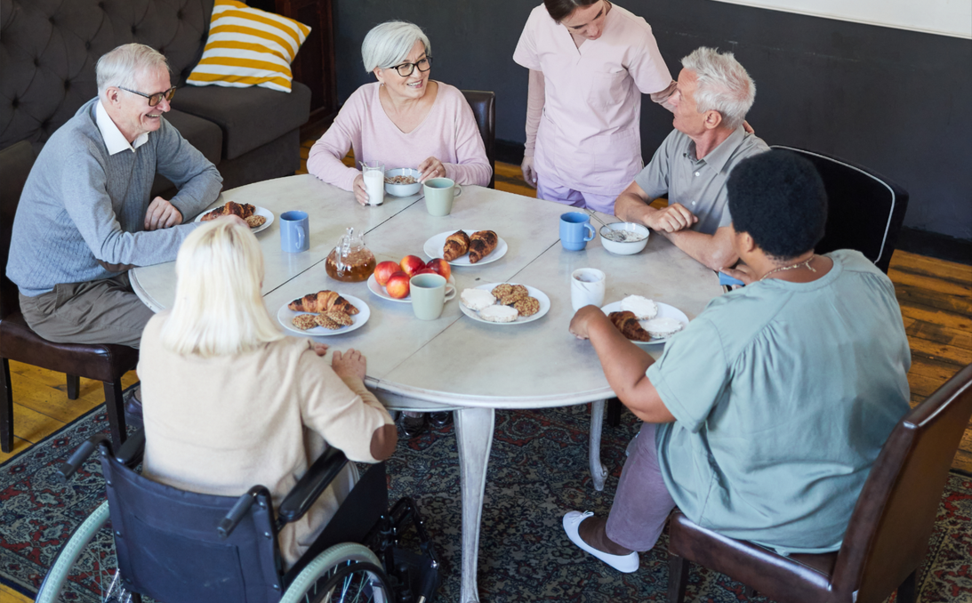
Use Physics Tuition to Increase Your Confidence
One might find it quite difficult to learn physics. Many students lose confidence while attending classes. However, a tuition center can change this. It provides regular practice for the students. One will also receive personal help while learning at one’s own pace. Teachers will rectify mistakes made by the students. The students will learn difficult physics topics flawlessly. Here, we have mentioned how a physics tuition center can make you more confident.
  Small Groups Mean More Attention
The number of students reading in a tuition center is not large. It is unlike schools where many students read at the same time. In any tuition center, the teachers will remember every student easily. They can do it by seeing their faces.

Slide 3
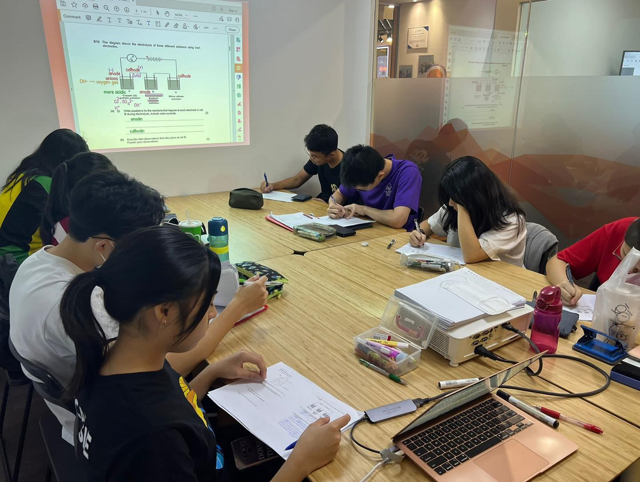
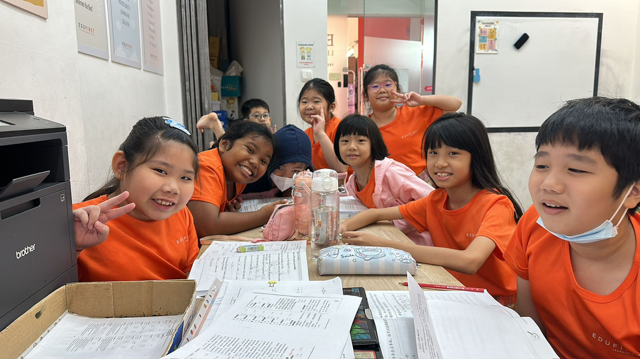
  You Practice Problems Every Week
One has to practice daily for understanding physics. Schools will not provide endless time to learn this tough subject. On the other hand, tuition in Tampines will provide adequate time to master the subject. If any student makes mistakes, the tuition center will help rectify the errors. The tutors will also repeat their teaching, thus making it simple for the learners.
  Mistakes Become Learning Steps
Mistakes might appear to be overwhelming at home. On the other hand, committing mistakes in a tuition center is normal. If you make errors, no one is going to taunt you.

Slide 4

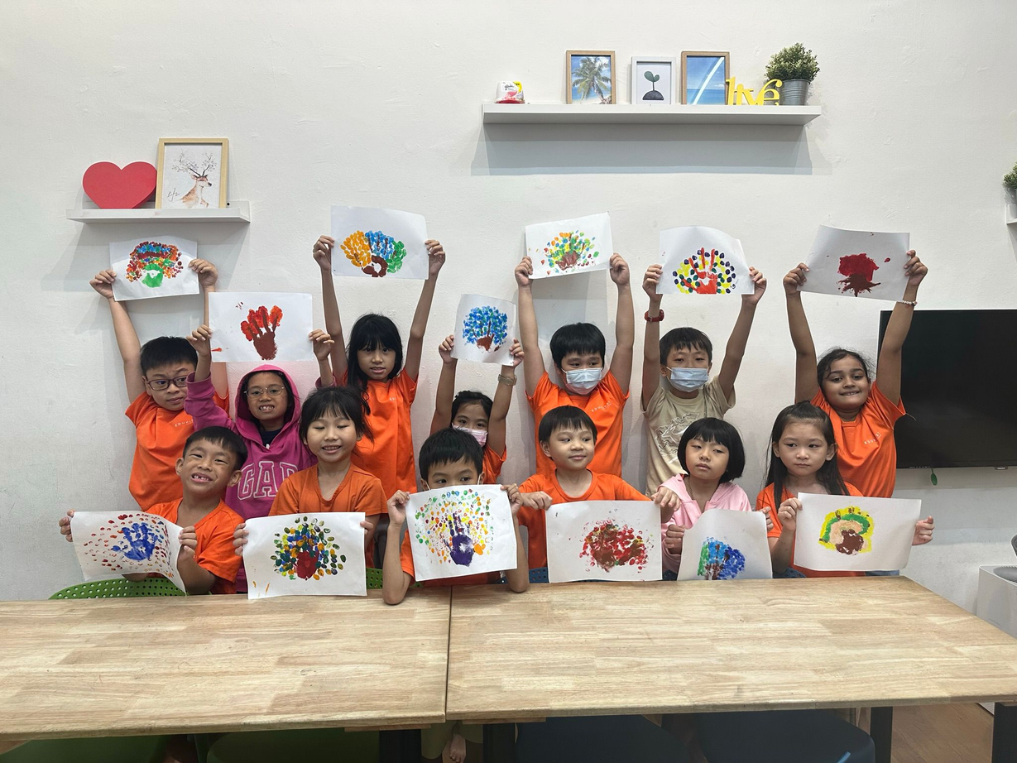
EduFirst Tuition Centre in Hougang
EduFirst Learning Centre is a tuition centre in Bukit Timah which provides classes catered for Pre-Primary, Primary and Secondary levels.
Established since 2010 and after years after years of track record producing top students, EduFirst soon became well-known tuition centre.

Slide 5
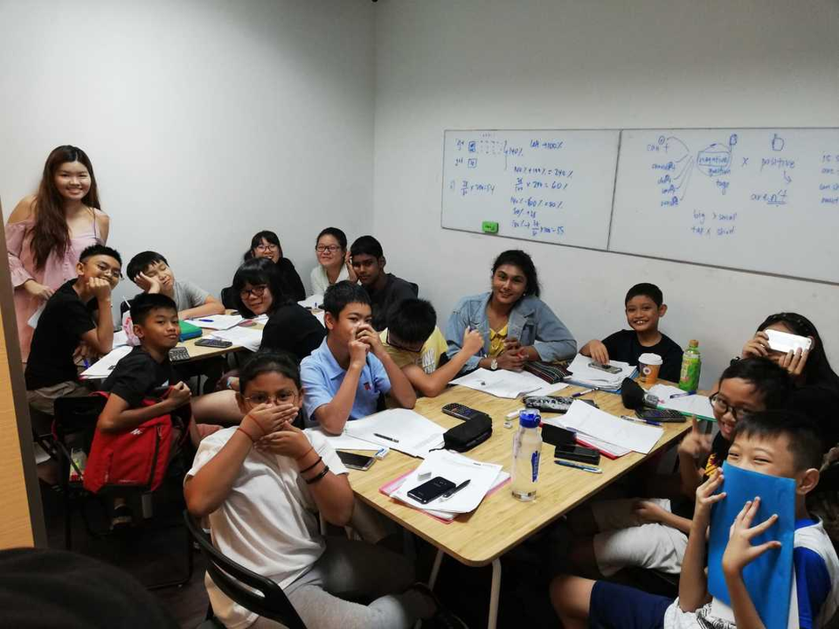
AEIS Tuition Exam Format Why EduFirst?
Since 2010, we have been offering AEIS/S-AEIS tuition to many students from China, Myanmar, Brunei, Malaysia, India, Indonesia, Pakistan, Hong Kong and Vietnam. Many of them have been successful in obtaining placements in our local schools.
Our group sizes are small, with a maximum of only 6 students in a class. We are familiar with the syllabus requirements and the type of questions that would be tested during the examination.

Slide 6
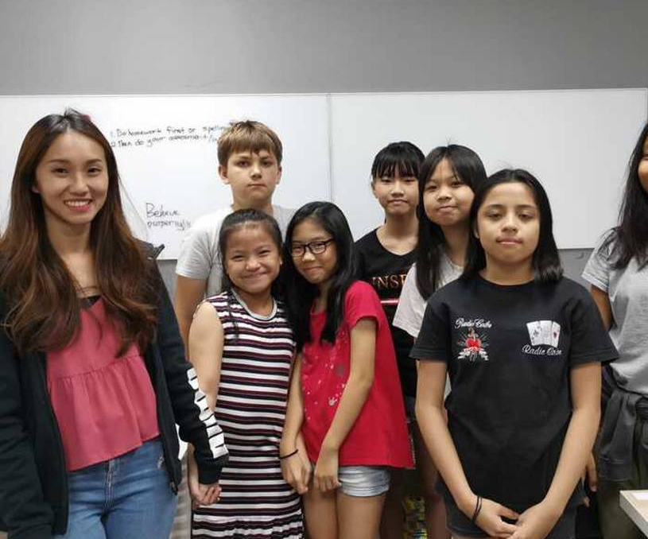
Final Thoughts
A Hougang tuition centre for physics does not simply teach formulas. It will boost your confidence significantly. Your doubts will vanish quickly, and tests will feel less intimidating. You will become braver and stronger. You cannot become confident overnight.
It needs the right environment that will be provided by the tuition center. Have faith in yourself. You will be able to master physics within a short time.
www.edufirst.com.sg

