Slide 1
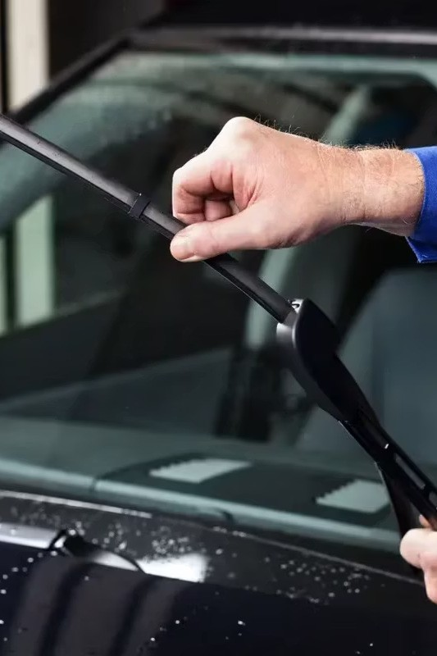


Do"'t Let Weatker Hold You Back
Ever been caught in a sudden downpour or faced dust-coated windscreens that make driving stressful? That moment of blurry vision is a risk no driver should face. Our premium car windscreen wipers ensure crystal-clear visibility in any condition.
carwindscreenwipers.com.au

Slide 2






PkD Ckooss O”r Pi;srs?
Frss Fns" DslivsrD
Nationwide shipping across Australia at no extra cost
9i ;ls Rs"”r"s
No hassle, no fuss return policy
D”il" "o lns"
Durable construction for long-term performance
6srodD"n ic Dssig"
Engineered for optimal performance
Tool-Frss I"s"nll
Easy installation in minutes
9"rsnk-Frss Frscisio"
Crystal clear cleaning every time
carwindscreenwipers.com.au

Slide 3
















Pi;srs Cor To; Cnr Drn"ds
Car Windscreen Wipers offers premium windscreen wipers for all your favorite car brands, ensuring perfect fit and performance.
carwindscreenwipers.com.au

Slide 4
Pkn" 9s"s 7s 6;nr"
D”il" Cor 6”s"rnlin" Ronds
Specially designed to handle unpredictable weather–from torrential rain to scorching heat–giving you reliable performance wherever you drive.
)CCor"lsss Rs;lncs s""
Save time with easy-to- install wipers. Whether a quick fix or complete replacement, our products fit seamlessly with most car models in minutes.
CrDs"nl Clsnr 9nCs"D Don't let streaks or smudges compromise your safety. Our
wipers deliver streak-free, precise cleaning for maximum visibility on the road.
Frovs" ❹”nli"D
Join thousands of satisfied Australian drivers who count on us for durable, high- performance wipers that exceed expectations.
carwindscreenwipers.com.au

Slide 5

O”r Co ;ls"s Frod”c" Rn"gs
Cnr Pi"dscrss" Pi;srs
Engineered with high-performance materials for streak-free, silent operation. Whether
drizzle or downpour, they'll clear your path every time.
Pi"dscrss" Pi;sr Rs;lncs s" "
Replace worn-out wipers quickly with our high-quality options. Built for perfect fit and lasting durability with hassle-free installation.
Rsnr Pi"dskisld Pi;sr Dlndss
Precision-designed to eliminate smears and streaks, giving you crystal-clear visibility no matter what's behind you.
carwindscreenwipers.com.au

Slide 6

Hon "o Ckooss "ks Rigk" Pi;srs
01
K"on ?o”r Ƭskicls
Check your car's manual or measure existing wipers to find the correct size for your windscreen.
02
Co"sidsr Psn"ksr Co"di"io"s
Choose wipers designed for your climate. Durable rubber and aerodynamic frames work best for heavy rain and dust.
03
look Cor ❹”nli"D Xn"srinls
Invest in wipers made with natural rubber or silicone for streak-free cleaning and extended durability.
04
Cksck I"s"nlln"io" )nss
Ensure wipers are compatible with your vehicle's arms. Most modern wipers offer tool-free installation.
carwindscreenwipers.com.au

Slide 7
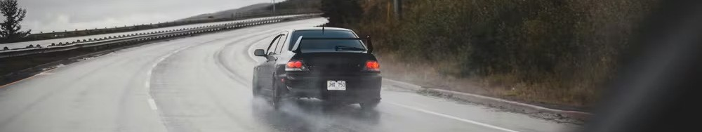




Rsnl Drivsrs, Rsnl Rsvisns
"After switching to these wipers, I noticed a real improvement in visibility. They handle all conditions much better than my previous ones."
"I've had my new wipers for a few weeks now. They do a solid job, and the installation was straightforward. Happy with the purchase."
"I didn't expect much, but these wipers have really impressed me. They leave a clear view without any streaking, even in heavy rain. Must try these on your car."
Venessa Tagore
Sydney, NSW
Saif Khalil
Melbourne, VIC
Liam Hill
Brisbane, QLD
carwindscreenwipers.com.au

Slide 8
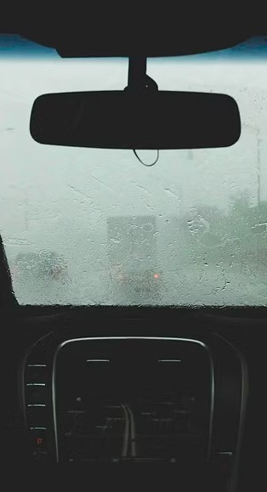
Ready for Clearer, Safer Drives?
Don't compromise your vision–upgrade to premium car windscreen wipers now! Whether it's heavy rain or dusty roads, our wipers offer unbeatable performance for over 3,500 car models.
Fast, Free Skippi"g
Delivered across Australia at no extra cost
Perfect Fit Guara"tee
Compatible with thousands of car models
Pre iu Quality
Built to withstand Australian conditions
Make the switch today for better visibility and safer driving!

Slide 9
Rsnck 7s -
Address:
Sydney, NSW, Australia, New South Wales
Contact No.:
0406261142
Email:
info@carwindscreenwipers.com.au
Website:
https://www.carwindscreenwipers.com.au/
Facebook:
https://www.facebook.com/carwindscreenwipers/
Instagram:
https://www.instagram.com/carwindscreenwipers
YouTube:
https://www.youtube.com/channel/UCvSnKspHJnQQvL2yKV5T-Kw
carwindscreenwipers.com.au

