Slide 1

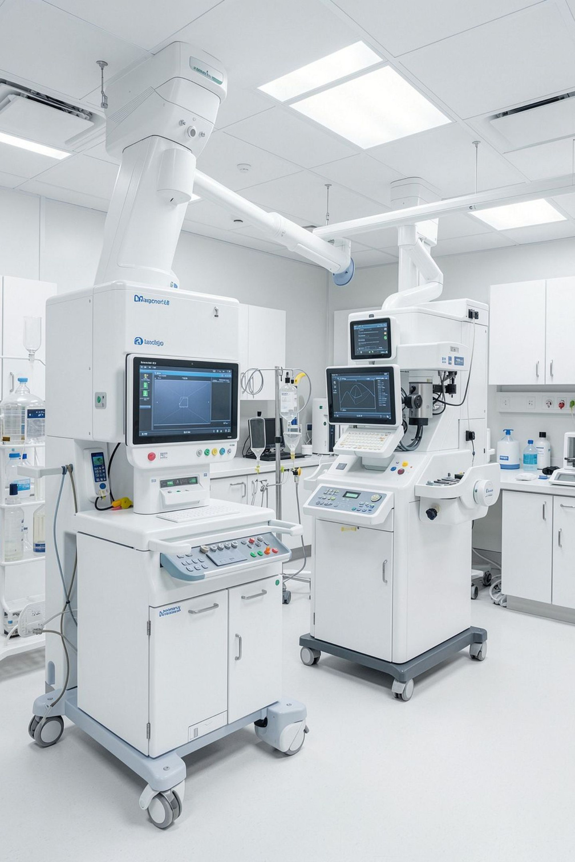

WellCare Labs
Complete Diagnostic & Health Testing Services — Reliable laboratory testing for better health awareness.
WELLCARELABS.IN

Slide 2

About WellCare Labs
WellCare Labs provides diagnostic testing and health checkup services with a focus on accessible, convenient, and reliable diagnostic care. Our services are designed for routine health monitoring and preventive screening — making it easier for patients to stay informed about their health.

Slide 3






Our Diagnostic Services
Blood Tests
Health Checkups
Comprehensive blood analysis for key health markers
Full-body screening packages for routine monitoring
Preventive Screening
Specialized Lab Tests
Early detection tests to identify health risks
Advanced diagnostics for specific medical needs
Checkup Packages
Home Sample Collection
Curated packages for different health requirements
Convenient sample pickup at your doorstep

Slide 4



PREVENTIVE HEALTHCARE
Full Body Health Checkups
Our comprehensive health screening options help monitor multiple health parameters at once. Different packages are available to suit different health requirements, making it easy to choose the right level of screening for your needs.
Multi-parameter monitoring
Routine preventive healthcare
Convenient testing options in Pune

Slide 5
Popular Blood Tests
CBC Test
1
Complete Blood Count for overall health assessment
LFT Test
2
Liver Function Test to evaluate liver health
Thyroid Tests
3
Screening for thyroid function and hormone levels
Testosterone & Prolactin
4
Hormone tests for reproductive and metabolic health
Vitamin & Diabetes Tests
5
Key screenings for nutrient levels and blood sugar

Slide 6

Health Checkup Packages
Complete & Full Body
Comprehensive screening covering all major health parameters
Male & Female
Gender-specific checkups tailored to unique health needs
Vitamin Screening
Packages focused on vitamin and nutrient deficiency detection
Diabetes & Fitness Panels
Specialized panels for metabolic health and fitness monitoring

Slide 7


Home Sample Collection
WellCare Labs offers convenient sample collection at home, reducing the need to visit a diagnostic center. Our home collection service is suitable for routine blood testing and health screening — designed for greater convenience and accessibility.
Doorstep convenience
No clinic visit needed
Routine & screening tests

Slide 8
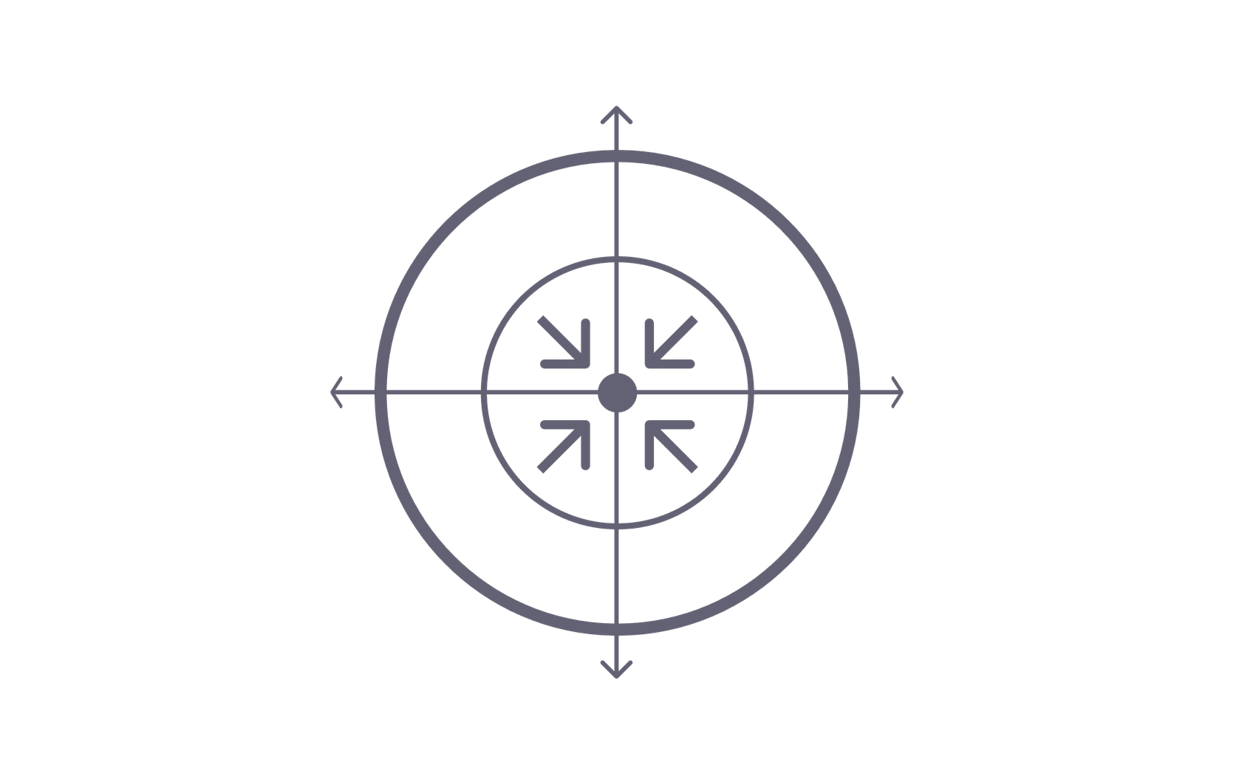
Why Preventive Testing Matters
Regular Monitoring
Proactive Management
Early Detection
Doctor Evaluation
Preventive testing supports regular health monitoring, helps identify abnormal results that need medical attention, and enables doctors to evaluate health information alongside symptoms and medical history — encouraging proactive health management.

Slide 9





Why Choose WellCare Labs
Wide Test Range
A wide range of diagnostic tests and health checkup packages for different needs
Convenient Services
Convenient testing services including home sample collection for greater accessibility
Professional Support
Professional laboratory support with easy online access to diagnostic information
Customer Focus
Strong focus on customer convenience throughout the testing process

Slide 10
Contact WellCare Labs
📍 Location
🕐 Operating Hours
Shop 113, First Floor, A-Wing, Sai Vision Mall, Pimple Saudagar, Pimpri-Chinchwad, Pune, Maharashtra – 411027
24×7
WellCare Labs is available around the clock for all your diagnostic and health testing needs in Pune.
📞 Phone
+91 9158980898
PUNE, MAHARASHTRA
DIAGNOSTIC SERVICES
✉️ Email
info@wellcarelabs.in
🌐 Website
wellcarelabs.in

