Slide 1


Quora Web Solution
Website Design and
Development
Company
Web Design & Web Development
Company in Bangalore, India
www.quorawebsolution.com
+91 9986 056 909
info@quorawebsolutions.com
24A, 1st Main Rd, Chandra Reddy
Layout, Koramangala 4th Block,
Koramangala, Bengaluru,
Karnataka 560034

Slide 2

The Role of UX/UI in Website Design: What Every Business Should Demand from a Development Partner
In today’s fast-paced digital landscape, your website often serves as the first interaction between your business and potential clients. As such, it’s crucial that your website not only captures attention with appealing visuals but also provides an intuitive, seamless experience.
www.quorawebsolution.com

Slide 3

This is where the principles of User Experience (UX) and User Interface (UI) design become essential. To ensure your website's success, businesses must understand the significance of both UX and UI and what they should expect from a web development partner.
Understanding UX and UI
www.quorawebsolution.com

Slide 4
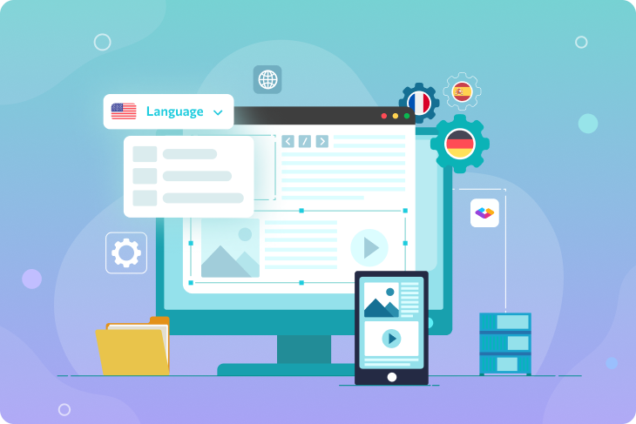
Before diving into the importance of UX/UI, it's essential to differentiate the two concepts:
The User Interface (UI) refers to the visual design and layout of a website. This includes elements like buttons, colors, typography, images, and overall aesthetic appeal. UI is all about creating an attractive, easy-to-use interface that facilitates engagement.
www.quorawebsolution.com

Slide 5

UX (User Experience), on the other hand, focuses on how a user interacts with the website. It encompasses everything from ease of navigation to speed, functionality, and overall user satisfaction. A well-designed UX ensures that users find the website easy to navigate and intuitive to use.
In essence, UI is how your website looks, and UX is how it feels and functions. For a website to succeed, both need to work harmoniously together.
www.quorawebsolution.com

Slide 6
Why UX/UI Design Matters for Your Business
1. First Impressions Matter
Visitors form an opinion about your website in just a few seconds. If your website looks cluttered or is hard to navigate, users will leave before you even have a chance to engage them. A clean, visually appealing UI combined with smooth, effortless navigation can make an excellent first impression, keeping visitors interested and engaged.
2. Boosts Conversion Rates
One of the key reasons to prioritize UX/UI is its direct influence on conversion rates. Whether you're trying to get visitors to sign up for a newsletter, buy a product, or fill out a form, the design of your website plays a crucial role in driving those actions.
www.quorawebsolution.com

Slide 7
A user-friendly interface, paired with an intuitive experience, makes it easier for users to complete tasks and take action, which ultimately increases conversions.
3. Builds Trust and Credibility
Your website reflects your brand. A polished, functional design conveys professionalism and establishes trust with your audience. When users encounter a website with a confusing interface, long load times, or outdated design, they may question your brand’s credibility. A smooth, consistent UX/UI can solidify your brand’s reputation and encourage users to stay longer.
4. Improves SEO and Retention
An optimized website, with well-designed UX/UI elements, is more likely to rank higher in search engine results.
www.quorawebsolution.com

Slide 8
Google’s algorithms favor websites that offer fast load times, mobile compatibility, and a great user experience. Additionally, sites that are easy to navigate and provide an enjoyable experience are more likely to retain visitors, reducing bounce rates and improving SEO rankings.
What to Expect from Your Development Partner
When choosing a website design and development company, you should demand a strong focus on both UX and UI. Here’s what you should expect from a professional development partner:
1. User-Centered Design
Your development team should take a user-centric approach, considering your target audience’s needs, preferences, and behaviors. They should use data and research to inform design choices, ensuring the website aligns with user expectations and business objectives.
2. Prototypes and Wireframes
www.quorawebsolution.com

Slide 9
A reliable development partner will provide you with wireframes and prototypes early in the design process. These allow you to visualize how the website will function and look before any coding begins, giving you the opportunity to refine and optimize the layout.
3. Mobile Optimization
With more people browsing the web via smartphones, your website must be mobile-responsive. A mobile-first design ensures that users have a seamless experience, whether they’re on a phone, tablet, or desktop. Expect your development partner to prioritize mobile optimization as a key part of the design process.
4. Accessibility
An accessible website ensures that all users, regardless of their abilities, can navigate your site effectively.
www.quorawebsolution.com

Slide 10
A reputable development partner will adhere to web accessibility guidelines, ensuring that your site is usable for individuals with disabilities, including those using screen readers or other assistive technologies.
5. Continuous Testing and Refinement
UX/UI is an ongoing process. Your development partner should continually test the website’s usability, making adjustments based on user feedback and behavior. This iterative approach helps ensure that your website remains effective and optimized for user engagement over time.
Conclusion
UX/UI design is integral to creating a successful website. A website that is visually appealing, functional, and easy to navigate enhances user satisfaction, boosts conversion rates, and strengthens your brand’s reputation.
www.quorawebsolution.com

Slide 11
When working with a development partner, make sure they understand the critical importance of UX and UI. By prioritizing user experience and interface design, you can create a website that not only attracts visitors but converts them into loyal customers.
How Website Design and Development Companies Integrate SEO, UX, and Branding to Create Websites That Perform and Deliver Results
In today’s digital world, businesses must have an online presence that not only looks appealing but also functions effectively and delivers measurable results.
www.quorawebsolution.com

Slide 12
A well-designed and developed website does just that—connecting brands with their audience while enhancing visibility, user experience, and overall performance. To achieve this, top-tier website design and development companies integrate three critical components: SEO (Search Engine Optimization), UX (User Experience), and branding. Together, these elements play an essential role in creating a website that is not only visually stunning but also performs well in search engines, engages users, and reflects the brand's identity.
SEO (Search Engine Optimization) for Visibility
SEO plays a crucial role in every website development project. A beautifully designed site can go unnoticed if it is not optimized for search engines like Google, Bing, or Yahoo. Website design and development companies make sure that SEO best practices are integrated into websites from the very beginning.
They begin by researching and incorporating relevant keywords into the website’s content, structure, and metadata. This helps the site rank higher in search engine results, increasing organic traffic.
www.quorawebsolution.com

Slide 13
SEO-friendly website development also involves optimizing website speed, mobile responsiveness, and site architecture—making sure the site loads quickly and is accessible on all devices.
Additionally, these companies ensure proper internal linking, creating an easy-to-navigate structure that helps both search engines and users find key pages. By focusing on SEO from the outset, businesses can improve their search engine rankings and attract more visitors to their website, which is crucial for generating leads and growing online sales.
UX (User Experience) for Engagement
User experience (UX) refers to how visitors interact with a website and how easy and enjoyable that interaction is. A website that’s hard to navigate or slow to load can frustrate visitors and drive them away. Website design and development companies are keenly aware of the importance of a seamless UX and design websites with this in mind.
www.quorawebsolution.com

Slide 14
When integrating UX, the focus is on creating a clear, intuitive navigation system that allows visitors to find information quickly. Designers employ user-centric design principles, ensuring that websites are aesthetically pleasing, visually organized, and easy to navigate. They also emphasize responsive design, making sure the site adapts perfectly to different screen sizes and devices, especially mobile phones, where the majority of users now access websites.
To further enhance the user experience, website developers focus on speed optimization, minimizing load times to reduce bounce rates. Fast loading times and smooth interactions lead to better user retention, increased engagement, and higher conversion rates. A positive UX fosters trust with visitors and encourages them to explore further, whether it’s reading blog posts, filling out contact forms, or making purchases.
Branding for Identity
www.quorawebsolution.com

Slide 15
Branding is about representing your business’s values, voice, and image consistently across every touchpoint, including your website. A website is often the first impression a potential customer has of a brand, and it must accurately reflect the company’s personality and core values.
Website design and development companies ensure that the branding elements—such as color schemes, typography, logos, and imagery—are aligned with the company’s branding guidelines. The visual design is crafted to evoke the right emotions and reinforce the brand’s identity. Whether it’s a modern, professional look or a playful, creative aesthetic, the website’s design must communicate the essence of the business.
Additionally, content plays a pivotal role in branding. The tone, messaging, and content style should align with the target audience's preferences and build trust.
www.quorawebsolution.com

Slide 16
Website development companies work closely with businesses to create consistent, compelling content that complements the site’s design and enhances its ability to connect with visitors on an emotional level.
The Synergy of SEO, UX, and Branding
When SEO, UX, and branding are effectively integrated into the website design and development process, the result is a high-performing website that not only attracts traffic but also engages visitors and strengthens the brand’s reputation. These elements complement each other:
SEO drives more qualified traffic to the site.
UX ensures that visitors remain engaged, interact, and take action.
Branding reinforces the company’s identity and builds trust.
www.quorawebsolution.com

Slide 17
By integrating these three components, website design and development companies create websites that deliver results—boosting visibility, improving user engagement, and enhancing brand presence. The end product is a website that not only meets the needs of the business but also provides a memorable experience for users.
Conclusion
Website design and development is now about more than just creating visually attractive sites. It’s about creating websites that are functional, engaging, and aligned with the brand’s identity.
www.quorawebsolution.com

Slide 18
By focusing on SEO, UX, and branding, professional website design and development companies ensure that the website performs at its best, delivering both short-term and long-term results. Whether it’s attracting more visitors, increasing conversions, or strengthening brand loyalty, the integration of these key elements is essential for a website to truly thrive in the competitive digital landscape.
www.quorawebsolution.com

Slide 19
Quora Web Solution: Quora Web Solution is a trusted website development company based in Bangalore, India, offering a wide array of services to not only domestic but global clientele. Be it Website Design and Development, SEO services, Digital Marketing, Branding, App Development, Ecommerce Solution, and Logo Creation . Quora Web Solution has the best website developers offering top quality services and that is the reason why we are well known as one of the best Website Development Companies in Bangalore, India.
Visit Us - www.quorawebsolution.com
Call Us - +91 9986 056 909
Mail Us - info@quorawebsolutions.com
www.quorawebsolution.com

Slide 20

WORDPRESS DEVELOPMENT
ECOMMERCE DEVELOPMENT
PHP DEVELOPMENT
CMS DEVELOPMENT
DRUPAL DEVELOPMENT
WEBSITE SERVICES
WEBPORTAL DEVELOPMENT
MAGENTO DEVELOPMENT
WEBSITE DEVELOPMENT
JOOMLA DEVELOPMENT
SMALL BUSINESS DEVELOPMENT
CHEAP WEBSITE DEVELOPMENT
STATIC WEBSITE DEVELOPMENT
DYNAMIC WEBSITE DEVELOPMENT
WEBSITE DESIGN COMPANY
TOUR AND TRAVEL WEBSITE DEVELOPMENT
Services

