Slide 1
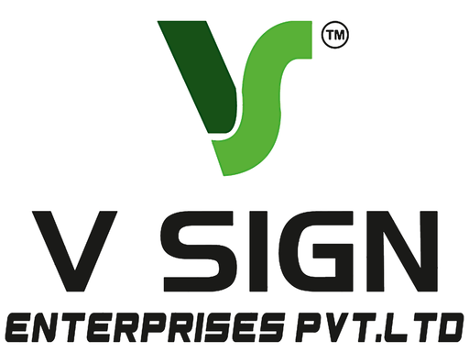
ACP LED SIGN BOARD HYDERABAD
Premium ACP LED Sign Boards for Modern Business Branding
ACP LED Sign Board Hyderabad is an effective signage solution for businesses looking for durability, visibility, and a professional appearance.

Slide 2
Why Businesses Choose
ACP Sign Boards
  Lightweight yet strong structure
  Clean and modern appearance
  Flexible design possibilities
  Suitable for outdoor branding
  Easy to customize
  Excellent brand visibility

Slide 3
Benefits of ACP LED Sign Boards
High Visibility
Professional Appearance
Custom Designs
Durable Construction
Energy-Efficient Lighting

Slide 4
Suitable for Different Businesses
ACP LED Sign Board Hyderabad can be customized
according to the business type, building design, and
available installation space.

Slide 5
ACP LED Sign Board Solutions Include
  3D Acrylic Letters on ACP
  Stainless Steel Letters on ACP
  Backlit LED Sign Boards
  Frontlit LED Sign Boards
  Weather-resistant outdoor signage
  Customized sizes and colors

Slide 6
Our Signage Process
From Design to Installation
  Site Survey
  Design
  Fabrication
  Installation

Slide 7
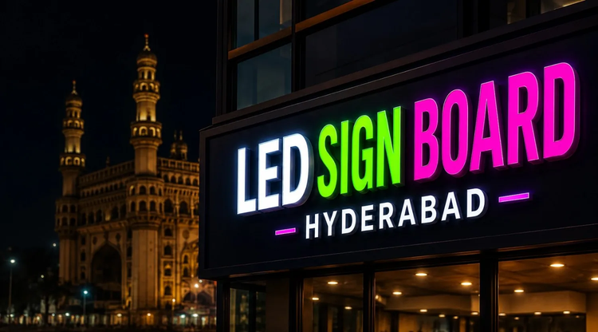
Make Your Brand More Visible
Contact V Sign Enterprise Pvt. Ltd.
Website:
www.vsignpvtltd.com
Phone:
099087 06363
Email:
vsign.pvtlt@gmail.com
plot no : 27 &28, Plot No. 27, Rd Number 1, Samathapuri Colony, New Nagole, Samathapuri, Kothapet, Hyderabad, Telangana 500102
Address:

