Slide 1
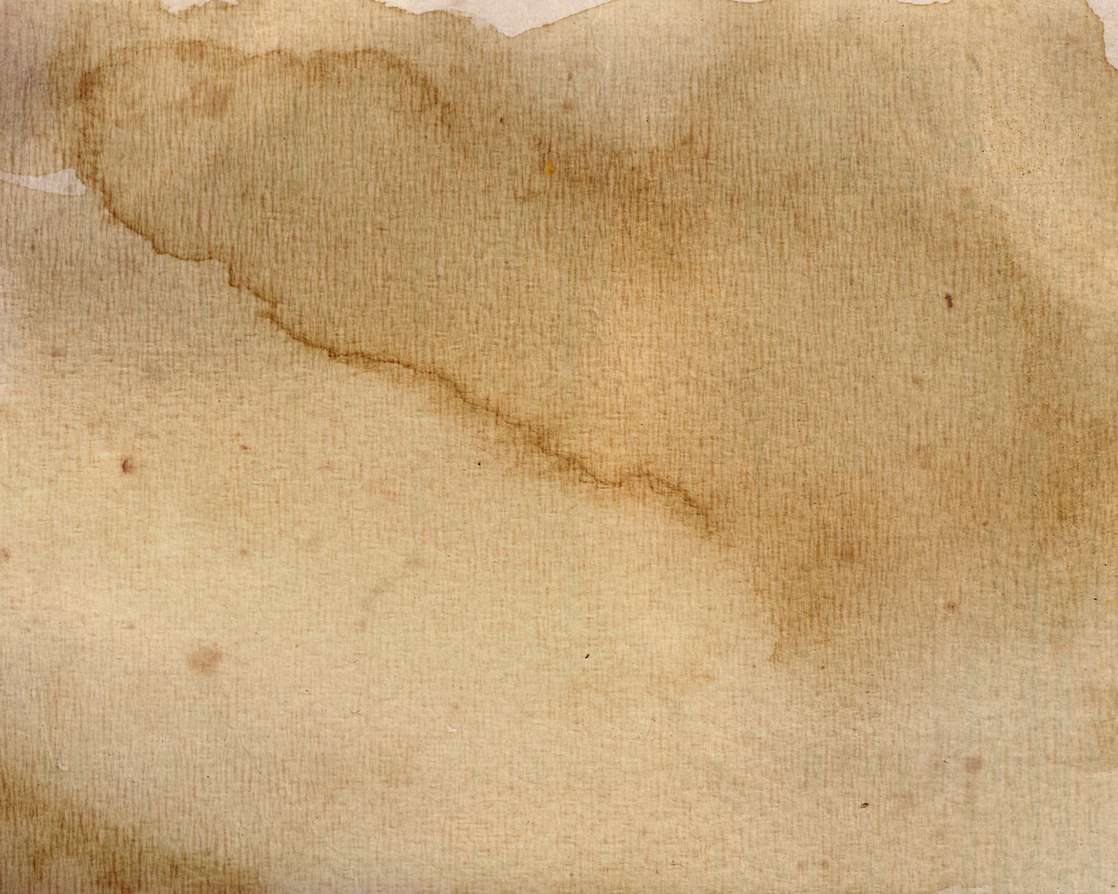
Best Hair Transplant Clinic in London
Experience the best hair transplant clinic in London offering surgical techniques, natural-looking results, expert care, and personalised treatment plans.

Slide 2
Hair Transplant Reviews Manchester
Read genuine hair transplant reviews in Manchester showcasing real patient experiences, natural results, recovery journeys, and trusted care from Dr Ditta.

Slide 3
Hair Restoration Surgeon UK
Choose a trusted hair restoration surgeon in UK delivering natural hair transplant results through advanced techniques, personalised care, and proven expertise.

Slide 4
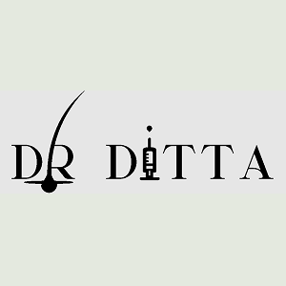
Contact Us
About: Dr. Ditta Hair Transplants provides expert, natural-looking hair restoration across the UK, led by GMC-registered surgeon Dr. Ditta, delivering outstanding, proven patient results.
Address: Cheshire, London, Manchester, England, UK
Phone No.: 07300 825 826
Website: https://drdittahairtransplant.com/

