Slide 1

MicroThermics: Aseptic Filling Machine
Aseptic Filling Machine

Slide 2
About Us
MicroThermics is a global leader in small batch pasteurizers, HTST/UHT pasteurization, sterilizers, and aseptic processors. Many everyday products, from beverages to medications, are developed or produced using our equipment. We also collaborate with MTI BioScience to develop liquid cannabis products and extract cannabinoids like CBD. Companies choose us to reduce development costs, increase efficiency, and accelerate market entry. Our commitment to quality and innovation, supported by a dedicated team, ensures top-tier products and services.

Slide 3
What is Aseptic Filling?
Aseptic filling is a sterile packaging process that eliminates harmful microorganisms from both the product and the packaging environment. This ensures the product's safety and integrity throughout its shelf life, without the need for preservatives or refrigeration.
MicroThermics: Leading the Aseptic Revolution
MicroThermics is a frontrunner in the aseptic processing equipment domain. For years, we've been empowering manufacturers with cutting-edge solutions that guarantee unmatched precision, performance, and efficiency.

Slide 4
Why Choose MicroThermics Aseptic Filling Machines?
Uncompromising Safety and Quality: Our machines are designed to meet the most stringent regulations, ensuring the sterility of your products from filling to sealing.
Versatility Across Applications: From dairy and juices to plant-based alternatives, our aseptic filling machines can handle a wide range of food and beverage products.
Enhanced Efficiency and Reduced Waste: MicroThermics' technology streamlines production processes, minimizing waste and maximizing your output.
Future-Proofing Your Operations: With a commitment to innovation, MicroThermics ensures you have the tools to stay ahead of evolving safety standards and consumer preferences.

Slide 5
Beyond the Machine: MicroThermics Expertise
MicroThermics offers more than just best-in-class aseptic filling machines. Our team of experts is dedicated to providing comprehensive support, including:
Application-specific consultations to identify the ideal solution for your needs.
Seamless integration with existing production lines.
Ongoing service and maintenance to ensure optimal performance.

Slide 6
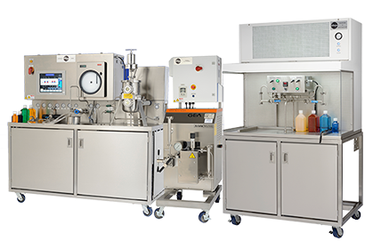
Investing in Your Success
MicroThermics aseptic filling machines are an investment in the future of your food and beverage production. Contact us today to discuss how our solutions can elevate your product quality, extend shelf life, and empower you to meet the ever-growing demand for safe, delicious, and long-lasting products.

Slide 7
Contact Us
3216–102 Wellington Ct. Raleigh, NC 27615 USA
Phone: 9198788045
Email: info@microthermics.com
https://www.linkedin.com/company/microthermics-inc
https://www.facebook.com/microthermics
https://twitter.com/microthermics
https://microthermics.com/

