Slide 1

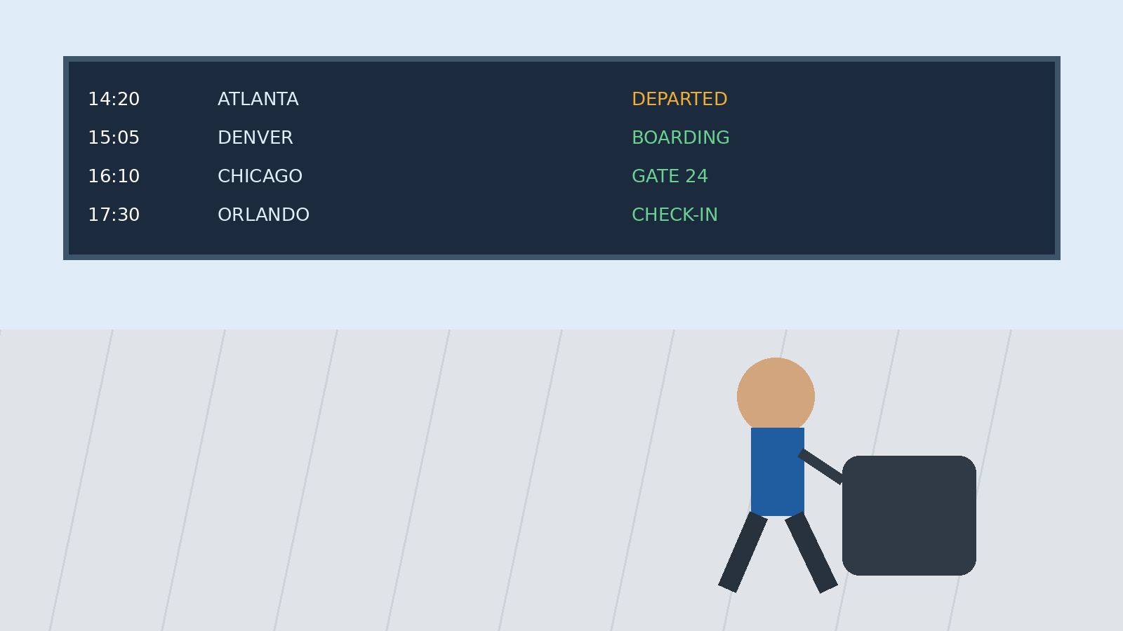
Frontier Airlines Missed Flight
What to Do Next: A Step-by-Step Guide
Stay calm, check your options, and take the right next step.
Call: +1-888-212-0809
AirFlyPolicy.com

Slide 2
Introduction
Missing a flight can be stressful, but the next steps are usually easier when you act quickly. This guide explains what to check, who to contact, and how to protect the rest of your itinerary. If you are dealing with a frontier airlines missed flight, focus first on your booking status and available travel options.
• Check your itinerary and departure status.
• Contact the airline as soon as possible.
• Ask what options apply to your ticket.
AirFlyPolicy.com | Frontier Airlines Travel Guide | 2/10

Slide 3
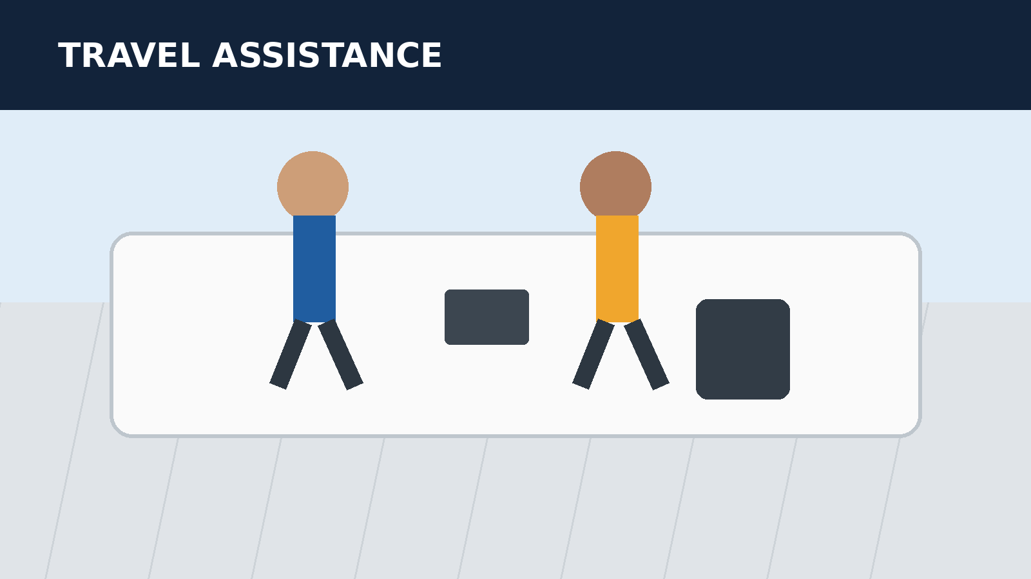
What to Do Immediately After Missing Your Frontier Flight
If you realize you will not make the departure, avoid waiting until later in the day. Check your reservation, confirm the flight status, and speak with an airline representative. Acting promptly can help you understand whether any rebooking or other assistance is available under the conditions attached to your itinerary.
• Confirm whether the flight has already departed.
• Keep your confirmation and identification ready.
• Ask clearly what your immediate options are.
AirFlyPolicy.com | Frontier Airlines Travel Guide | 3/10

Slide 4
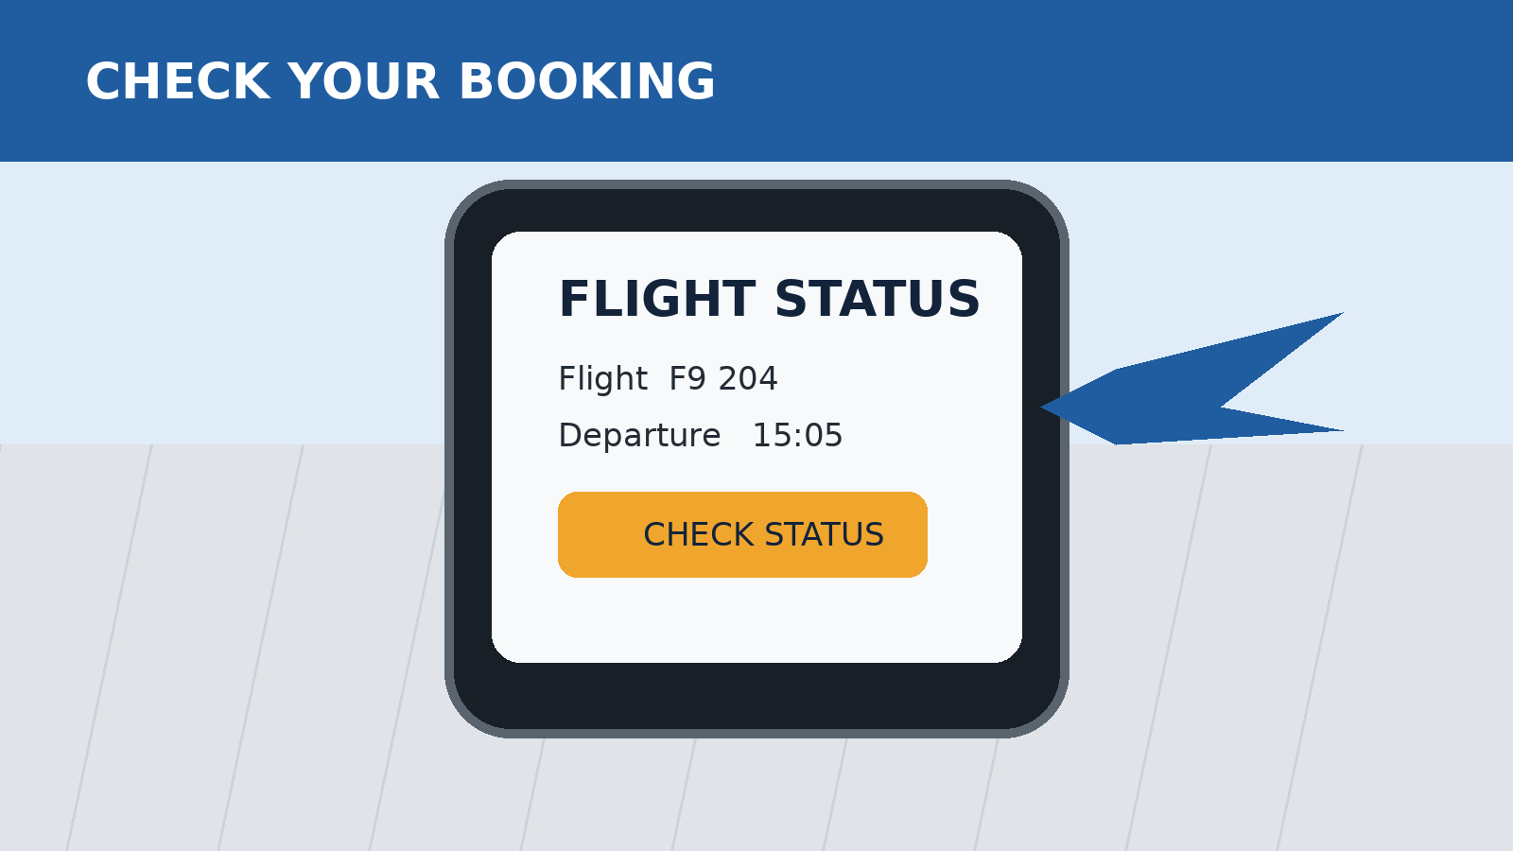
Check Your Booking and Flight Status
Start with the reservation details connected to your trip. Review the flight number, date, departure time, and itinerary segments. This helps you identify whether the missed departure affects only one flight or other connected travel. Use the latest booking information when speaking with an airline representative.
• Verify the booking reference and passenger name.
• Check every segment in the itinerary.
• Look for schedule or status updates.
• Keep screenshots or confirmation emails available.
AirFlyPolicy.com | Frontier Airlines Travel Guide | 4/10

Slide 5
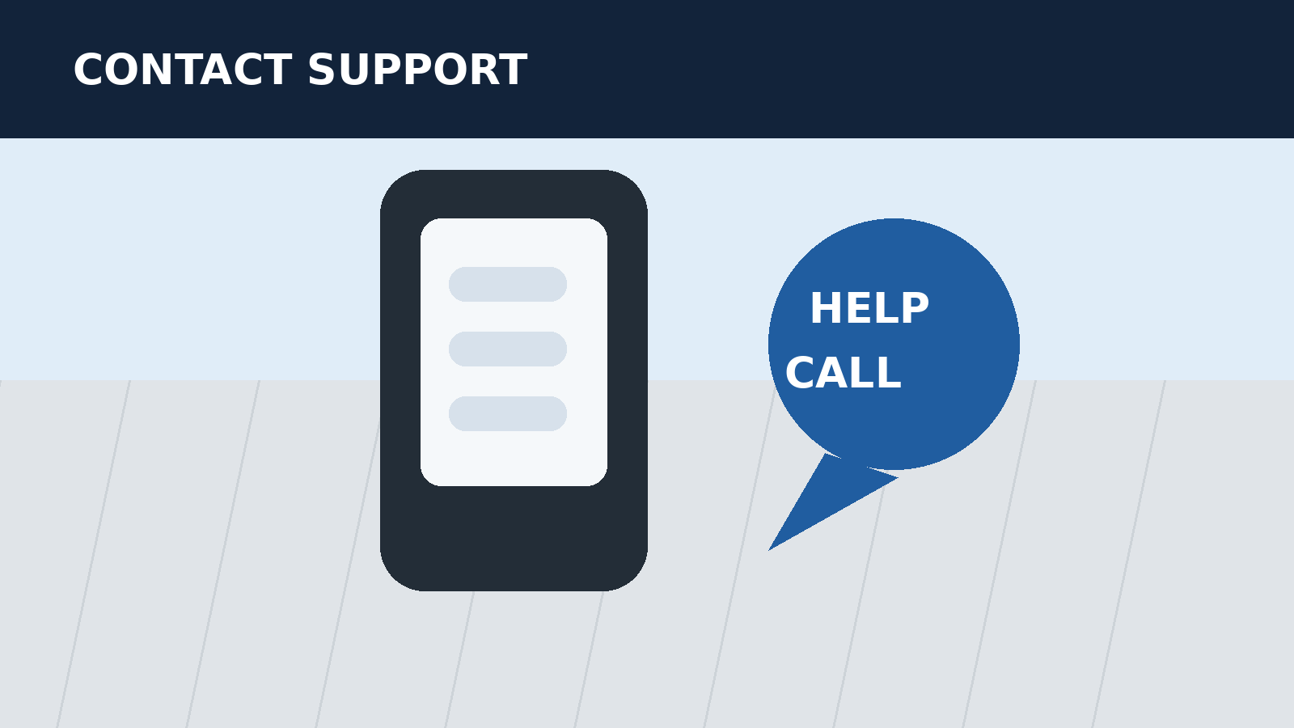
Contact Frontier and Ask About Your Options
Once you confirm the situation, contact Frontier through an appropriate customer-service channel or speak with an airport representative. Explain that you missed the scheduled departure and ask what choices are currently available. Keep the conversation focused on your booking so the representative can review the applicable options.
• Provide your confirmation details accurately.
• Ask whether your reservation remains active.
• Request available alternatives for your journey.
• Note any instructions you are given.
AirFlyPolicy.com | Frontier Airlines Travel Guide | 5/10

Slide 6
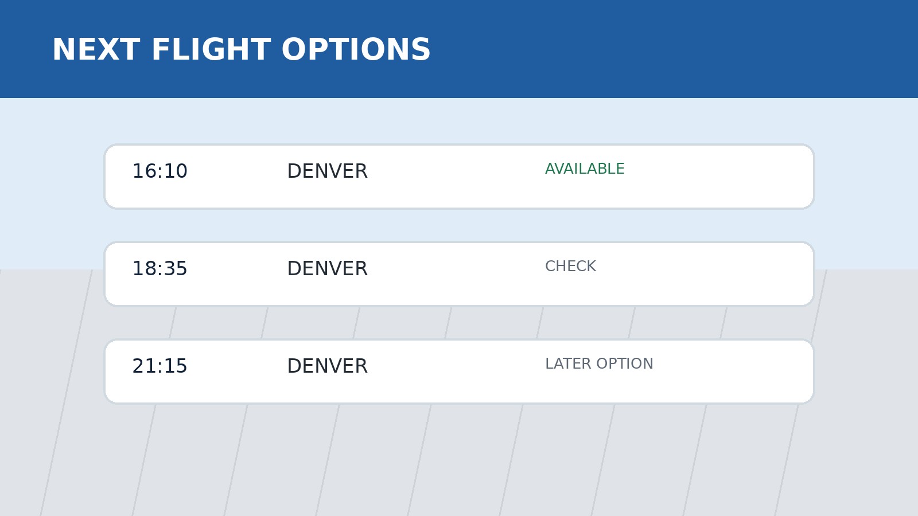
Understand Same-Day or Rebooking Possibilities
Depending on your fare, booking conditions, timing, and availability, different solutions may apply after a missed departure. Do not assume that every ticket receives the same treatment. Ask specifically what rebooking possibilities are available and whether you need to take action immediately to continue your trip.
• Ask about the next available flight.
• Confirm any conditions attached to the option.
• Check whether your original itinerary remains usable.
• Get the updated itinerary in writing.
AirFlyPolicy.com | Frontier Airlines Travel Guide | 6/10

Slide 7
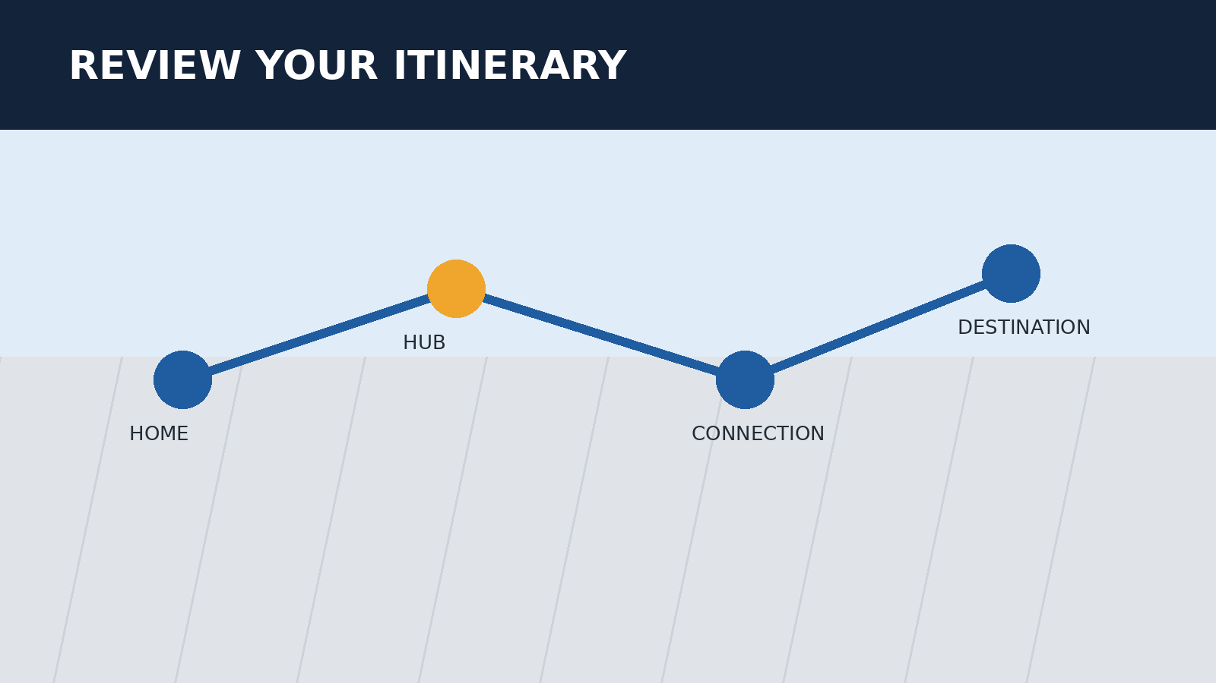
Know What Happens to Your Remaining Itinerary
A missed departure can affect later segments, especially when several flights are linked in one reservation. Before making new plans, ask whether the rest of your itinerary is still active. Confirm each remaining segment so you do not arrive at the airport expecting a flight that is no longer available.
• Review all remaining flight segments.
• Ask how the missed segment affects the booking.
• Confirm the status of onward flights.
• Save any updated confirmation details.
AirFlyPolicy.com | Frontier Airlines Travel Guide | 7/10

Slide 8
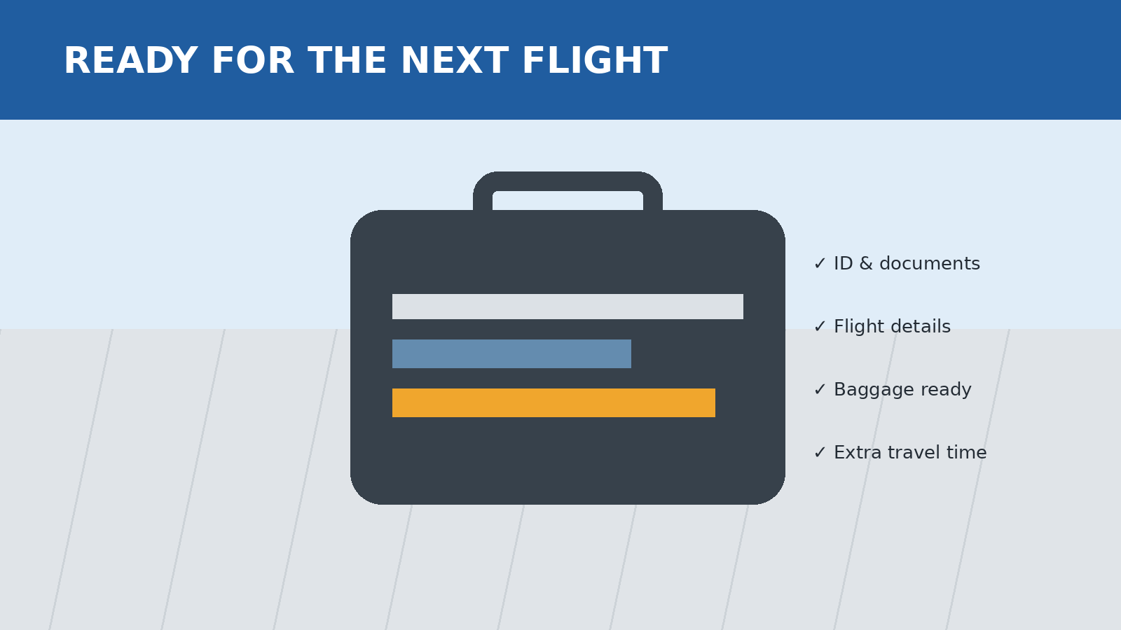
Prepare for Your Next Flight
After securing your next travel plan, prepare carefully for the revised departure. Recheck the airport, terminal information, flight time, baggage requirements, and identification documents. Build extra time into your schedule and monitor updates before leaving. A simple checklist can reduce stress and help prevent another missed departure.
• Reconfirm the new departure details.
• Check in according to the current instructions.
• Allow extra airport travel time.
• Keep your documents and booking information accessible.
AirFlyPolicy.com | Frontier Airlines Travel Guide | 8/10

Slide 9
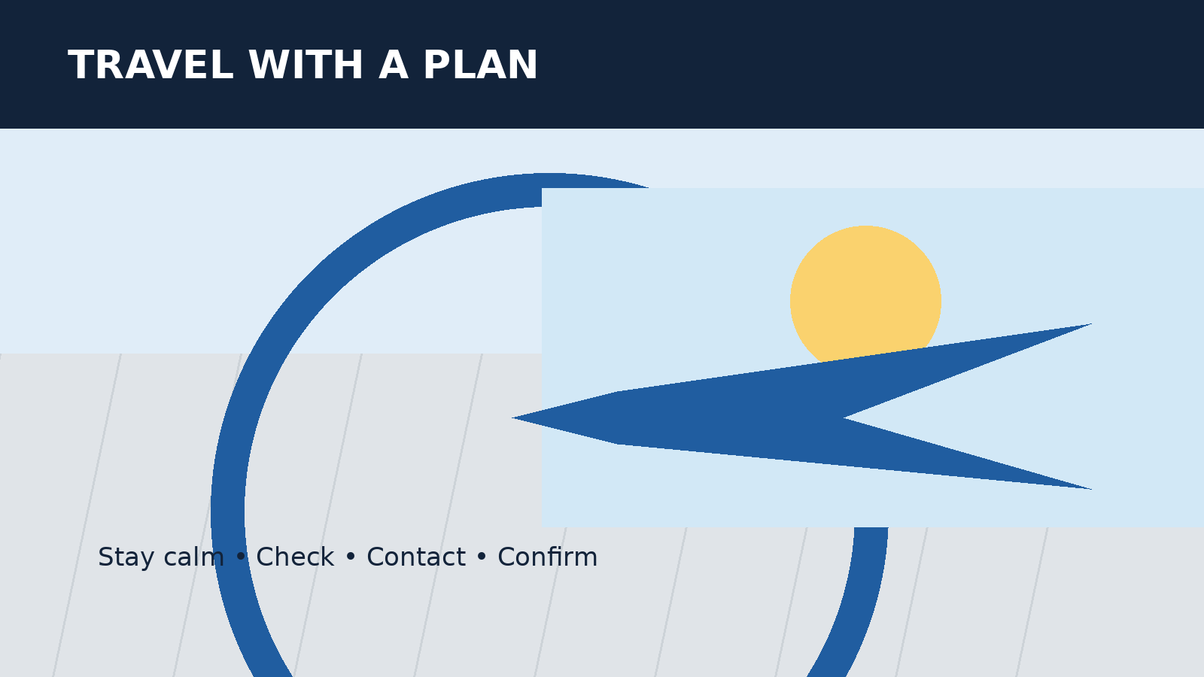
Conclusion
A missed departure does not mean you should stop planning. Review your booking, contact the airline promptly, and confirm how the remaining itinerary is affected. For a frontier airlines missed flight, staying organized and asking clear questions can help you understand the practical next steps.
Need travel assistance?
Call +1-888-212-0809
Keep your booking details ready for faster assistance.
AirFlyPolicy.com | Frontier Airlines Travel Guide | 9/10
AirFlyPolicy.com | Frontier Airlines Travel Guide | 9/10

Slide 10
Contact AirFlyPolicy
Website
https://www.airflypolicy.com/
Phone
+1-888-212-0809
Travel information and booking assistance
AirFlyPolicy.com
Original travel illustrations created for this presentation.

