Slide 1

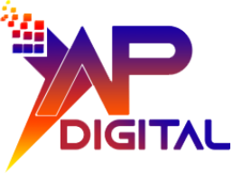
XapDigital · Integration planning
Native vs Middleware
vs Custom API:
Integration Decision Guide
Choose the connection that fits your workflow,
delivery constraints, and long-term ownership.
A practical guide for business and operations leaders

Slide 2

Define the project
Start with the
business outcome
Describe what must work before choosing how systems connect.
Map the workflow
Define the workflow, systems, data, timing, and consequence of failure.
Set the delivery boundaries
Set the project owner, budget, deadline, and success measures.
2

Slide 3
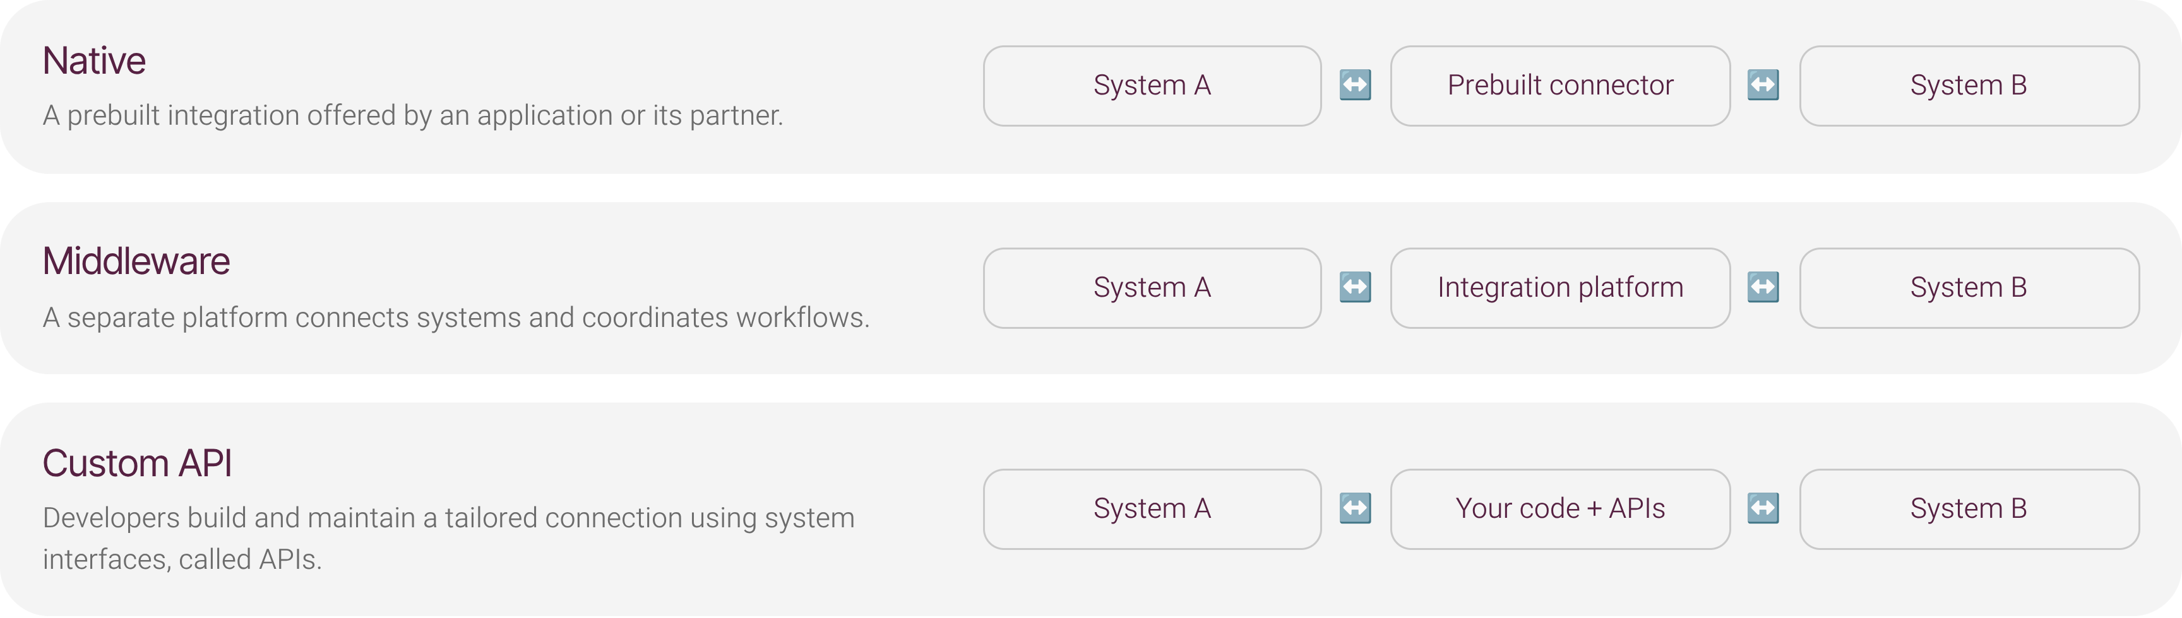
Understand the approaches
Three routes connect systems differently
3

Slide 4
Weigh the trade-offs
Compare speed, flexibility, and ownership
Dimension | Native | Middleware | Custom API
Speed | Can be quickest when the connector fits | Prebuilt tools can accelerate coordination | Requires engineering and testing
Flexibility | Features depend on the provider | Coordinates workflows and reuses integrations | More control over tailored behavior
Ownership | Provider controls connector changes | Adds platform costs and dependency | Your team maintains the code over time
Qualitative trade-offs, not numerical scores or guarantees. Confirm capabilities for your specific systems.
4

Slide 5
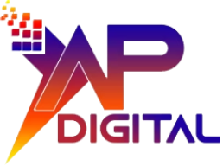
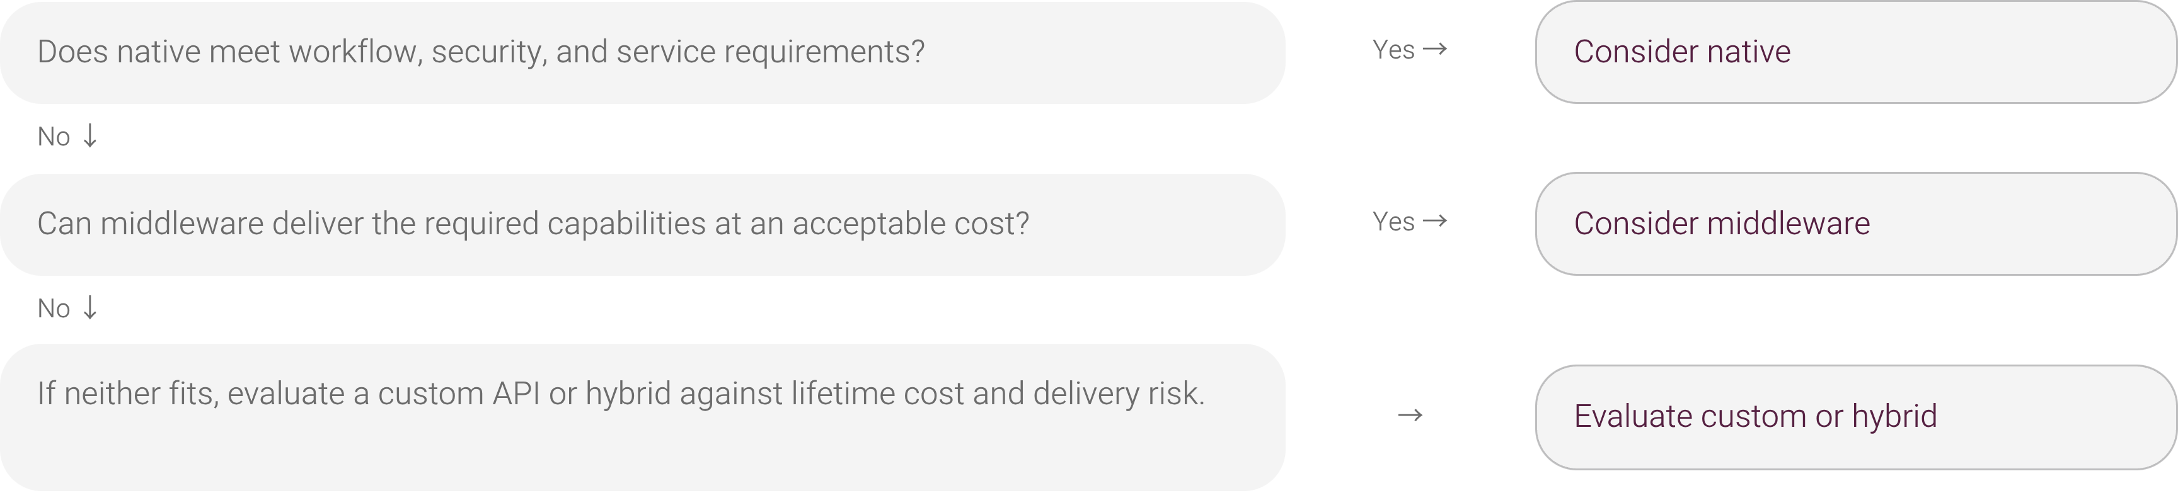
Make the decision
Choose based on fit, then validate
Validate the shortlist with a representative workflow and failure-recovery test before committing.
5

Slide 6



Plan beyond launch
Account for the full lifecycle
The delivery estimate is only part of the commitment.
Confirm capability
Price the lifetime
Own the operation
Evaluate data coverage, timing, security, reliability, and vendor support.
Compare setup, licensing, engineering, monitoring, changes, and exit costs.
Assign an owner for incidents and data quality, and test failure recovery.
6

Slide 7
XapDigital
Contact Us
Discuss your ecommerce integration project with XapDigital.
info@xapdigital.com
Explore XapDigital ecommerce solutions
Contact XapDigital

