Slide 1

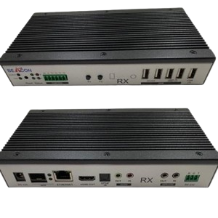
WHY A KVM EXTENDER OVER IP IS THE FUTURE OF REMOTE WORKSPACES?
www.avextender.com

Slide 2
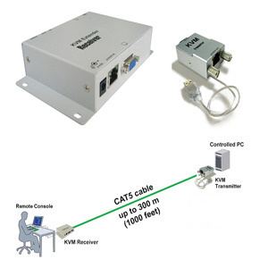
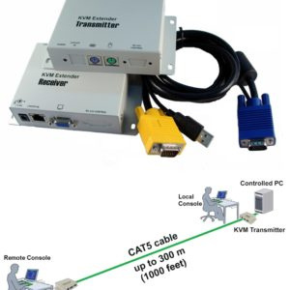
INTRODUCTION
As time progresses, remote work has advanced from a ‘stop-gap’ solution to a ‘go-to’ method for how businesses operate today. Employees seek tools that offer more flexibility, confidentiality, and ease of access without being ‘chained’ to a single work location. A KVM Extender over IP solves that problem. It allows professionals to virtually access and manage computers from anywhere in the world while still enjoying the speed and performance.
www.avextender.com

Slide 3
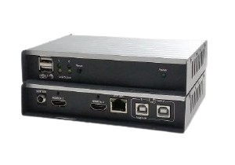
BREAK FREE FROM DISTANCE
Distance is productivity’s worst enemy. KVM Extender over IP solves this problem by allowing employees to work on powerful machines located in guarded data centers from the convenience of their homes or other offices.
A RELIABLE PARTNER FOR CONFIDENTIAL WORK
The security of sensitive information is a significant concern for many remote businesses. With KVM Extender over IP, businesses can rest assured that the computers are kept in a safe, controlled environment; only the screen adds remote streams of keyboard and mouse signals over the network.
www.avextender.com

Slide 4
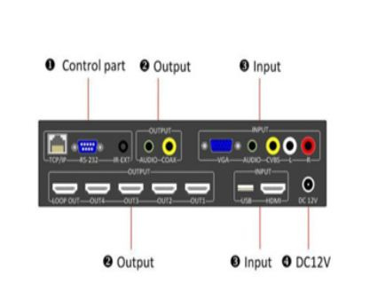
COMPARISON: TRADITIONAL KVM VS KVM EXTENDER OVER IP
Feature | Traditional KVM | KVM Extender Over IP
Distance Coverage | Limited by cable length | Virtually unlimited over IP
Setup Flexible | Fixed and Rigid | Scalable and adaptable
Security of Data | Risk of transfer | No data transfer, only signal
www.avextender.com

Slide 5
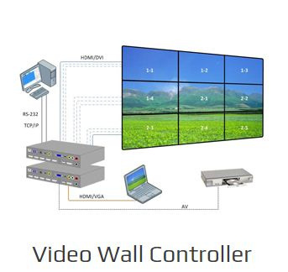
EMPOWERING IT TEAMS
In the view of IT departments, KVM Extender Over IP is no longer a luxury. It allows for solving problems in a fraction of the conventional system with a lower overhead cost. It will enable the technicians to resolve the system challenges in real time, regardless of their proximity to the machines.
PREPARING FOR THE HYBRID FUTURE
The future of work is going to be hybrid. Employees desire the ability to work from home, while employers want the productivity that comes from the centralization of hardware. KVM Extenders over IP achieve both outcomes.
www.avextender.com

Slide 6
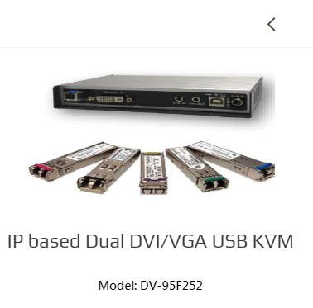
COST-EFFECTIVE GROWTH FOR ALL SIZES
In the view of IT departments, KVM Extender Over IP is no longer a luxury. It allows for solving problems in a fraction of the conventional system with a lower overhead cost. It will enable the technicians to resolve the system challenges in real time, regardless of their proximity to the machines.
THE FINAL WORD
Streamlined productivity and flexible security are two characteristics sought after in today’s workspace solutions. A KVM Extender over IP enables companies to control employee productivity and data resources while allowing employees to work remotely.
www.avextender.com

Slide 7



CONTACT US
886-2-27883399
www.avextender.com
info@avextender.com
12F-3, No. 29-1, Lane 169, Kangning St., XiZhi Dist., New Taipei City, Taiwan
Thank You

