Slide 1
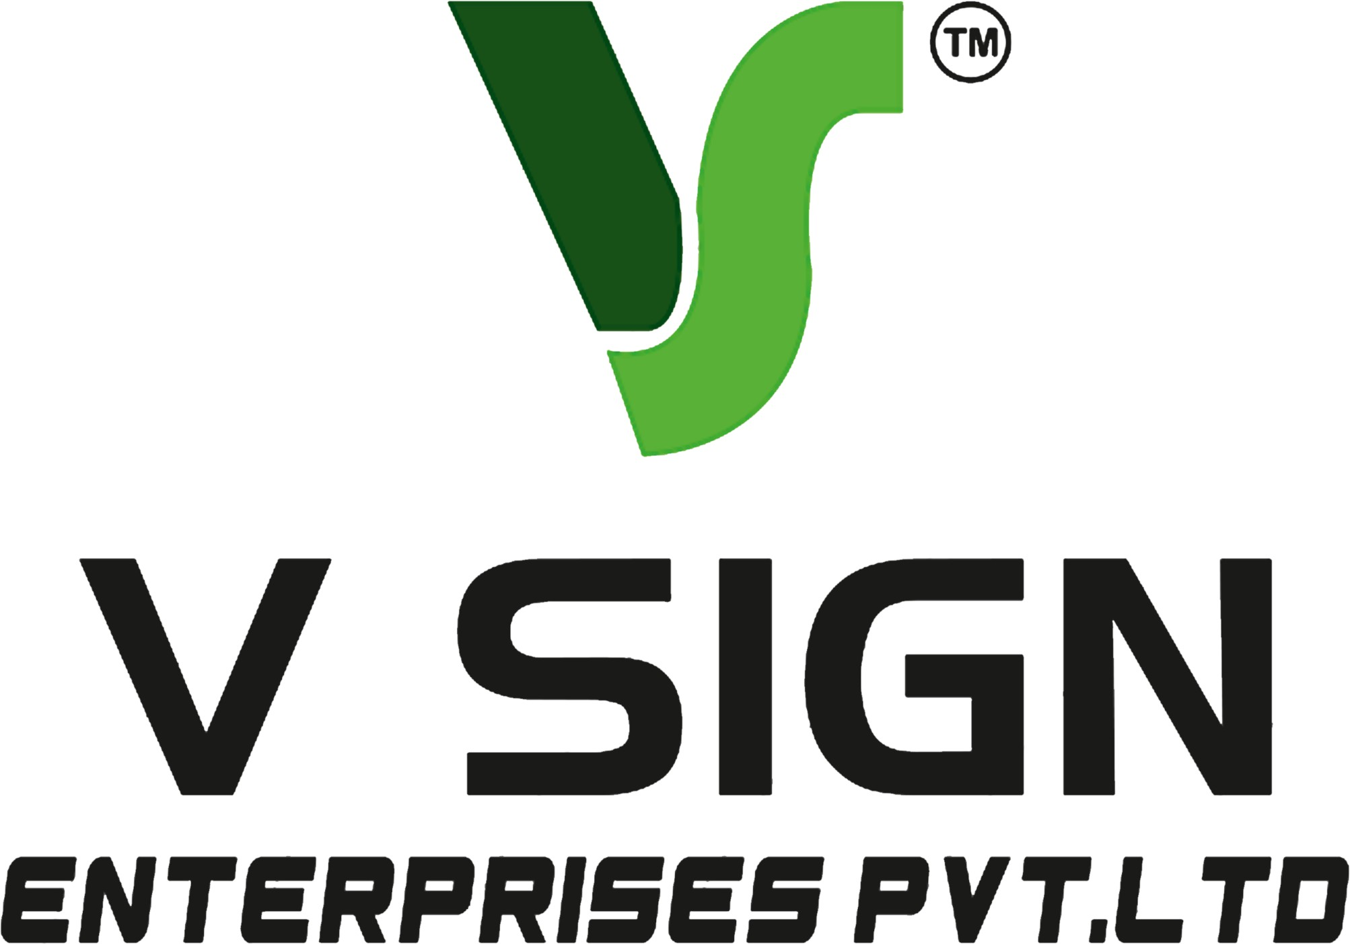
ACP LED Sign Board Hyderabad is a premier signage solution provider for all types of businesses
Your storefront is among the initial impressions that your visitors will form in today's competitive business scene. A professionally designed ACP LED Sign Board Hyderabad is able to give your business a thorough first impression and make your business visible at night as well as day. If you have any retailing business, restaurant, hospital, school, showroom, office or commercial building, it is a good idea to invest in a high-quality ACP LED sign board.
V Sign Pvt. Ltd. specializes in the design, creation and installation of high quality ACP LED sign boards in Hyderabad. We use the best materials and cutting-edge technology to produce beautiful signage that will look great and hold up in all weather conditions, while promoting your business. We offer full solutions to site inspection, design, fabrication and installation.
What is an ACP LED Sign Board?
ACP LED Sign Board Hyderabad is a sign board that is created using Aluminium Composite Panels (ACP) sheets and illuminated LED acrylic or metal letters. ACP offers a smooth, durable and elegant backdrop, with LED lights ensuring you have great visibility during the daytime and at night time.
ACP sheets are well known for their lightness, corrosion-resistant property and durability; they are among the most popular materials used in the manufacture of commercial signboards.
Benefits of ACP LED Sign Board Hyderabad
There are various reasons why you should opt for an ACP LED Sign Board Hyderabad:
Excellent quality and high style
The 24/7 visibility factor is achieved with bright LED illumination.
Resistant to weather and long-lasting materials.
Low maintenance requirements
Energy-efficient LED technology
Unique sizes, colors and fonts
Long operational life
Ideal for use in the interior and exterior

Slide 2
The advantages of ACP LED sign boards render them an excellent investment for companies aiming to enhance their branding and draw in more customers.
Where ACP LED Sign Boards Are Used
A customized ACP LED Sign Board Hyderabad can be used in a variety of industries such as:
Retail shops
Shopping malls
Hospitals
Hotels
Restaurants
Educational institutions
Corporate offices
Banks
Clinics
Real estate projects
Commercial complexes
Industrial facilities
An appealing signboard will make your website more visible and establish your brand.
Custom ACP LED Sign Board Design
Business branding is different for each company. We at V Sign Pvt. Ltd. provide customized ACP LED Sign Board Hyderabad solutions based on the requirements of your business.
We can customize the following:
Multiple ACP sheet colors.
Acrylic LED letters
Stainless steel letters
Front-lit LED letters
Backlit halo letters
3D illuminated letters
Laser-cut lettering
Corporate branding elements
Waterproof LED modules
All signs are made specifically to your company's sign branding guidelines and positioning.

Slide 3
High-Quality Materials
Materials can directly affect the durability of a signboard. Our ACP LED Sign Board Hyderabad solutions employ top-notch materials, such as:
High-quality ACP sheets
Waterproof LED modules
Premium acrylic letters
Stainless steel fabrication
Powder-coated metal frames
Rust-resistant hardware
High-quality electrical wiring
When you invest in top quality materials, you can be sure that your signboard will look the same for several years.
Professional Installation
Correct mounting is crucial to safety and aesthetics. Our installation team works in accordance with the industry best practices to make sure mounting is secure and professionally done.
We include the following in our installation:
Site inspection
Measurement
Design approval
Fabrication
Electrical testing
Safe installation
Final quality inspection
This systematic approach guarantees customer satisfaction and long-lasting performance.

Slide 4
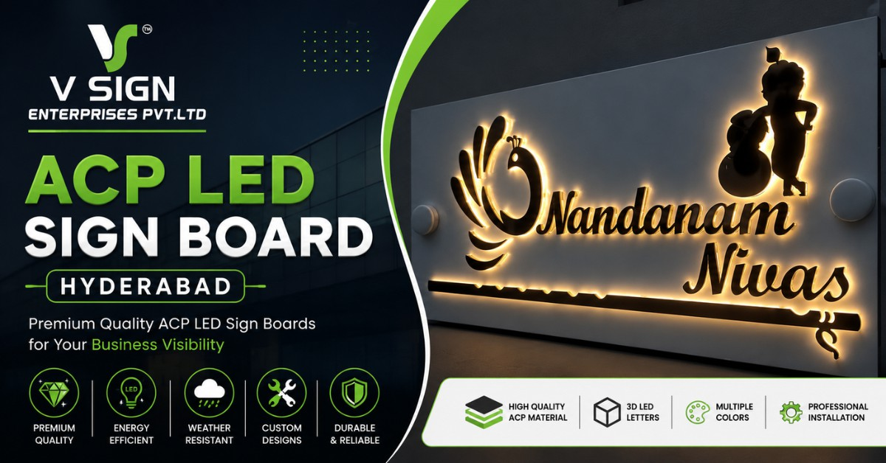
Why you should choose V Sign Pvt. Ltd.?
V Sign Pvt. Ltd. is the name that every business in Hyderabad has trusted upon due to our commitment towards quality, creativity, and customer satisfaction.
Our strengths include:
Experienced design professionals
Modern manufacturing equipment
Premium-quality materials
Customized solutions
Competitive pricing
On-time project completion
Professional installation
Excellent customer support
We have done signage projects in hospitals, schools, offices, hotels, showrooms, commercial buildings and retail outlets all over Hyderabad.
Applications of ACP LED Sign Board Hyderabad
Here are some of the ideal applications for our ACP LED Sign Board Hyderabad solutions:
Shop front branding
Corporate office signage
Building name boards
Hotel entrance boards
Hospital signage
School branding

Slide 5
Mall signage
Restaurant branding
Commercial complexes
Industrial units
All projects are customised to ensure maximum exposure and a contemporary and refined look.
Energy-Efficient LED Technology
LED lights use a lot less electricity than conventional lighting. Our ACP LED Sign Board Hyderabad uses premium LED modules which offer:
High brightness
Low power consumption
Longer lifespan
Minimal heat generation
Uniform lighting
Reliable performance
This will help save maintenance costs and help businesses see the light of the day and night.
Maintenance Tips
To maintain your ACP LED Sign Board Hyderabad in a new look:
Regularly clean the ACP surface.
Regularly check electrical connections.
Clean acrylic letters of dust.
Inspect LED modules once a year.
Plan for professional servicing as necessary.
By maintaining your signage properly, you can prolong its lifespan and keep it looking visually appealing.
ACP is the preferred choice for reasons that include:
ACP has been a popular material for commercial signage due to its many advantages:
Excellent strength
Lightweight construction
Modern appearance
Easy fabrication
Weather resistance

Slide 6
Color stability
Corrosion resistance
Long service life
The features make ACP to be suitable in the different climatic conditions in Hyderabad while retaining the premium look.
Conclusion
When it comes to finding a trustworthy ACP LED Sign Board Hyderabad, it is essential to select a professional signage manufacturer. An effective ACP LED sign board can help to build your brand presence, make your business more visible, and draw in more customers.
ACP LED signage solutions are available at V Sign Pvt. Ltd. which offers full consultation, design, fabrication and installation services. For the retail stores, office, hospital, hotel, showroom and commercial building, we create durable, attractive and customized signage solutions to make your business stand out in the city of Hyderabad.
Details -
Website -https://vsignpvtltd.com/
Address - plot no : 27 &28, Plot No. 27, Rd Number 1, Samathapuri Colony, New Nagole, Samathapuri, Kothapet, Hyderabad, Telangana 500102
Contact No -099087 06363
Email- vsign.pvtlt@gmail.com

