Slide 1

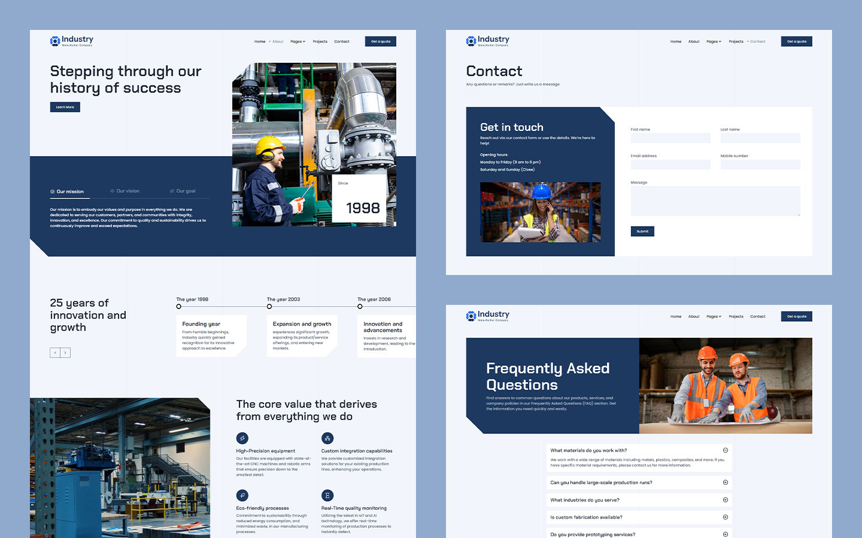
Quora Web Solution
Website Design and
Development
Company
Web Design & Web Development
Company in Bangalore, India
www.quorawebsolution.com
+91 9986 056 909
info@quorawebsolutions.com
24A, 1st Main Rd, Chandra Reddy
Layout, Koramangala 4th Block,
Koramangala, Bengaluru,
Karnataka 560034

Slide 2

Custom vs. Template Design: What Website Development Companies Recommend for Your Brand
In the rapidly evolving digital landscape, your website serves as the face of your brand.
www.quorawebsolution.com

Slide 3

Whether you're launching a new business, rebranding, or looking to improve your online presence, the decision between custom website design and template-based design is crucial.
www.quorawebsolution.com

Slide 4

Both approaches offer distinct advantages and potential drawbacks. Understanding these differences can help you make an informed choice that aligns with your brand's goals, budget, and audience.
Custom Website Design: Tailored to Perfection
A custom website design is crafted from scratch to meet the unique needs and vision of your brand.
www.quorawebsolution.com

Slide 5
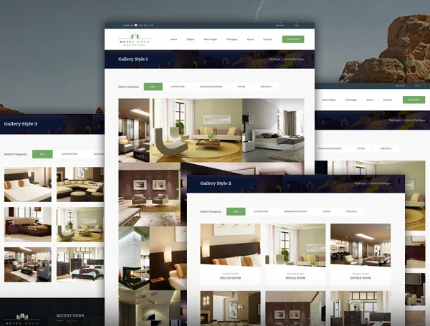
Website development companies often recommend this approach for businesses seeking a distinctive online presence that sets them apart from competitors.
Advantages of Custom Design:
www.quorawebsolution.com

Slide 6
Unique Branding: A custom design allows for complete creative freedom, ensuring your website reflects your brand’s personality, values, and goals.
Scalability and Flexibility: Custom sites are built to grow with your business. As your needs evolve, your website can be easily modified or expanded.
Optimized Performance: Custom websites are typically optimized for speed, user experience (UX), and search engine optimization (SEO), leading to better performance and higher rankings.
Tailored Functionality: You can integrate specific features and functionalities that are essential to your business operations.
Drawbacks of Custom Design:
Higher Costs: Custom websites require more time and expertise, which translates into higher development costs.
www.quorawebsolution.com

Slide 7
Longer Development Time: Building a website from scratch is a time-intensive process, which may delay your launch.
Ongoing Maintenance: Custom sites often require continuous support and updates, adding to long-term costs.
Template-Based Design: Quick and Cost-Effective
Template-based design involves using pre-designed website layouts, which can be customized to some extent. This approach is popular among startups, small businesses, and individuals looking for a cost-effective and quick solution.
Advantages of Template Design:
Cost-Effective: Templates are significantly cheaper than custom designs, making them ideal for businesses with limited budgets.
www.quorawebsolution.com

Slide 8
Faster Deployment: Since the design framework is already in place, websites can be launched quickly.
Ease of Use: Many templates come with user-friendly content management systems (CMS) like WordPress, allowing non-technical users to manage content easily.
Variety of Choices: There are thousands of templates available, catering to different industries and styles.
Drawbacks of Template Design:
Limited Customization: Templates have restrictions on design and functionality, which may not fully align with your brand’s unique identity.
Lack of Uniqueness: Since templates are available to the public, there's a risk of having a website that looks similar to others.
Performance Issues: Some templates are not optimized for speed or SEO, potentially affecting user experience and search rankings.
www.quorawebsolution.com

Slide 9
Scalability Challenges: As your business grows, you may encounter limitations in expanding or modifying the template.
What Website Development Companies Recommend
When advising clients, website development companies consider several factors to recommend the best approach:
Budget: If you have a limited budget, a high-quality template might be the best starting point. For businesses with more resources, investing in a custom design can provide long-term benefits.
Business Goals: If your website needs specific functionalities or you aim to stand out in a competitive market, custom design is preferable. For simpler, informational sites, templates can suffice.
Timeline: If you need to launch quickly, templates offer a faster solution.
www.quorawebsolution.com

Slide 10
Custom designs require more time but result in a unique product.
Long-Term Vision: Companies planning for significant growth should consider custom design for its scalability and flexibility.
Conclusion
Both custom and template website designs have their merits and challenges. The right choice depends on your brand’s unique needs, goals, and resources. Website development companies can guide you through this decision, ensuring your website not only looks great but also performs effectively to drive business success. Whether you opt for a fully customized site or a well-chosen template, the key is to create a user-friendly, visually appealing, and functional website that represents your brand authentically.
Why Your Business Needs a Professional Website Design and Development Company to Stay Competitive
www.quorawebsolution.com

Slide 11
In today’s digital age, a business’s online presence is often the first point of contact with potential customers. A professionally designed and developed website isn’t just a luxury—it’s a necessity for businesses aiming to remain competitive in a rapidly evolving marketplace. Here’s why partnering with a professional website design and development company is crucial for your business’s success.
1. First Impressions Matter
Your website acts as the digital storefront of your brand, often shaping the first impression potential customers have of your business. A professionally designed site immediately conveys credibility and trustworthiness, which can make or break a visitor's decision to engage with your business. Poorly designed websites, on the other hand, can drive potential customers away within seconds.
2. Customized Design Reflecting Your Brand Identity
Professional designers ensure that your website reflects your unique brand identity.
www.quorawebsolution.com

Slide 12
Unlike generic templates, custom designs are tailored to align with your company’s values, mission, and goals. This personalized touch helps differentiate your business from competitors and creates a memorable user experience.
3. Enhanced User Experience (UX)
A website must be more than visually appealing—it needs to be user-friendly. Professional developers focus on creating intuitive navigation, fast load times, and mobile responsiveness. These factors contribute to a seamless user experience, keeping visitors engaged and encouraging them to return.
4. Search Engine Optimization (SEO) Benefits
A well-developed website is optimized for search engines, improving your visibility in search results. Professional web developers incorporate SEO best practices, such as clean coding, fast loading speeds, and strategic keyword placement, to enhance your site’s ranking and attract organic traffic.
5. Mobile Responsiveness is Non-Negotiable
www.quorawebsolution.com

Slide 13
As mobile devices have become the primary means of accessing the internet, ensuring your website features a responsive design is no longer optional—it’s a critical requirement. Professional web development companies ensure that your site functions flawlessly across all devices and screen sizes, providing a consistent user experience.
6. Advanced Security Measures
With the increasing prevalence of cyber threats, cybersecurity has become a critical priority for businesses of every size. Professional web development companies implement robust security protocols to protect your website from potential threats. Regular updates, secure coding practices, and SSL certificates are just a few measures taken to safeguard your data and that of your customers.
7. Time and Cost Efficiency
While it might seem cost-effective to build a website in-house or use DIY platforms, the time and effort required often outweigh the benefits.
www.quorawebsolution.com

Slide 14
Professional web developers have the expertise and tools to deliver high-quality websites efficiently, allowing you to focus on other critical aspects of your business.
8. Ongoing Support and Maintenance
The digital landscape is constantly evolving, and your website needs regular updates to stay relevant. Professional web design and development companies offer ongoing support and maintenance services, ensuring your site remains functional, secure, and up-to-date with the latest trends and technologies.
9. Competitive Advantage
In a crowded market, a professionally designed website can give you a significant competitive edge. It not only attracts more visitors but also converts them into loyal customers. A polished, functional, and engaging website positions your business as a leader in your industry.
Conclusion
www.quorawebsolution.com

Slide 15
Investing in a professional website design and development company is more than just an aesthetic choice—it’s a strategic move that can significantly impact your business’s growth and success. From creating a strong first impression to ensuring top-notch security and performance, professional web services are essential for staying competitive in today’s digital marketplace. Don’t let an outdated or poorly designed website hold your business back—partner with professionals to unlock your brand’s full potential online.
www.quorawebsolution.com

Slide 16
Quora Web Solution: Quora Web Solution is a trusted website development company based in Bangalore, India, offering a wide array of services to not only domestic but global clientele. Be it Website Design and Development, SEO services, Digital Marketing, Branding, App Development, Ecommerce Solution, and Logo Creation . Quora Web Solution has the best website developers offering top quality services and that is the reason why we are well known as one of the best Website Development Companies in Bangalore, India.
Visit Us - www.quorawebsolution.com
Call Us - +91 9986 056 909
Mail Us - info@quorawebsolutions.com
www.quorawebsolution.com

Slide 17

WORDPRESS DEVELOPMENT
ECOMMERCE DEVELOPMENT
PHP DEVELOPMENT
CMS DEVELOPMENT
DRUPAL DEVELOPMENT
WEBSITE SERVICES
WEBPORTAL DEVELOPMENT
MAGENTO DEVELOPMENT
WEBSITE DEVELOPMENT
JOOMLA DEVELOPMENT
SMALL BUSINESS DEVELOPMENT
CHEAP WEBSITE DEVELOPMENT
STATIC WEBSITE DEVELOPMENT
DYNAMIC WEBSITE DEVELOPMENT
WEBSITE DESIGN COMPANY
TOUR AND TRAVEL WEBSITE DEVELOPMENT
Services

